Slide 1
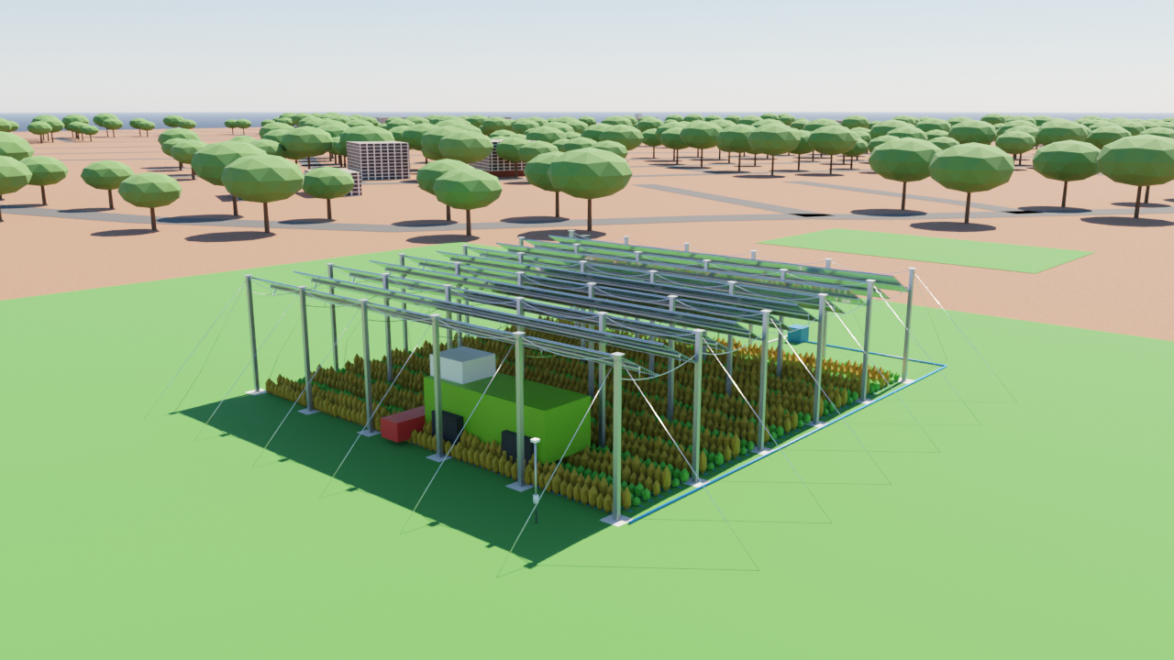
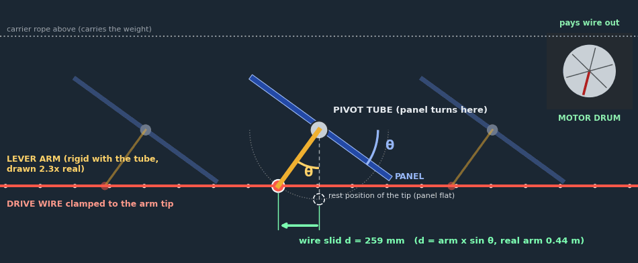
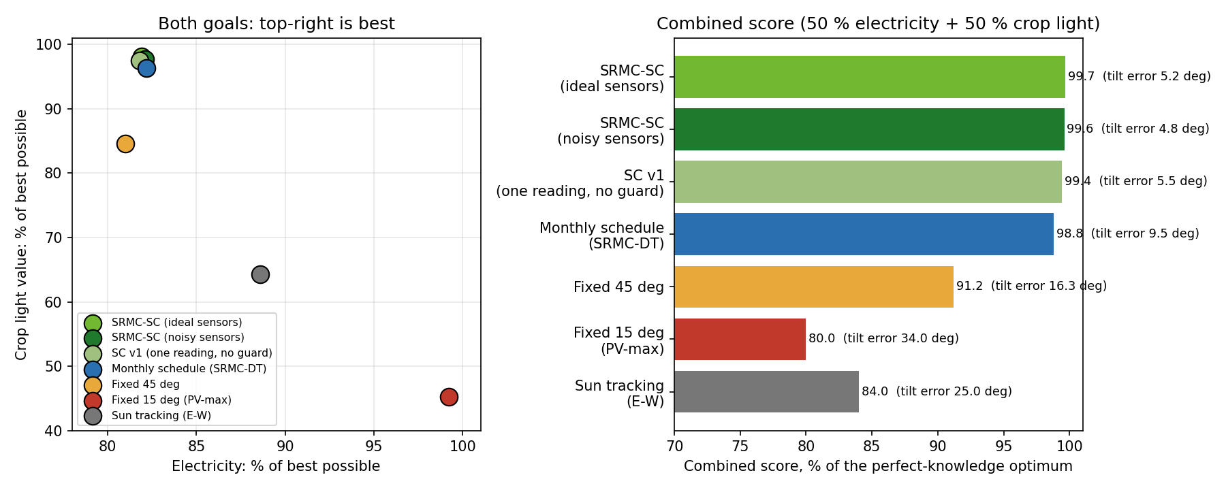
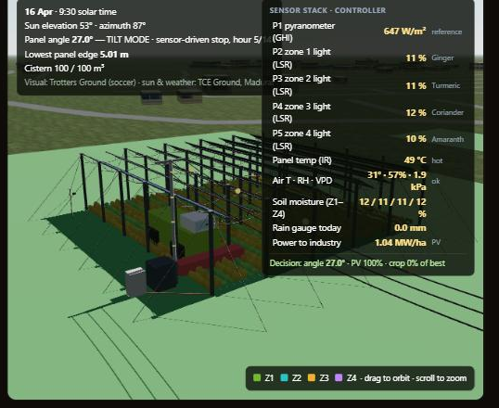
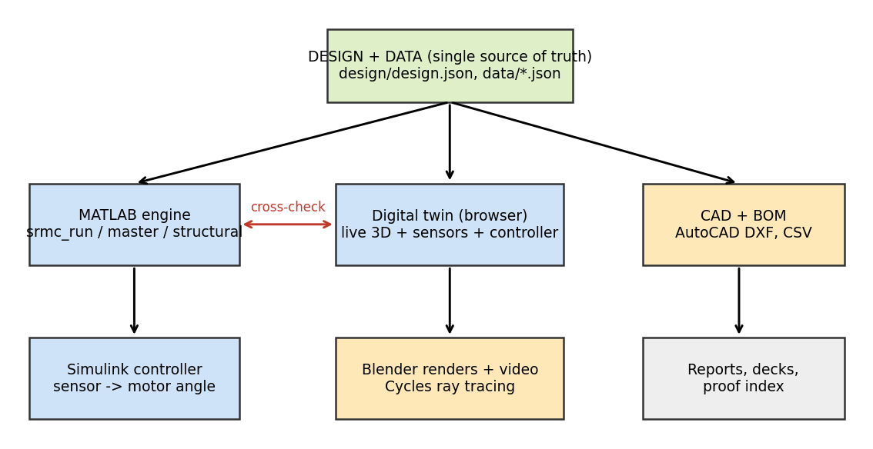
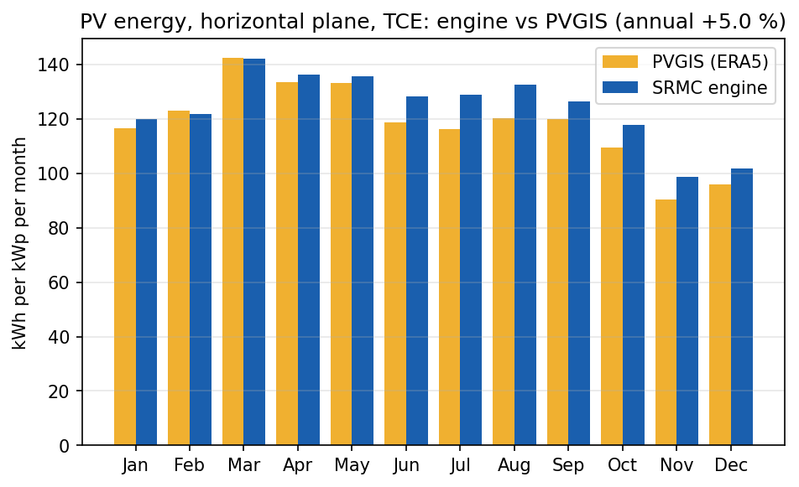
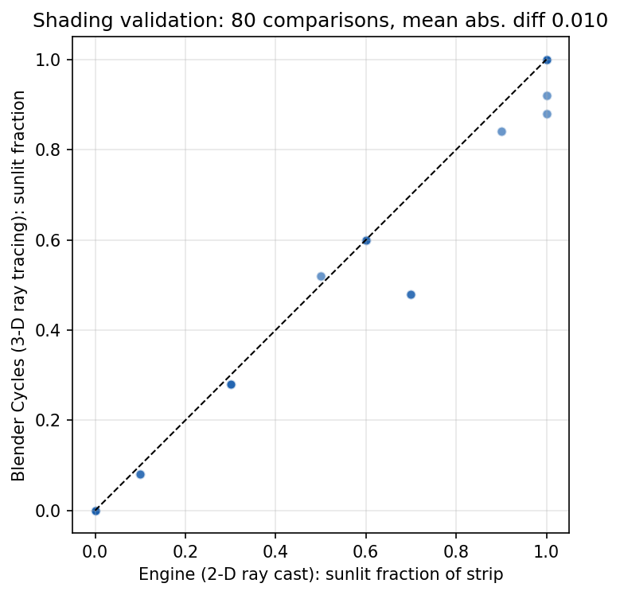
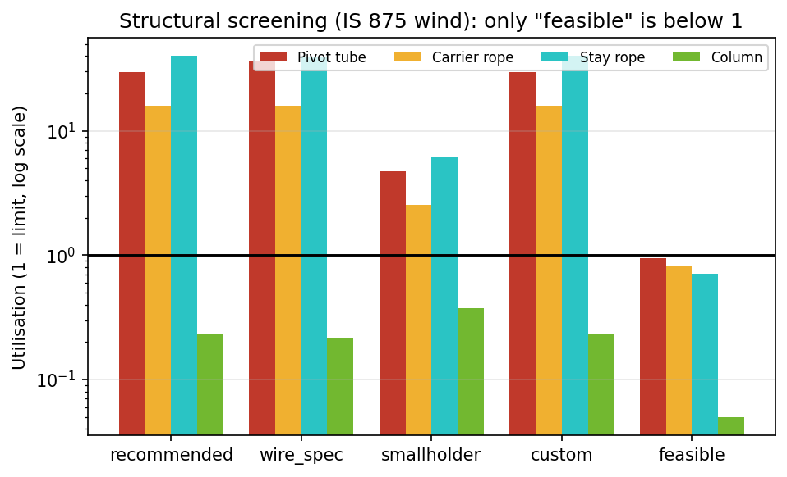
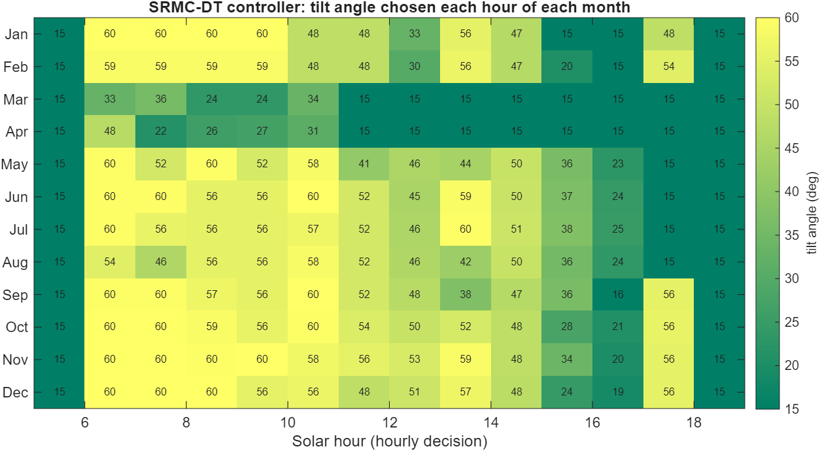
Agrovoltaic Canopy for Protection and Sustainable Farming
Team: ______
Guide: ______
Dept: _______
R3 to R7
Six sensors tilt the panels to optimise crop light and electricity; a gutter harvests rain; power is sold to a nearby industry. Digital-twin study, TCE ground, Madurai (9.88 N).
THE PROBLEM AND THE IDEA
THE DESIGN (BLENDER RENDER, TCE GROUND)
• Small farms live on crop income alone: weather and prices decide.
• One frame over the farm: panels 4.5 m up on stainless wire ropes, crops below.
• Panels tilt for sun. In rain they close into a sealed roof (3 deg fall) that feeds a gutter, an underground cistern and drip irrigation.
• Six sensors tell the controller how to balance electricity and crop light.
• The power is sold to a nearby industry: the farmer gets a monthly share plus crop income.
10 panels on a 25 m wire run; pivot 5.58 m; lowest edge 4.5 m (harvester fits)
HOW THE MOTOR TILTS THE PANELS
THE SIX-SENSOR CONTROLLER
• Six sensors: pyranometer, PAR, DHT11, soil moisture, rain, wind. Rain = flat roof (3 deg); night = park.
• Otherwise: best tilt 15-60 deg for 50 % electricity + 50 % crop light. PAR corrects the model; heat or dry soil = more shade.
• Year-long test: 99.6 % of the best score (electricity 82 %, crop light 98 %).
• Wire slides by d; it is clamped to the tip of a lever arm on every panel.
• The arm turns the pivot tube: tilt = arm swing, d = arm x sin(tilt).
• A guide pulley lets the wire turn at the row end.
LIVE DIGITAL TWIN (OFFLINE, IN A BROWSER)
Both goals (top-right is best): six-sensor controller 99.6 % of the best score
ONE DESIGN FILE FEEDS EVERYTHING
• Sun, shadows, panel angle, drive wire, sensors, water, money.
• 7 climates, 9 soils, 24 crops.
⚠ Sensors are simulated, not measured.
• MATLAB + Simulink, web twin, AutoCAD DXF + 22-item BOM, Blender Cycles. MATLAB and twin agree to 0.0000 % on 22 outputs.
PROOF: THREE INDEPENDENT CHECKS
Solar output vs PVGIS: +5.0 % (sunshine data differs by +5.2 %)
Shadows vs Blender 3-D ray tracing: mean difference 0.010 (80 cases)
Wind check (IS 875): 12.5 m bays fail (rope 16x); 5 m rope grid passes
RESULTS PER HECTARE (TCE, ASSUMED PRICES)
HONEST LIMITS
Design | PV kWh/m2 | Crop light | Total INR lakh
Hourly plan (SRMC-DT) | 238 | 34 % | 55.0
Fixed 45 deg | 233 | 32 % | 52.5
PV-only, fixed 15 deg | 291 | 14 % | 68.2
⚠ Simulation only: no field or prototype data.
⚠ Tariff (INR 3/kWh) and farmer share (30 %) are assumptions.
⚠ Investor payback is long (about 41 years).
• A PV-only design earns more money; the controller case rests on crops, water and soil.
• Structure is a screening check, not a certified design.
• Farmer income about INR 2 lakh per ha per month (range 1.4 to 3.0).
• Rain covers 94 % of irrigation.
• Controller: +55 % crop income vs fixed 45 deg.
Data: NASA POWER, PVGIS (EC-JRC), OpenStreetMap (ODbL). Tools: MATLAB / Simulink R2025a, Blender 5.2, three.js. Full R3-R7 decks, report, viva Q&A and proof index in the review pack.

