Slide 1
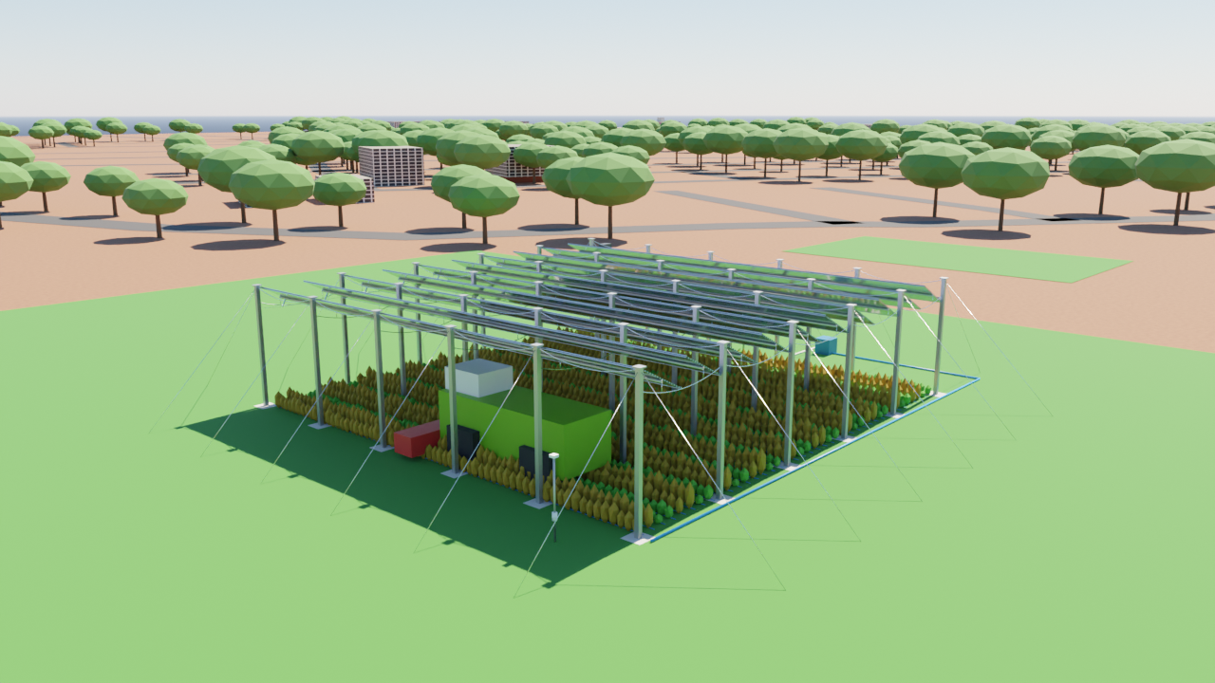
REVIEW 0
Sensor-driven tilt control that co-optimises solar energy and crop light
Agrovoltaic Canopy for Protection and Sustainable Farming
Prototype sensors + MATLAB digital twin | TCE ground, Madurai
Student: ______________________
Guide: ______________________ Date: __________
Notes:
Review 0 shows the live chain: real sensors on the ESP board -> MATLAB -> tilt decision. Say at the start: pyranometer, PAR and wind are SIMULATED sensors; DHT11, soil and rain are REAL.

Slide 2
What the system decides
One decision every few seconds: the panel angle that gives energy AND the light the crop needs
Pyranometer
SIM
PAR sensor
SIM
Soil moisture
REAL
how much sunlight, so how much energy to harvest
light actually reaching each crop zone
root-zone water: irrigation and stress
DHT11
REAL
Rain sensor
REAL
Wind
SIM
temperature and humidity: VPD (plant water stress)
rain: panels to a 3 degree slope, water to the cistern
gust above 15 m/s: panels stowed edge-on (90 degrees)
Goal: a tilt rule that is better for energy AND crops than pure sun tracking or a fixed angle, shown with numbers.
Notes:
Six inputs, one output (the angle). The controller is a rule stack plus an optimiser. Real vs simulated is labelled on every card.

Slide 3
What is real and what is simulated
Stated openly, so every number on the next slides can be trusted for what it is
Quantity | Source on the day | Status | Why
Air temperature, humidity | DHT11 on the prototype | REAL | sensor installed
Soil moisture | soil moisture module -> A0 | REAL | sensor installed, calibrated dry/wet
Rain | rain sensor module -> D5 | REAL | sensor installed
Pyranometer (W/m2) | MATLAB sun model for TCE + sky icon (clear, hazy, partly cloudy, overcast) | SIM | no pyranometer available yet
PAR above / under canopy | computed from the pyranometer value and the canopy shadow model | SIM | no PAR sensor available yet
Wind speed | slider on the dashboard | SIM | no anemometer yet
Panel tilt | shown on the MATLAB drawing only | SIM | no actuator on the prototype
The simulated sensors use the same equations as the validated model (PVGIS comparison +5.0 %, Blender ray tracing 0.010). They are placeholders for a real pyranometer and PAR sensor, which would only replace two inputs.
Notes:
Judges will ask about the pyranometer. Answer: it is a software sensor for Review 0, labelled SIM on the screen. The control code does not change when a real one is connected.

Slide 4
System architecture
Sensors -> ESP board -> USB -> MATLAB -> decision -> tilt on screen and irrigation
REAL sensors
ESP8266 / ESP32
MATLAB dashboard
Controller
DHT11 (temperature, humidity)
soil moisture
rain sensor
reads sensors every second
sends one text line over USB (115200 baud)
parses the line, calibrates soil
logs CSV, draws live plots
wind stow > rain 3 deg > night park > optimise energy + crop light
Backup: ESP32 with the same serial protocol
MATLAB also runs without hardware (Simulate mode)
SIM sensors
Outputs
pyranometer, PAR, wind (sliders + sky icon)
panel angle on screen, pump ON/OFF, cistern level, evidence files
Notes:
USB serial is used because it needs no WiFi and is the most reliable in a lab. The same MATLAB code runs in Simulate mode, so the demo works even if a wire comes loose.

Slide 5
Hardware wiring
NodeMCU ESP8266 (CP2102) main board, ESP32 as backup; everything on 3.3 V and one common ground
Sensor | Sensor pin | ESP8266 NodeMCU | ESP32
DHT11 | VCC / DATA / GND | 3V3 / D2 / GND | 3V3 / GPIO4 / GND
Soil moisture | VCC / AO / GND | 3V3 / A0 / GND | 3V3 / GPIO34 / GND
Rain sensor | VCC / DO / GND | 3V3 / D5 / GND | 3V3 / GPIO27 / GND (AO to GPIO35 optional)
• ESP8266 has only one analog pin: soil on A0, rain on the digital output D5
• D4 on-board LED lights while rain is detected
• Avoid D3, D4 and D8 for sensors (they set the boot mode)
• Never put 5 V on A0 or a D pin
Bring-up check (5 minutes)
• Upload the sketch, open the Serial Monitor at 115200
• See SRMC,5231,31.0,54.0,712,0,-1 every second
• Wet the rain plate: rainWet turns 1
• Push the soil probe into wet soil: soilRaw drops
Notes:
Full pin map is in firmware/PIN_MAP.md. The photo of the board shows the CP2102 USB chip, so install that driver if no COM port appears.

Slide 6
Firmware and data protocol
One text line per second; the same MATLAB code reads either board
SRMC,<millis>,<tempC>,<rh>,<soilRaw>,<rainWet>,<rainRaw>
SRMC,5231,31.0,54.0,712,0,-1
• DHT11 decoded in the sketch itself (no library to install); a failed read sends -999 and MATLAB keeps the last good value
• Soil: 8 reads averaged, then calibrated to % with two captured points (dry in air, wet in water)
• Rain: digital output, sensitivity set by the module potentiometer
• Parser rejects boot messages and noise (tested: T01 to T03)
• Source = Serial uses the real board; Source = Simulate generates realistic data for rehearsal
• Every run can be saved: dashboard image + CSV log
Notes:
The firmware was written without access to the board, so the bench checklist in the documents folder is the first thing to run on the day.

Slide 7
Control algorithm (simple enough to explain, precise enough to test)
Rules in priority order, then an optimiser over every angle from 15 to 60 degrees in 0.5 degree steps
1 Wind >= 15 m/s
2 Rain sensor wet
3 Night
4 Otherwise
stow at 90 degrees
slope 3 degrees to the gutter, fill the cistern
park at 15 degrees
optimise energy + crop light
Optimiser (rule 4)
Stress makes the controller smarter
J(a) = w * PV(a) / PVmax + (1 - w) * Crop(a) / Cropmax
• VPD from DHT11 > 2.5 kPa or dry soil raises the stress index
• Stress lowers the light the crops need (by up to 30 %), so the controller can accept more shade and more energy
• Pump: ON below 35 % soil moisture, OFF above 55 % (hysteresis), water from the rain cistern
• PV(a): module power for angle a (row shading, incidence angle, cell temperature from the DHT11)
• Crop(a): mean light factor of the 4 crop zones, from PAR under / above the canopy
• w = 0.5 by default; the slider moves it from crop-only to energy-only
Notes:
Explain in one breath: safety first (wind), then water (rain), then the optimiser. The optimiser is a plain search over 91 angles with a transparent score, not a black box.

Slide 8
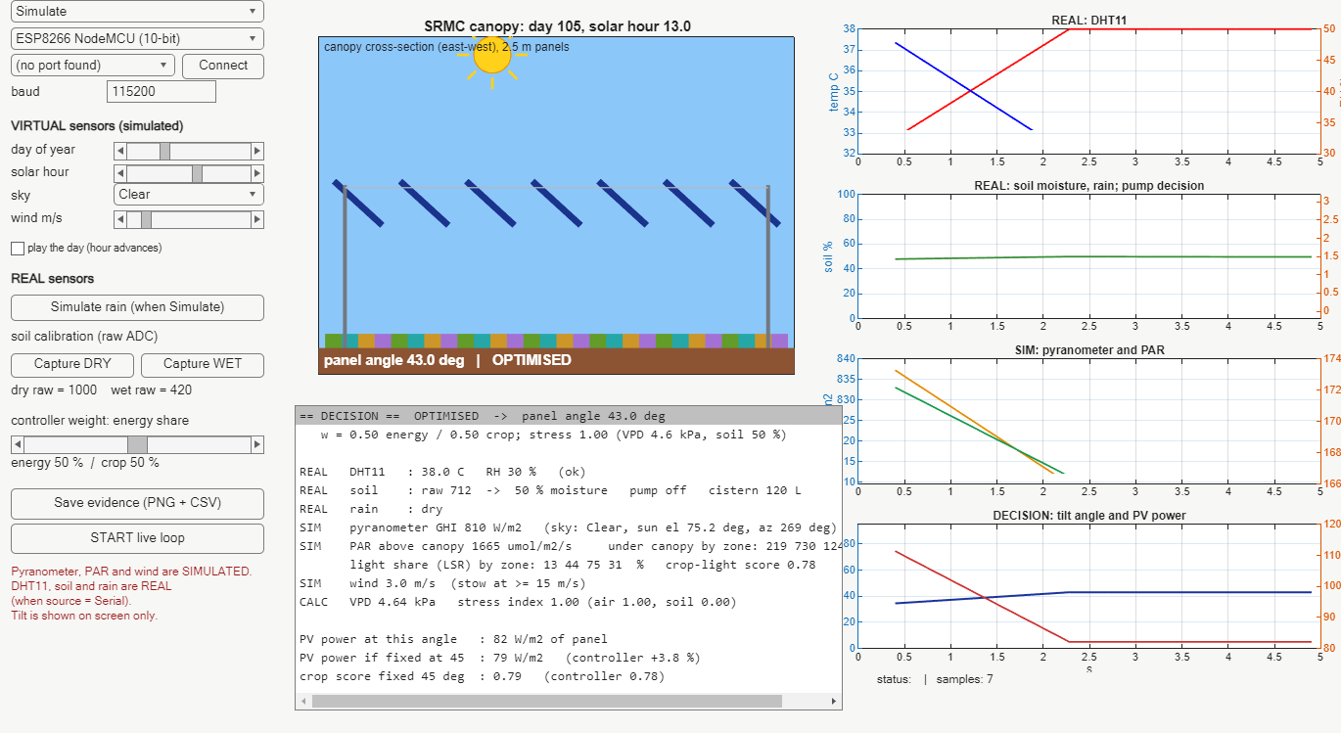
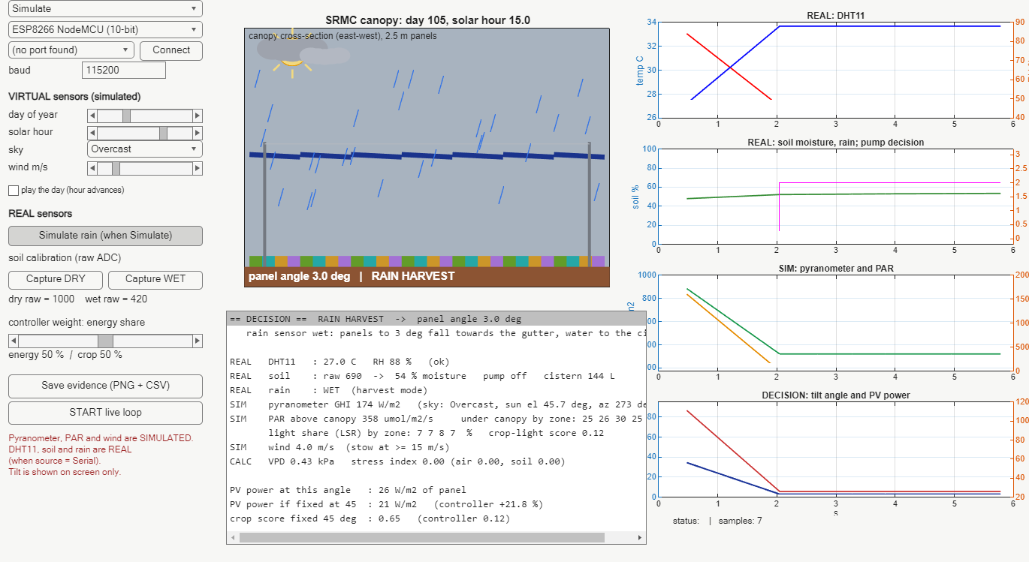
Live MATLAB dashboard
Same code and screen for Simulate and Serial mode; two situations shown large
Hot, dry air (VPD 4.6 kPa): stress index 1.0, controller chooses 43 degrees at 13 h
Rain sensor wet: panels to the 3 degree slope, cistern fills
• Left: controls (source, sky icon, wind, calibration, weight). Centre: canopy drawing with sun and sky icon, panel angle, decision text with REAL / SIM tags. Right: live plots.
• Other situations are in results/screens: clear noon (43.5 degrees), gust 18 m/s (stow at 90 degrees), dry soil (pump ON), low morning sun (60 degrees).
Notes:
Left column: controls. Centre: canopy drawing with sun icon, sky icon and panel angle. Right: live plots. Real and simulated values are tagged in the text panel.

Slide 9
Test evidence 1: decision logic (16 of 16 software-in-the-loop tests pass)
Simulated inputs; this proves the rules and the physics, not the sensors (sensor tests are done on the bench)
ID | Test | Result
T01 | Parse a good serial line | PASS
T02 | DHT11 failure (-999) flagged, not used | PASS
T03 | Boot / garbage line ignored | PASS
T04 | Soil calibration 0 / 50 / 100 % | PASS
T05 | VPD at 30 C, 50 % RH = 2.12 kPa | PASS
T06 | Rain wet -> 3 degree slope | PASS
T07 | Wind 15.0 stows, 14.9 does not | PASS
T08 | Wind stow overrides rain | PASS
ID | Test | Result
T09 | Night: park 15 degrees, no PV | PASS
T10 | Optimiser = brute-force best angle | PASS
T11 | Noon PV >= fixed 45 degrees | PASS
T12 | Heat stress changes the angle | PASS
T13 | Overcast GHI < 40 % of clear | PASS
T14 | Pump hysteresis 35 / 55 % | PASS
T15 | Empty cistern stops the pump | PASS
T16 | Equals the validated engine | PASS
Files: results/test_results.csv and .md; reproduce with review0_run_tests in MATLAB (about 1 minute).
Notes:
T16 is the strongest proof: the MATLAB functions give the same zone light and PV as the JavaScript engine used in the twin. T10 checks the optimiser against brute force.

Slide 10
Result: energy and crop light together (clear day, simulated sky)
Each strategy as a percentage of the best strategy for that quantity; day 105, TCE, 6 to 18 h
Reading the chart
• Sun tracking: best energy (100 %) but only 27 % of the crop light
• Fixed 45 degrees: 74 % energy, 81 % crop
• SRMC controller: 75 % energy, 89 % crop; average 82 % (tracking 63 %, fixed 45: 77 %)
Notes:
Honest reading: the controller does not beat tracking on energy; it gives up about a quarter of the energy to give the crops most of their light. The average favours the controller by construction (equal weights), so the weight slider matters. Pure tracking is outside the wire-drive specification (two positions), shown only as a reference. Numbers come from day_comparison.csv.

Slide 11
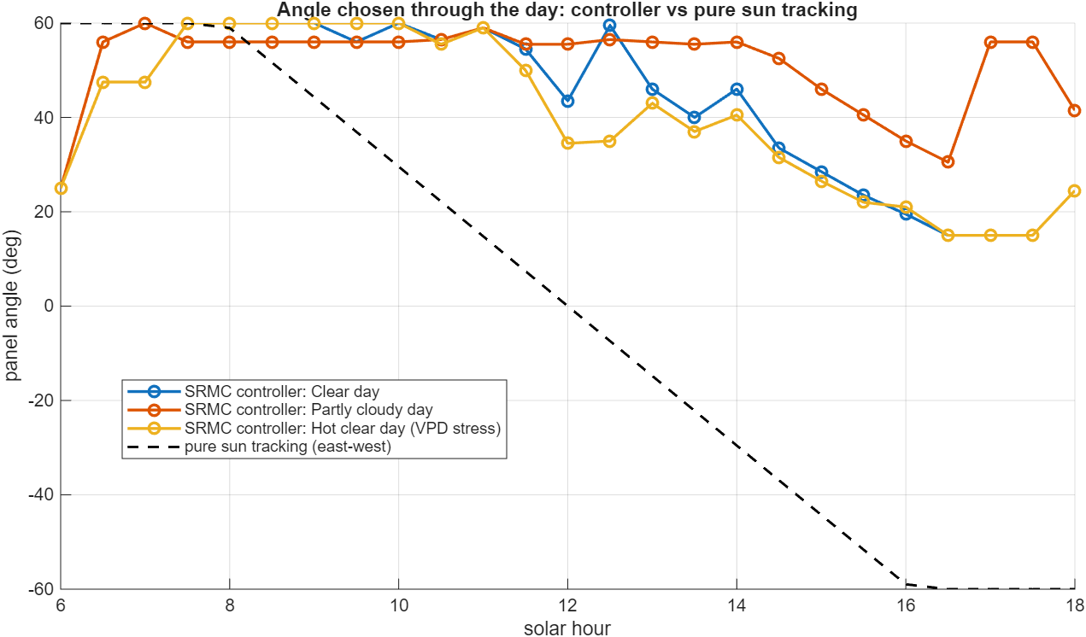
Result: the angle the controller chooses through the day
Compared with pure sun tracking (dashed), clear, partly cloudy and hot-dry days
• Morning: steep (about 55 to 60 degrees) so crops get light while the sun is low
• Afternoon on clear days: flatter, more energy
• Partly cloudy day: stays steeper because the crop needs the light that is left
• Hot, dry air (VPD stress): flatter around midday: more shade for the crop, more energy
• Tracking would turn negative (west); the wire-drive design has two positions, so it is only a reference
Notes:
The jumps between half-hour steps are caused by a flat objective; in the real motor a 2 degree dead-band would stop needless movement (listed as next step).

Slide 12
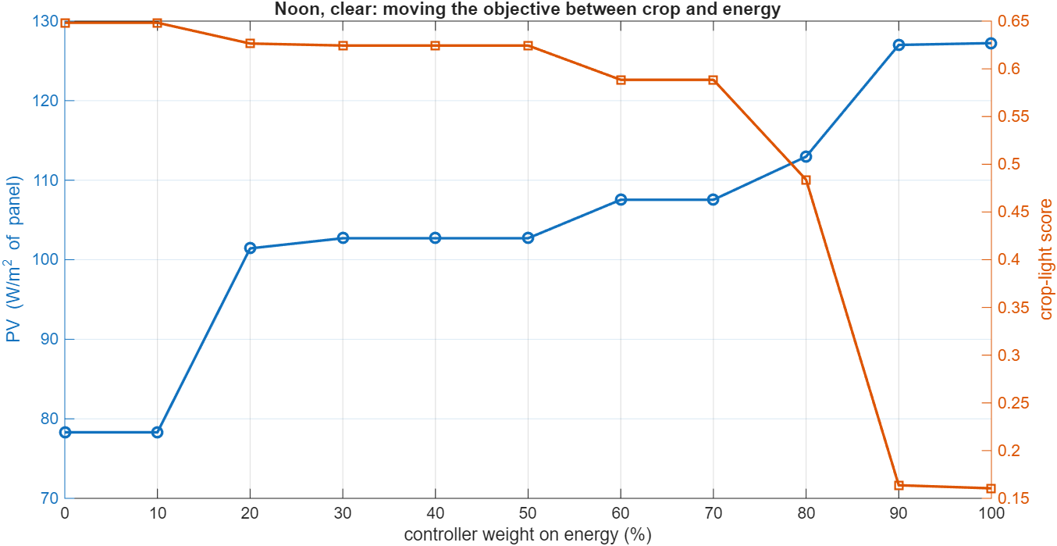
Result: one slider moves the farm between "crop first" and "energy first"
Noon, clear sky: the energy weight w from 0 to 100 %
w (energy) | angle | PV W/m2 | crop score
0 % | 60 deg | 78 | 0.65
20 % | 44.5 deg | 101 | 0.63
40 % | 43.5 deg | 103 | 0.62
60 % | 39.5 deg | 108 | 0.59
80 % | 34.5 deg | 113 | 0.48
100 % | 15 deg | 127 | 0.16
The farmer or operator chooses w; the code does the rest. Review 4 prices the choice.
Notes:
This is the practical meaning of co-optimisation: the weight is a policy knob, the optimiser finds the best angle for that policy at every moment.

Slide 13
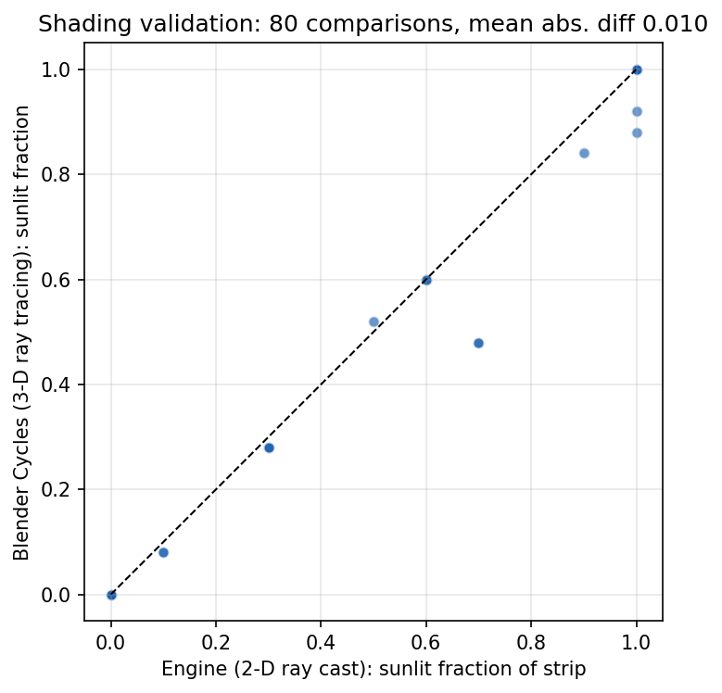
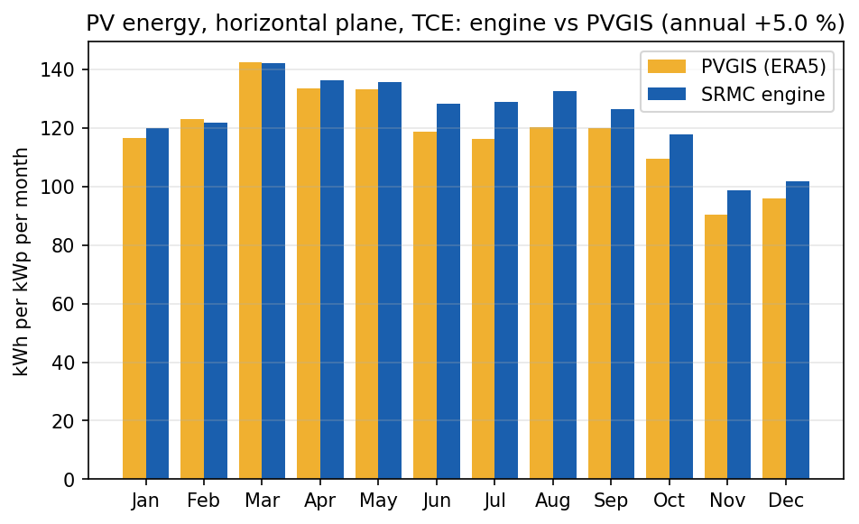
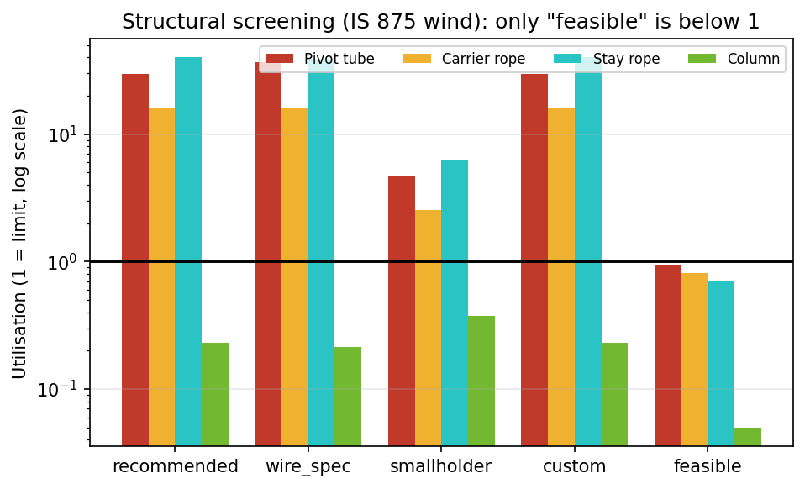
The model under the demo is validated
Same equations as the earlier reviews; independent references, not field data
PV energy vs PVGIS: +5.0 % (of which +5.2 % is the sunshine dataset)
Shadow model vs Blender ray tracing: mean difference 0.010
Structure: 12.5 m bays fail, the 5 m rope grid passes (screening)
JavaScript twin vs MATLAB engine: identical results (0.0000 % on 22 quantities). This checks the code, not the physics.
Not done: comparison with measured field data (no pyranometer or field plot yet).
Notes:
These are in the earlier review folders (Review 2 and Review 1). Say clearly what they are not: they are not field measurements.

Slide 14
Bench evidence from the prototype (added on the day)
Photos and readings taken at the college; the table is filled with measured values
Photo: ESP8266 wired to DHT11, soil and rain sensors
Screenshot: Serial Monitor showing SRMC lines
Screenshot: MATLAB dashboard with the real board (Source = Serial)
Bench test | Reference | Measured | Pass criterion
DHT11 temperature | room thermometer / phone | _____ C vs _____ C | within 2 C (datasheet)
DHT11 humidity | reference hygrometer | _____ % vs _____ % | within 5 % RH (datasheet)
Soil: dry (air) / wet (water) | raw readings | dry _____ wet _____ | wet raw clearly below dry raw
Rain detection | drop on the plate | detected in _____ s | rain = 1 within 2 s
Rain dry again | wipe the plate | cleared in _____ s | rain = 0 within 30 s
End to end | wet plate -> MATLAB | 3 degree mode in _____ s | under 5 s
Notes:
Replace the three frames with photos and screenshots on the morning of the review; fill the table with the real numbers. Do not leave blanks on screen.

Slide 15
Feasibility and practical constraints
What limits the prototype today and what the plan is
Constraint | Effect | Plan
DHT11 accuracy: +-2 C, +-5 % RH | VPD estimate is approximate | use as a trend and a stress flag; upgrade to SHT31 later
Resistive soil probe corrodes and drifts | moisture % drifts over weeks | capacitive probe; recalibrate (two-point) each session
ESP8266 has one analog input | soil uses A0, rain uses the digital pin | ESP32 backup (several ADC pins)
No real pyranometer / PAR sensor | light inputs are simulated | add a calibrated silicon pyranometer and a quantum PAR sensor; no code change
No actuator on the prototype | tilt shown on screen only | wire-drive winch with 0.5 degree encoder (full-scale design is in Reviews 1 and 4)
USB cable to a PC | not field deployable | WiFi/MQTT version of the same protocol
Screening-level models | results are estimates | validate against local weather data and a field plot
Notes:
Feasibility is about being honest on constraints and showing a path. Every constraint has a cheap mitigation.

Slide 16
SDG mapping and cost-effectiveness
Impact of the idea (left) and the cost of the prototype kit (right)
SDG | How the project contributes | Indicator
7 Clean energy | solar power from farmland, sold to industry | kWh per hectare
2 Zero hunger | crops keep the light they need under the panels | crop-light score
6 Water | rain harvested from the panel roof, drip irrigation | m3 harvested; % rain-fed
13 Climate action | avoided grid emissions | kg CO2 per kWh
1 / 8 Livelihood | monthly income from the industry plus crops | INR per month
Prototype part | Indicative price | Your bill
NodeMCU ESP8266 | INR 250-400 | INR ____
ESP32 (backup) | INR 400-700 | INR ____
DHT11 | INR 60-150 | INR ____
Soil moisture module | INR 50-120 | INR ____
Rain sensor module | INR 50-120 | INR ____
Wires, breadboard, USB cable | INR 100-250 | INR ____
Indicative prices are market ranges for hobby-grade parts; replace them with your bill. The complete sensor kit costs a few hundred to about one thousand rupees.
A calibrated pyranometer costs far more (typically tens of thousands of rupees), which is why Review 0 uses a virtual one and a low-cost silicon sensor is the planned upgrade.
Notes:
Prices are indicative and must be replaced by the real bill before presenting a cost figure. The economic case of the full system (farmer income, payback) is in Review 5 and depends on assumed prices.

Slide 17
Time management and progress
The computer study is complete; Review 0 adds the real sensors
Design + CAD
Solar + shadow
Digital twin
Controller
Economics
Review 0 sensors
Real PAR sensor
Actuator + field
completed
completed
completed
completed
completed
this review
planned
planned
Milestone | Evidence file
Design preset, structural screening, CAD drawings, BOM | Review 1 folder
Sun, PV and shadow model validated (PVGIS, Blender) | Review 2 folder
Digital twin, JavaScript vs MATLAB check | Review 3 folder
Controller, Simulink test day, comparisons | Review 4 folder
Sensitivity, Monte Carlo, final report, poster | Review 5 folder
Review 0: firmware, dashboard, 16 tests, results | Review0 folder
Notes:
Each earlier review has its own folder with deck, results and README; use them to answer questions about any stage.

Slide 18
Summary and next steps
• Real DHT11, soil and rain sensors feed MATLAB through an ESP board; pyranometer, PAR and wind are simulated and labelled
• One controller: wind stow, rain slope, night park, then an optimiser for energy + crop light with stress adaptation
• 16 of 16 logic tests pass; the physics equals the validated engine
• Clear day: the controller keeps 75 % of the best energy and 89 % of the best crop light; sun tracking keeps 100 % and 27 %
Next
• Add a real pyranometer and PAR sensor
• Add a 2 degree dead-band and a motor driver
• Log a week of real sensor data
• Compare against local weather data
Simulation and prototype sensors only. Prices and farmer-income figures are assumptions (see Review 5).
Notes:
Close with what is claimed and what is not. Invite questions on any slide; the proof index in Review 5 maps every claim to a file.

