Slide 1
R5: Digital twin of the canopy
Live twin: structure, sensors, controller, water and economics
One file drives the twin, MATLAB, CAD and Blender
Browser app: SRMC_Digital_Twin.html (three.js, MIT) - runs offline

Slide 2
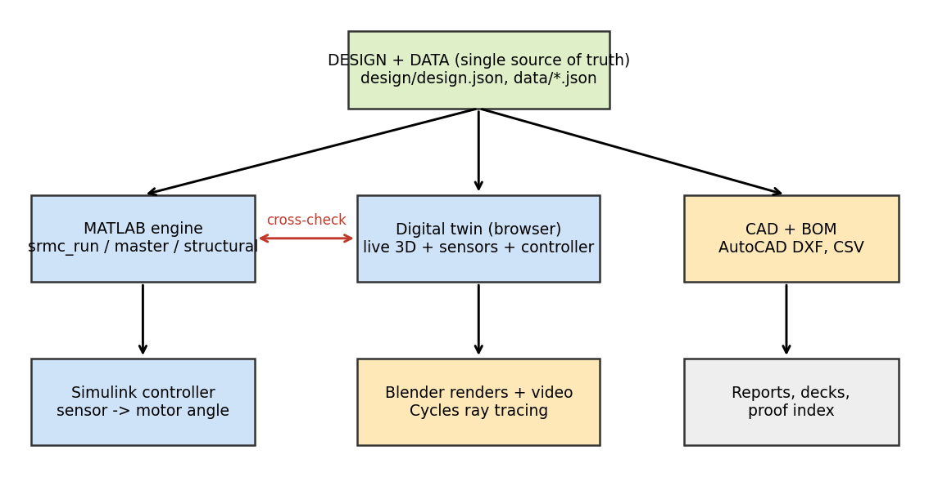
Architecture: one source of truth
design/design.json + data/*.json -> twin, MATLAB, CAD, Blender
R5 Digital twin | Agrovoltaic Canopy for Protection and Sustainable Farming, TCE Madurai | 2
Notes:
MATLAB and the JavaScript engine implement the same equations independently and are cross-checked on 22 outputs.

Slide 3
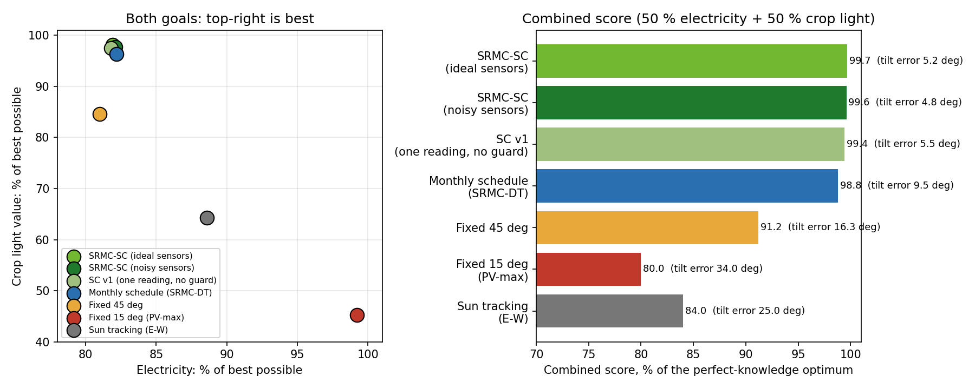
The twin runs the six-sensor controller
• Open the twin: the six-sensor controller is ON by default. The panels follow the rule: rain = flat roof, night = park, otherwise the best mix of electricity and crop light.
• Sensor card on the 3D tab: pyranometer, PAR under the canopy, DHT11 temperature and humidity (VPD), soil moisture, rain sensor, anemometer.
• Controller panel: sliders for cloud cover, DHT11 temperature and humidity, soil moisture; the rain button is the rain sensor. A decision trace explains each tilt.
• Year-long test: 99.6 % of the best combined score with noisy sensors (82 % of the best electricity, 98 % of the best crop light value, tilt error 4.8 deg).
• The sensor values here are simulated; Review 0 shows the real ESP board feeding DHT11, soil and rain readings to MATLAB.
R5 Digital twin | Agrovoltaic Canopy for Protection and Sustainable Farming, TCE Madurai | 3
Notes:
Live demo order: 3D tab, play day, then drag cloud cover up, then temperature 40 C and humidity 25 %, then soil 15 %, then press Rain mode.

Slide 4
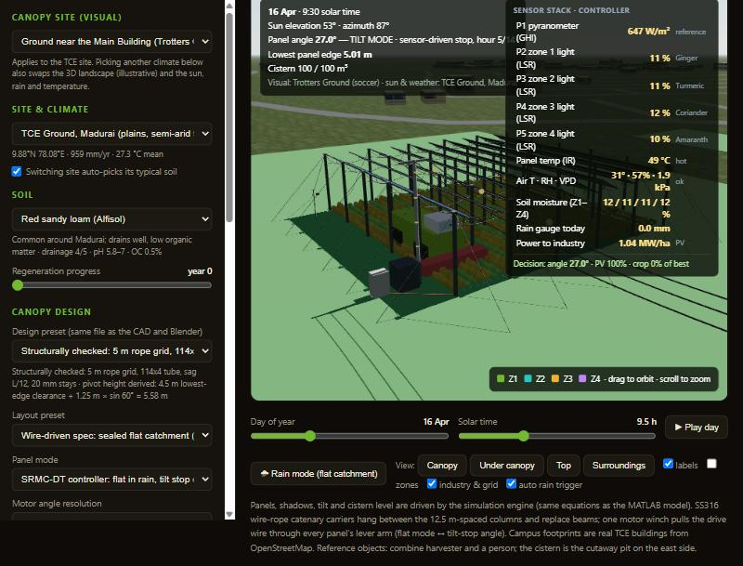
The twin in operation (3D, sensors, controller)
• Panels at 27.0 deg chosen for this hour.
• Sensor stack: pyranometer P1, zone light P2-P5, panel IR, T/RH/VPD, soil moisture, rain gauge.
• Lowest edge 5.01 m at this angle.
• Real TCE building footprints (OpenStreetMap).
Screenshot of the running twin, 16 April 09:30 solar time (TCE ground)
R5 Digital twin | Agrovoltaic Canopy for Protection and Sustainable Farming, TCE Madurai | 4
Notes:
Drive wire follows the lever arms; panels move to the controller angle; sensor card on the right.

Slide 5
Simulated sensors and the decision they feed (six sensors + modelled panel temperature)
Signal | Model | Used for
P1 pyranometer (GHI) | kt x extraterrestrial; Erbs split | reference light, night park
P2-P5 zone light (LSR) | 2-D ray cast per zone strip | crop-light value in the objective
Panel IR temperature | Huld/Faiman cell temperature | PV efficiency; heat flag > 45 C
Air T, RH, VPD | monthly means + daily cycle | ET0 and stress flag > 2.5 kPa
Soil moisture (4 zones) | daily root-zone water balance | irrigation trigger, yield stress
Rain gauge | deterministic daily schedule from NASA monthly rain | flat (rain) mode, harvest
Wind | monthly mean; gust test in Simulink | wind stow at 15 m/s (anemometer)
!Simulated, not measured. Say this explicitly in the review.
R5 Digital twin | Agrovoltaic Canopy for Protection and Sustainable Farming, TCE Madurai | 5
Notes:
These are simulated signals. In a real installation each becomes a physical sensor; the controller logic does not change.

Slide 6
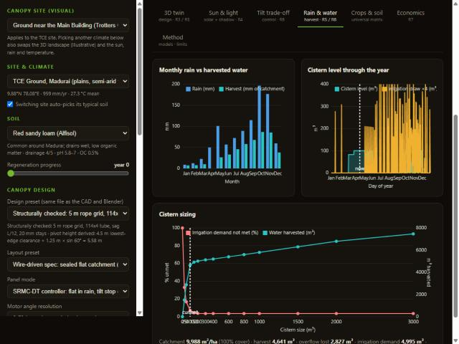
Rain harvest, cistern and irrigation
• Harvest ~4,640 m3/yr per hectare against irrigation demand ~4,930-5,000 m3 (twin vs MATLAB rounding).
• About 94 % of irrigation is met from rain; the rest from a borewell.
• Cistern sizing curve in the app; model uses 100 m3.
• Weather-year runs: drier year (rain -30 %) still meets 90 %.
Twin: monthly rain vs harvest, cistern level, cistern sizing curve
R5 Digital twin | Agrovoltaic Canopy for Protection and Sustainable Farming, TCE Madurai | 6
Notes:
Daily water balance: sealed flat canopy catches events >= 5 mm, first flush 0.5 mm, runoff 0.85, drip efficiency 0.9.

Slide 7
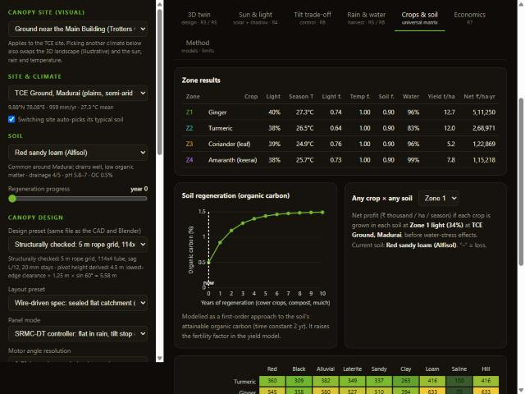
Any crop in any soil (universal matrix)
• Crop yield = potential x light x temperature x soil x FAO water-stress factor.
• Soil regeneration: organic carbon rises toward a soil-specific ceiling (tau 2 yr).
• Same canopy, other soils: crop net income on saline soil is ~8x lower than on loam.
Net profit by crop and soil at the light of the selected zone
R5 Digital twin | Agrovoltaic Canopy for Protection and Sustainable Farming, TCE Madurai | 7
Notes:
Soil library (9 types: pH, drainage, water holding, salinity, organic carbon) and crop library (24 crops) are editable JSON.

Slide 8
Universal: same design in seven climates
Climate (typical soil) | PV kWh/m2 | Crop light % | Rain-fed % | Farmer INR/month/ha
TCE Ground, Madurai / red_sandy_loam | 238 | 34 | 94 | 198,943
Coastal tropical / sandy | 225 | 34 | 98 | 190,442
Mountain / hill / hill_forest | 227 | 34 | 84 | 194,847
Humid tropical / laterite | 228 | 34 | 93 | 192,322
Arid desert / sandy | 243 | 31 | 72 | 179,419
Northern plains / alluvial | 215 | 32 | 82 | 174,447
Deccan plateau / black_cotton | 228 | 32 | 75 | 179,844
Illustrative landscapes except TCE (real footprints). Farmer income uses the assumed 30 % share at INR 3/kWh (R7).
R5 Digital twin | Agrovoltaic Canopy for Protection and Sustainable Farming, TCE Madurai | 8
Notes:
T2_universal_climates.csv from matlab/srmc_master.m. The visual changes landscape per climate (illustrative).

Slide 9
Implementation check: JavaScript twin vs MATLAB
Quantity | Twin (JS) | MATLAB | Difference
PV energy (kWh/m2/yr) | 237.55* | 237.55* | 0.0000 %
Rain harvested (m3) | same | same | 0.0000 %
Irrigation demand (m3) | same | same | 0.0000 %
Zone yields (4) | same | same | 0.0000 %
Farmer income, investor net | same | same | 0.0000 %
Selected crops | ginger, turmeric, coriander, amaranth | identical | -
*value format depends on angle step. Agreement proves the two codes are the same model; it does not by itself prove the physics (see R4 validation against PVGIS and Blender). The twin rounds pivot height to 0.01 m, so its on-screen numbers differ from MATLAB by up to 0.2 %.
R5 Digital twin | Agrovoltaic Canopy for Protection and Sustainable Farming, TCE Madurai | 9
Notes:
Full log: evidence/logs/crosscheck_js_vs_matlab.txt (22 quantities).

Slide 10
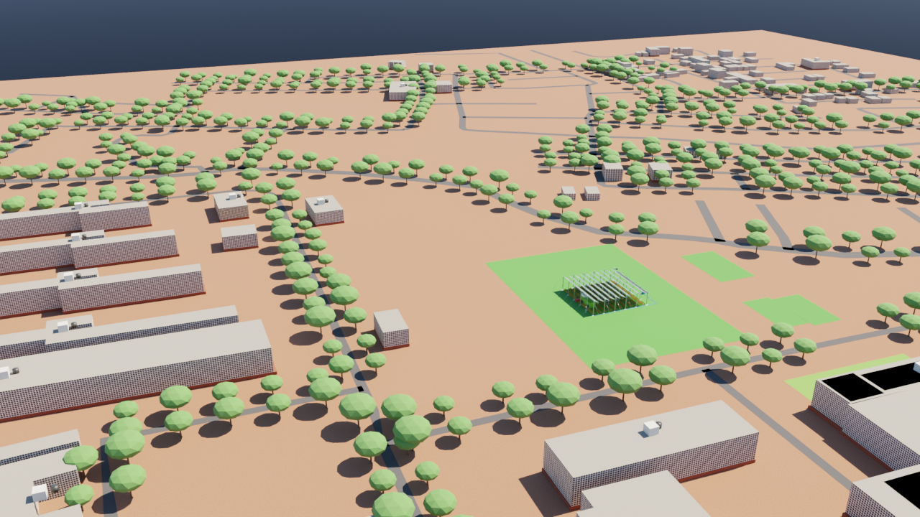
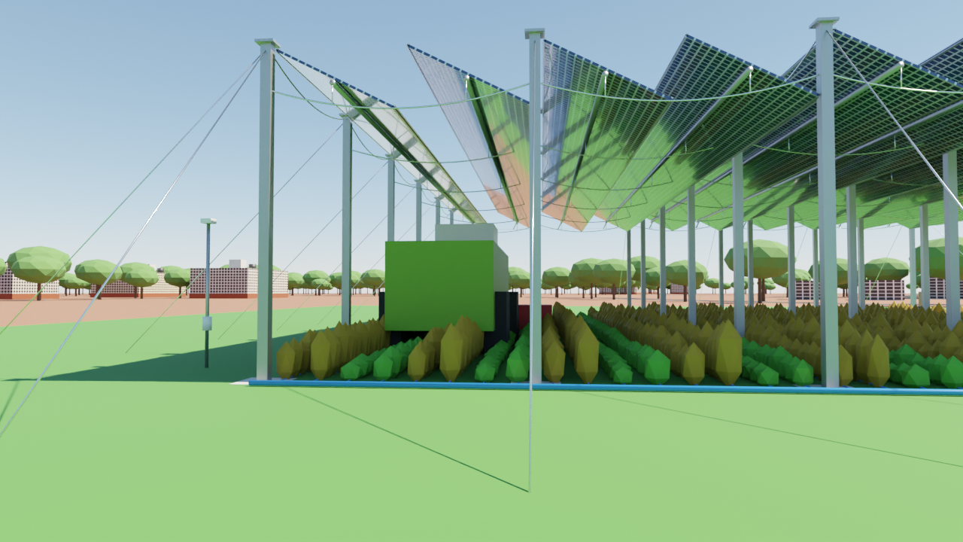
Visual twin: TCE campus context and under-canopy view
Real TCE footprints, tree-lined roads (street-view photos used as look reference only)
Under the canopy at 1.7 m eye height
R5 Digital twin | Agrovoltaic Canopy for Protection and Sustainable Farming, TCE Madurai | 10

Slide 11
Limits of R5
⚠ The twin simulates sensors; no on-site data. A physical pilot would calibrate it.
• Landscapes for other climates are illustrative, not surveyed.
• Building facades are stylised from OpenStreetMap footprints and reference photos, not surveyed models.
• Crop parameters (light need, Ky, yield, price) are typical literature-style values rounded for a screening model.
• Proof: PROOF_INDEX rows 13-17; twin file SRMC_Digital_Twin.html; screens in evidence/screens.
R5 Digital twin | Agrovoltaic Canopy for Protection and Sustainable Farming, TCE Madurai | 11
Notes:
References for this review are listed on the last slide and in reviews/REFERENCES.md. Evidence files are indexed in reviews/PROOF_INDEX.md.

