Slide 1
R6: Control algorithm and simulation results
Six-sensor controller: pyranometer, PAR, DHT11, soil moisture, rain sensor and anemometer tilt the panels to co-optimise electricity and crop light
A decision at every step, 0.5 deg resolution; flat roof (3 deg) in rain; night park; extra shade in heat or dry soil
MATLAB engine + Simulink block diagram

Slide 2
Control problem and rules
• Two physical positions from the wire spec: tilt mode 15-60 deg, flat (rain) mode with a 3 deg fall to the gutter.
• Priority: anemometer wind stow (15 m/s: 90 deg) > rain sensor (3 deg flat roof) > night park (15 deg) > six-sensor optimiser.
• Each hour the controller chooses the angle that maximises J = w x PV/PVmax + (1-w) x crop-value/cropmax (w = 0.5 default).
• Crop value = sum over zones of light-response x temperature x soil x price, only for crops that are in season.
• Search: coarse stops every 5 deg, refined to the motor/encoder resolution of 0.5 deg around the best.
R6 Control | Agrovoltaic Canopy for Protection and Sustainable Farming, TCE Madurai | 2
Notes:
Explain why both terms are normalised to the best option in the hour: the units differ (kWh vs rupees).

Slide 3
Six-sensor controller: what each sensor does
• Pyranometer: how much sun there is. Below 20 W/m2 = night, park at 15 deg.
• PAR sensor under the panels: how much light the crop really gets. It corrects the model (PAR divided by pyranometer).
• DHT11: air temperature and humidity give VPD. Hot, dry air = plant stress = accept more shade.
• Soil moisture: below 20 % = dry. More shade, drip irrigation ON.
• Rain sensor: wet = flat roof at 3 deg, water to the gutter and cistern.
• Anemometer: wind at or above 15 m/s (54 km/h) = storm: panels edge-on at 90 deg; resume below 12 m/s.
• Decision: try every angle 15 to 60 deg in 0.5 deg steps and pick the best combined score J = 50 % electricity + 50 % crop light value. Keep the angle unless the gain is above 2 % (protects the motor).
R6 Control | Agrovoltaic Canopy for Protection and Sustainable Farming, TCE Madurai | 3
Notes:
Say it in one sentence: keep just enough light for the crop and give the rest to the panels. The weight 50/50 is a setting; the twin has a slider. The PAR correction means: if the PAR sensor reads less light than the model predicts (dirt, cloud pattern), the optimiser scales the crop light by that ratio (limited to 0.7 to 1.3).

Slide 4
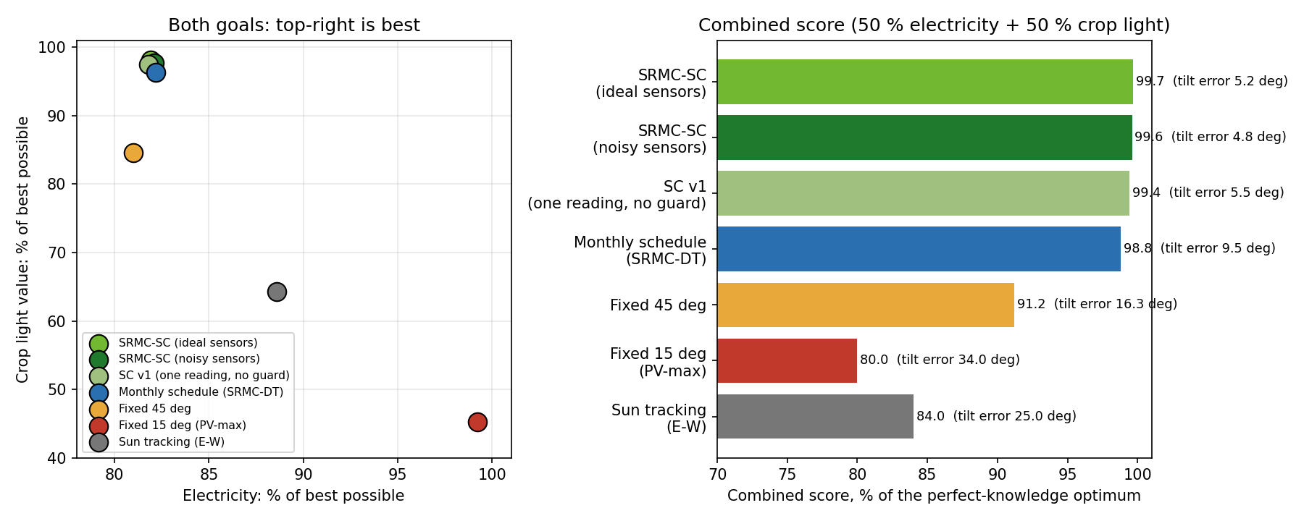
How accurate is the control? Year-long test
Strategy | Electricity, % of best | Crop light value, % of best | Combined score, % of best
SRMC-SC (ideal sensors) | 81.9 | 98.1 | 99.7
SRMC-SC (noisy sensors) | 82.1 | 97.7 | 99.6
SC v1 (one reading, no guard) | 81.8 | 97.5 | 99.4
Monthly schedule (SRMC-DT) | 82.2 | 96.3 | 98.8
Fixed 45 deg | 81.0 | 84.6 | 91.2
Fixed 15 deg (PV-max) | 99.2 | 45.2 | 80.0
Sun tracking (E-W) | 88.6 | 64.3 | 84.0
R6 Control | Agrovoltaic Canopy for Protection and Sustainable Farming, TCE Madurai | 4
Notes:
Test (calm to moderate wind; wind stow is checked in Simulink and in the MATLAB cross-check): 12 representative days x 3 sky states x 2 soil states x 14 daylight hours = 864 cases. Sensors = truth plus noise (pyranometer 5 %, PAR 5 %, DHT11 +-2 C and +-5 % RH, soil +-3 %). 100 % = perfect-knowledge optimum of the same combined score. The score is the controller own objective, so it is not an independent measure of crop yield; the yield and money results come from the hourly-plan runs in T1. Fixed 15 deg gives the most electricity but only 33 % of the crop light value.

Slide 5
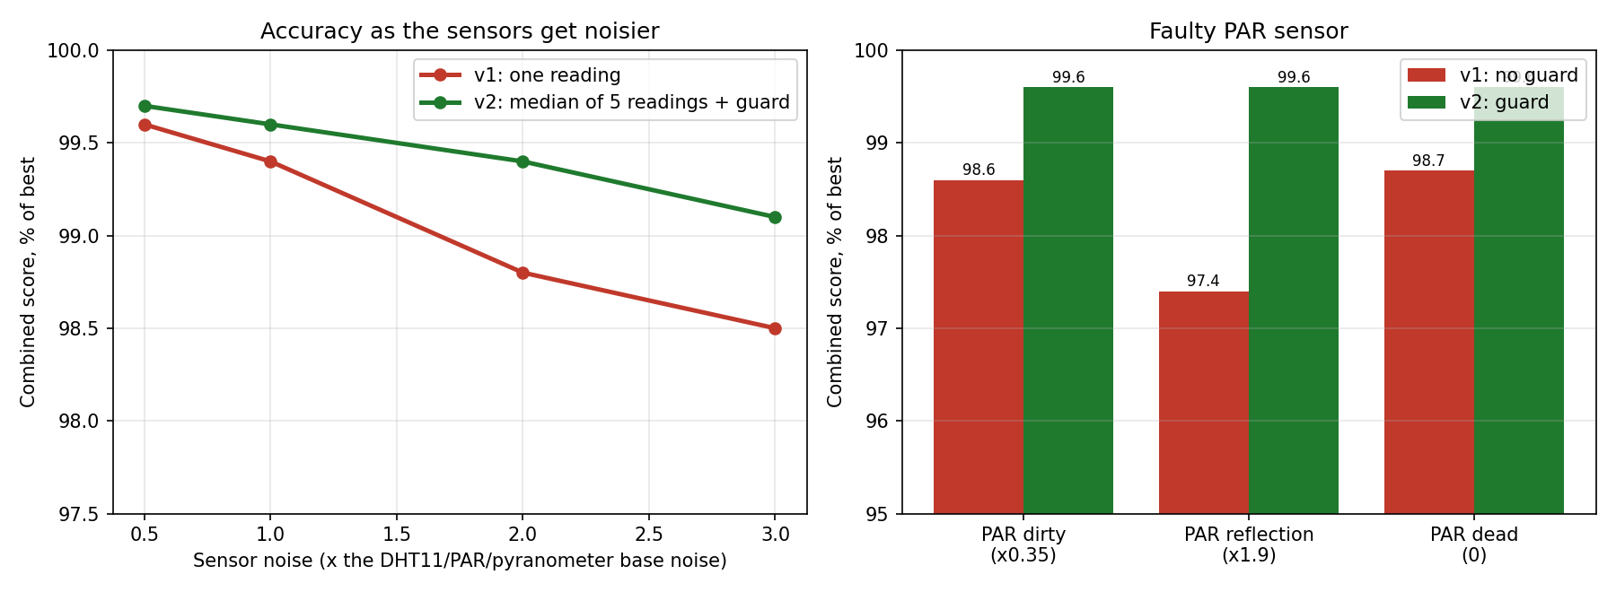
Robust to noisy and faulty sensors
R6 Control | Agrovoltaic Canopy for Protection and Sustainable Farming, TCE Madurai | 5
Notes:
v1 takes one reading per decision. v2 takes the median of 5 readings per channel and ignores a PAR sensor that reads less than half or more than 1.6 times what the model predicts. At 3 times the base noise the combined score is 98.5 percent for v1 and 99.1 percent for v2. With a dirty, reflecting or dead PAR sensor, v1 drops to 97.4 to 98.7 percent and v2 stays at 99.6 percent.

Slide 6
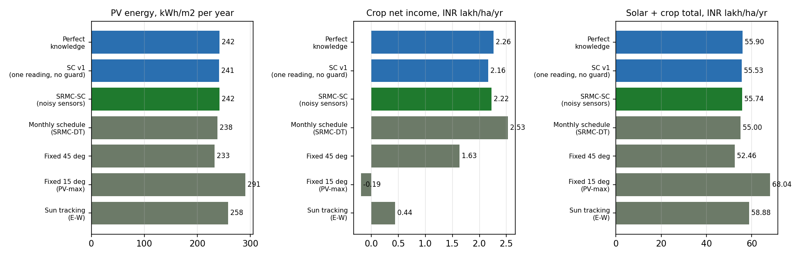
Yield and rupees (engine model, per hectare per year)
R6 Control | Agrovoltaic Canopy for Protection and Sustainable Farming, TCE Madurai | 6
Notes:
Each strategy hourly angles (clear-sky, normal soil) run through the engine crop, water and economics model. The six-sensor controller gives 242 kWh/m2 and INR 55.7 lakh in total, against 238 and 55.0 for the monthly plan and 233 and 52.5 for a fixed 45 degree panel. Crop income is INR 2.2 lakh against 2.5 (plan) and 1.6 (fixed 45). A PV-only panel still earns most rupees (68.0 lakh) but destroys the crop income. Prices are assumptions.

Slide 7
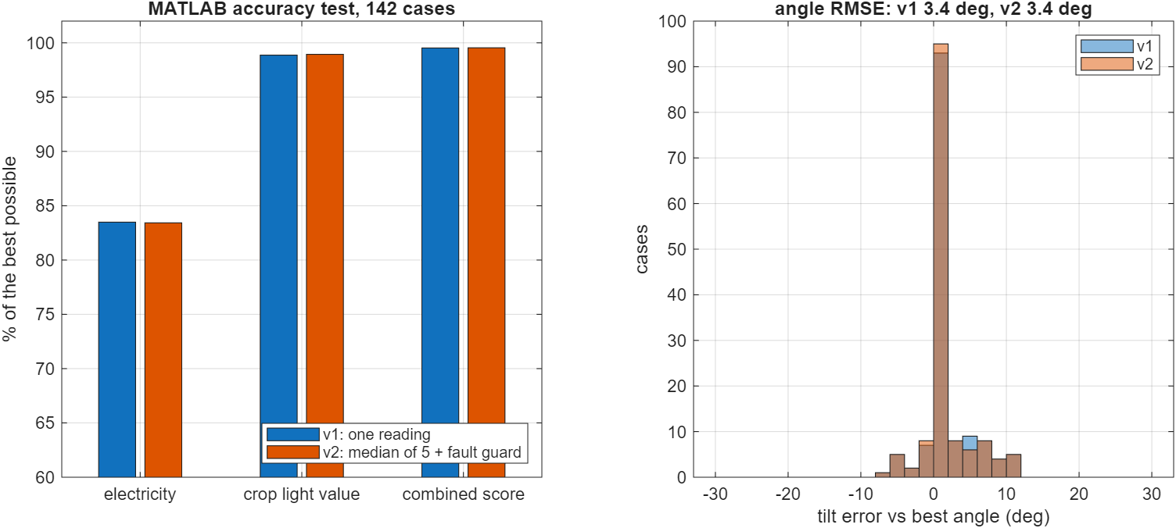
Accuracy measured in MATLAB
• 142 test cases (4 months x 3 skies x 2 soils x daylight hours) with the same noisy sensor readings as the web twin.
• MATLAB repeats the decisions with its own controller and scores every angle with its own physics against the best possible angle.
• Result: combined score 99.5 % of the best, electricity 83 %, crop light value 99 %, tilt error 3.4 deg. MATLAB and the twin chose the identical angle in 140 of 142 cases (the other two differ by up to 6 deg where the score is flat).
R6 Control | Agrovoltaic Canopy for Protection and Sustainable Farming, TCE Madurai | 7
Notes:
Files: matlab/srmc_sc_accuracy.m, results/accuracy_matlab.csv and .json, figures fig_matlab_accuracy.png, fig_matlab_angles.png.

Slide 8
Controller safety: fallbacks, move limits, wear count
• Soil probe fault (no reading, out of range, jump above 40 points, stuck for 3 daytime hours): the controller switches to the water-balance model value.
• Rain sensor fault: wet for 30 minutes in dry sunny air = ignored (panels keep tracking); dry in real rain with a forecast, RH 90 % and a dark sky = flat roof anyway.
• Move limits: at least 120 s between moves, at most 12 moves an hour, at most 900 deg of travel a day. Rain flat roof, storm stow and night park are never blocked.
• Wear count: moves, degrees of travel, metres of drive wire, drum turns, reversals. A clear day: about 64 moves, 330 deg, 2.5 m of wire, 6.5 drum turns.
• Two hours of 1-minute cloud flicker: 92 moves with no protection, 14 with the 2 % hysteresis, 24 with limits but no hysteresis. 8 of 8 tests pass.
R6 Control | Agrovoltaic Canopy for Protection and Sustainable Farming, TCE Madurai | 8
Notes:
Files: results/safety_tests.md, safety_flicker.csv, code in sensor_controller.js (makeSafe). Tested in simulation only.

Slide 9
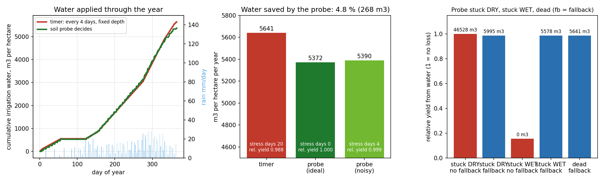
Water link: the soil probe decides when irrigation runs
R6 Control | Agrovoltaic Canopy for Protection and Sustainable Farming, TCE Madurai | 9
Notes:
Probe-triggered irrigation uses 5,372 m3 per hectare a year against 5,641 m3 for a timer (every 4 days, fixed depth): 4.8 % saved, 0 water-stress days instead of 20. A probe stuck dry without a fallback wastes about 46,500 m3; stuck wet without a fallback kills the yield (0.155); with the fallback (stuck 3 days or dead: run the timer) both stay at timer level. Same daily water balance as the twin; simulated.

Slide 10
Water link results (per hectare per year)
Strategy | Water m3 | Stress days | Relative yield | Saved vs timer
Timer (every 4 days, fixed depth) | 5641 | 20 | 0.988 | 0 %
Soil probe decides (ideal probe) | 5372 | 0 | 1 | 4.8 %
Soil probe, noisy (+-3 points) | 5390 | 4 | 0.999 | 4.4 %
Probe stuck DRY, no fallback | 46528 | 0 | 1 | -724.9 %
Probe stuck DRY, with fallback | 5995 | 20 | 0.988 | -6.3 %
Probe stuck WET, no fallback | 0 | 157.5 | 0.155 | 100 %
Probe stuck WET, with fallback | 5578 | 20 | 0.988 | 1.1 %
Probe dead (no reading), with fallback | 5641 | 20 | 0.988 | 0 %
R6 Control | Agrovoltaic Canopy for Protection and Sustainable Farming, TCE Madurai | 10

Slide 11
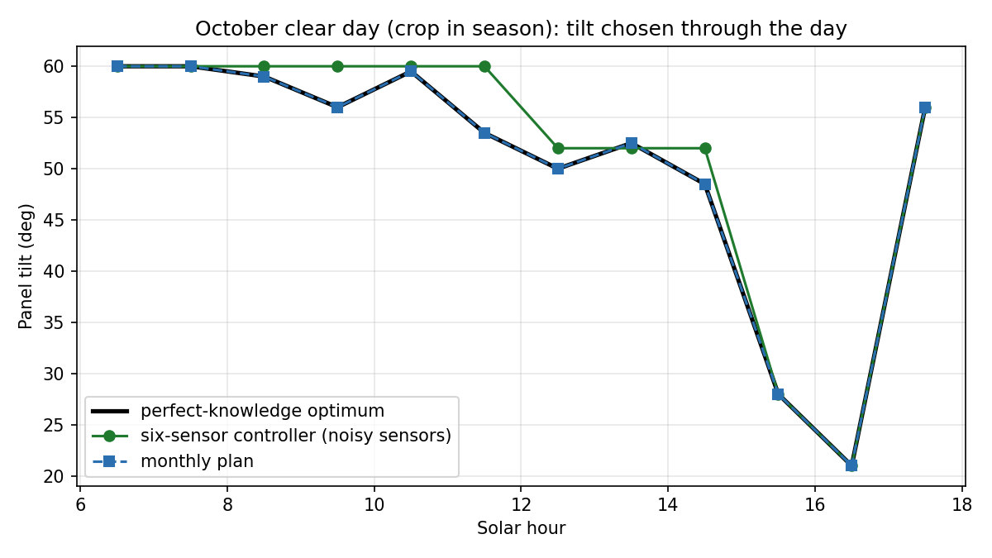
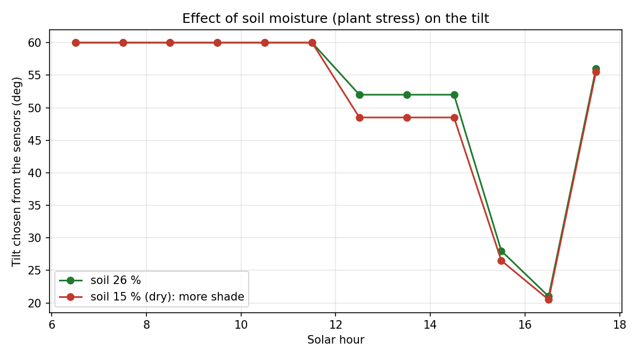
Tilt through the day, and the effect of dry soil
R6 Control | Agrovoltaic Canopy for Protection and Sustainable Farming, TCE Madurai | 11
Notes:
Left: October clear day (crop in season), tilt chosen by the six-sensor controller with noisy sensors follows the perfect-knowledge optimum; the monthly plan is up to 15 degrees away from the best angle (tilt error 9.5 deg against 4.8 deg). Right: the same day with dry soil (15 %): the controller accepts more shade because dry soil lowers the light the crop needs.

Slide 12
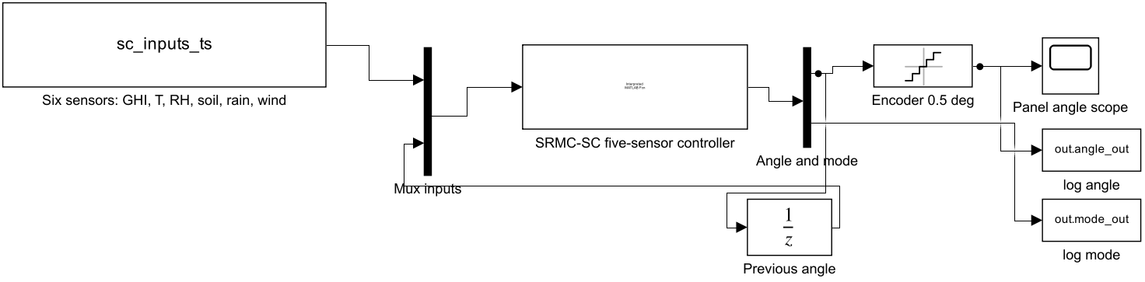
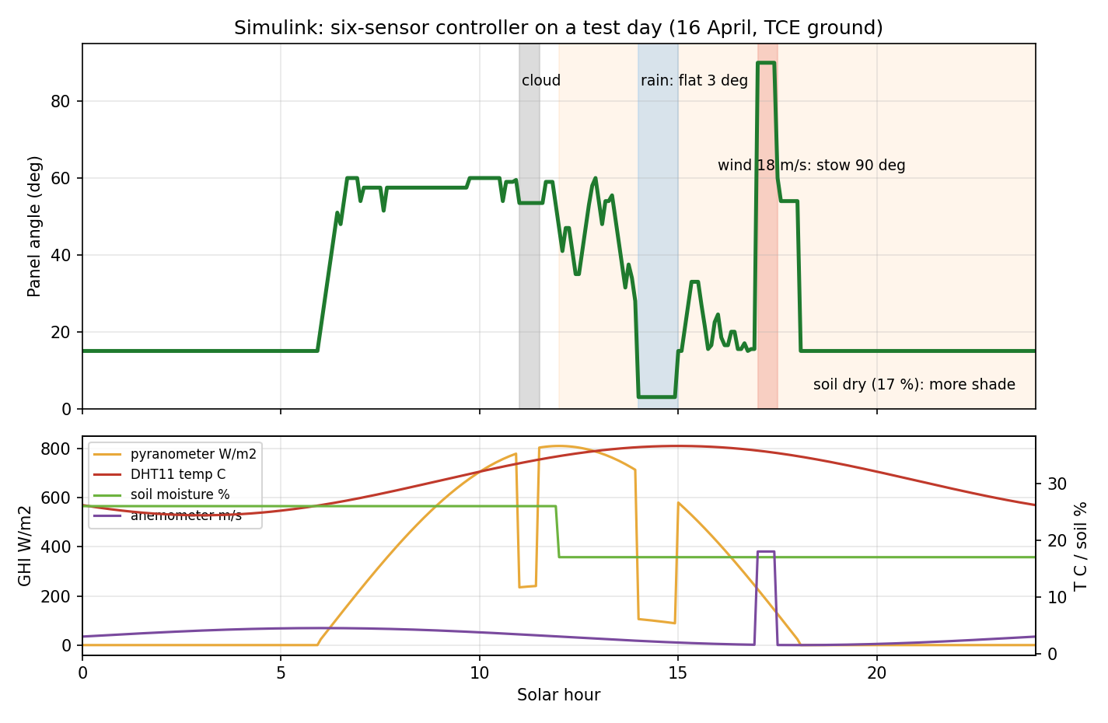
Simulink: six-sensor controller on a test day
R6 Control | Agrovoltaic Canopy for Protection and Sustainable Farming, TCE Madurai | 12
Notes:
Block diagram: sensors (From Workspace) to the controller block (same rule as the twin) with a unit delay feeding the previous angle back, 0.5 deg encoder quantiser. Test day 16 April: cloud 11:00 to 11:30, rain 14:00 to 15:00 (flat 3 deg), soil dries to 17 % after 12:00.

Slide 13
MATLAB and the web twin make the same decisions
• 40 random sensor states (sun, cloud, DHT11, soil, rain, wind, previous angle) run through MATLAB (srmc_sensor_controller.m) and through the JavaScript twin.
• Result: same mode in 40 of 40 cases, identical angle in 40 of 40 (0.0 deg difference).
• Hysteresis (2 % of the score) stops the panels hunting; the median of 5 readings and a PAR fault guard keep the decisions accurate with noisy or faulty sensors (see the Accuracy slides).
• Files: matlab/srmc_sc_crosscheck.m, results/crosscheck_sensor_controller_matlab_vs_js.txt.
R6 Control | Agrovoltaic Canopy for Protection and Sustainable Farming, TCE Madurai | 13

Slide 14
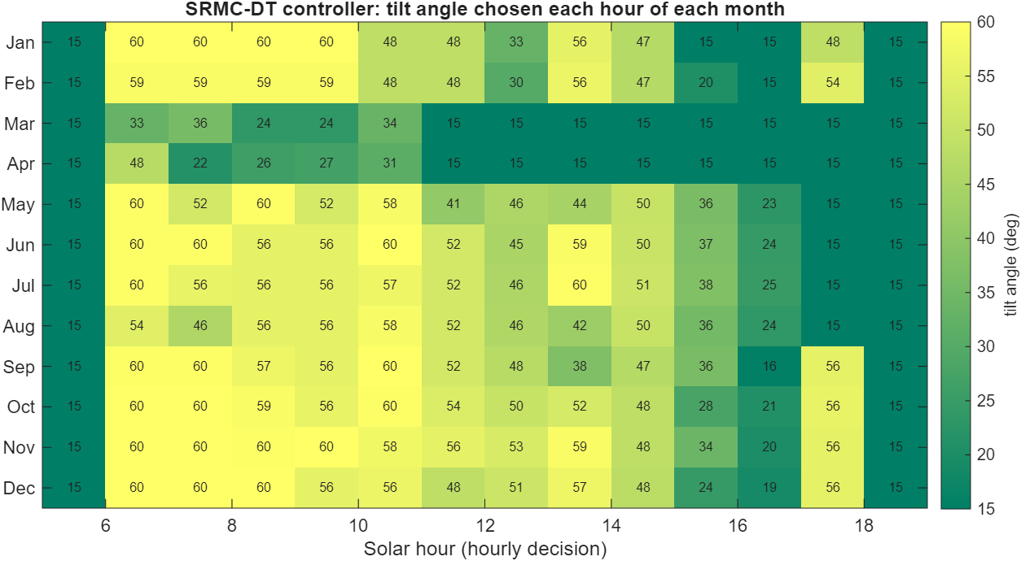
Controller output: angle chosen each hour, each month
Steeper angles (yellow) in crop months; flat energy-optimal angles (15 deg) outside the season
R6 Control | Agrovoltaic Canopy for Protection and Sustainable Farming, TCE Madurai | 14
Notes:
Computed by srmc_run.m for the checked design.

Slide 15
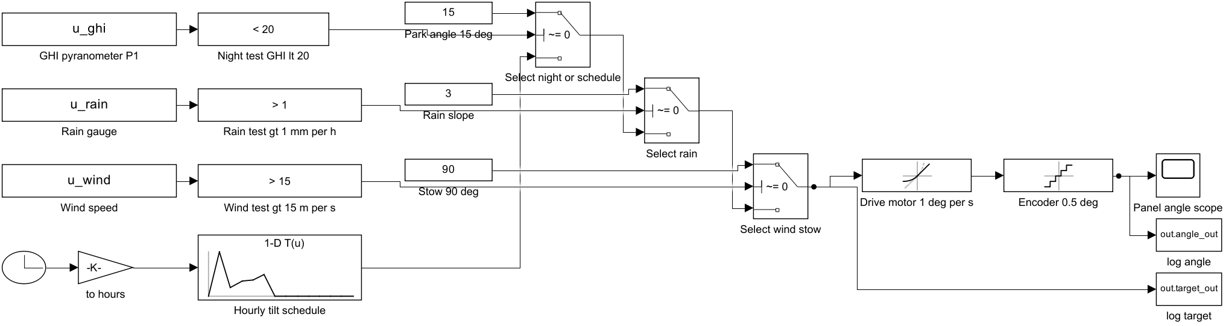
Simulink model of the hourly-plan controller (planner and fallback)
out/simulink/srmc_controller.slx: lookup of hourly schedule, three priority switches, rate limiter (1 deg/s), 0.5 deg quantiser
R6 Control | Agrovoltaic Canopy for Protection and Sustainable Farming, TCE Madurai | 15
Notes:
Built programmatically by matlab/build_simulink_controller.m

Slide 16
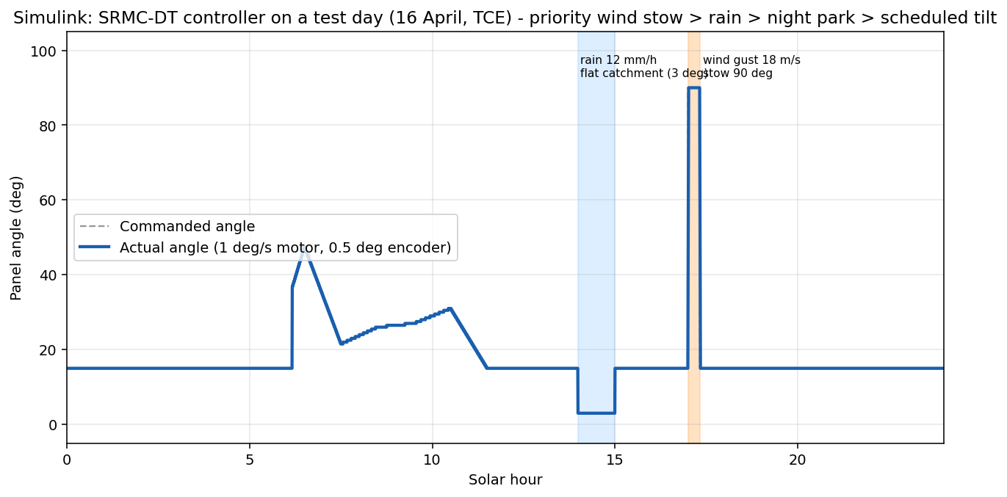
Simulink test day of the hourly plan: rain and wind gust
• Checked: night 15.0, morning 24.0, noon 15.0, rain 3.0, stow 90.0 deg.
• Actual angle follows command with the motor rate limit.
• Rain flag also reduces GHI in the test signal.
Night 15 deg, morning ~24 deg, rain 14-15 h -> 3 deg, gust 17:00 -> 90 deg stow, motor-limited transitions
R6 Control | Agrovoltaic Canopy for Protection and Sustainable Farming, TCE Madurai | 16
Notes:
Logged values: evidence/simulink/controller_log.csv.

Slide 17
Controller vs fixed designs (TCE, per hectare per year)
Design | PV kWh/m2 | Light % | Solar L | Crop L | Total L | Rain-fed %
SRMC-DT controller (50% energy / 50% crop) | 238 | 34 | 52.5 | 2.53 | 55.0 | 94
Fixed 45 deg tilt stop | 233 | 32 | 50.8 | 1.63 | 52.5 | 93
PV-max fixed 15 deg | 291 | 14 | 68.2 | -0.05 | 68.2 | 94
Crop-max controller (w = 0) | 224 | 36 | 48.3 | 2.86 | 51.2 | 93
PV-max controller (w = 1) | 295 | 15 | 69.4 | -0.09 | 69.3 | 94
The controller beats fixed 45 deg by ~5 % in total value and ~55 % in crop income. !A PV-only design earns more MONEY at these assumed prices; the controller case rests on crop, water and soil benefits that are not priced.
R6 Control | Agrovoltaic Canopy for Protection and Sustainable Farming, TCE Madurai | 17
Notes:
L = INR lakh. Source: out/matlab/T1_controller_comparison.csv (matlab/srmc_master.m).

Slide 18
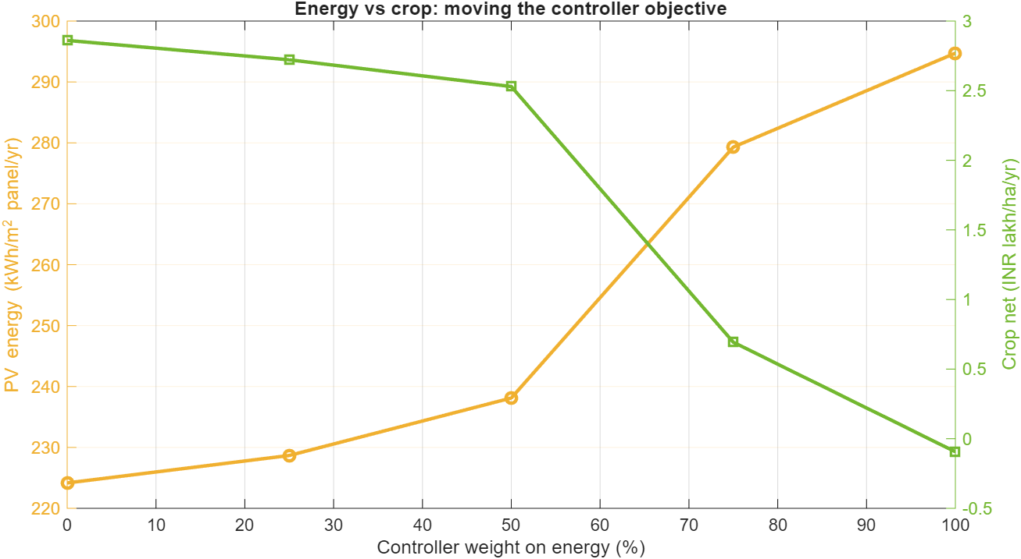
Moving the objective weight
• More weight on energy -> more PV, crop income falls to zero.
• Weight on crops -> light 36 %, PV 224 kWh/m2.
• The curve is the Pareto trade-off to show a judge.
Energy-weight sweep 0 to 100 %
R6 Control | Agrovoltaic Canopy for Protection and Sustainable Farming, TCE Madurai | 18
Notes:
w = 0.5 is the default; the farmer or the industry can choose another weighting.

Slide 19
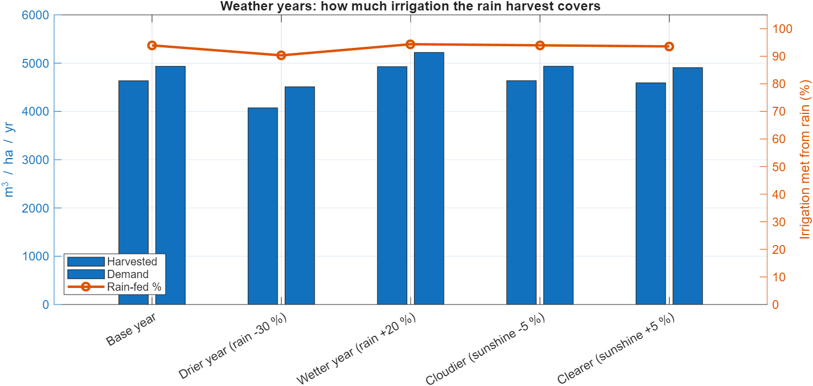
Weather years (full model re-run)
• Drier year: irrigation from rain stays ~90 %.
• Cloudier year: farmer income -4 %.
• Rain harvest is the key resilience feature.
Rain -30 %, +20 %; sunshine -5 %, +5 %
R6 Control | Agrovoltaic Canopy for Protection and Sustainable Farming, TCE Madurai | 19
Notes:
T6_physics_scenarios.csv

Slide 20
Why sensor-driven control is worth it - and what it does not prove
• Compared with a fixed 45 deg stop: +2 % electricity, +3.5 % light, +55 % crop income, same rain-fed fraction.
• The controller protects the crop and the structure: flat sealed roof in rain, more shade in heat or dry soil. The anemometer stows the panels edge-on at 90 deg in a storm (15 m/s, resume below 12 m/s).
⚠ It does not beat a PV-only design on rupees today: crop income is small next to solar income at INR 3/kWh.
⚠ Not validated on hardware: no motor, sensor noise, wind dynamics or communication delay are in the model.
• Next evidence: hardware-in-loop test or a one-row pilot; price the water, soil and resilience benefits.
R6 Control | Agrovoltaic Canopy for Protection and Sustainable Farming, TCE Madurai | 20
Notes:
Present the honest result first - it is more credible than a one-sided claim.

Slide 21
Limits of R6 and what is NOT claimed
• Objective weights and crop light-response curves are assumptions; results move with them (see sensitivity in R7).
• The note in the SRMC-DT document that panels "trim flatter to admit light" conflicts with the geometry: in this model steeper tilt admits more light; the model follows the physics.
• Panel temperature > 45 C and VPD > 2.5 kPa are monitored and reported, not yet inside the optimiser objective.
• Proof: PROOF_INDEX rows 18-24; matlab/srmc_master.m; matlab/build_simulink_controller.m.
R6 Control | Agrovoltaic Canopy for Protection and Sustainable Farming, TCE Madurai | 21
Notes:
References for this review are listed on the last slide and in reviews/REFERENCES.md. Evidence files are indexed in reviews/PROOF_INDEX.md.

