Slide 1
R7: Economics, farmer income and final conclusions
Who earns what, how sure are we, and what has to be true
Farmer + investor view, sensitivity, Monte Carlo, break-even tariff
All prices are assumptions to be replaced by quotes

Slide 2
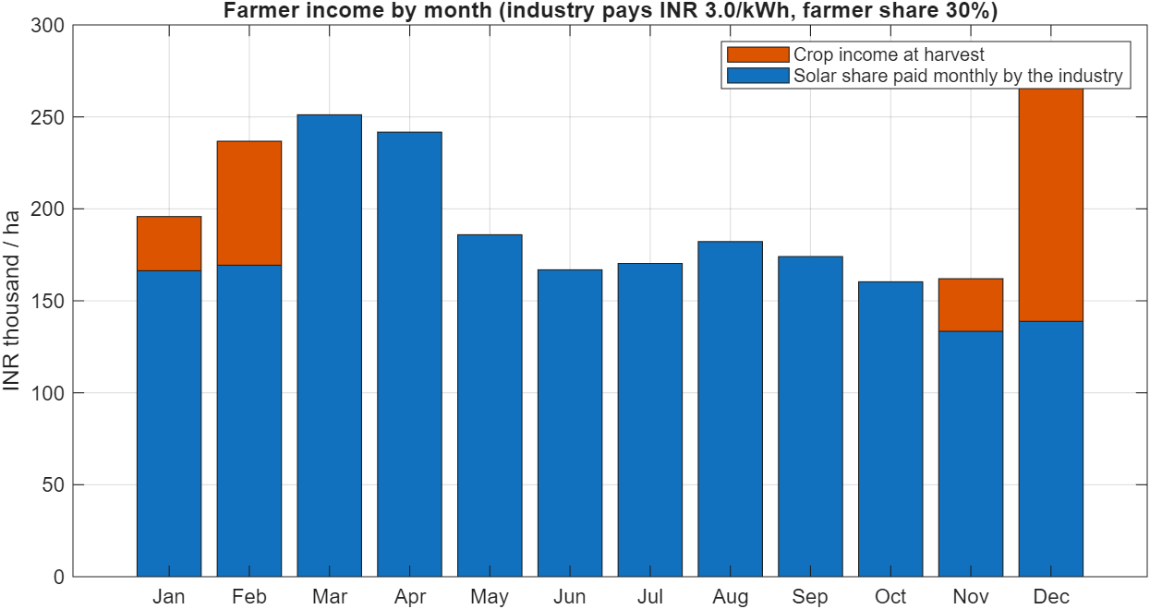
Business model
• The industry buys the electricity at a tariff (assumed INR 3.0/kWh) under a PPA / open-access arrangement.
• The farmer receives a share of that payment every month (assumed 30 %) and keeps all crop income, paid at harvest.
• The investor/operator funds the canopy, pays O&M and keeps the remaining 70 %.
• Rain harvested in the cistern irrigates the crops; surplus water and soil benefits are not priced.
• Result per hectare per year (checked design): farmer ~INR 23.9 lakh = INR 1.99 lakh per month; investor net ~INR 31 lakh.
Farmer income by month: solar share monthly, crops at harvest
R7 Economics and final | Agrovoltaic Canopy for Protection and Sustainable Farming, TCE Madurai | 2
Notes:
Each number is a model output under assumed prices; say so.

Slide 3
Assumptions - status of each
Input | Value | Status / where to get the real number
Industry tariff | INR 3.0/kWh | ASSUMED - PPA quotation / TNERC order for open-access
Farmer share | 30 % | ASSUMED - negotiated contract or land lease
Capex | INR 60,000/kWp + cistern INR 7,000/m3 | ASSUMED - supplier quotes (rope grid likely costs more)
O&M | 1.5 % of capex per year | ASSUMED
Crop prices, costs | library values (e.g. ginger INR 60/kg) | TYPICAL - check Agmarknet / local mandi
CO2 factor | 0.71 kg/kWh | APPROX. - use the latest CEA grid emission factor
Subsidy | 0 % (sweep to 30 %) | PM-KUSUM / state schemes - verify eligibility
R7 Economics and final | Agrovoltaic Canopy for Protection and Sustainable Farming, TCE Madurai | 3
Notes:
Nothing on this slide is a measured or quoted price.

Slide 4
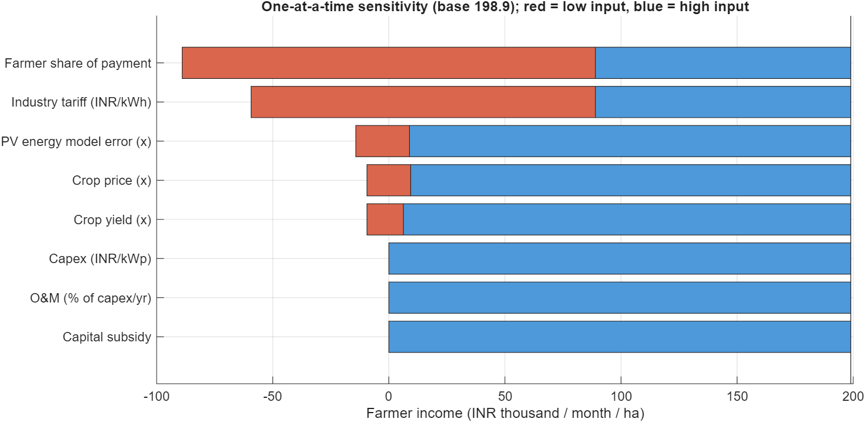
One-at-a-time sensitivity: farmer income
Farmer share and tariff dominate; crop price and yield barely move the income
R7 Economics and final | Agrovoltaic Canopy for Protection and Sustainable Farming, TCE Madurai | 4
Notes:
matlab/srmc_sensitivity.m (T5_tornado.csv).

Slide 5
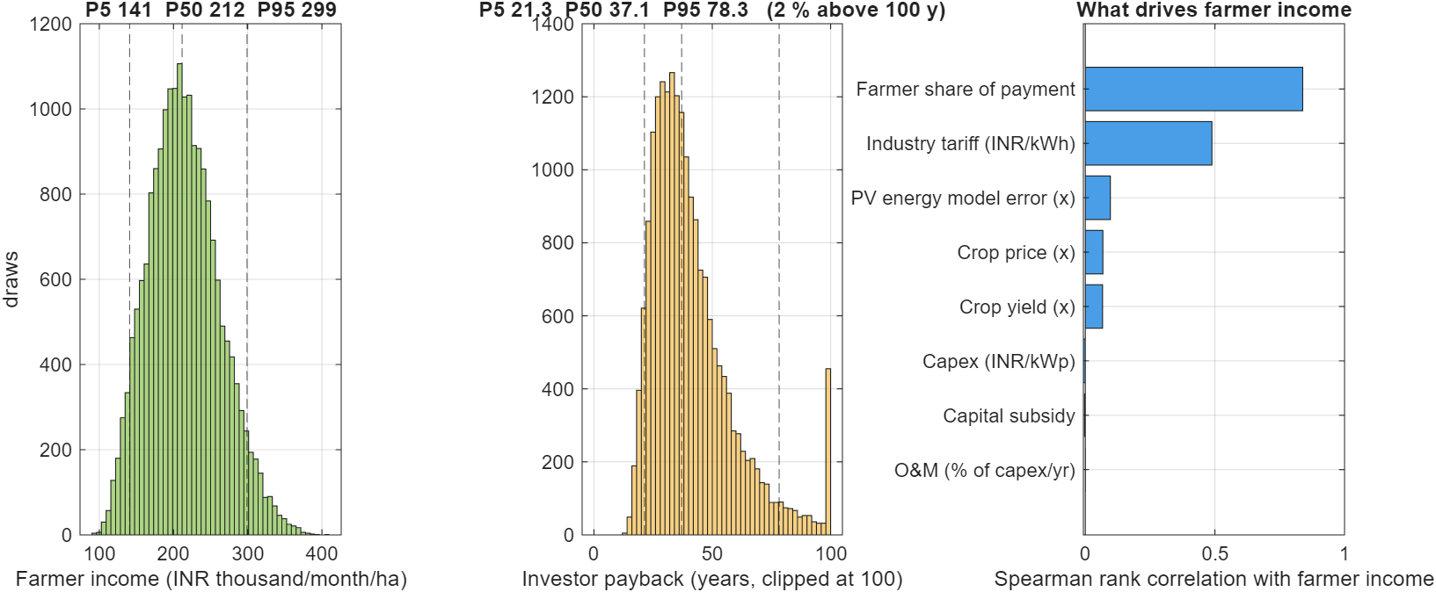
Monte Carlo (20,000 draws, triangular inputs)
Farmer income P5/P50/P95 = INR 1.41 / 2.12 / 2.99 lakh per month per hectare
R7 Economics and final | Agrovoltaic Canopy for Protection and Sustainable Farming, TCE Madurai | 5
Notes:
Investor payback P5/P50/P95 = 21 / 37 / 78 years. P(income >= INR 1 lakh/month) = 100 %; >= 2 lakh = 60 %. P(investor payback <= 20 yr) = 3 %.

Slide 6
⚠ The investor case is the weak link
Investor payback target | Farmer share | Tariff needed (INR/kWh) | Farmer income (INR/month/ha)
10 years | 10 % | 6.81 | 155,649
10 years | 30 % | 8.76 | 540,374
10 years | 50 % | 12.26 | 1,232,879
15 years | 10 % | 4.83 | 116,591
15 years | 30 % | 6.22 | 389,721
15 years | 50 % | 8.70 | 881,355
20 years | 10 % | 3.85 | 97,062
20 years | 30 % | 4.95 | 314,394
20 years | 50 % | 6.92 | 705,593
A 15-year payback at a 30 % farmer share needs about INR 6.2/kWh - above typical industrial tariffs. Closing the gap needs lower capex, subsidy or a lower farmer share. State this openly.
R7 Economics and final | Agrovoltaic Canopy for Protection and Sustainable Farming, TCE Madurai | 6
Notes:
Base case investor payback is ~41 years (37 years at P50) because the investor keeps 70 % of the sales.

Slide 7
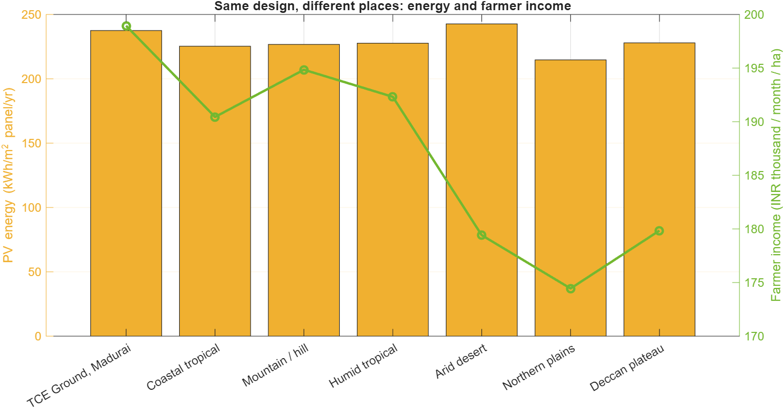
Water, soil and environment
• Rain harvest ~4,640 m3 per hectare per year covers ~94 % of irrigation (drier year: ~90 %).
• About 1,690 t CO2 per year per hectare avoided at 0.71 kg/kWh (approximate grid factor).
• Soil: organic carbon rises toward a soil-specific ceiling over ~6-8 years (model assumption, tau 2 yr).
• Universal check: 7 climates, 9 soils - the same four shade crops win everywhere at ~34 % light; salinity is the real soil risk (crop net ~8x lower than loam).
⚠ Water, soil and resilience benefits are not converted to rupees in the totals.
Same design, seven climates
R7 Economics and final | Agrovoltaic Canopy for Protection and Sustainable Farming, TCE Madurai | 7
Notes:
Do not claim a water credit or carbon income without a market route.

Slide 8
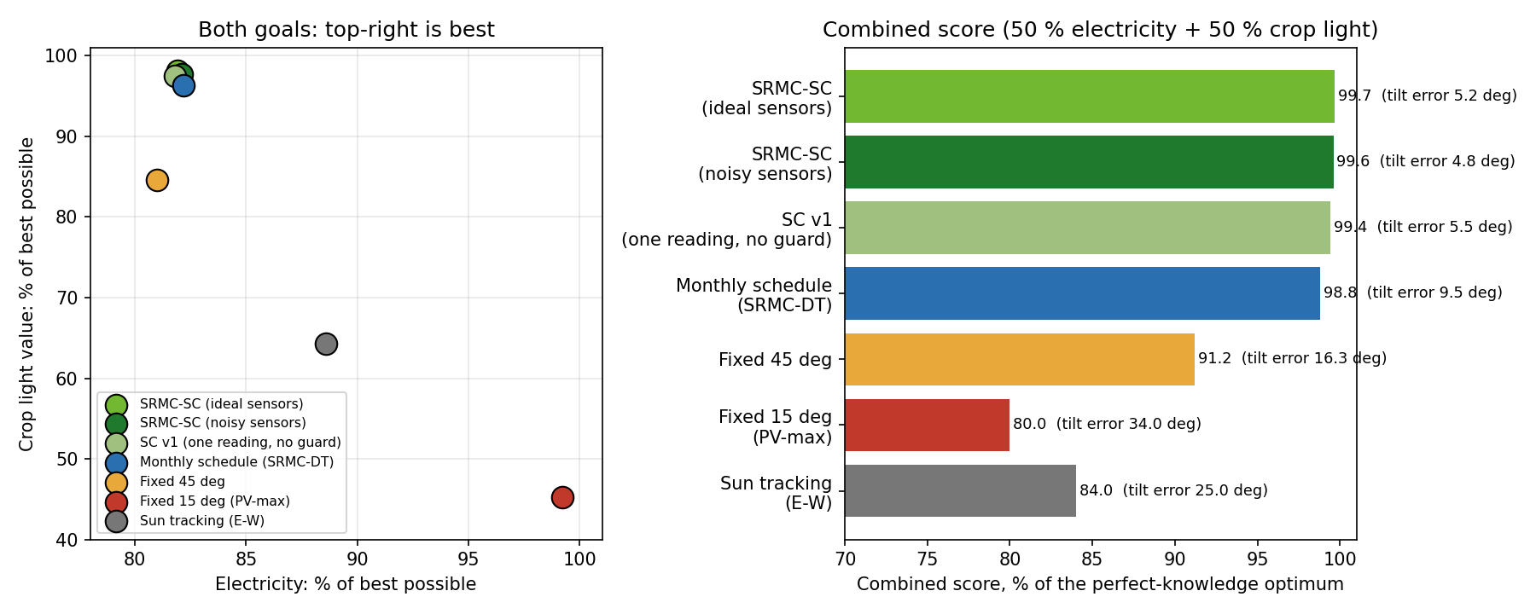
Both goals together: what the sensors achieve
• Six sensors decide every tilt. Year-long test with noisy sensors: 99.6 % of the best combined score, tilt error 4.8 deg.
• Electricity 82 % of the best possible, crop light value 98 % of the best possible. A PV-only panel gets 99 % of the electricity but only 45 % of the crop light value.
• Against the monthly plan (98.8 %) and a fixed 45 deg panel (91.2 %) the sensor controller is closer to the optimum.
• Money results stay assumption-based (tariff INR 3/kWh, farmer share 30 %). Our electricity costs about INR 6 to 7 per kWh with interest, near the Tamil Nadu industrial grid charge (INR 7.50), above big solar farms (INR 2 to 2.6).
R7 Economics and final | Agrovoltaic Canopy for Protection and Sustainable Farming, TCE Madurai | 8
Notes:
The combined score is the controller own objective. Independent checks (PVGIS, Blender, MATLAB) validate the solar and shadow parts, not the crop or money parts.

Slide 9
Conclusions
• A wire-rope canopy with hourly sensor-driven tilt and a flat rain mode is modelled consistently across MATLAB, a live twin, CAD and ray-traced renders.
• PV model within PVGIS (energy per irradiation); shadow model within 0.010 of a 3-D ray tracer.
• The 12.5 m-bay concept fails structural screening; a 5 m rope grid with heavier tube passes.
• The controller improves crop income ~55 % vs fixed 45 deg at +2 % PV; PV-only still earns more rupees.
• Farmer income is dominated by the contract (tariff x share), not by the crop - the contract is the key risk.
R7 Economics and final | Agrovoltaic Canopy for Protection and Sustainable Farming, TCE Madurai | 9
Notes:
Summarise in five lines.

Slide 10
Limits and future work
⚠ All results are simulation only; no field or prototype data.
• Replace assumed prices with quotes; obtain rope datasheets, a soil/geotechnical report and a PPA term sheet.
• Add hourly weather, validated crop light-response and a real PV module datasheet.
• Price water, soil and resilience; test a one-row pilot with the sensor stack.
• Patent / novelty: run a formal prior-art search before claiming novelty (documents in NEEDED_DOCUMENTS.md).
R7 Economics and final | Agrovoltaic Canopy for Protection and Sustainable Farming, TCE Madurai | 10
Notes:
References for this review are listed on the last slide and in reviews/REFERENCES.md. Evidence files are indexed in reviews/PROOF_INDEX.md.

Slide 11
References (selected)
• Dupraz C. et al. (2011) Renewable Energy 36(10): 2725-2732.
• Barron-Gafford G.A. et al. (2019) Nature Sustainability 2: 848-855, doi:10.1038/s41893-019-0364-5.
• Weselek A. et al. (2019) Agron. Sustain. Dev. 39: 35, doi:10.1007/s13593-019-0581-3.
• Trommsdorff M. et al. (2021) Renewable & Sustainable Energy Reviews 140: 110694.
• Huld T. et al. (2010) Solar Energy 84(2): 324-338.
• Allen R.G. et al. (1998) FAO Irrigation & Drainage Paper 56.
• Doorenbos J., Kassam A.H. (1979) FAO I&D Paper 33.
• BIS IS 875 (Part 3): 2015 Wind loads.
• PVGIS (EC-JRC); NASA POWER; OpenStreetMap contributors (ODbL).
• Full list with verification status: reviews/REFERENCES.md
R7 Economics and final | Agrovoltaic Canopy for Protection and Sustainable Farming, TCE Madurai | 11
Notes:
Five of these were confirmed by web search during preparation; see REFERENCES.md for status of the rest.

