Slide 1
R3: Design of the wire-driven agrivoltaic canopy
Structure, mechanism, drawings and bill of materials
Project: Agrovoltaic Canopy for Protection and Sustainable Farming (six-sensor controller)
Site: Thiagarajar College of Engineering ground, Madurai (9.88 N, 78.08 E)
Scope: fully computer-based study (no physical prototype claimed)

Slide 2
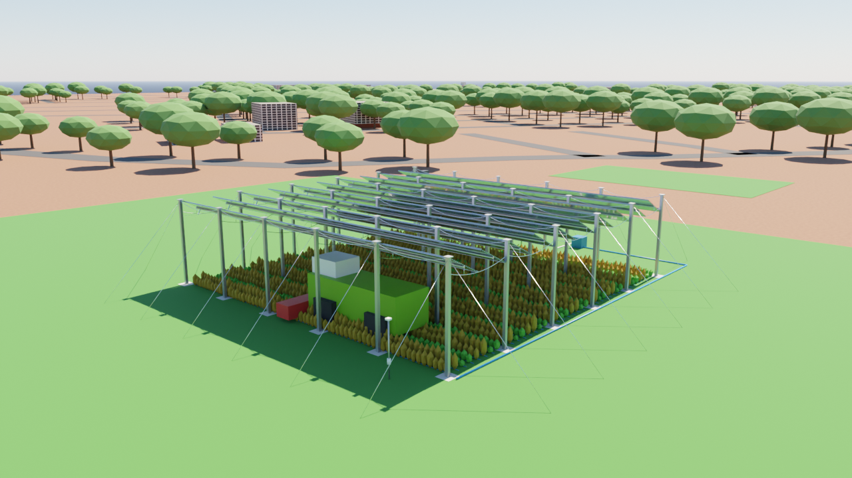
What we are building and why
• Solar panels on a stainless-steel wire-rope canopy 4.5 m above crops; panels tilt (15-60 deg) for sun and go nearly flat (3 deg) in rain.
• Flat mode turns the panels into a roof: rain runs to a gutter, into an underground cistern, then to drip irrigation.
• The electricity is sold to a nearby industry; the farmer receives a share every month plus his crop income.
• One motor pulls a single SS316 drive wire through lever arms on every panel - no per-panel motors.
• Everything is designed from ONE file (design.json) so the drawings, models and simulations cannot disagree.
Blender render of the checked design (TCE ground)
R3 Design | Agrovoltaic Canopy for Protection and Sustainable Farming, TCE Madurai | 2
Notes:
Open with the farmer story: the farmer wins because the same land produces crops, harvested rain and a monthly solar income.

Slide 3
Two source documents - and how the conflict was resolved
Item | Wire-driven spec (Rev 1.0) | SRMC Engineering Guidelines | Used in design
Panel mechanism | Flat or 15-60 deg, single wire, 0.5 deg encoder | not specified | spec
Lowest-edge clearance | >= 4.0 m | 4.5 m standard | 4.5 m (stricter)
Column spacing | rows 12-18 m, >= 6 m lane | 4-5 m (smallholder) | 5 m grid (structure check, slide 5)
Structural wire | - | SS316 16 mm 7x19 catenary | 16 mm carrier, 20 mm stays
Drive wire | SS316 6 mm 7x19 | - | 6 mm 7x19
Tilt range | 15-60 deg | +-8-10 deg trim (SRMC-DT note) | 15-60 deg (user decision)
All values live in design/design.json; presets: recommended, wire_spec, smallholder, custom, feasible.
R3 Design | Agrovoltaic Canopy for Protection and Sustainable Farming, TCE Madurai | 3
Notes:
Where two project documents differ, the design keeps both by assigning each to a different element (drive wire vs structural wire) and takes the stricter value where they overlap.

Slide 4
Design file and derived pivot height
• Pivot axis height is DERIVED, never typed: required lowest-edge clearance + (panel width / 2) x sin(max tilt).
  – 4.5 m + (2.497 / 2) x sin 60 deg = 5.58 m
• 10 panels, each 2.497 m wide on a 2.5 m pitch (3 mm EPDM seal gap) along a 25 m wire run: single motor allowed (<= 30 m, <= 20 panels).
• Panels are long (25 m) pivoting plates supported every 5 m by hangers from rope carriers.
• Five presets can be switched in the twin, MATLAB, CAD and Blender from the same file.
⚠ The first presets (12.5 m bays) fail the structural screening - see next slide.
R3 Design | Agrovoltaic Canopy for Protection and Sustainable Farming, TCE Madurai | 4
Notes:
Explain that a change of panel width or tilt limit automatically moves the pivot height, which keeps the harvester clearance guaranteed.

Slide 5
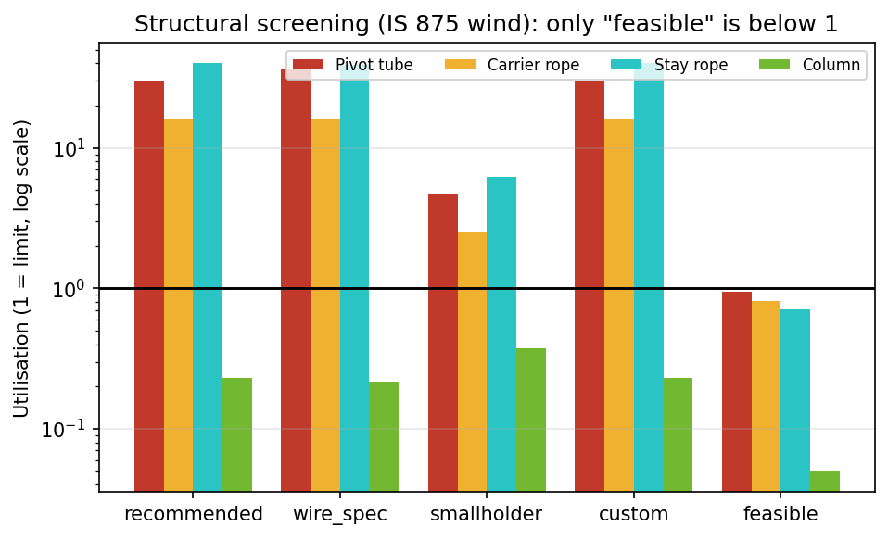
Structural screening decides the layout
• Wind: Vb 39 m/s (Madurai), pressure 0.88 kN/m2; ULS roof load 1.58 kN/m2.
• 12.5 m bays: rope 16x, stay 40x, 60 mm tube 30x over capacity.
• Fix: 5 m rope grid, CHS 114.3x4 tube, sag span/12, 20 mm stays -> all below 1.
⚠ Rope strengths are indicative (0.6 d^2 kN) - confirm with supplier datasheets.
Utilisation = demand / capacity at ULS (1 = limit). IS 875 wind, indicative rope strengths.
R3 Design | Agrovoltaic Canopy for Protection and Sustainable Farming, TCE Madurai | 5
Notes:
Hand calculations in matlab/structural_check.m. The 12.5 m bays overload the 16 mm rope about 16x and the 60 mm tube about 30x.

Slide 6
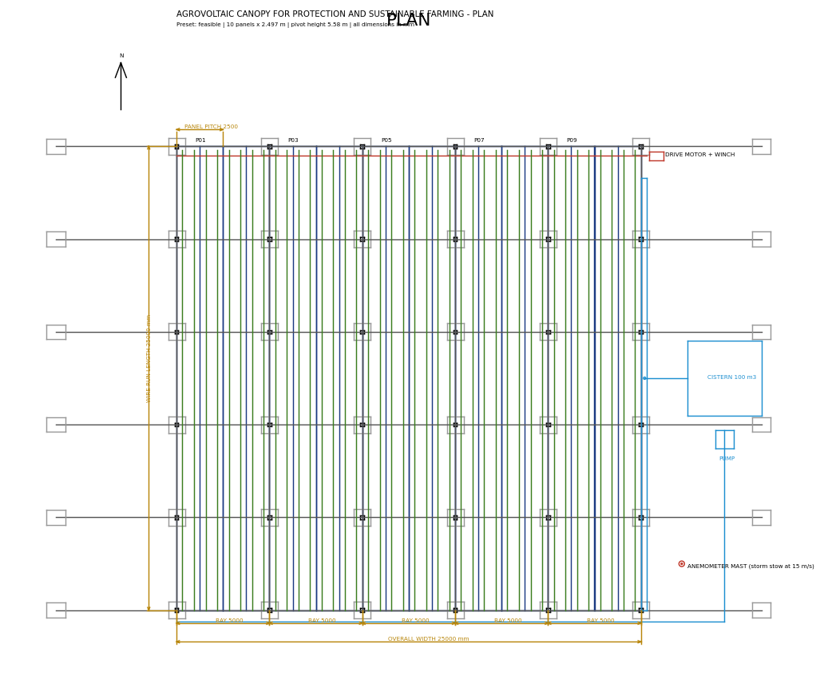
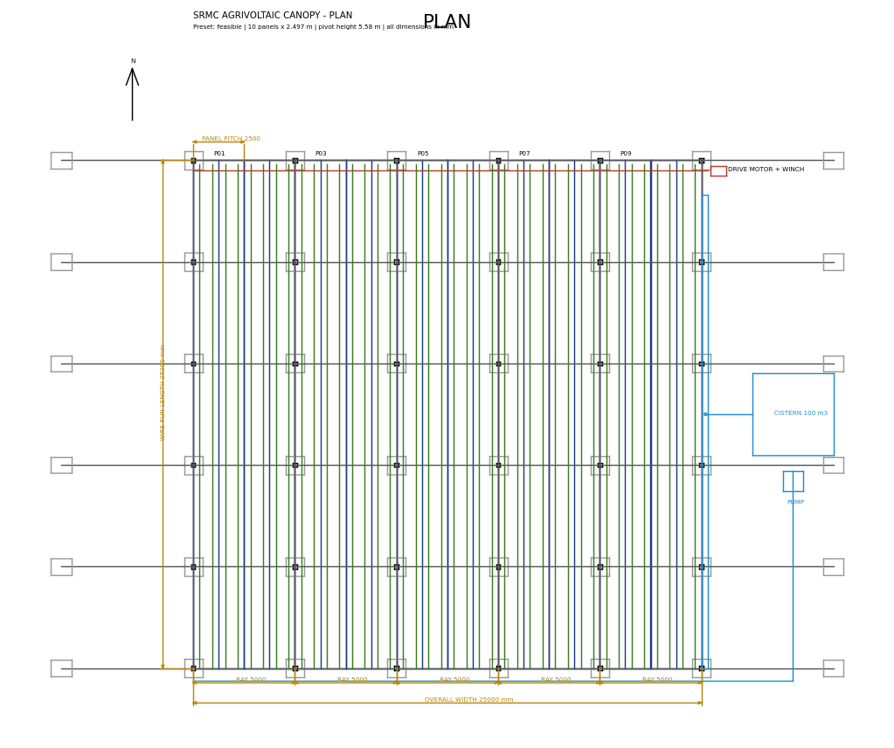
Drawing 1: plan (AutoCAD DXF)
out/cad/SRMC_feasible_plan.dxf - dimensions in mm
R3 Design | Agrovoltaic Canopy for Protection and Sustainable Farming, TCE Madurai | 6
Notes:
Columns on a 5 m grid, panels N-S, gutter on the east edge, cistern, pump, drip laterals, drive motor.

Slide 7
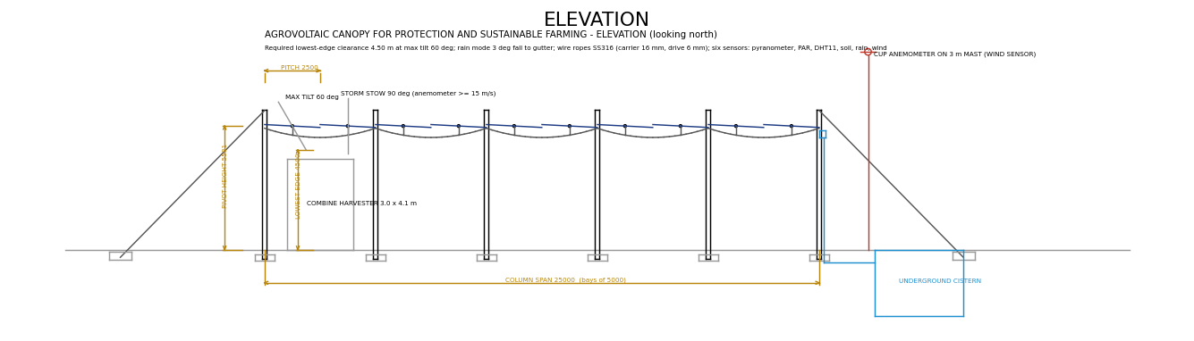
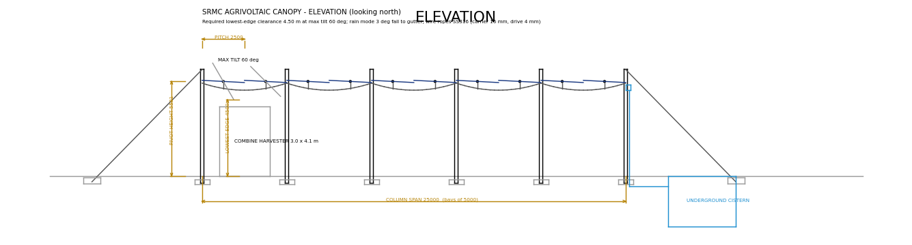
Drawing 2: elevation with the clearance check
Lowest panel edge at 60 deg tilt = 4.50 m (harvester 4.1 m high)
R3 Design | Agrovoltaic Canopy for Protection and Sustainable Farming, TCE Madurai | 7
Notes:
Shows pivot height 5.58 m, max-tilt outline, stays to ground anchors, underground cistern.

Slide 8
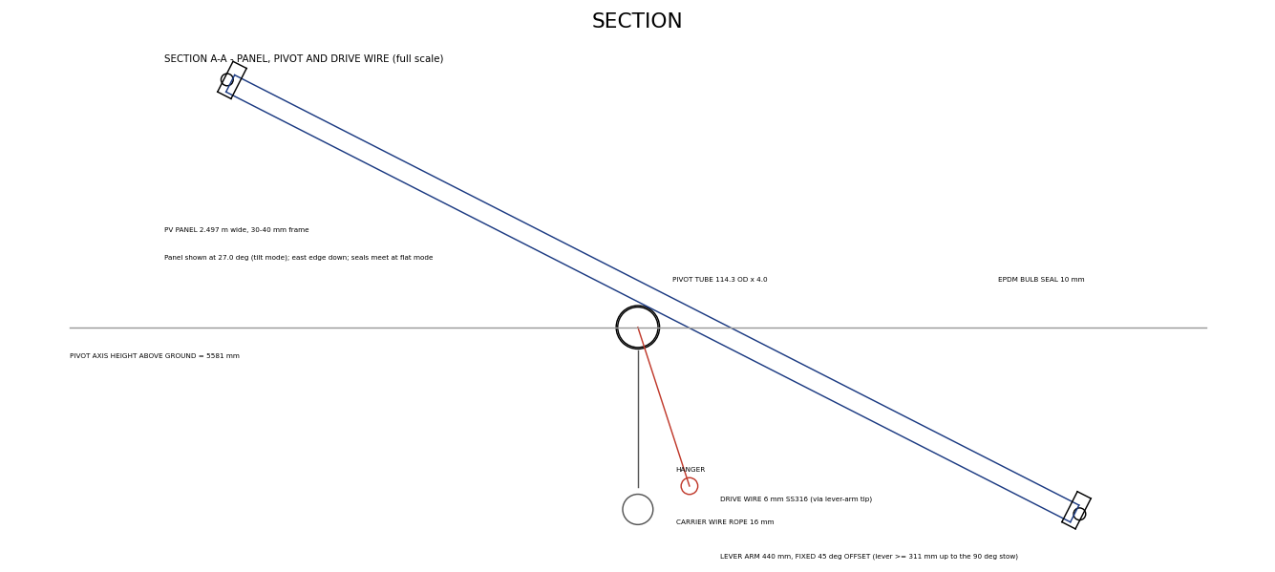
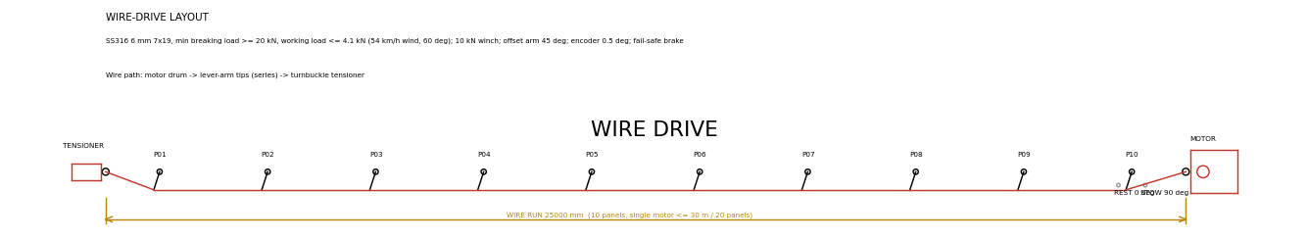
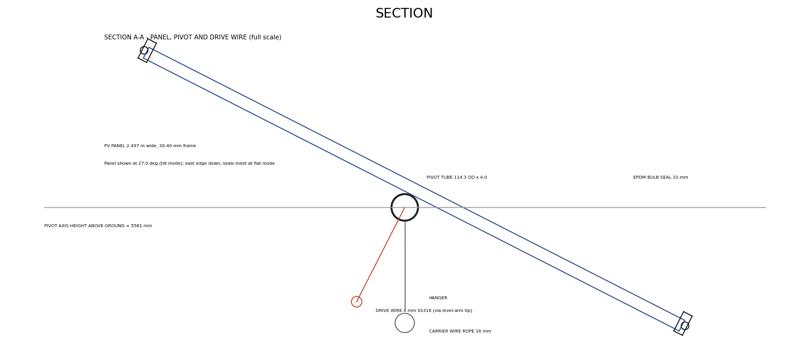
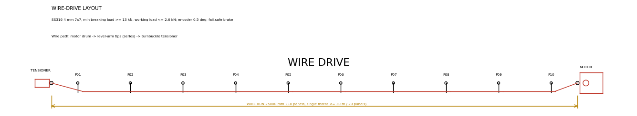
Drawings 3-4: panel section and wire-drive layout
Drive wire path: motor drum -> lever-arm tips -> tensioner
Section A-A: pivot tube, seals, lever arm, carrier rope
R3 Design | Agrovoltaic Canopy for Protection and Sustainable Farming, TCE Madurai | 8

Slide 9
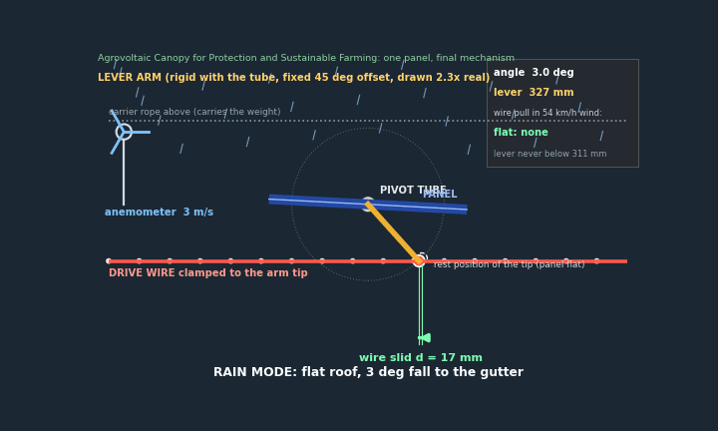
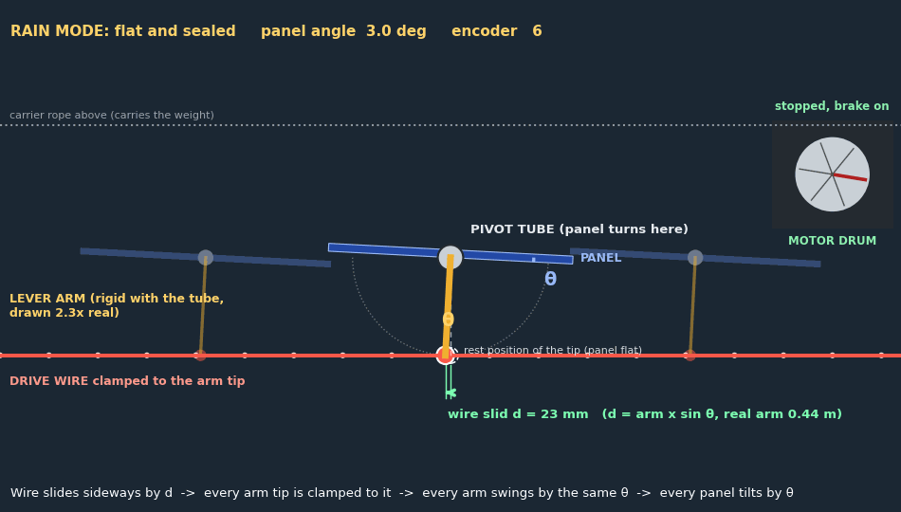
Close-up of ONE panel: the wire slides, the arm swings, the panel tilts
• The motor pays out or winds in the wire.
• d = arm x sin(theta): at 60 deg the wire has slid about 358 mm.
• All arms are on the same wire, so all panels move together.
• Rain: arm straight down, panels flat and sealed.
Animated in slideshow mode. Red = drive wire, yellow = lever arm, green arrow = how far the wire slid (d).
R3 Design | Agrovoltaic Canopy for Protection and Sustainable Farming, TCE Madurai | 9
Notes:
This is the key picture. The wire is clamped to the tip of the arm. The arm is rigid with the pivot tube under the panel. Slide the wire sideways by d and the arm swings by theta, so the panel tilts by theta. One wire is clamped to all arms, so all panels tilt together. d = arm length x sin(theta); real arm 0.44 m, drawn 2.3x bigger.

Slide 10
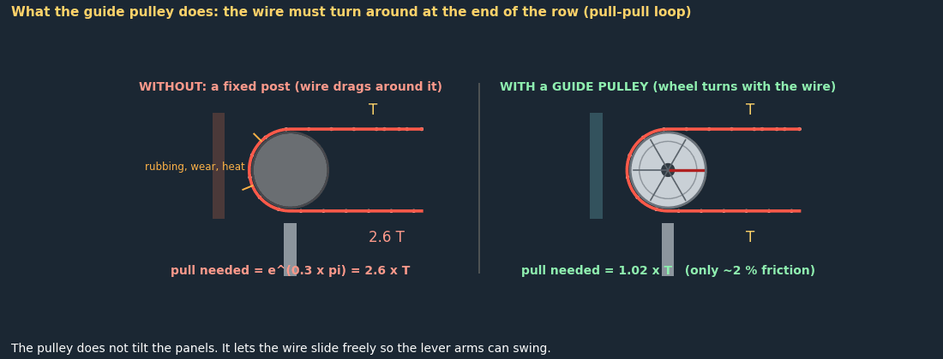
The guide pulley (grey circle): why it is there
• Grooved stainless wheel on a bearing, mounted on a bracket.
• Turns the wire around at the end of the row (pull-pull loop).
• Without it: about 2.6x more pull, wear, drifting angle.
• With it: about 2 % friction loss, long wire life.
⚠ mu = 0.3 is a typical value, not a measurement.
Animated in slideshow mode. Left: fixed post. Right: grooved guide pulley.
R3 Design | Agrovoltaic Canopy for Protection and Sustainable Farming, TCE Madurai | 10
Notes:
The wire has to turn around at the end of the row because the drive is a pull-pull loop. A fixed post makes the wire rub: by the capstan rule the pull is multiplied by e^(mu x theta), about 2.6 times for a 180 degree wrap with mu = 0.3. A grooved wheel on a bearing turns with the wire so the loss is only about 2 percent. The pulley does not tilt the panels; it lets the wire slide so the arms can swing. Pulley diameter about 80 mm for the 4 mm wire (20 times the wire diameter).

Slide 11
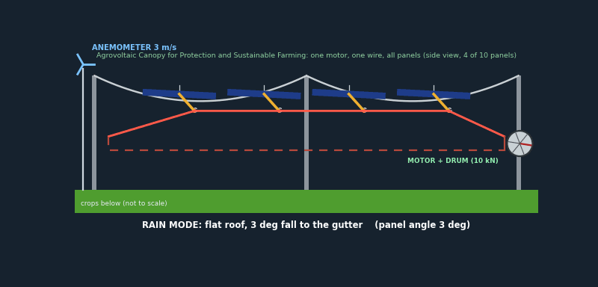
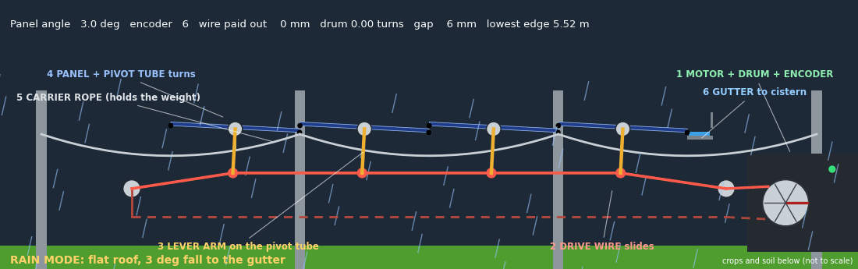
How the motor tilts the panels (animation)
• Controller sets a target angle; motor turns the drum (encoder counts every 0.5 deg).
• Drive wire slides through pulleys; it is clamped to the tip of every lever arm.
• Each arm is welded to its pivot tube, so the panel turns by sin(angle) = wire travel / arm length.
• Rain: panels settle at 3 deg and seal; heat or dry soil: more shade. Anemometer: wind stow at 15 m/s, using a 45 deg offset lever arm.
⚠ Design finding: one wire with both ends fixed cannot slide; needs a take-up (counterweight/spring) or this pull-pull loop (about 2x wire).
Animated in slideshow mode. Same animation in the twin: tab Mechanism. Lever arms drawn 2x bigger; 4 of the 10 panels shown.
R3 Design | Agrovoltaic Canopy for Protection and Sustainable Farming, TCE Madurai | 11
Notes:
Walk through the animation: 1 motor and drum, 2 drive wire, 3 lever arm, 4 panel and pivot tube, 5 carrier rope, 6 gutter. The wire is a closed pull-pull loop because a single wire with both ends fixed cannot move the arms.

Slide 12
Bill of materials (25 x 25 m demonstration unit, 131 kWp)
Item | Qty | Unit
Column, GI RHS 200 x 200 mm, 6.73 m long | 36 | nos
Foundation pad 0.9 x 0.9 m | 36 | nos
Carrier wire rope SS316 16 mm 7x19 | 152.8 | m
Longitudinal wire rope SS316 16 mm | 152.8 | m
Stay wire rope SS316 20 mm 7x7 | 222.9 | m
Ground anchor (screw/rock, or 1.6 m3 buried concrete) | 24 | nos
Turnbuckle M24 SS316 (>= 72 kN) | 24 | nos
PV panel 2.497 x 25.0 m (pivoting) | 10 | nos
Pivot tube S355 galv CHS 114.3 x 4.0 mm, 25.0 m | 10 | nos
Pivot bearing block, self-aligning, IP65 | 60 | nos
Hanger rod / wire, carrier to bearing | 15.0 | m
Lever arm SS316 0.44 m, 45 deg offset | 10 | nos
The CAD unit is one 25 m x 25 m module; the simulations are normalised per hectare.
R3 Design | Agrovoltaic Canopy for Protection and Sustainable Farming, TCE Madurai | 12
Notes:
Full list: reviews/evidence/cad/SRMC_feasible_BOM.csv (22 items).

Slide 13
Hardware changes after the strength check
Part | First parts list | Final design | Why
Drive wire | SS316 4 mm | SS316 6 mm 7x19 | wire load 4.1 kN at 54 km/h wind; 4 mm allows 4.6 kN (0.9, too tight)
Motor winch | 3 kN | 10 kN, about 0.25 kW | 3 kN is at its limit near 45 km/h wind and 1.4x over at 54 km/h
Turnbuckle (stay) | M16 SS316 | M24 SS316, >= 72 kN | stay pull 36 kN
Ground anchor | block 1.0 x 0.8 x 0.35 m (6.6 kN) | screw/rock anchor or 1.6 m3 concrete | each stay lifts about 26 kN
Lever arm | plain arm: no lever at 90 deg | 45 deg offset arm | needed for the 90 deg wind stow
Wind sensor | none | cup anemometer on a mast | storm stow at 15 m/s
Carrier rope 16 mm | ok (0.37) | unchanged | uses 37 % of allowed load
Pivot tube 114.3 x 4 | ok (0.76) | unchanged | tube length 4.7 m between supports
Column RHS 200 x 200 x 6 | ok (0.05) | unchanged | very strong
R3 Design | Agrovoltaic Canopy for Protection and Sustainable Farming, TCE Madurai | 13
Notes:
All loads at 140 km/h basic wind speed (IS 875-3), panels held, screening level. The motor numbers use a flat-plate coefficient of 1.0 and a 5 cm centre-of-mass offset. Weights, costs and installation steps are in documents/SRMC_8Panel_Guide_and_Cost.docx.

Slide 14
8-panel set (4.4 kWp): weights and cost
• 8 x 550 Wp monocrystalline modules (27.5 kg each, 220 kg) in 2 rows of 4 on a 5 m x 5 m bay; 4 columns, 2 tubes, 2 carrier ropes, 4 stays, one winch.
• SS316 rope weights from supplier listings: 16 mm = 0.975 kg/m, 12 mm = 0.549, 10 mm = 0.381, 8 mm = 0.244; rule 0.00381 x d x d kg/m.
• Above-ground weight about 1.6 t; concrete about 20 t with buried anchors (less with screw anchors).
• Indicative cost INR 6 to 10 lakh (mid about 7 lakh, about INR 1.6 lakh per kWp). Price rates are assumptions; replace them with quotes.
• Files: documents/SRMC_8Panel_Guide_and_Cost.docx, SRMC_Component_Strength_Table.docx, 8panel_BOM.csv.
R3 Design | Agrovoltaic Canopy for Protection and Sustainable Farming, TCE Madurai | 14

Slide 15
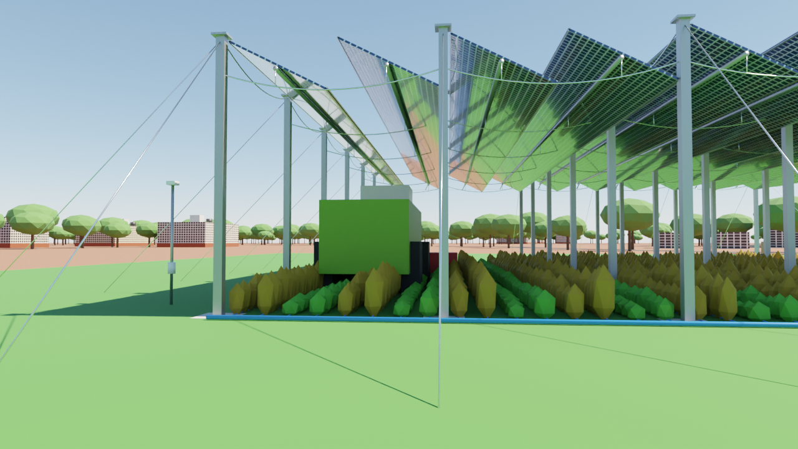
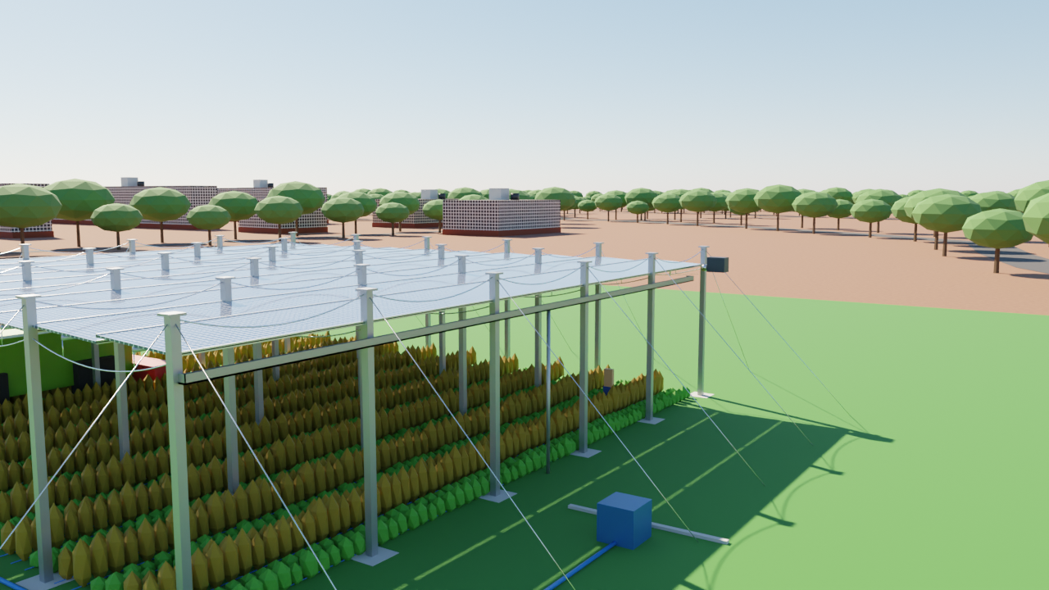
Visual design check (Blender, Cycles ray tracing)
Under the canopy: crops, drip lines, harvester clearance
Rain mode: 3 deg fall to the gutter
R3 Design | Agrovoltaic Canopy for Protection and Sustainable Farming, TCE Madurai | 15

Slide 16
Limits of R3 and what a supervisor can verify
• Drawings are generated from the design file; they were previewed in Python but not opened in AutoCAD here - open once and add a title block.
⚠ Structural numbers are screening-level hand calculations, not a certified design (no connection, fatigue, foundation or soil data).
• Rope strengths and the guideline 250 kN working-load figure must be checked against supplier datasheets.
• Tube, rope and column sizes in the BOM are from the checked preset; costs are assumptions (R7).
• Proof: reviews/PROOF_INDEX.md rows 1-6; design/design.json; out/cad; matlab/structural_check.m.
R3 Design | Agrovoltaic Canopy for Protection and Sustainable Farming, TCE Madurai | 16
Notes:
References for this review are listed on the last slide and in reviews/REFERENCES.md. Evidence files are indexed in reviews/PROOF_INDEX.md.

