Slide 1
R4: Solar resource, shadow and light model
Sun path, canopy shadow, crop light and PV output at TCE
Data: NASA POWER climatology; validated against PVGIS and Blender Cycles
Models: matlab/srmc_run.m = engine/srmc_engine.js (cross-checked)

Slide 2
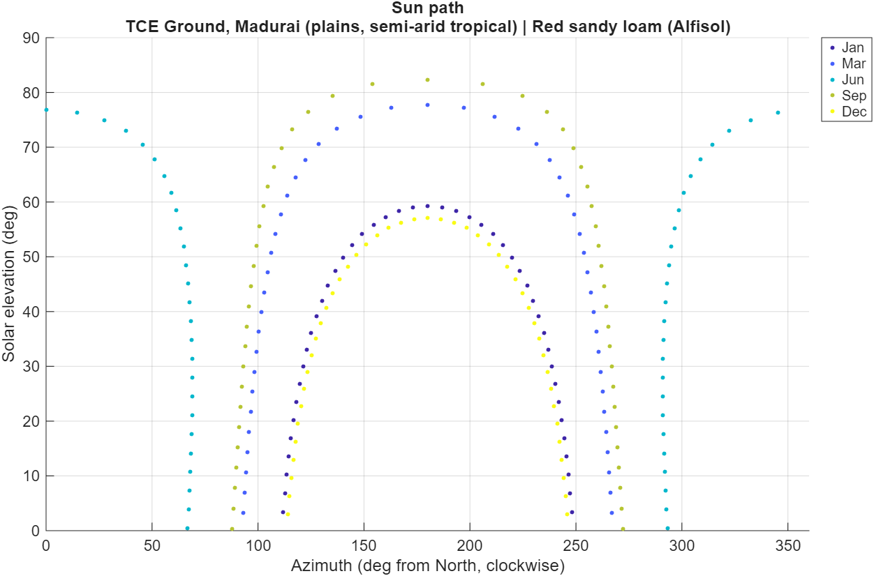
Site and sun path (9.88 N)
• Latitude 9.88 N: sun path nearly east-west.
• Declination: 23.45 sin(360/365 (284+n)).
• Solar time used; longitude/equation of time not needed for daily sums.
• Climate: NASA POWER monthly means (T, range, rain, clearness kt, RH, wind).
Sun path on 21 Dec, 21 Mar, 21 Jun, 21 Sep; near-equatorial site
R4 Solar and shadow | Agrovoltaic Canopy for Protection and Sustainable Farming, TCE Madurai | 2
Notes:
Sun is almost overhead around April and August; in June it passes north of the zenith.

Slide 3
Irradiance model
• Monthly clearness index kt (NASA ALLSKY_KT) x extraterrestrial radiation -> global horizontal GHI.
• Diffuse fraction by Erbs et al. (1982); beam = (GHI - DHI) / sin(elevation).
• Reference evapotranspiration: Hargreaves-Samani (1985) with the same site data.
• Annual GHI in the model: 2,033 kWh/m2; PVGIS (ERA5): 1,933 kWh/m2 -> +5.2 % (dataset difference).
⚠ Monthly-mean sky: no cloud-by-cloud variability. Replace with hourly data for a final study.
R4 Solar and shadow | Agrovoltaic Canopy for Protection and Sustainable Farming, TCE Madurai | 3
Notes:
The +5.2 % is traceable to NASA vs ERA5 sunshine data, not to the geometry.

Slide 4
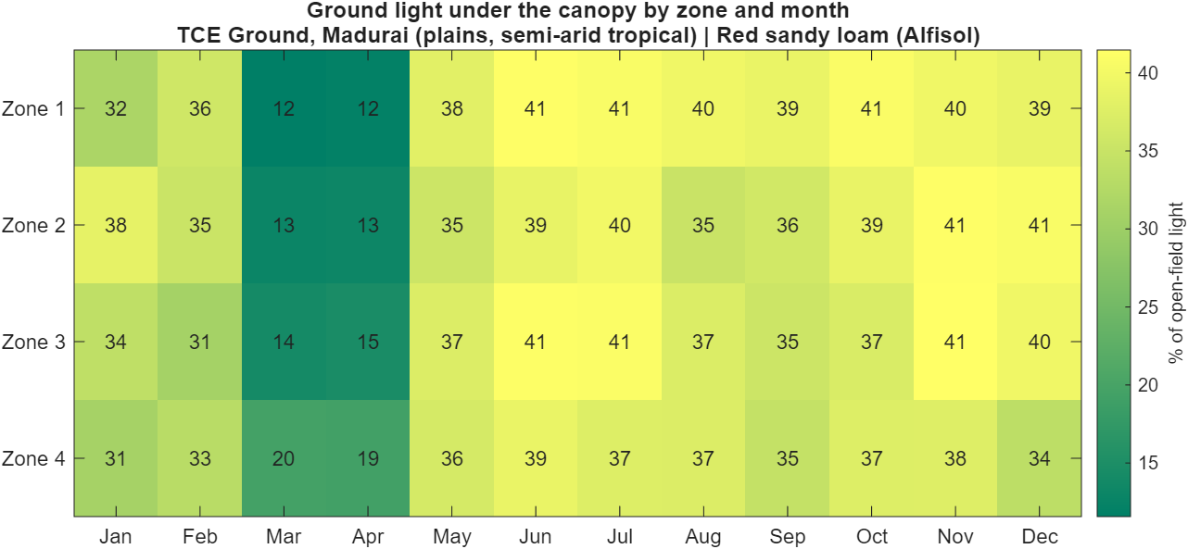
Canopy shadow model (2-D ray casting)
• Panels run north-south; the cross-section east-west is exact for long panels.
• For 40 ground points per row pitch and every hour: ray to the sun tests intersection with every panel plate.
• Row count grows automatically at low sun so long shadows are not truncated (fixed during validation).
• Diffuse light: isotropic sky view factor per ground point (24 sky directions).
• The pitch is split into four zone strips; monthly light is 12-41 % of open field (lowest in Mar-Apr, when no crop is growing and the controller favours electricity).
Light by zone and month (% of open field)
R4 Solar and shadow | Agrovoltaic Canopy for Protection and Sustainable Farming, TCE Madurai | 4
Notes:
Zone strips are where the four crop zones sit across each panel pitch.

Slide 5
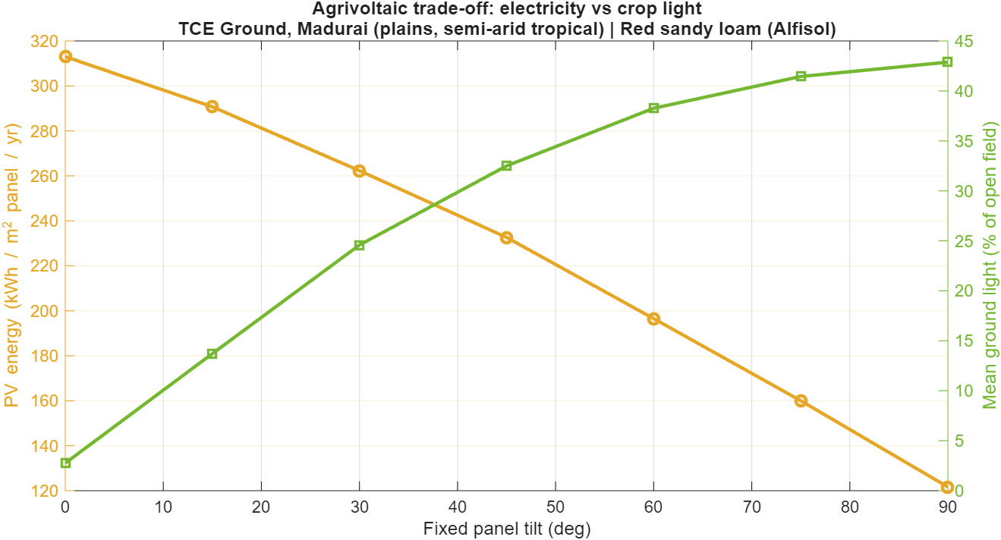
Light vs electricity trade-off (fixed tilt sweep)
• 0 deg: highest PV, almost no light to crops.
• 60 deg: ~38 % crop light, much less PV.
• Controller picks the angle every hour instead of one fixed value.
Steeper tilt lets more light through but costs electricity
R4 Solar and shadow | Agrovoltaic Canopy for Protection and Sustainable Farming, TCE Madurai | 5
Notes:
This is the core agrivoltaic trade-off the controller manages.

Slide 6
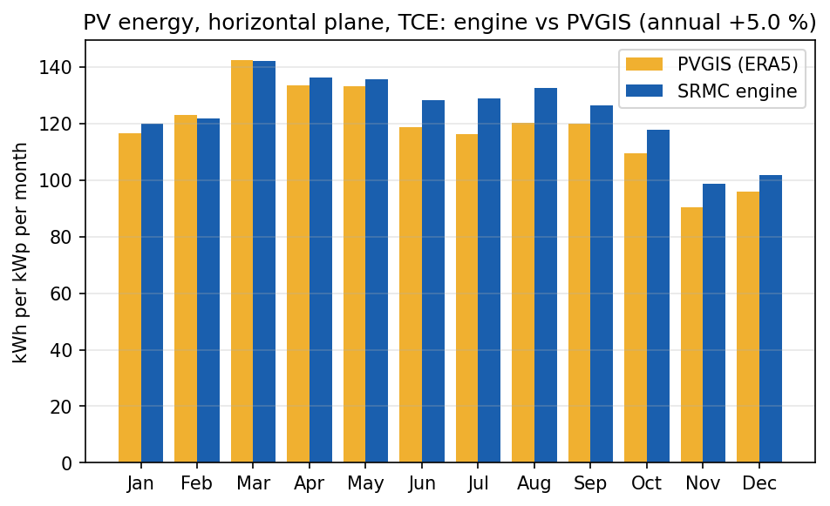
PV module model validated against PVGIS
• Energy per unit irradiation now matches PVGIS.
• Jan-May within 3 %; Jun-Nov +6 to +11 % because NASA kt is higher than ERA5 in the monsoon.
• Source: out/physics/pvgis_PVGIS-ERA5.json, tools/validate_pv.js.
Horizontal plane, TCE, 14 % system losses. Annual: +5.0 % energy, +5.2 % irradiation
R4 Solar and shadow | Agrovoltaic Canopy for Protection and Sustainable Farming, TCE Madurai | 6
Notes:
Module model: Huld et al. (2010) c-Si power model (as used by PVGIS) + ASHRAE incidence-angle modifier (b0 = 0.05). First version was +11 % high; the model upgrade removed the excess.

Slide 7
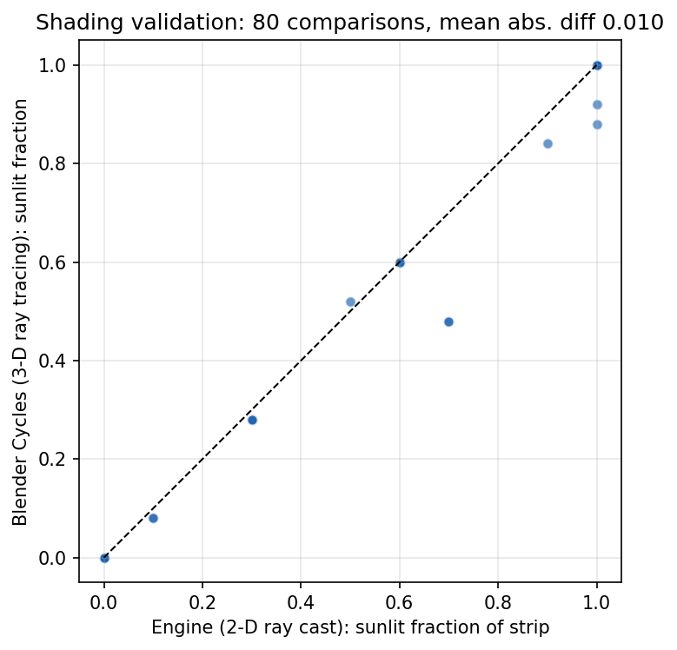
Shadow model validated against Blender Cycles
• Same geometry, different method (3-D vs 2-D).
• Validation also exposed and fixed a truncated-row bug at low sun.
• Scripts: blender/validate_shading.py, tools/shade_ref.js.
• Residual differences: panel thickness, sub-pixel edges.
Direct-beam sunlit fraction per zone strip: 20 sun/tilt cases x 4 strips = 80 comparisons
R4 Solar and shadow | Agrovoltaic Canopy for Protection and Sustainable Farming, TCE Madurai | 7
Notes:
Independent ray tracer (Cycles, direct light only, wide canopy). Mean abs diff 0.010; 96 % within 0.10; max 0.22.

Slide 8
Result: light and energy for the checked design
• Mean crop light 34 % of open field (12-41 % by month; lowest in Mar-Apr when no crop is in season).
• PV output 238 kWh per m2 of panel per year = 1,134 kWh/kWp with the hourly controller.
• Fixed 15 deg gives 291 kWh/m2 but only 14 % light; fixed 45 deg gives 233 kWh/m2 and 33 % light.
• At 34 % light the model selects shade-tolerant crops: ginger, turmeric, coriander, amaranth.
• Open-field comparison: same site and model, no panels -> 100 % light.
R4 Solar and shadow | Agrovoltaic Canopy for Protection and Sustainable Farming, TCE Madurai | 8
Notes:
Quote numbers from out/matlab/T1_controller_comparison.csv.

Slide 9
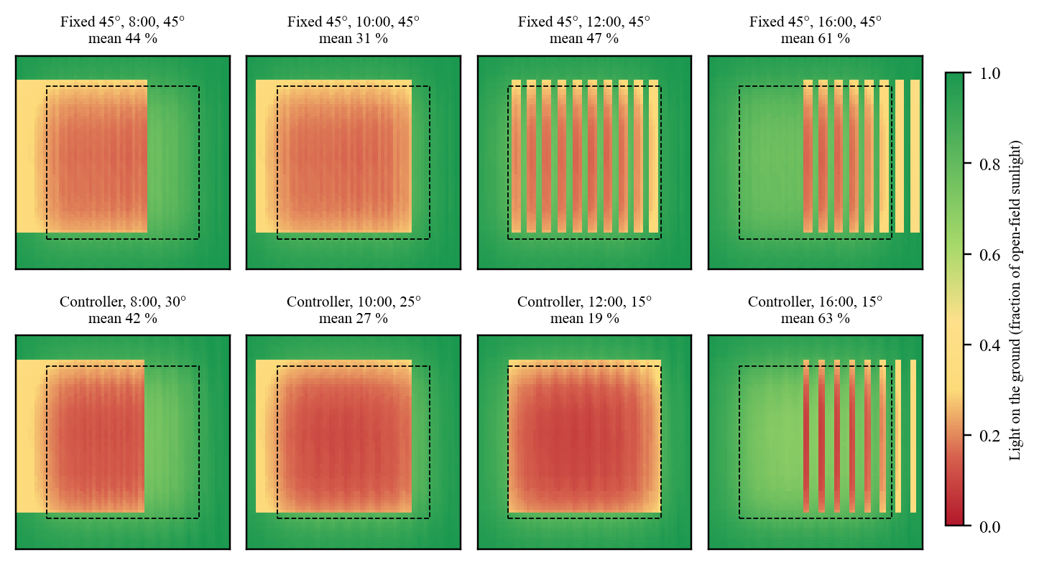
Ground light map: where the crop is shaded
• 3-D ray cast of the 25 m x 25 m array: red = heavy shade, yellow = partial, green = well lit. Any day, hour and tilt in the twin (Ground map tab).
• Top row: fixed 45 deg. Bottom row: the angle chosen by the controller at 8:00, 10:00, 12:00 and 16:00 on 21 March.
• Check against the 2-D engine in the middle of the array: mean difference of the light fraction 0.05. The 3-D map is higher on average (0.32 against 0.28) because shadow leaves through the row ends.
• Clear sky, opaque panels, flat ground.
R4 Solar and shadow | Agrovoltaic Canopy for Protection and Sustainable Farming, TCE Madurai | 9

Slide 10
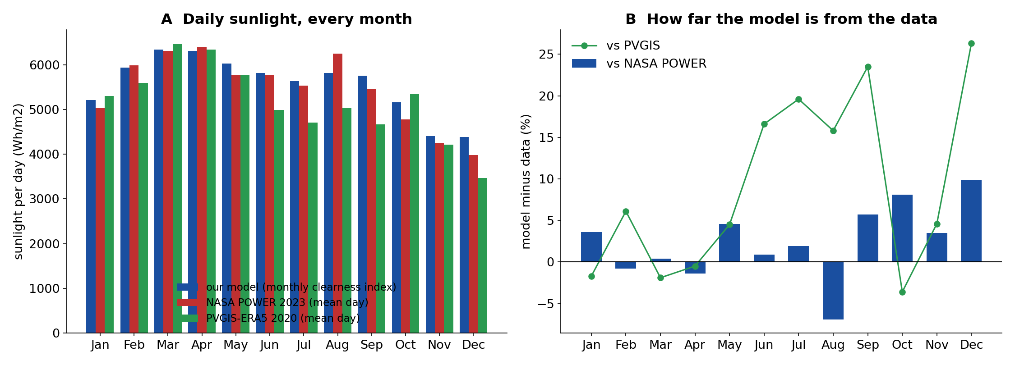
Sunlight model against NASA POWER and PVGIS, month by month
• Against NASA POWER hourly 2023: year average +2.0 %, monthly -6.9 % to +9.9 %, hourly shape RMSE 40-91 W/m2.
• Against PVGIS-ERA5 of the single year 2020: +7.9 % on average, +16 to +26 % in June to September and December. One reanalysis year differs from the long-term climate (multi-year PVGIS: +5.0 %).
• The model is a good typical year, not a prediction of one year. PAR share: NASA 0.444, model 0.45.
• Satellite and reanalysis data, not a pyranometer on the TCE roof: a check, not a field validation.
R4 Solar and shadow | Agrovoltaic Canopy for Protection and Sustainable Farming, TCE Madurai | 10

Slide 11
Uncertainty and limits of R4
⚠ Validation covers geometry and the PV module model; it is NOT validated against on-site pyranometer or PAR measurements (none exist).
• Isotropic diffuse sky; no ground-reflected light; panels treated as infinite plates (end effects ignored).
• Crop light response (lmin, lopt) is a literature-style parameter per crop, not measured at TCE.
• To close the gap: install one pyranometer + PAR sensor under a pilot row, or compare with PVGIS hourly data.
• Proof: PROOF_INDEX rows 7-12.
R4 Solar and shadow | Agrovoltaic Canopy for Protection and Sustainable Farming, TCE Madurai | 11
Notes:
References for this review are listed on the last slide and in reviews/REFERENCES.md. Evidence files are indexed in reviews/PROOF_INDEX.md.

