Slide 1

THIAGARAJAR COLLEGE OF ENGINEERING, MADURAI 625 015
Department of Electrical and Electronics Engineering
AGROVOLTAIC CANOPY FOR PROTECTION AND SUSTAINABLE FARMING
Review : prototype demonstration, six-sensor smart tilt controller (computer simulation)
Thanwin S S (2303917710521118)
Chandru P M (2303917710521304)
Kuberaeshwaran S (2303917710521307)
Mukilan A (2303917710521311)
Guide: Dr. M. Meenakshi Devi, Assistant Professor, EEE | Academic year 2026-27, Semester VII

Slide 2
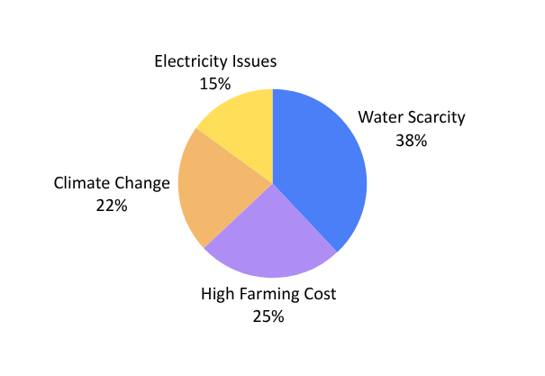
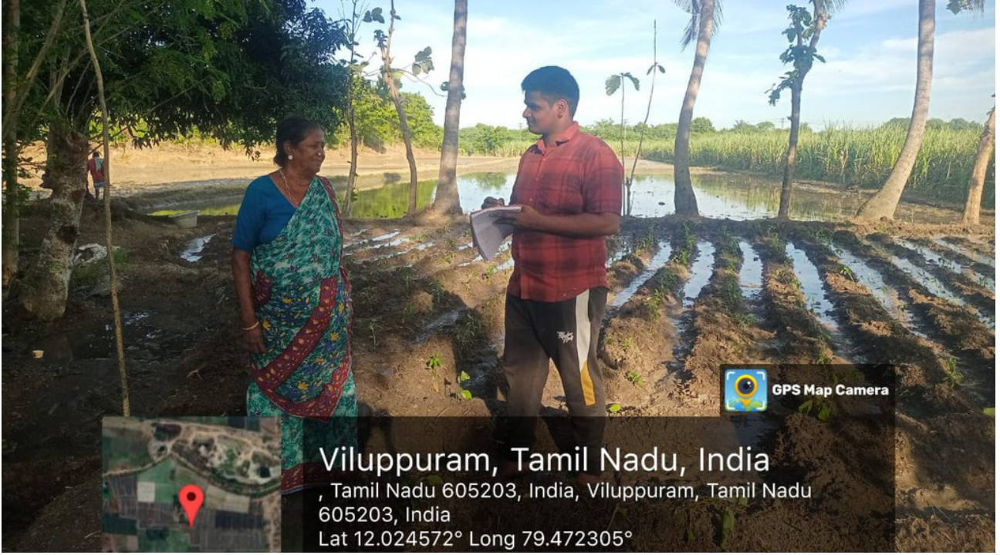
Problem and Need
Land, water and income are in conflict for small and marginal farmers
Water scarcity and cost
38 % of surveyed farmers named water scarcity and 25 % high farming cost as the top problem.
Solar takes farmland
Ground-mounted solar removes land from cultivation.
Field survey, Viluppuram district: 38 % water, 25 % cost, 22 % climate, 15 % electricity
The need
A canopy that chooses the panel angle from sensors, so that the crop gets the light it needs and the panels still make electricity, harvests rain for irrigation and stays safe in storms.
Review question: can six sensors choose the angle accurately, and can we show it before building hardware?
Fixed agrivoltaics cannot adapt
They cannot react to sun, cloud, heat, wind or rain, so they waste energy or shade the crop.
TCE EEE Project III, Review | Agrovoltaic Canopy for Protection and Sustainable Farming
2

Slide 3
Objectives and What Review Delivers
Everything runs on the computer: no board, no wiring
Objectives of Review
Review rubric | Marks | Where in this deck
Prototype demonstration | 20 | slides 8, 9, 10
Testing and validation evidence | 10 | slides 11, 12, 13
Feasibility | 5 | slides 14, 15
SDG and cost | 5 | slides 14, 15
Time management | 5 | slide 16
Questions | 5 | slide 17
1 Simulate six sensors from real, named datasheets, each adjustable by hand
2 Decide the panel angle from the sensors: safety, then water, then energy and crop light
3 Show the result live in a MATLAB dashboard with plain-word explanations
4 Measure the accuracy of the co-optimisation against the best possible angle
5 Prove every number: datasheets, NASA POWER and PVGIS data, tests, checksums
6 Estimate the cost if the sensors were real
Honest status: a validated computer simulation. The sensor readings are generated or typed, not measured. No field trial yet.
TCE EEE Project III, Review | Agrovoltaic Canopy for Protection and Sustainable Farming
3

Slide 4

The Idea and the System
Sensors in, best angle out: electricity for sale, light for the crop, rain for the tank
How it works
1 Six sensors read sun, plant light, air, soil, rain, wind
2 The controller picks the tilt every step
3 A motor and wire tilt all panels together
Why it is new
The angle balances electricity and crop light (half and half, adjustable).
Plant stress (hot, dry air or soil) is used as an input.
Every decision is explained in plain words.
Site: TCE Madurai (9.88 N, 78.08 E). Panels: 8 x 550 Wp. Tilt range 15-60 deg; rain 3 deg; storm 90 deg.
TCE EEE Project III, Review | Agrovoltaic Canopy for Protection and Sustainable Farming
4

Slide 5
The Six Sensors: Simulated After Real Devices
Each reading follows the device datasheet; the datasheet files are downloaded as proof
# | Reading | Real device simulated | Range | Accuracy | Output signal
1 | Sunlight | Apogee SP-110 pyranometer | 0-2000 W/m2 | +-5 % | 0.20 mV per W/m2
2 | Plant light (PAR) | Apogee SQ-110 quantum sensor | 0-4000 umol/m2/s | +-5 % | 0.20 mV per umol
3 | Air temperature | DHT11 | 0-50 deg C | +-2 deg C | digital
4 | Air humidity | DHT11 (same chip) | 20-90 % RH | +-5 % RH | digital
5 | Soil moisture | DFRobot SEN0193 v1.2 | 2.5 V dry to 1.2 V wet | needs dry/wet calibration | analog 1.2-2.5 V
6 | Rain | YL-83 / FC-37 + LM393 | wet / dry | trimmer threshold | digital, LOW = wet
7 | Wind speed | Adafruit 1733 anemometer | 0.5-32.4 m/s | +-1 m/s worst case | analog 0.4-2.0 V
How a simulated reading works: the slider is the physical quantity and the dashboard also shows the signal the real device would output (837 W/m2 on the SP-110 is 167 mV; 20 m/s on the Adafruit 1733 is 1.39 V). Every sensor can be set by hand.
TCE EEE Project III, Review | Agrovoltaic Canopy for Protection and Sustainable Farming
5

Slide 6
The Solar Panels: 8 x JinkoSolar Tiger Pro 550 Wp
Real module, values read from the official datasheet we downloaded
Item | Value
Model | JKM550M-72HL4-V (mono)
Maximum power (STC) | 550 Wp
Vmp / Imp | 40.90 V / 13.45 A
Voc / Isc | 49.62 V / 14.03 A
Efficiency | 21.33 %
Size / weight | 2274 x 1134 x 35 mm / 28.9 kg
Our array | 8 panels = 4.4 kWp
The array: 2 rows x 4 modules (landscape)
550 Wp
550 Wp
550 Wp
550 Wp
550 Wp
550 Wp
550 Wp
550 Wp
The tilt controller moves all panels together by one wire. 40.90 V x 13.45 A = 550 W.
Series string voltage at maximum power: 4 x 40.9 = 163.6 V per row
Total 8 x 550 = 4,400 Wp
TCE EEE Project III, Review 0 | Agrovoltaic Canopy for Protection and Sustainable Farming
6

Slide 7

How the Controller Decides
Safety first, then water, then energy and crop light
Priority rules
1 Wind 15 m/s or more: stow edge-on at 90 deg
2 Rain sensor wet: 3 deg slope, rain runs to the tank
3 Night: park at 15 deg
Otherwise: co-optimise
Try every angle from 15 to 60 deg (0.5 deg steps) and pick the best of
J(a) = w x Electricity(a) + (1 - w) x CropLight(a)
w = 0.5 by default (slider). Hot, dry air or dry soil lowers the light the crop needs, so the panels give more shade. Pump on below 35 % soil water, off above 55 %.
TCE EEE Project III, Review | Agrovoltaic Canopy for Protection and Sustainable Farming
7

Slide 8
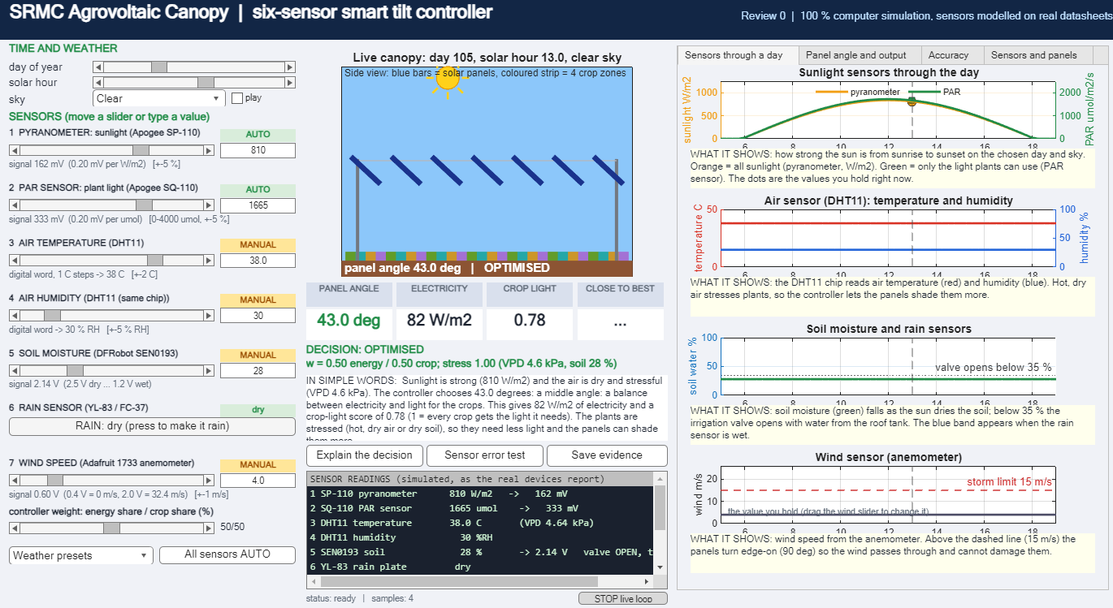
Prototype: the MATLAB Dashboard
Seven readings from six devices, all adjustable by hand, with the decision explained in words
What the judges can do
Move a slider or type a value for any sensor (MANUAL tag)
Press a weather preset: clear noon, cloud, hot dry, rain, storm, night
Press RAIN: panels go flat
Set wind to 20 m/s: panels stow at 90 deg
Read the decision in plain words
Open the four graph tabs
TCE EEE Project III, Review | Agrovoltaic Canopy for Protection and Sustainable Farming
8

Slide 9
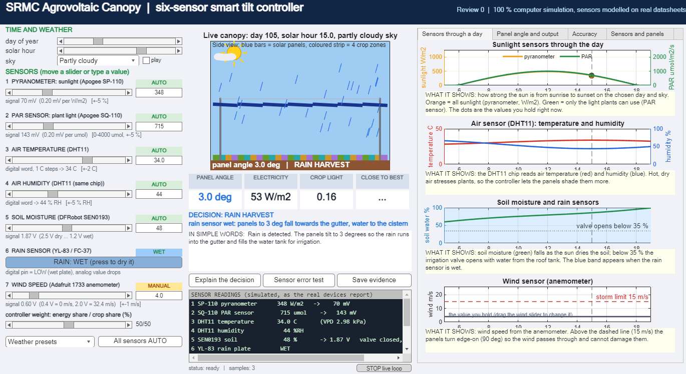
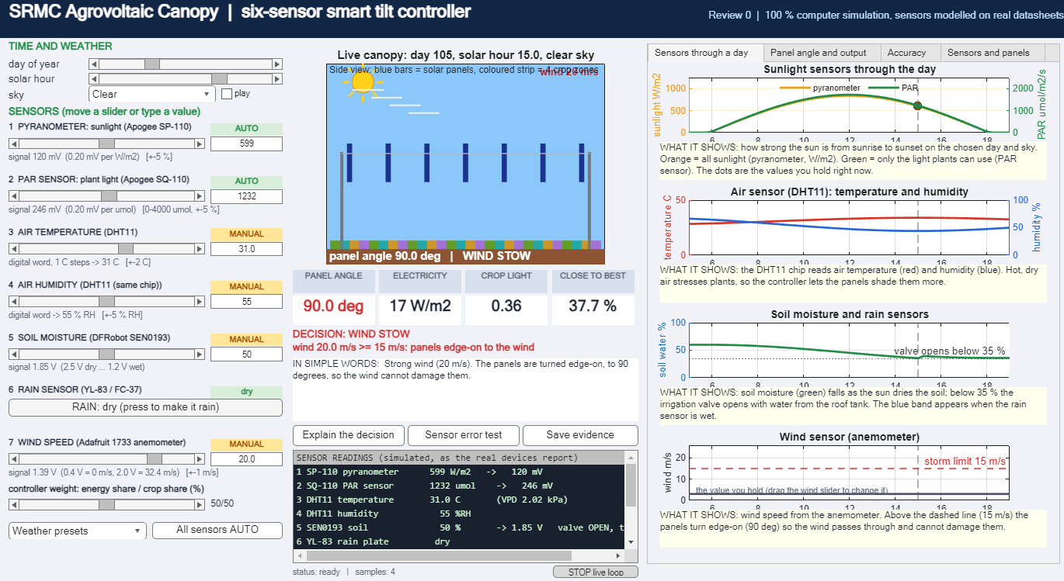
Live Demo: Change a Sensor, the Panels React
Five steps, about two minutes
1
Clear noon
preset: panels settle at 43 deg for the best mix
2
Drag sunlight or PAR
the angle changes with the light
Rain: 3 deg
Wind 20 m/s: 90 deg
3
Hot, dry preset
crop is stressed: more shade
Each graph says what it shows
Under every graph there is a one-line explanation in plain words, so a judge can read the dashboard without help.
Tip: open the dashboard once before the review and press every preset.
4
Press RAIN
panels flat at 3 deg, tank fills
5
Wind to 20 m/s
stow edge-on at 90 deg
TCE EEE Project III, Review | Agrovoltaic Canopy for Protection and Sustainable Farming
9

Slide 10
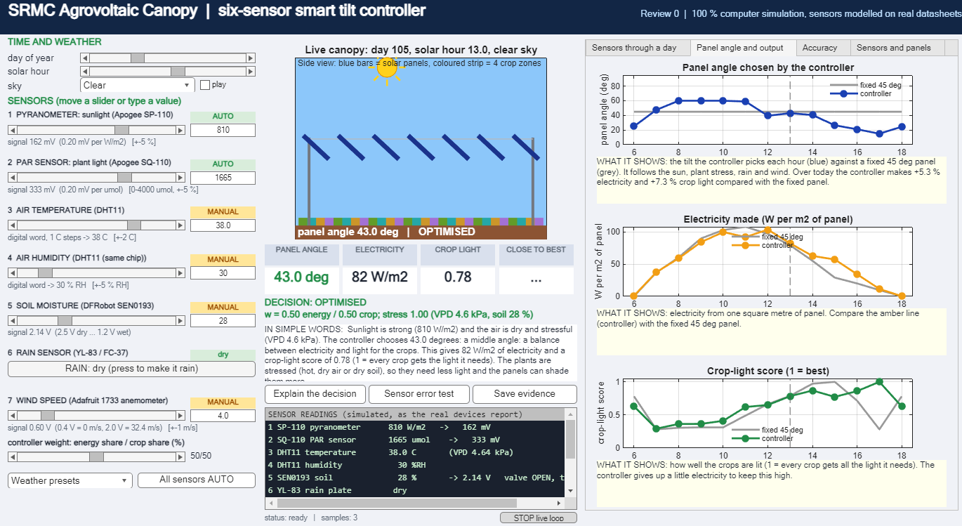
What the Graphs Show
Sensors through a day, and the panel angle and output against a fixed 45 deg panel
Sensors through a day
Angle and output
Sunlight and PAR rise and fall with the sun; temperature and humidity move together; soil dries until the valve opens; wind stays below the 15 m/s storm limit.
The controller changes the angle through the day (blue) while a fixed panel cannot. On this hot, clear April day it makes about +5 % electricity and +8 % crop light against fixed 45 deg.
TCE EEE Project III, Review | Agrovoltaic Canopy for Protection and Sustainable Farming
10

Slide 11
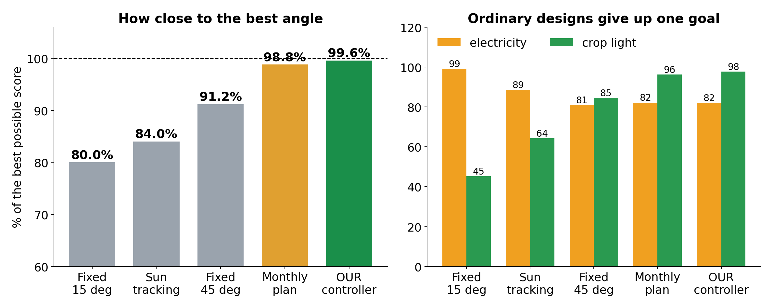
Result: Accuracy of the Co-Optimisation
How close the chosen angle is to the best possible angle (half electricity, half crop light)
What we obtained
99.6 %
of the best possible score over 864 noisy test cases, with datasheet-sized sensor errors.
Ordinary designs reach 80 to 91 % and give up either crop light or electricity.
Simulation: measured against the controller's own goal, not real crop yield.
Design | Score | Electricity | Crop light | Error
Fixed 45 deg | 91.2 % | 81.0 % | 84.6 % | 16.3 deg
Our controller | 99.6 % | 82.1 % | 97.7 % | 4.8 deg
TCE EEE Project III, Review | Agrovoltaic Canopy for Protection and Sustainable Farming
11

Slide 12
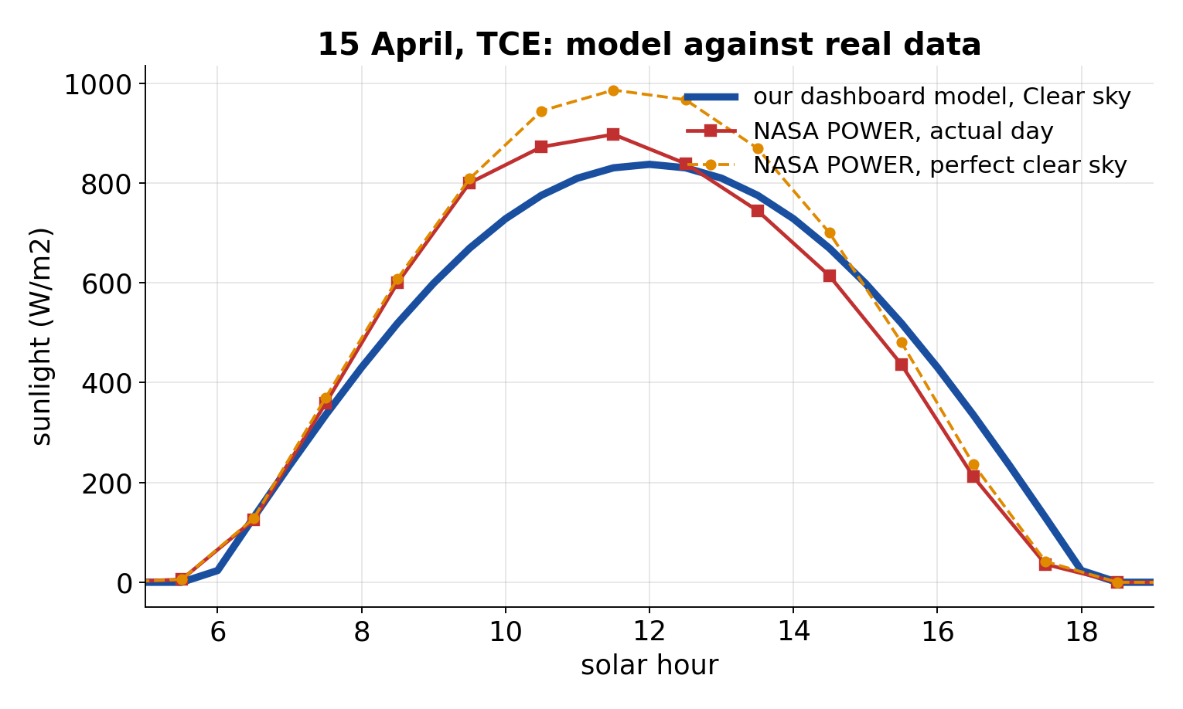
Testing and Validation
29 of 29 software tests pass; the sunlight model is checked against NASA POWER and PVGIS
Checks done
15 April | Wh/m2
Our Clear day | 6502
NASA actual | 6539
PVGIS mean | 6337
Review 0 tests: 16 of 16 pass (decision rules, sensor errors, physics, explanation)
Sensor and tracker tests: 13 of 13 pass
Yearly electricity vs PVGIS: +5.0 %
Shadow model vs Blender 3-D: mean difference 0.010
Web twin and MATLAB model: identical results
Sunlight vs NASA POWER and PVGIS (right)
Dashboard Clear day = a typical clear April day: daily energy within 0.6 % of NASA POWER actual day and 2.6 % above PVGIS April mean. Plant-light share: NASA 0.444, dashboard 0.45. Noon peak is below a perfectly cloudless day (837 vs 986 W/m2). These are satellite data, not a sensor on the TCE roof.
TCE EEE Project III, Review | Agrovoltaic Canopy for Protection and Sustainable Farming
12

Slide 13

Proof: Datasheets, Data and Checks
Every file is in the Proof folder (Proof/10_Review0_Sensors_and_Panels) and on GitHub
What we can show | File | It proves
Pyranometer manual | 01_pyranometer_ApogeeSP110_manual.pdf | 0.20 mV per W/m2, +-5 %, 0-2000 W/m2
PAR manual | 02_PAR_ApogeeSQ110_manual.pdf | 0.20 mV per umol, +-5 %, 410-655 nm
DHT11 datasheet | 03-04_airTemp_and_humidity_DHT11_datasheet.pdf | +-2 deg C, +-5 % RH
Soil and rain sensor pages | 05_soilMoisture_*, 06_rain_* | output 1.2-2.5 V; wet/dry plate
Anemometer datasheet | 07_wind_Adafruit1733_datasheet_C2192.pdf | 0.4-2.0 V = 0-32.4 m/s
Panel datasheet | P1_panel_JinkoSolar_JKM550M-72HL4-V_datasheet.pdf | 550 Wp, 40.90 V, 13.45 A, 21.33 %
NASA POWER and PVGIS data | sunlight_datasets/ (5 files) | where the sunlight data comes from
Model vs data | TRUST_sunlight_model_vs_NASA_PVGIS.png | daily energy within about 1-3 %
Accuracy test | T11_accuracy_v2.csv (864 cases) | 99.6 % vs 91.2 % fixed 45 deg
GitHub
Also: SHA-256 checksum of every proof file (MANIFEST.csv) and the Review 0 Evidence Book (Word) for the judges.
TCE EEE Project III, Review | Agrovoltaic Canopy for Protection and Sustainable Farming
13

Slide 14
Cost Estimate: If the Dashboard Sensors Were Real
Indicative estimates in INR, not quotes; the simulation itself costs nothing
Item | Research-grade kit | Low-cost kit
Sunlight sensor (Apogee SP-110 / reference cell) | 28,000 | 1,500
PAR sensor (Apogee SQ-110 / reference cell) | 28,000 | 1,500
Anemometer (Adafruit 1733) | 6,500 | 6,500
DHT11 + soil sensor + rain sensor | 700 | 700
ESP32 board + ADC (ADS1115 x 2) | 1,400 | 1,400
Amplifier, enclosure, cables | 3,000 | 1,500
Total sensing and control kit | 67,600 | 13,100
Panels (assumed)
8 x 550 Wp = 4,400 Wp
at about INR 16 per Wp:
about INR 70,000
This simulation
INR 0
MATLAB (college licence) and the web twin; no hardware.
Assumptions: Apogee sensors about US$ 250-300 each plus import duty and GST; other prices typical Indian retail. Replace with quotes before purchase. The earlier Phase II sensing kit (DHT11, soil, rain, ESP) was about INR 700. A year of calibration of the Apogee sensors is not included.
TCE EEE Project III, Review | Agrovoltaic Canopy for Protection and Sustainable Farming
14

Slide 15

Feasibility, SDG Relevance and Limits
SDGs
7 clean energy from farmland | 2 crops keep their light | 6 rain harvested for irrigation | 13 climate action | 8 farmer income
Feasibility
Limits (we state them first)
Sensing kit costs INR 13,100 to 67,600; all parts are standard and available in India
The controller needs only a small board; a distilled neural network for an ESP32 was tested in simulation
All results are reproducible: code and proof are on GitHub
Simulation only: sensor readings are generated or typed
Sunlight checked against satellite data, not a roof sensor
Accuracy is against our own goal, not crop yield
Prices and farmer share are assumptions
TCE EEE Project III, Review | Agrovoltaic Canopy for Protection and Sustainable Farming
15

Slide 16
Review Status, Remaining Work and Plan
What is finished and what comes next
Done
Dashboard with 6 real-model sensors, all manual
Day graphs, accuracy and sensor-error tests
29 of 29 tests pass
Datasheets and datasets downloaded as proof
Evidence Book, poster, presentation
Code on GitHub
Review 3,4
now: sensors and controller
Review 4,1
design and CAD
Review 4,1
solar and shadow
Review 4,2
digital twin
Review 4,2
control and simulation
Review ,4,3
economics and final
TCE EEE Project III, Review | Agrovoltaic Canopy for Protection and Sustainable Farming
16

Slide 17
Conclusion and Questions
Conclusion
Likely questions
Six sensors, each modelled on a real device and adjustable by hand, choose the panel angle live in a MATLAB dashboard
The co-optimisation reaches 99.6 % of the best possible score; ordinary designs reach 80-91 %
Sunlight is checked against NASA POWER and PVGIS; every datasheet and dataset is stored as proof
If built for real, the sensing kit costs INR 13,100 to 67,600
Next: real sensors, one month of data, wind check, paper
Are the sensors real? No: models of real devices, datasheets on file
Where does the sunlight come from? Sun position and NASA POWER clearness index, checked against NASA and PVGIS
Why trust 99.6 %? Best angle found by trying every angle, with sensor errors added
What is next? Real sensors and one month of data
Thank you | Questions and discussion
TCE EEE Project III, Review | Agrovoltaic Canopy for Protection and Sustainable Farming
17

