Slide 1

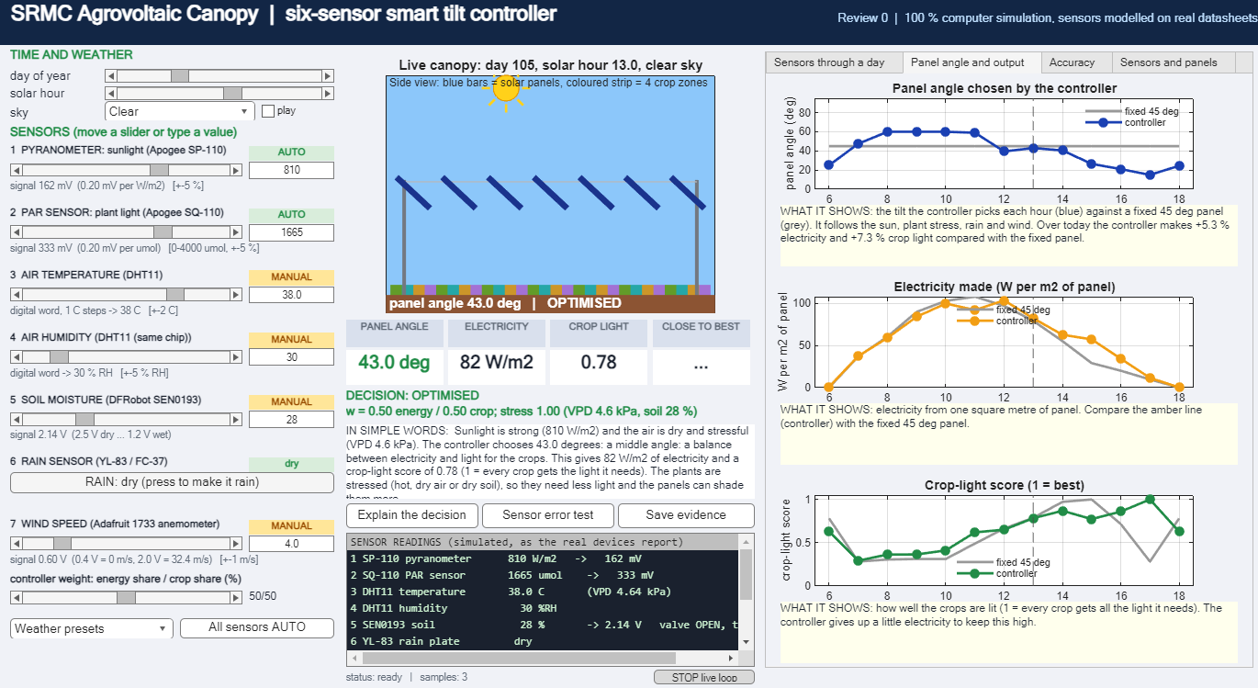


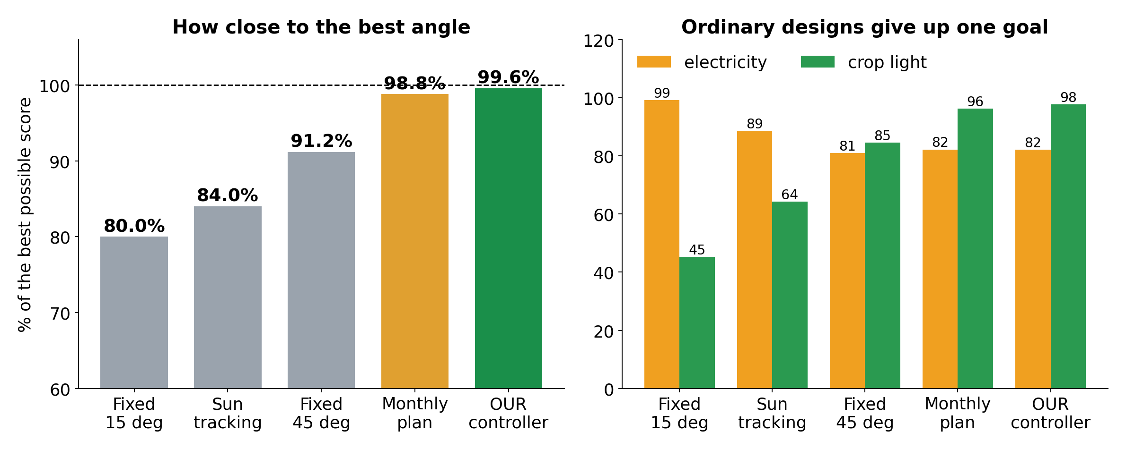
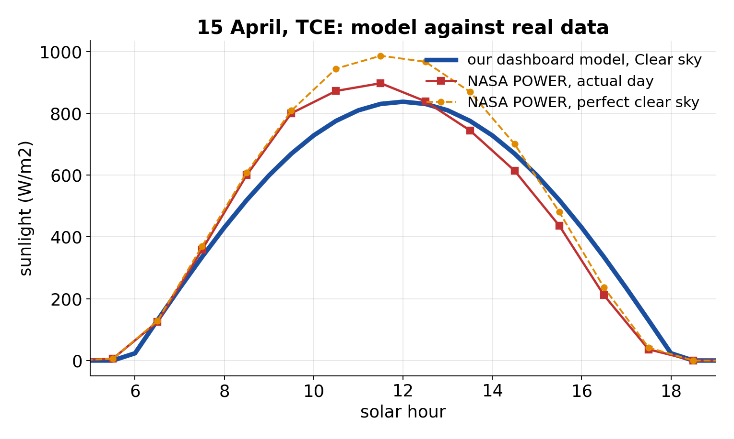

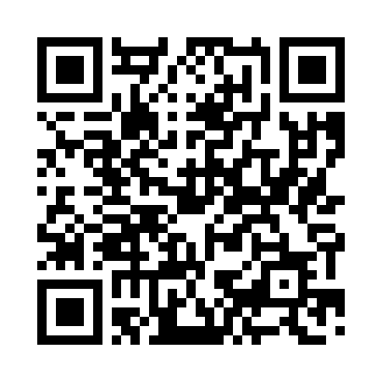
THIAGARAJAR COLLEGE OF ENGINEERING, MADURAI 625 015 | Department of EEE
AGROVOLTAIC CANOPY FOR PROTECTION AND SUSTAINABLE FARMING
Six sensors in, best panel angle out: the crop and the solar panels both win
Thanwin S S | Chandru P M | Kuberaeshwaran S | Mukilan A Guide: Dr. M. Meenakshi Devi
REVIEW 0
Project III | 2026-27
99.6 %
6
4.4 kWp
29 / 29
accuracy of the co-optimisation against the best possible angle (fixed 45 deg: 91.2 %)
sensors, each simulated from a real datasheet and adjustable by hand
8 x JinkoSolar Tiger Pro JKM550M-72HL4-V panels, 550 Wp each
software tests pass; sunlight checked against NASA POWER and PVGIS
1
LIVE MATLAB DASHBOARD: change any sensor, the panels react
2
HOW IT DECIDES
4
Safety first
Wind 15 m/s or more: stow at 90 deg
Rain: 3 deg, fill the tank
Night: park at 15 deg
Otherwise
Best of 15-60 deg for 1/2 electricity + 1/2 crop light; more shade if hot and dry
1
2
3
3
THE SYSTEM
1 Seven readings from six real devices: slider or typed number, tagged MANUAL or AUTO. 2 Live canopy: the blue panels tilt.
3 The decision, in plain words. 4 Day graphs: sensors, angle, electricity, crop light, accuracy. Each graph has a one-line explanation.
4
SIX SENSORS = SIX REAL DEVICES
5
ACCURACY: WHAT WE OBTAINED
Apogee SP-110
pyranometer: sunlight
0-2000 W/m2, +-5 %
Apogee SQ-110
PAR: light plants use
0-4000 umol/m2/s, +-5 %
DHT11
air temperature and humidity
0-50 C +-2 C | 20-90 % +-5 %
DFRobot SEN0193
soil moisture (capacitive)
1.2-2.5 V analog
YL-83 / FC-37
rain plate + LM393
wet / dry, digital
Adafruit 1733
cup anemometer: wind
0-32.4 m/s, +-1 m/s
Our six-sensor controller: 99.6 % of the best possible score, 4.8 deg from the best angle. Fixed 45 deg: 91.2 % (16.3 deg). Sun tracking: 84.0 %. Fixed 15 deg: 80.0 %. 864 noisy cases, simulation.
Panels: 8 x JinkoSolar Tiger Pro JKM550M-72HL4-V, 550 Wp, 40.90 V, 13.45 A, 21.33 %, 2274 x 1134 mm (datasheet on file)
6
CAN YOU TRUST THE SUNLIGHT?
7
PROOF YOU CAN OPEN
8
IF IT WERE REAL: COST (INR)
✓ 7 sensor and panel datasheets, downloaded
✓ NASA POWER + PVGIS sunlight data
✓ Model vs data figure and numbers
✓ Accuracy test file (864 cases)
✓ SHA-256 checksum of every proof file
✓ Evidence Book (Word) for the judges
✓ Code and results on GitHub
Research-grade sensing kit
67,600
Low-cost sensing kit
13,100
8 panels, 4.4 kWp (assumed)
70,000
Dashboard Clear day 6502 Wh/m2 vs NASA POWER 6539 and PVGIS 6337. Plant-light share 0.444 vs 0.45. A check against satellite data, not a roof sensor.
This simulation
0
Estimates, not quotes. Sensors: 2 Apogee ~INR 56,000, anemometer 6,500, DHT11 + soil + rain 700, ESP32, ADC, wiring.
NEXT Real sensors and one month of logged data | wind-tunnel or CFD run to settle the storm stow | crop-light and yield measurement | paper submission
HONEST LIMITS Simulation only. Sensor readings are generated or typed, not measured. Accuracy is against the controller's own goal, not crop yield. Prices are estimates.
Scan for code and proof

