Slide 1

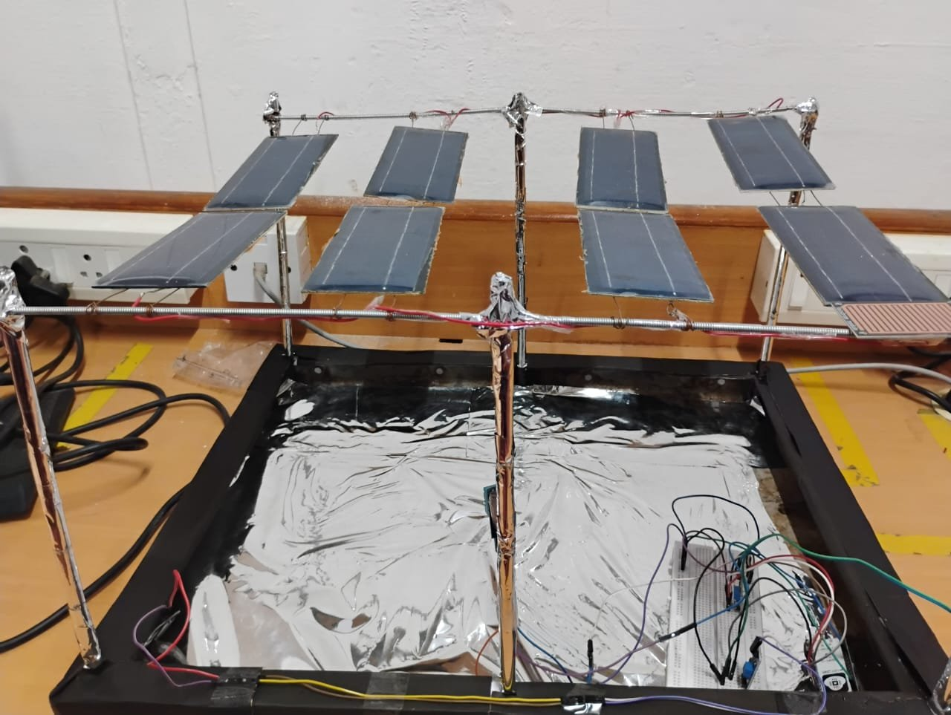
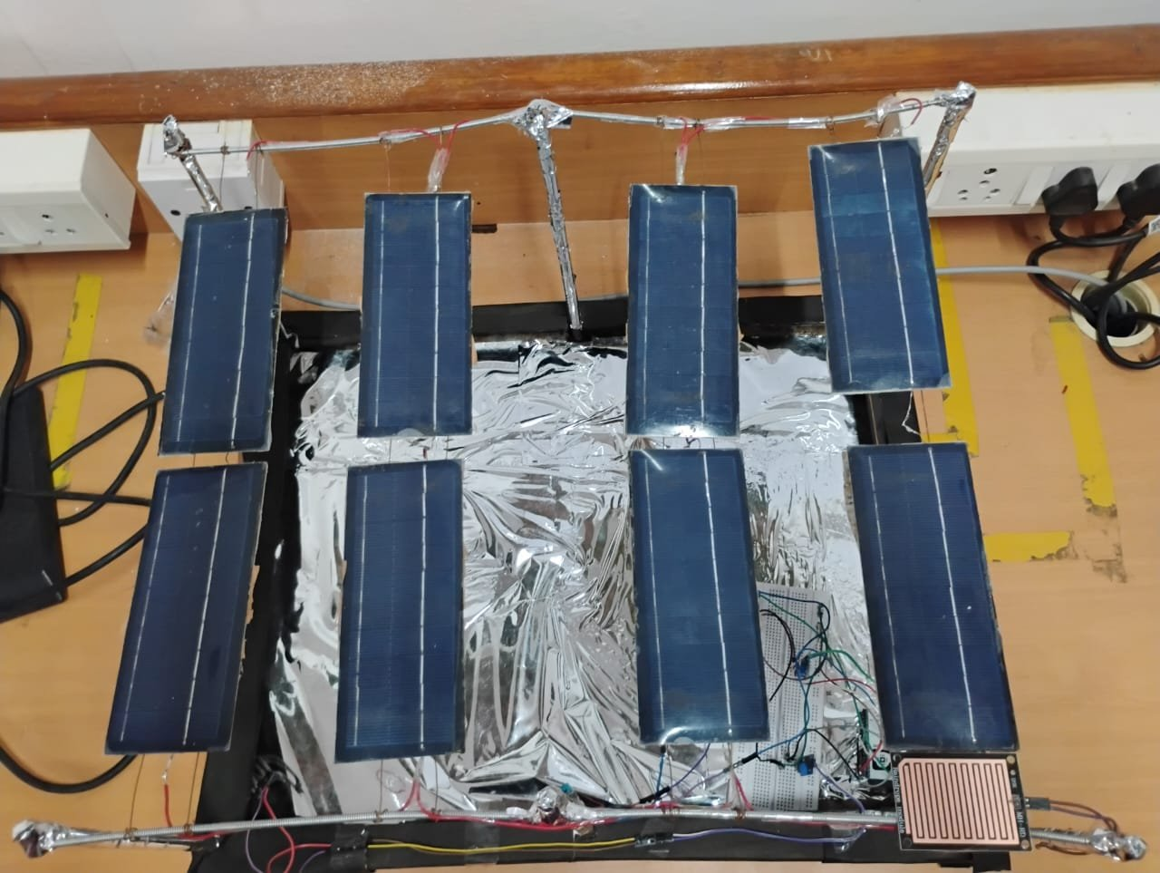
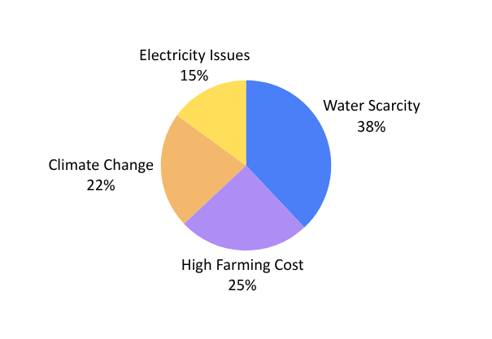
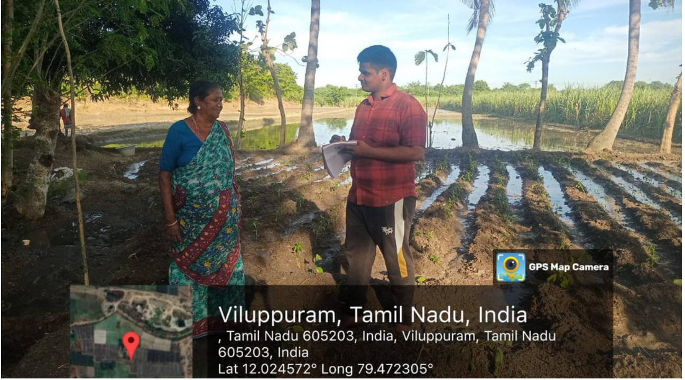
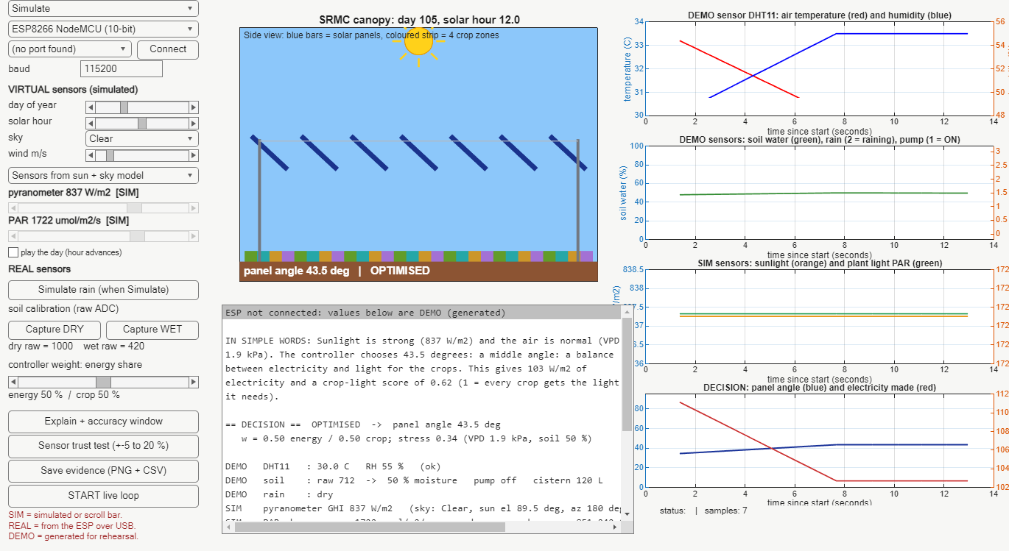

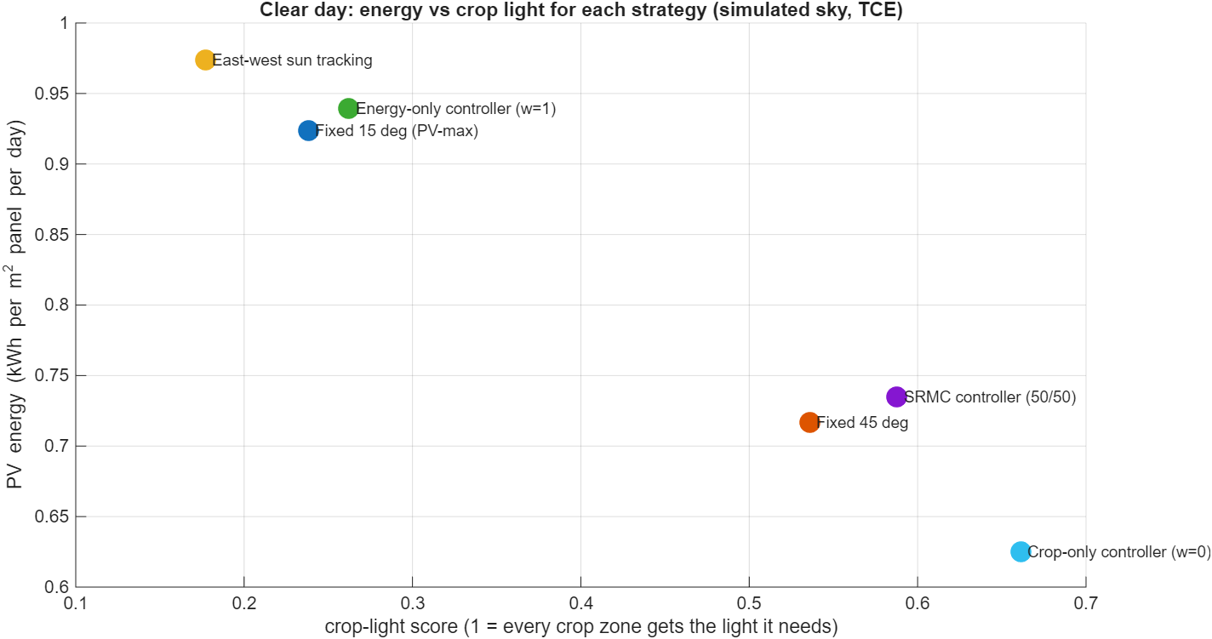


THIAGARAJAR COLLEGE OF ENGINEERING, MADURAI – 625 015 | Department of EEE
AGROVOLTAIC CANOPY FOR PROTECTION AND SUSTAINABLE FARMING
Thanwin S S · Chandru P M · Kuberaeshwaran S · Mukilan A | Guide: Dr. M. Meenakshi Devi | Project III, 2026–27
PROBLEM AND NEED
PROTOTYPE
• Small farmers face water scarcity (38 %), high cost (25 %), climate stress (22 %) and unreliable power (15 %)
• Solar farms take farmland; fixed agrivoltaics cannot adapt
• Need: low-cost, explainable, sensor-driven canopy
STAKEHOLDER SURVEY
Scaled 4 × 2 panel array; real DHT11, soil, rain sensors via ESP board to MATLAB
LIVE DASHBOARD
Farmer interviews, Viluppuram district → 13 requirements
SYSTEM ARCHITECTURE
Clear noon: 43.5°; REAL / SIM tags; decision explained in words
RESULTS (CLEAR DAY)
 | PV % | Crop %
Track | 100 | 27
Fixed 45° | 74 | 81
SRMC | 75 | 89
Against fixed 45°: electricity +2.5 %, crop light +9.7 %. MPPT efficiency 99.83 %.
CONTROL LOGIC
• Wind ≥ 15 m/s: stow 90°
• Rain: 3° slope, fill tank
• Night: park 15°
• Else maximise J(a) = w·PV + (1−w)·Crop
• Hot, dry air lowers crop-light need
• Pump ON < 35 %, OFF > 55 %
TESTING
• 29 of 29 software tests pass
• Sensor error ±5 % costs 2.5 % electricity
• Checked against PVGIS (+5.0 %) and Blender (0.010)
SDGs AND COST
Sensing kit ≈ ₹700
Prototype budget ₹2.9 lakh
Payback 4–6 years
Next (Semester VIII):
Real pyranometer and PAR sensor, motorised tilt, PCB fabrication, Wi-Fi link and one week of field data. Limits: sunlight, PAR and wind are simulated in this phase.

