Slide 1

THIAGARAJAR COLLEGE OF ENGINEERING, MADURAI – 625 015
Department of Electrical and Electronics Engineering
AGROVOLTAIC CANOPY FOR PROTECTION AND SUSTAINABLE FARMING
Project III – Phase II: New Idea and Prototyping (CDIO)
Thanwin S S (2303917710521118)
Chandru P M (2303917710521304)
Kuberaeshwaran S (2303917710521307)
Mukilan A (2303917710521311)
Guide: Dr. M. Meenakshi Devi
Assistant Professor, EEE
Academic year 2026 – 2027 (Semester VII)

Slide 2
Problem and Motivation
Land, water and income are in conflict for small and marginal farmers
Low income and water scarcity
Solar farms take farmland
Water scarcity (38 %) and high farming cost (25 %) were the top challenges in our field survey.
Conventional ground-mounted solar removes land from cultivation.
Fixed agrivoltaics are not adaptive
No explainable, low-cost control
They cannot react to sun, cloud, heat stress, wind or rain, so they waste energy or shade the crop.
Existing systems are black boxes and rely on costly instruments.
Need: a low-cost, sensor-driven canopy that balances electricity and crop light, harvests rain and can be cooperatively owned.
TCE – EEE – Project III, Phase II | Agrovoltaic Canopy for Protection and Sustainable Farming
2

Slide 3
Objectives and Status
Measurable objectives of Phase II
Objective | Target | Status
Scaled prototype, 4 × 2 panel array | Built and photographed | Achieved
Real-sensor acquisition (ESP board to MATLAB) | 1 line / s; failed reads flagged | Firmware + parser tested
Angle close to the true optimum | Within 3° of full search | 0.0° at noon; 3° worst
Better than a fixed 45° panel | Energy and crop light higher | +2.5 % and +9.7 %
MPPT tracking efficiency | ≥ 98 % | 99.83 % (model)
Software tests | ≥ 95 % pass | 29 of 29 pass
Low-cost sensing kit | Below ₹1,000 | About ₹700
Motorised tilt, real light sensors | Hardware tested | Planned – Semester VIII
TCE – EEE – Project III, Phase II | Agrovoltaic Canopy for Protection and Sustainable Farming
3

Slide 4
Literature Survey and Research Gaps
12 papers, reports and standards reviewed
What the literature shows
Dupraz et al. (2011): land productivity up 35–73 % under PV
Barron-Gafford et al. (2019): better water-use efficiency in drylands
Yadav and Chandel (2013): tilt chosen for energy only
Elamri et al. (2018): panels redistribute rain; drainage matters
Jubayer and Hangan (2016): low tilt reduces wind load
Esram and Chapman (2007): Perturb and Observe MPPT
Gaps → design response
1 No energy–crop-light trade-off → weighted optimiser
2 Crop stress ignored → VPD stress index
3 Rain, wind, soil handled apart → one priority controller
4 Black-box control → plain-word explanation
5 Sensor error not quantified → sensor-trust study
6 Small-farm cost ignored → low-cost kit, cooperative model
TCE – EEE – Project III, Phase II | Agrovoltaic Canopy for Protection and Sustainable Farming
4

Slide 5
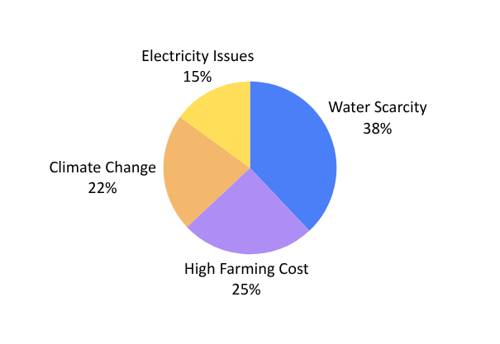
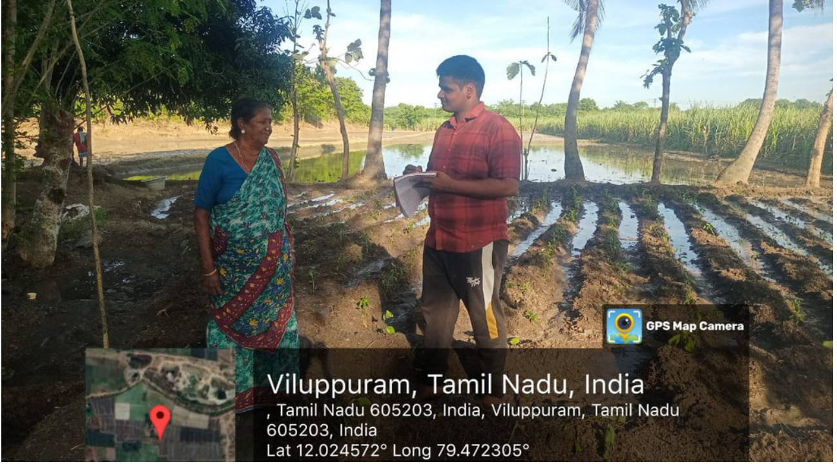
Stakeholder Survey and Requirements
Field interviews with farmers in Viluppuram district, Tamil Nadu
• Key requirements
• Harvest rainwater
• Pump on < 35 %, off > 55 % soil moisture
• More shade when hot and dry
• Wind stow at 15 m/s
• Explain every decision
• Flag failed sensors
• Sensing kit < ₹1,000
Water scarcity 38 % | High farming cost 25 % | Climate change 22 % | Electricity issues 15 %
Stakeholders: farmers, cooperatives / FPOs, solar developers, DISCOM and government, experts, community
TCE – EEE – Project III, Phase II | Agrovoltaic Canopy for Protection and Sustainable Farming
5

Slide 6

System Architecture
Sensors → controller → tilt, irrigation and power; rainwater to tank
Modules
1 Sensors
2 Monitoring screen
3 Tilt actuator
4 Canopy panels
5 Controller (ESP)
6–9 Pump, sprinkler, cooling, drip
10–11 Rain tank, filter and pump
12–14 Inverter and grid
This phase builds sensing, controller and display.
TCE – EEE – Project III, Phase II | Agrovoltaic Canopy for Protection and Sustainable Farming
6

Slide 7

Control Logic
Safety first, then water, then energy and crop light
Optimiser (every 0.5° from 15° to 60°)
J(a) = w · PV(a)/PVmax + (1 − w) · Crop(a)/Cropmax
w = 0.5 by default; operator can move it
• Hot, dry air (VPD > 2.5 kPa) or dry soil lowers the crop light needed by up to 30 %, so panels can shade more
• Pump hysteresis: ON below 35 %, OFF above 55 %; stops when tank is empty
• Dashboard tags every value REAL, SIM or DEMO and explains the decision in words
TCE – EEE – Project III, Phase II | Agrovoltaic Canopy for Protection and Sustainable Farming
7

Slide 8
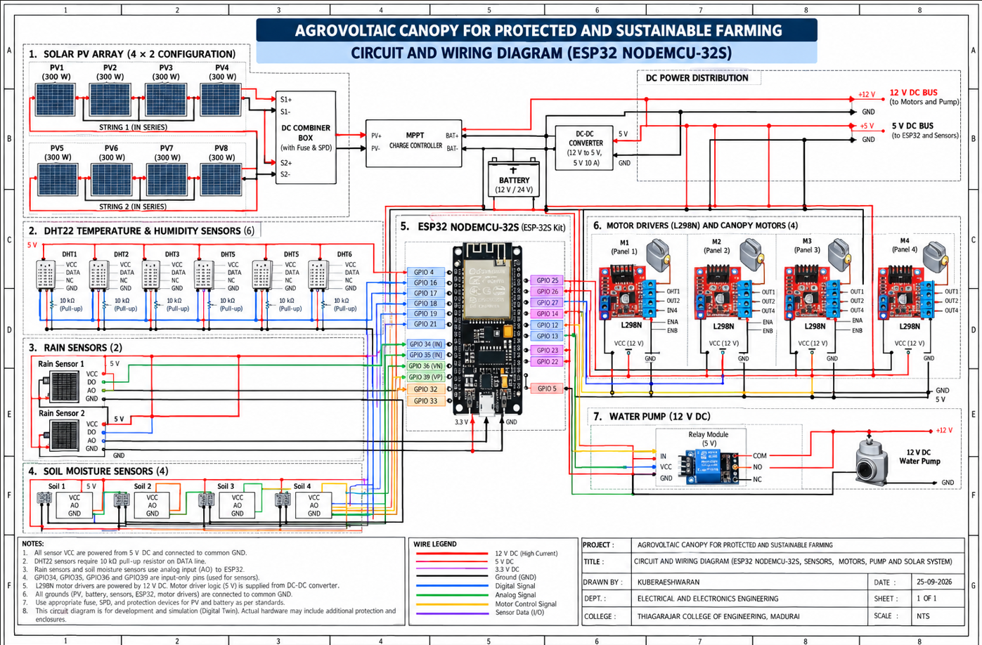
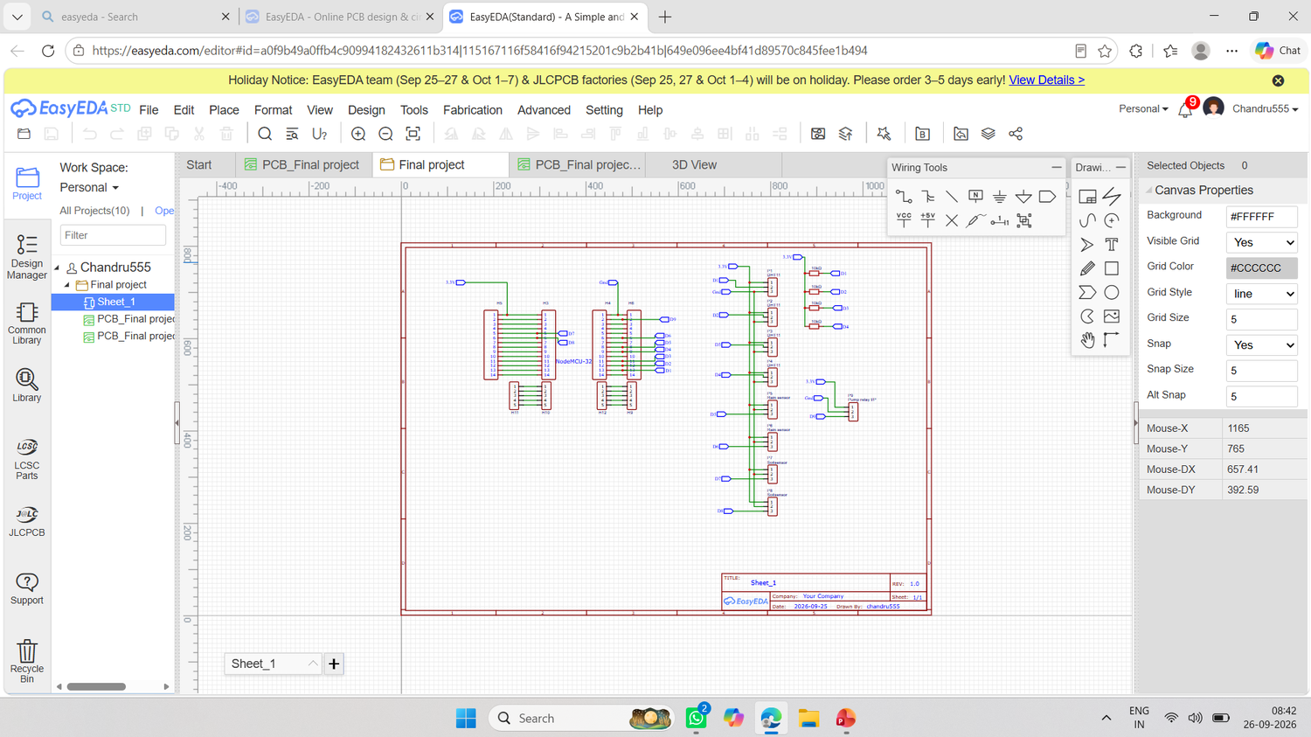
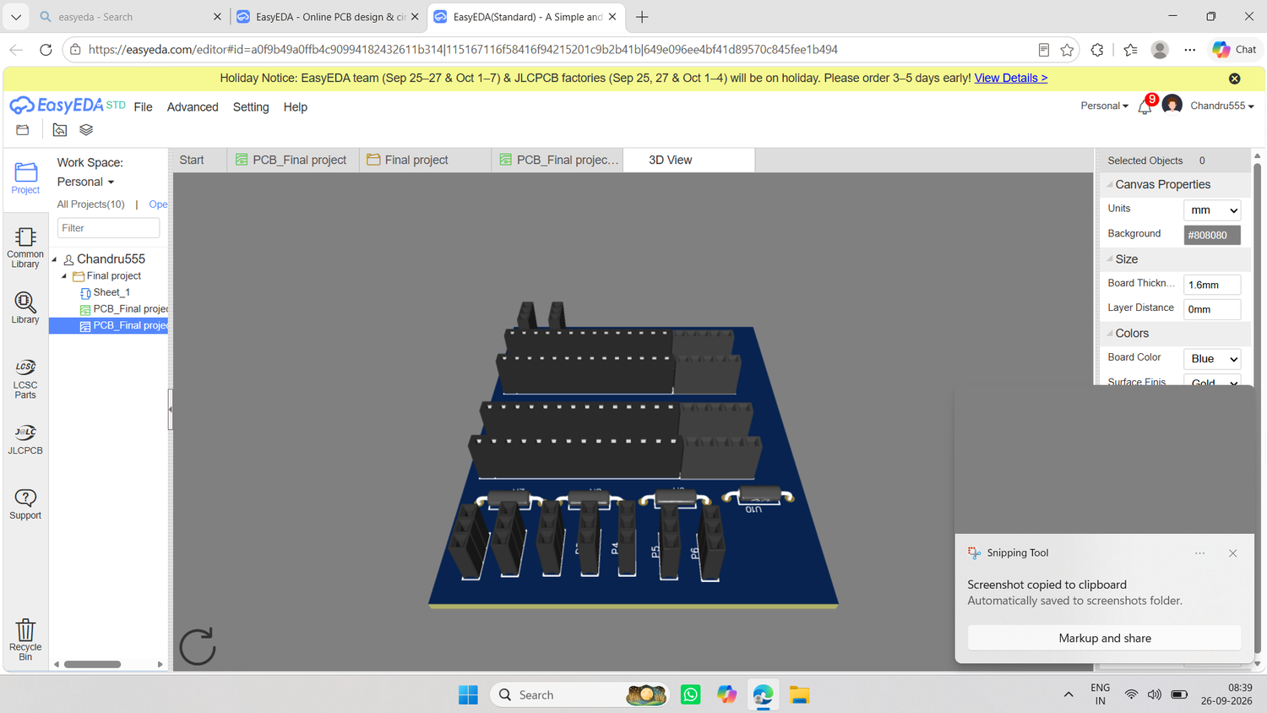
Hardware and Circuit Design
ESP32 control board, sensors, motor drivers, pump and solar chain
EasyEDA schematic and 3D PCB view
TCE – EEE – Project III, Phase II | Agrovoltaic Canopy for Protection and Sustainable Farming
8

Slide 9
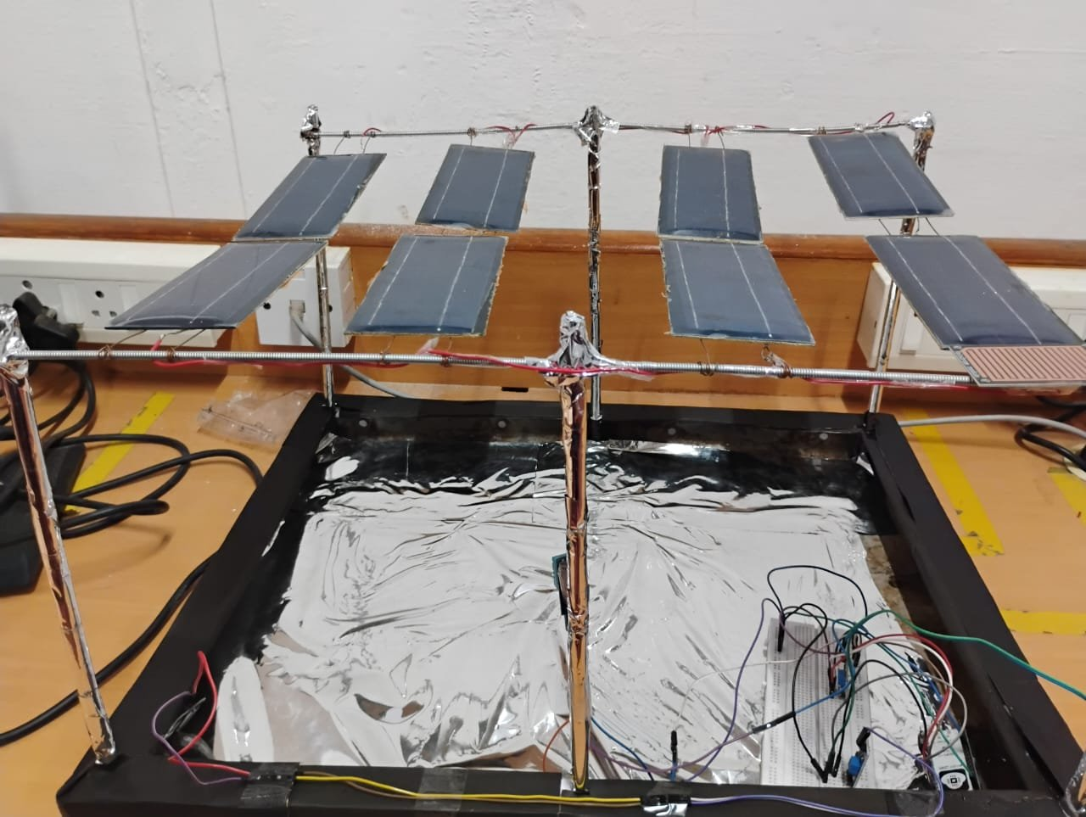
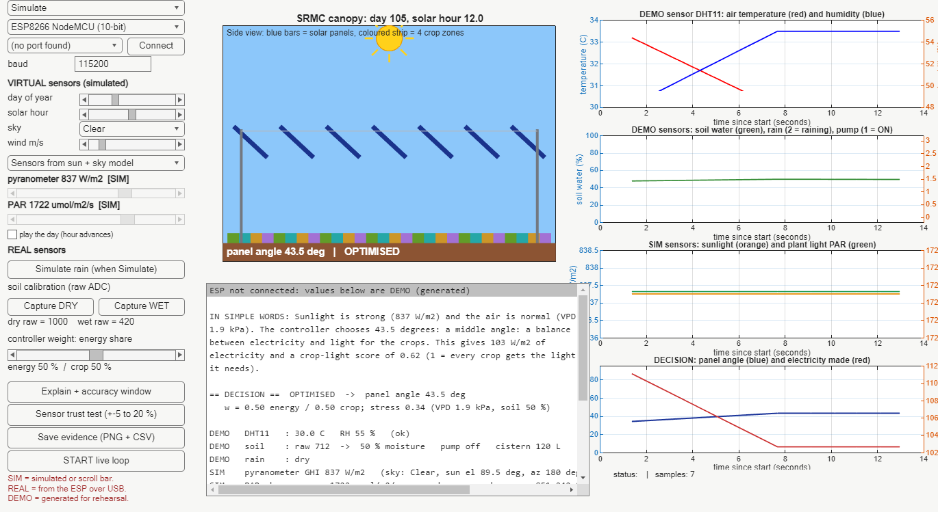
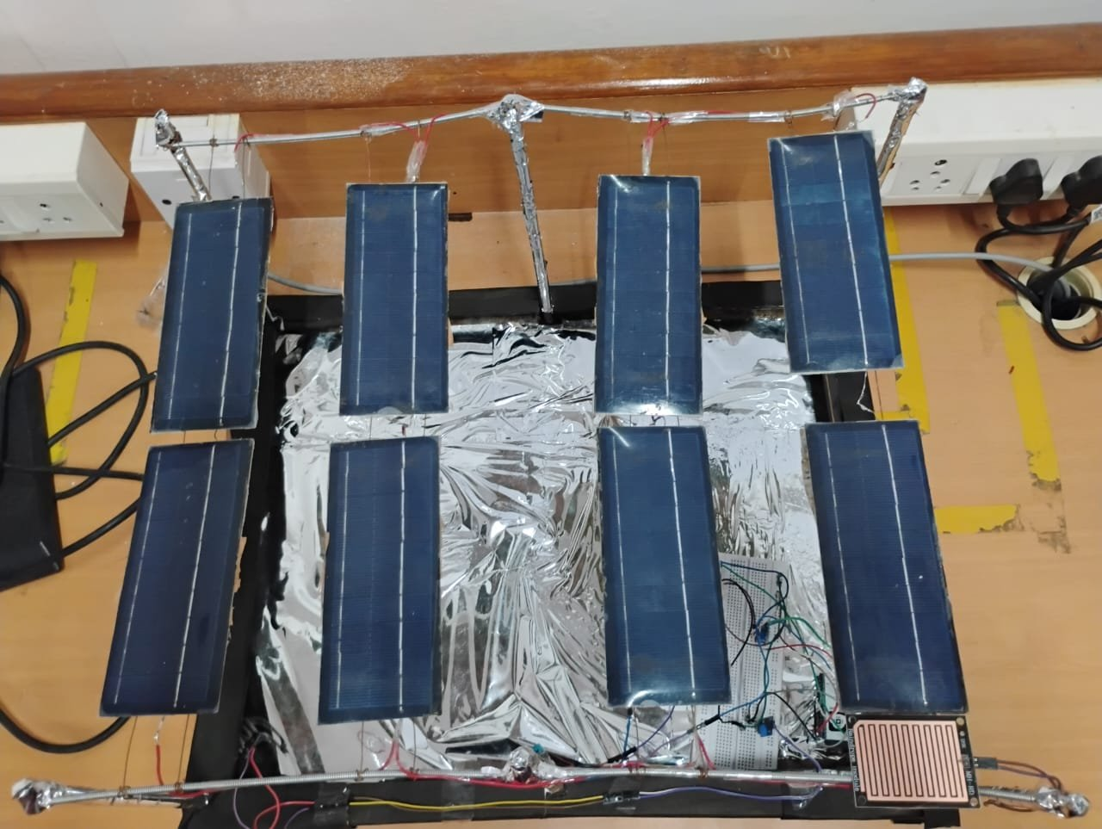
Working Prototype and Dashboard
Scaled 4 × 2 panel canopy with real DHT11, soil and rain sensors
Clear noon: controller chooses 43.5°; plain-word reason, REAL / SIM tags and live plots
TCE – EEE – Project III, Phase II | Agrovoltaic Canopy for Protection and Sustainable Farming
9

Slide 10
Testing and Validation
29 of 29 software tests passed
Test group | Count | Result
Rules, parser, physics (T01–T16) | 16 | All pass
Plausibility, real-sensor fields (S01–S07) | 7 | All pass
MPPT model (M01–M05) | 5 | All pass
Explain window = full search (X01) | 1 | All pass
Simulated-sensor error
±5 % error: 2.5 % less electricity on average
±10 % error: 5.1 % less
Worst half-hour: up to 35 %
A calibrated pyranometer is needed before field use
• Solar and shadow model: +5.0 % per year vs PVGIS; shadow difference 0.010 vs Blender
• Bench tests of DHT11, soil and rain sensors in progress (no measured value claimed yet)
TCE – EEE – Project III, Phase II | Agrovoltaic Canopy for Protection and Sustainable Farming
10

Slide 11
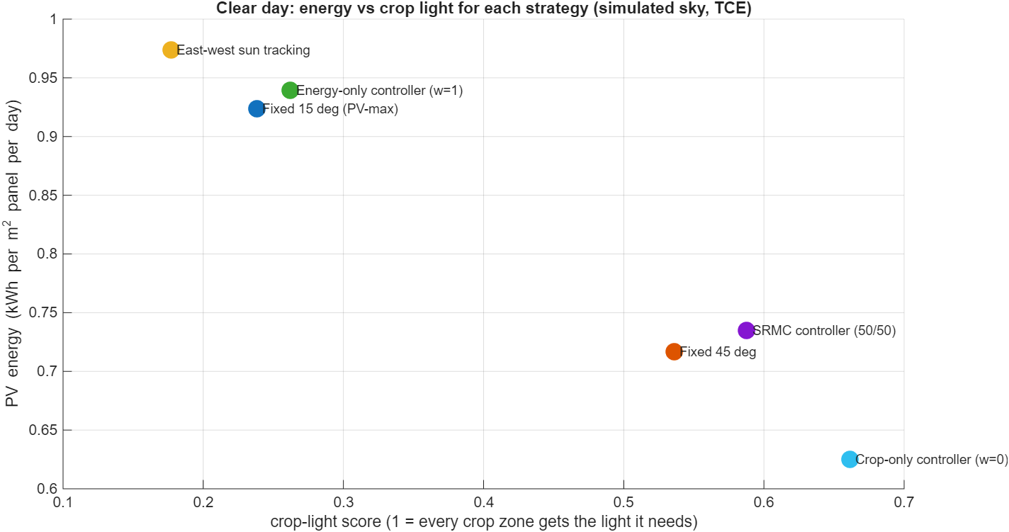
Result: Energy and Crop Light Together
Clear day, day 105, TCE, simulated sky
Strategy | PV % | Crop %
Sun tracking | 100 | 27
Fixed 45° | 74 | 81
SRMC controller | 75 | 89
Crop-only | 64 | 100
• Against fixed 45°: electricity +2.5 %, crop light +9.7 %
• Sun tracking is a reference only; the wire drive has two positions
Partly cloudy day: 78 % of best energy, 97 % of best crop light. Hot, dry day: 79 % and 88 %.
TCE – EEE – Project III, Phase II | Agrovoltaic Canopy for Protection and Sustainable Farming
11

Slide 12
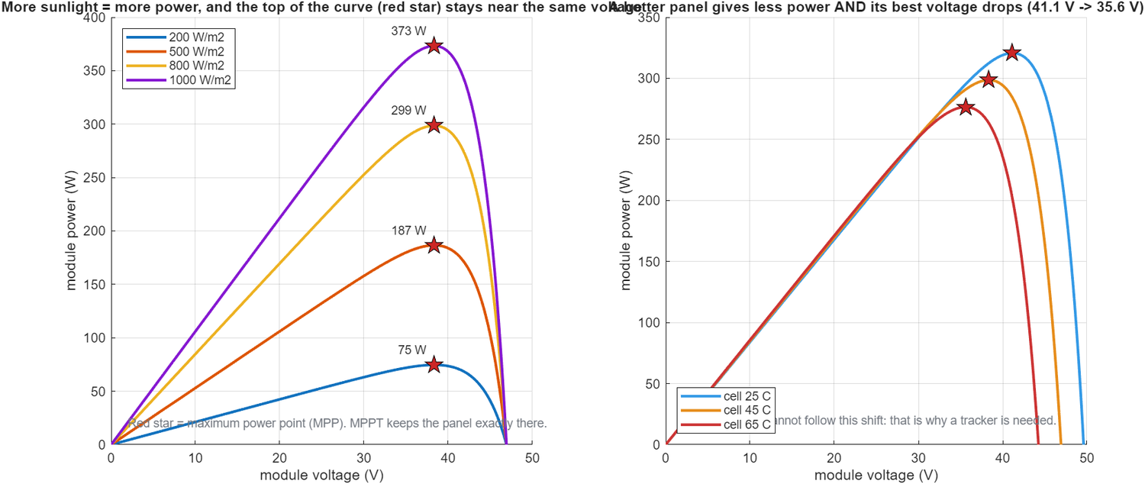
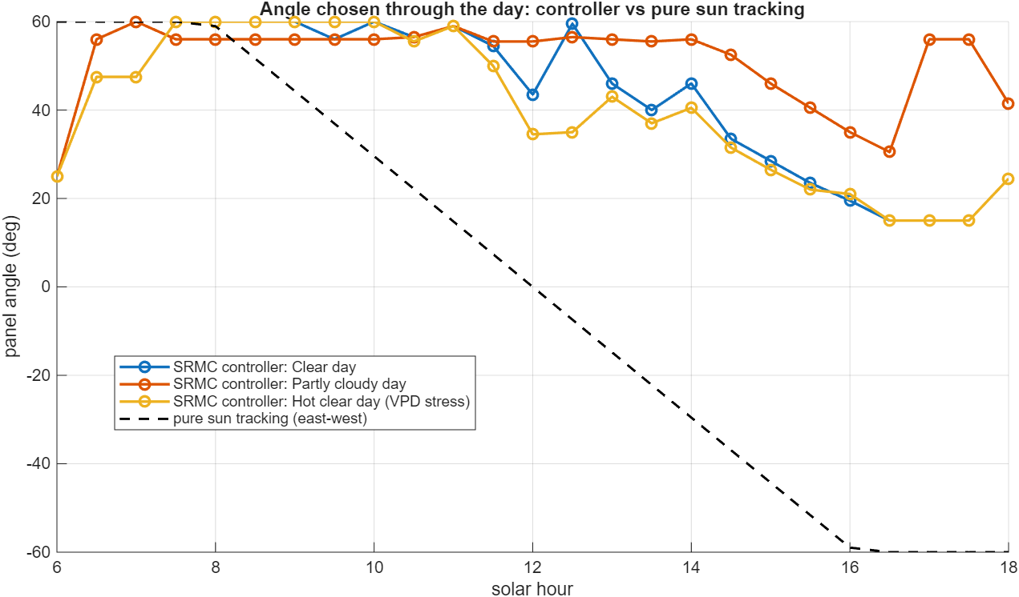
MPPT and Angle Behaviour
Perturb and Observe MPPT
Cloud test: 99.83 % tracking vs 96.95 % fixed voltage
Best voltage falls from 41.1 V (25 °C) to 35.6 V (65 °C)
Angle through the day
Steep in the morning so crops get light
Flatter on clear afternoons for energy; flatter at midday when hot and dry
TCE – EEE – Project III, Phase II | Agrovoltaic Canopy for Protection and Sustainable Farming
12

Slide 13

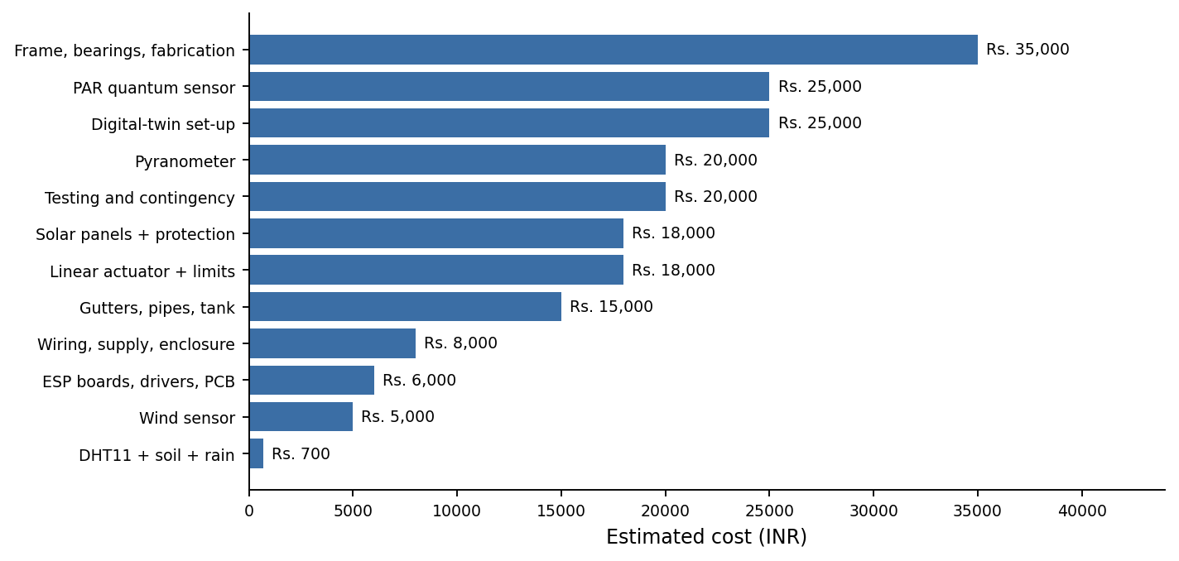
SDG Relevance and Cost
• SDG 7: clean solar power from farmland
• SDG 2: crops keep the light they need
• SDG 6: rain harvested for irrigation
• SDG 13: avoided grid emissions (about 5.6 t CO₂ per unit-year, assumed)
• SDG 8: farmer income and local jobs
Item | Estimate
Sensing kit (DHT11, soil, rain) | ≈ ₹700
Complete prototype budget | ₹2,91,700
Full-scale unit | ₹2.3–3.0 lakh
Payback (Sem. VI estimate) | 4–6 years
TCE – EEE – Project III, Phase II | Agrovoltaic Canopy for Protection and Sustainable Farming
13

Slide 14
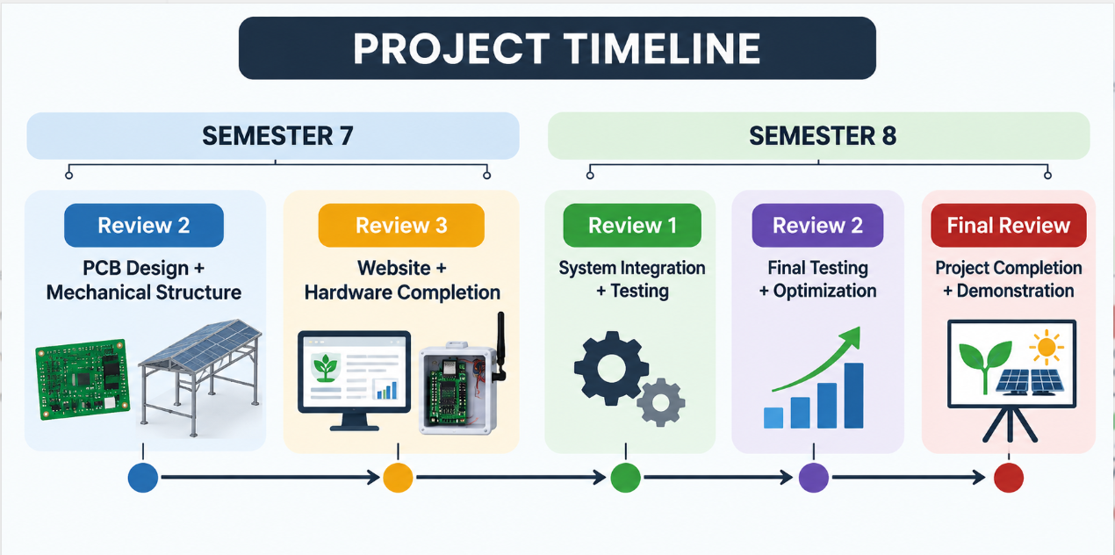
Plan for Semester VIII
Review | Work
1 Nov 2026 | Bench log, PCB, real sensors
2 Dec 2026 | Actuator + angle encoder
3 Jan 2027 | System integration
4 Feb–Mar 2027 | Final testing, field log, MPPT hardware
5 Apr 2027 | Final report and demonstration
• Add pyranometer, PAR sensor and anemometer (no controller change)
• Motorised tilt with 2° dead-band; Wi-Fi / MQTT link and web view
• One week of field data compared with weather data and simulation
TCE – EEE – Project III, Phase II | Agrovoltaic Canopy for Protection and Sustainable Farming
14

Slide 15
Conclusion
• Stakeholder needs were turned into nine functional and four non-functional requirements
• A scaled prototype with real DHT11, soil and rain sensors drives a MATLAB controller and dashboard
• Controller keeps 75 % of best electricity and 89 % of best crop light on a clear day; all 29 tests pass
• Limits stated openly: sunlight, PAR and wind are simulated; tilt is not yet motorised; field data pending
Thank you | Questions and discussion
TCE – EEE – Project III, Phase II | Agrovoltaic Canopy for Protection and Sustainable Farming
15

