Slide 1

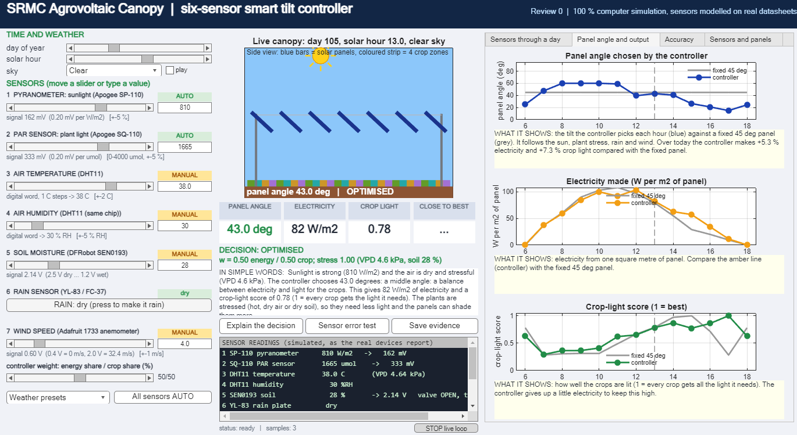


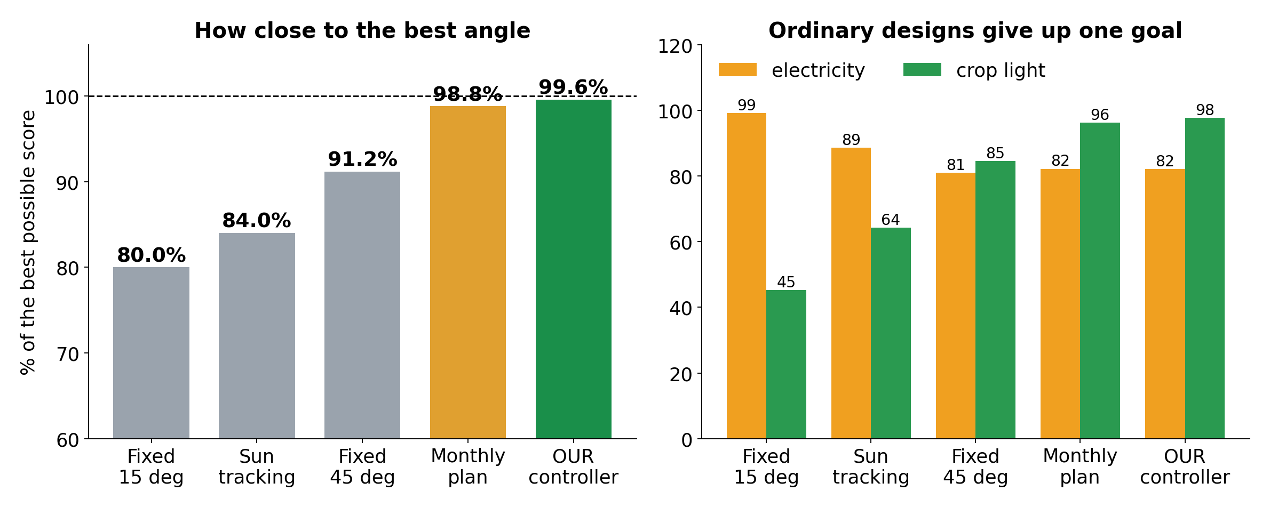
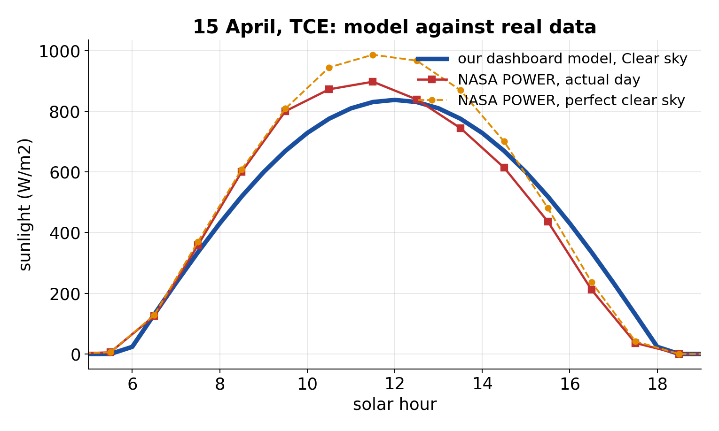

THIAGARAJAR COLLEGE OF ENGINEERING, MADURAI 625 015 | Department of EEE
AGROVOLTAIC CANOPY FOR PROTECTION AND SUSTAINABLE FARMING
Six sensors in, best panel angle out: the crop and the solar panels both win
Thanwin S S | Chandru P M | Kuberaeshwaran S | Mukilan A Guide: Dr. M. Meenakshi Devi
REVIEW
Project III | 2026-27
99.6 %
6
4.4 kWp
29 / 29
accuracy of the co-optimisation against the best possible angle (fixed 45 deg: 91.2 %)
sensors, each simulated from a real datasheet and adjustable by hand
8 x JinkoSolar Tiger Pro JKM550M-72HL4-V panels, 550 Wp each
software tests pass; sunlight checked against NASA POWER and PVGIS
1
LIVE MATLAB DASHBOARD: change any sensor, the panels react
2
HOW IT DECIDES
4
Safety first
Wind 15 m/s or more: stow at 90 deg
Rain: 3 deg, fill the tank
Night: park at 15 deg
Otherwise
Best of 15-60 deg for 1/2 electricity + 1/2 crop light; more shade if hot and dry
1
2
3
3
THE SYSTEM
1 Seven readings from six real devices: slider or typed number, tagged MANUAL or AUTO. 2 Live canopy: the blue panels tilt.
3 The decision, in plain words. 4 Day graphs: sensors, angle, electricity, crop light, accuracy. Each graph has a one-line explanation.
4
SIX SENSORS = SIX REAL DEVICES
5
ACCURACY: WHAT WE OBTAINED
Apogee SP-110
pyranometer: sunlight
0-2000 W/m2, +-5 %
Apogee SQ-110
PAR: light plants use
0-4000 umol/m2/s, +-5 %
DHT11
air temperature and humidity
0-50 C +-2 C | 20-90 % +-5 %
DFRobot SEN0193
soil moisture (capacitive)
1.2-2.5 V analog
YL-83 / FC-37
rain plate + LM393
wet / dry, digital
Adafruit 1733
cup anemometer: wind
0-32.4 m/s, +-1 m/s
Our six-sensor controller: 99.6 % of the best possible score, 4.8 deg from the best angle. Fixed 45 deg: 91.2 % (16.3 deg). Sun tracking: 84.0 %. Fixed 15 deg: 80.0 %. 864 noisy cases, simulation.
Panels: 8 x JinkoSolar Tiger Pro JKM550M-72HL4-V, 550 Wp, 40.90 V, 13.45 A, 21.33 %, 2274 x 1134 mm (datasheet on file)
6
CAN YOU TRUST THE SUNLIGHT?
7
PROOF YOU CAN OPEN
8
IF IT WERE REAL: COST (INR)
✓ 7 sensor and panel datasheets, downloaded
✓ NASA POWER + PVGIS sunlight data
✓ Model vs data figure and numbers
✓ Accuracy test file (864 cases)
✓ SHA-256 checksum of every proof file
✓ Evidence Book (Word) for the judges
✓ Code and results on GitHub
Research-grade sensing kit
67,600
Low-cost sensing kit
13,100
8 panels, 4.4 kWp (assumed)
70,000
Dashboard Clear day 6502 Wh/m2 vs NASA POWER 6539 and PVGIS 6337. Plant-light share 0.444 vs 0.45. A check against satellite data, not a roof sensor.
This simulation
0
Estimates, not quotes. Sensors: 2 Apogee ~INR 56,000, anemometer 6,500, DHT11 + soil + rain 700, ESP32, ADC, wiring.
NEXT crop-light and yield measurement | Digital Twin | paper submission
HONEST LIMITS Simulation only. Sensor readings are generated or typed, not measured. Accuracy is against the controller's own goal, not crop yield. Prices are estimates.

