Slide 1
ROBOTIC VISION / MULTICLASS CLASSIFICATION
PickSense
3,600 images
90.5% test accuracy
Occlusion Classification for Robotic Vision
Validated on all 600 test images
Supervised multiclass image classification for robotic perception
IMAGE
VISION MODEL
CLEAR / PARTIAL / HEAVY
Project update • August 2026
Notes:
PickSense is a computer vision project focused on object occlusion. The goal is to classify an object as clear, partially occluded, or heavily occluded. This is a supervised multiclass classification problem and represents an early perception step that could help a robot understand what it can see before interacting with an object. The updated project now uses 3,600 images and reaches 90.5 percent test accuracy.
Suggested time: ~30 seconds.

Slide 2
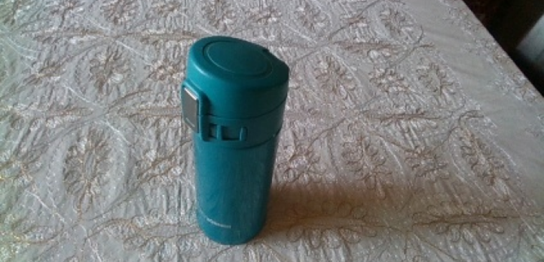
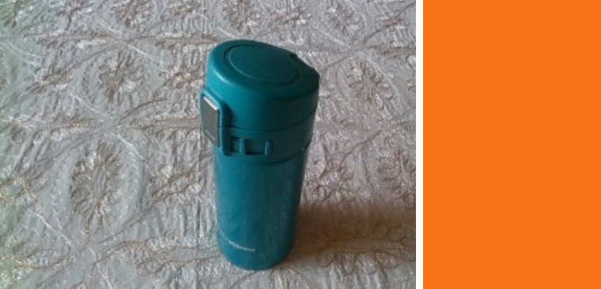
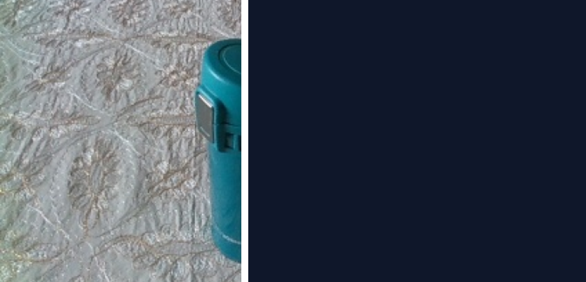
02 / 07
THE PROBLEM
Why Occlusion Matters
CLEAR
~0% occluded
PARTIALLY OCCLUDED
~25% occluded
HEAVILY OCCLUDED
~50% occluded
Illustrative visibility levels using one project image
THE PROBLEM
PICKSENSE ASKS
Objects are often blocked by other objects, making visual recognition harder.
How well can a vision model determine the level of object occlusion?
Scope: visibility classification, not grasp-success prediction.
PickSense • Computer Vision • August 2026
Notes:
Robots need visual information before they can manipulate objects. In real environments, objects are often partially hidden. PickSense focuses specifically on this perception problem. Given an image, the model must choose one of three occlusion levels. At this stage, PickSense is not predicting whether the robot can successfully grasp the object. It is first learning to understand how visible the object is.
Suggested time: ~40 seconds.

Slide 3
03 / 07
PROJECT ARCHITECTURE
PickSense ML Pipeline
01
02
03
04
05
01
DATA
LOADING
MODEL
TRAINING
EVALUATION
• OpenLORIS
• Google Drive
• Class labels
• ImageFolder
• DataLoader
• Batching
• ViT from scratch
• Pretrained ViT
• 3-class head
• Cross entropy
• AdamW
• GPU / Colab
• Accuracy
• Confusion matrix
• Predictions
OpenLORIS → persistent data → reproducible batches → two ViT paths → full test-set evidence
PickSense • Computer Vision • August 2026
Notes:
I organized PickSense as several layers instead of putting everything into one notebook. The data layer prepares and stores the data. PyTorch DataLoaders feed batches to the models. The model layer contains my Vision Transformer experiments. The training layer handles optimization on the GPU, and the evaluation layer now measures accuracy, class-level performance, and predictions across the complete test set.
Suggested time: ~48 seconds.

Slide 4
04 / 07
DATA PIPELINE
Data Infrastructure That Survives Colab
1
OpenLORIS
ENGINEERING JOURNEY
2
00 · PREPARE
300
3,600
3
GOOGLE DRIVE
prototype images
current images
4
TRAIN / TEST
3,000
600
3
5
IMAGEFOLDER
training
testing
balanced classes
6
DATALOADER
Seed 42 • original splits preserved • no train/test overlap • 114.4 MB
PickSense • Computer Vision • August 2026
Notes:
One challenge was repeatedly downloading data whenever Colab disconnected. I separated preparation from training. Notebook 00 downloads and stores the prepared data permanently in Google Drive. Notebook 01 only verifies and loads it. I initially used a 300-image prototype to debug the pipeline quickly. After the pipeline worked, I expanded it to 3,600 balanced images: 3,000 for training and 600 for testing, while preserving the original OpenLORIS splits.
Suggested time: ~45 seconds.

Slide 5
05 / 07
MODEL EXPERIMENTS
From Scratch vs. Transfer Learning
ViT FROM SCRATCH
PRETRAINED ViT-B/16
Starts with no learned visual knowledge
Reuses visual features learned from ImageNet
1
Image
1
Image
2
16×16 patches
2
Pretrained backbone
3
Patch embeddings
3
Frozen visual features
4
12 encoder blocks
4
New linear head
5
3-class head
5
3 PickSense classes
Corrected: pre-norm, one residual path, local patch-size checks
Best validated path for the current dataset
PickSense • Computer Vision • August 2026
Notes:
I first built a Vision Transformer from scratch. That path starts with no learned visual knowledge and must learn both features and classification from PickSense data. I also tested transfer learning with a pretrained ViT-B/16. Its backbone already represents shapes, edges, and textures, so I froze those parameters and trained a new three-class head. The scratch implementation also exposed architecture bugs that I corrected, including duplicated residual behavior and a global patch-size dependency. For the current dataset, the pretrained path is the strongest validated model.
Suggested time: ~48 seconds.

Slide 6
06 / 07
CURRENT RESULTS
More Data Made the Predictions Relevant
DATA SCALING
90.5%
10% · 36 images
58.3%
Earlier pretrained run
overall test accuracy
100% · 3,000 images
90.5%
543 / 600
Current validated run
correct predictions
+32.2 percentage points from using the complete training pool
TRAIN 97.4%
PER-CLASS ACCURACY
TEST 90.5%
Clear
93.5%
6.9-point gap
Partially occluded
91.0%
Heavily occluded
87.0%
PickSense • Computer Vision • August 2026
Notes:
The most important result is the data-scaling comparison. With only 10 percent of the earlier pool, the pretrained model trained on 36 images and reached 58.3 percent test accuracy. After expanding the dataset and using all 3,000 training images, test accuracy reached 90.5 percent, a gain of 32.2 percentage points. Across classes, clear reached 93.5 percent, partially occluded 91 percent, and heavily occluded 87 percent. The remaining gap is concentrated most strongly in heavy occlusion.
Suggested time: ~55 seconds.

Slide 7
07 / 07
LEARNING AND NEXT STEPS
What the Experiment Changed
CONTROLLED DATA-SCALING STATUS
NEXT STEPS
✓
·
·
·
✓
• Run 25% / 50% / 75% to map the full scaling curve.
• Add augmentation and robustness tests.
• Fine-tune selected pretrained layers.
• Compress the 327.4 MB model.
• Move toward real grasp-success labels.
10%
25%
50%
75%
100%
58.3%
pending
pending
pending
90.5%
WHAT I LEARNED
• A tiny training set can be memorized without generalizing.
• Data design and infrastructure changed accuracy more than another model tweak.
• The full test set and class-level metrics made the improvement defensible.
Machine learning performance is a system result: data + infrastructure + model + evaluation.
PickSense • Computer Vision • August 2026
Notes:
The controlled scaling experiment now has two verified endpoints: 10 percent and 100 percent. The intermediate 25, 50, and 75 percent runs are still useful future work because they would reveal the shape of the accuracy-versus-compute curve, so I have not invented those points. The biggest lesson is that machine learning is not only about choosing a model. Dataset design, infrastructure, architecture correctness, computational cost, and evaluation all affect the final system. Next I would add augmentation, selective fine-tuning, compression, and eventually replace the occlusion proxy with real grasp-success labels.
Suggested time: ~52 seconds.

