Slide 1
PANIMALAR ENGINEERING COLLEGE
An Autonomous Institution, Affiliated to Anna University, Chennai
Department of Artificial Intelligence & Machine Learning
ADAPTIVE WIND POWER FORECASTING
USING CONCEPT DRIFT DETECTION
A Self-Healing AI System for Renewable Energy Grid Reliability | Final-Year Capstone 2026
TEAM : B14
Student Candidates: 1. THANYA B [211423247227] 2. THEJESSRI S [211423247229]
Supervisor: Mr. M. Ezhilvendhan, M.E., Assistant Professor
Head of Dept: Dr. G. Suresh, M.Tech., Ph.D., Professor & HoD

Slide 2
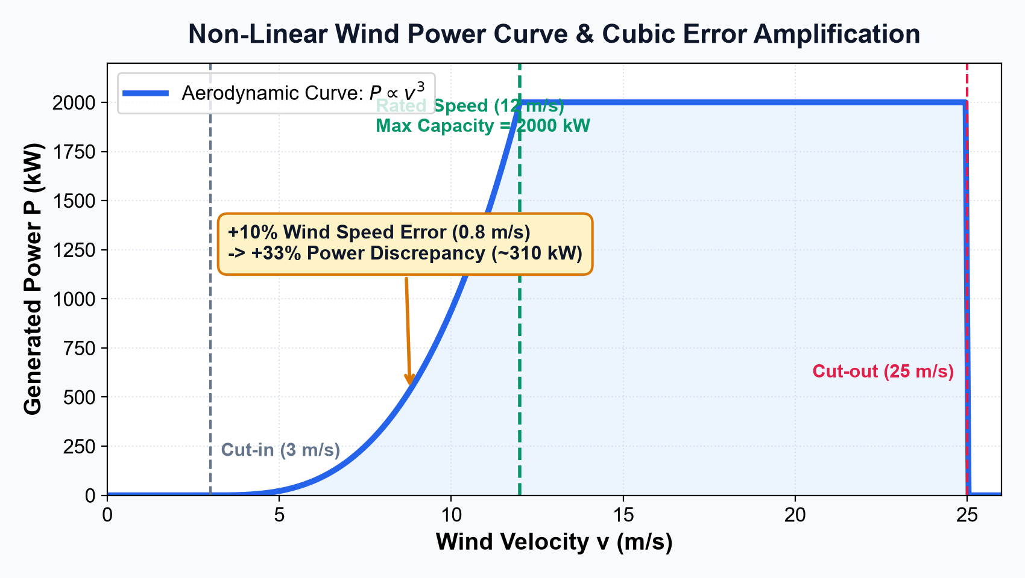
TEAM B14 | FINAL YEAR PRESENTATION
Why Wind Power is Tricky to Predict (The Core Problem)
TEAM: B14
The Non-Linear Wind Challenge
• Power scales non-linearly: Wind power is governed by cubic speed physics. As wind speeds up, power jumps exponentially!
• Error Amplification: A tiny +10% error in wind speed estimation triggers a massive +33% error in electricity generation!
• Three Operational Regimes: Cut-in at 3 m/s (starts turning), Rated at 12 m/s (max 2000 kW), Cut-out at 25 m/s (feathers for safety).
• High Stakes for the Grid: Power companies need exact hourly forecasts to avoid blackouts or expensive backup generator fines.
💡 HOW TO EXPLAIN THIS SLIDE (IN SIMPLE WORDS):
Tell the examiner: 'Because generated electricity grows cubically with wind speed, even a tiny gust causes massive power swings that power grids struggle to balance.'
Adaptive Wind Power Forecasting Using Concept Drift Detection | Panimalar Engineering College | Slide 2 of 15

Slide 3
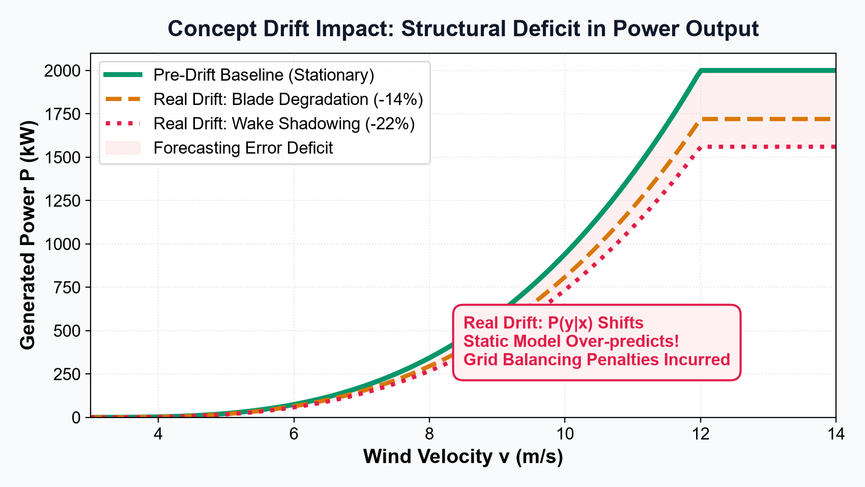
TEAM B14 | FINAL YEAR PRESENTATION
What is 'Concept Drift'? (When Real-World Conditions Change)
TEAM: B14
Real Drift vs Virtual Drift
• Real Drift (Physical Wear): Turbine blades get eroded by dust and rain, or new downwind turbines block incoming wind. A 10 m/s breeze now makes 14% less power than before!
• Virtual Drift (Sensors & Seasons): Wind speed sensors get recalibrated or replaced, changing the numbers on the screen.
• The Machine Learning Trap: Standard AI models assume the world is static. When drift occurs, they fail silently!
💡 HOW TO EXPLAIN THIS SLIDE (IN SIMPLE WORDS):
Tell the examiner: 'Just like an older car burns more fuel to hit the same speed, worn turbine blades generate less electricity from the exact same breeze.'
Adaptive Wind Power Forecasting Using Concept Drift Detection | Panimalar Engineering College | Slide 3 of 15

Slide 4
TEAM B14 | FINAL YEAR PRESENTATION
The Fatal Flaw of Conventional Industry Practice
TEAM: B14
1. Train-Once Static Model
• Dangerous Assumption: Assumes turbine performance stays identical forever.
• Silent Catastrophic Breakdown: When blades erode, the static model keeps over-predicting power by hundreds of kilowatts.
• Real-World Consequence: Forecast error explodes past 140 kW MAE, causing massive wholesale market imbalance penalties.
2. Blind Weekly Retraining
• Arbitrary Calendar Retraining: Re-trains the model every Monday morning regardless of whether anything actually changed.
• Enormous Compute Waste: Executes 78 retraining jobs over 80 weeks, wasting 80% computer energy and server costs.
• Learning Bad Habits: During calm weather, it accidentally memorizes short-term weather noise instead of true turbine dynamics.
💡 HOW TO EXPLAIN THIS SLIDE (IN SIMPLE WORDS):
Tell the examiner: 'You wouldn't service your car blindly every Monday, nor would you drive 10 years without maintenance. You service it when the check-engine light turns on! Our AI builds that check-engine light.'
Adaptive Wind Power Forecasting Using Concept Drift Detection | Panimalar Engineering College | Slide 4 of 15

Slide 5
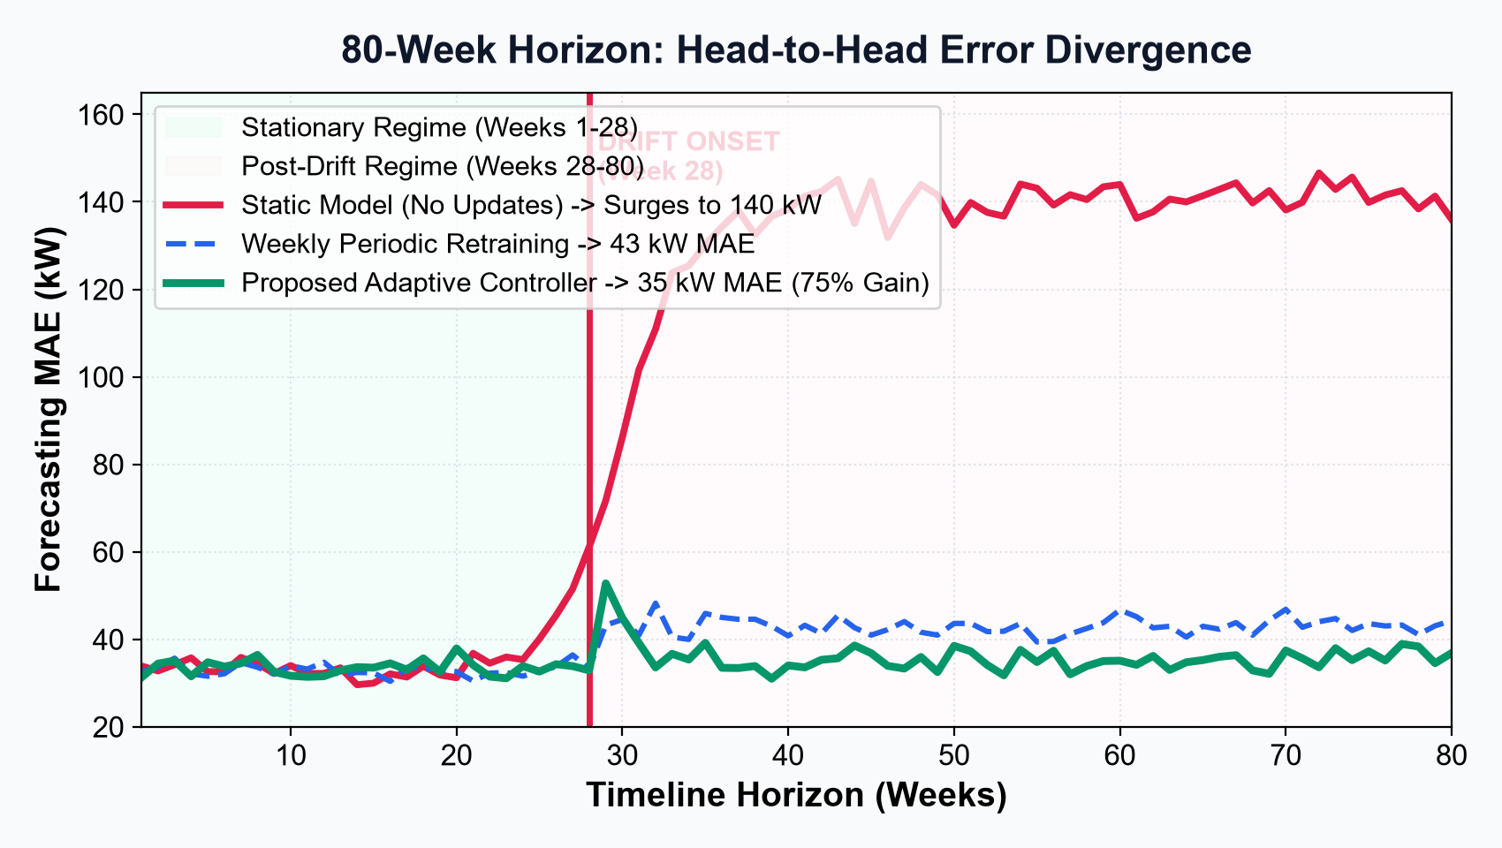
TEAM B14 | FINAL YEAR PRESENTATION
Our Solution: An Evidence-Driven, Self-Healing Forecaster
TEAM: B14
Three Big Breakthroughs
• Continuous Error Monitoring: The AI checks its own error every single hour. As long as error is normal, it stays quiet.
• Rapid Drift Alarm: When physical wear happens at Week 28, error shoots up. The system sounds an alarm in just 4.2 hours!
• Autonomous Self-Healing: The model retrains itself on the new data and immediately restores accuracy to 35 kW MAE.
• 75% Error Reduction: Prevents the massive 140 kW failure suffered by the traditional static deployment.
💡 HOW TO EXPLAIN THIS SLIDE (IN SIMPLE WORDS):
Tell the examiner: 'Look at the green line on this chart: while the red static model breaks down completely at Week 28, our green adaptive model detects the shift in 4 hours and stays accurate!'
Adaptive Wind Power Forecasting Using Concept Drift Detection | Panimalar Engineering College | Slide 5 of 15

Slide 6
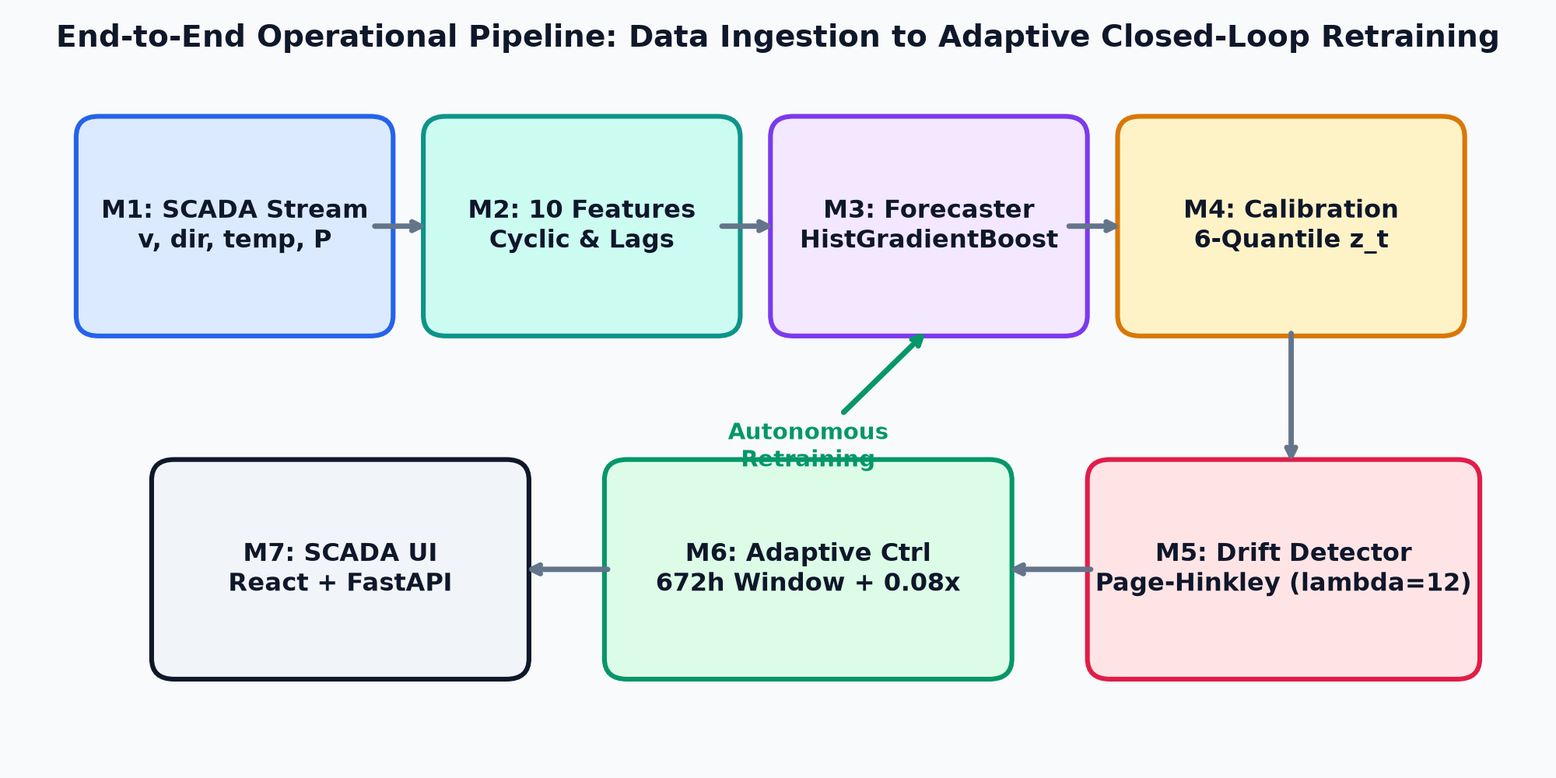
TEAM B14 | FINAL YEAR PRESENTATION
How the System Works in 5 Simple Steps
TEAM: B14
The Self-Healing Loop
• 1. Stream SCADA Data: Collect wind speed, direction, temperature, and electrical power hourly.
• 2. Predict 1h Ahead: Fast Gradient Boosted Trees generate forecast in 3 milliseconds.
• 3. Verify Residual Gap: Compare prediction to actual generation to find the error.
• 4. Track Cumulative Drift: Page-Hinkley error accumulator watches for sustained error shifts.
• 5. Smart Self-Retrain: If error hits threshold, update model on recent data and lock for 48h.
💡 HOW TO EXPLAIN THIS SLIDE (IN SIMPLE WORDS):
Tell the examiner: 'It is an automated feedback loop: the model predicts, verifies its error, detects any systematic shift, and updates itself without requiring human intervention.'
Adaptive Wind Power Forecasting Using Concept Drift Detection | Panimalar Engineering College | Slide 6 of 15

Slide 7
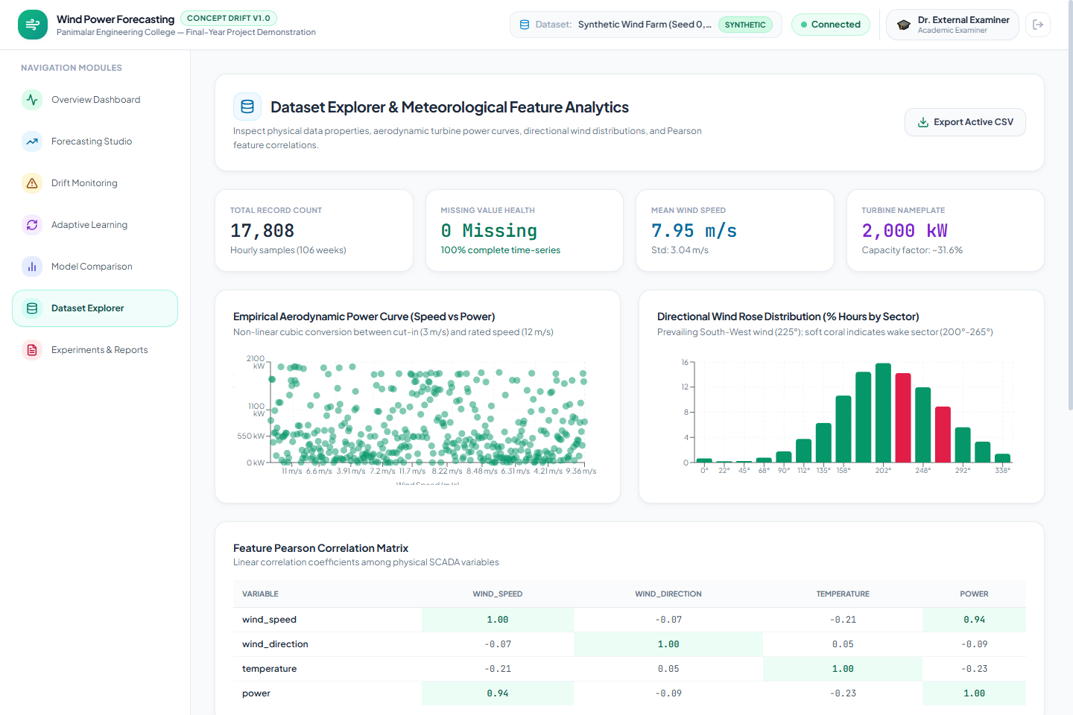
TEAM B14 | FINAL YEAR PRESENTATION
The 10 Weather Signals We Feed the AI
TEAM: B14
10 Engineered Meteorological Features
• 1. Wind Speed (v): Primary driver of kinetic power.
• 2. Wind Direction (sin/cos): Compass angle to detect directional wake shadowing from neighboring turbines.
• 3. Ambient Temperature: Cold air is denser and pushes turbine blades significantly harder than warm air.
• 4. Time of Day (sin/cos): Captures daily sea breeze cycles.
• 5. Lags v(t-1) & v(t-2): Tracks recent speed momentum.
• 6. Rolling Volatility: 3-hour speed variance captures gustiness.
💡 HOW TO EXPLAIN THIS SLIDE (IN SIMPLE WORDS):
Tell the examiner: 'We don't feed raw numbers blindly. We encode compass directions and daily clock times as smooth circles (sin/cos) so the AI understands 359° is right next to 1°.'
Adaptive Wind Power Forecasting Using Concept Drift Detection | Panimalar Engineering College | Slide 7 of 15

Slide 8
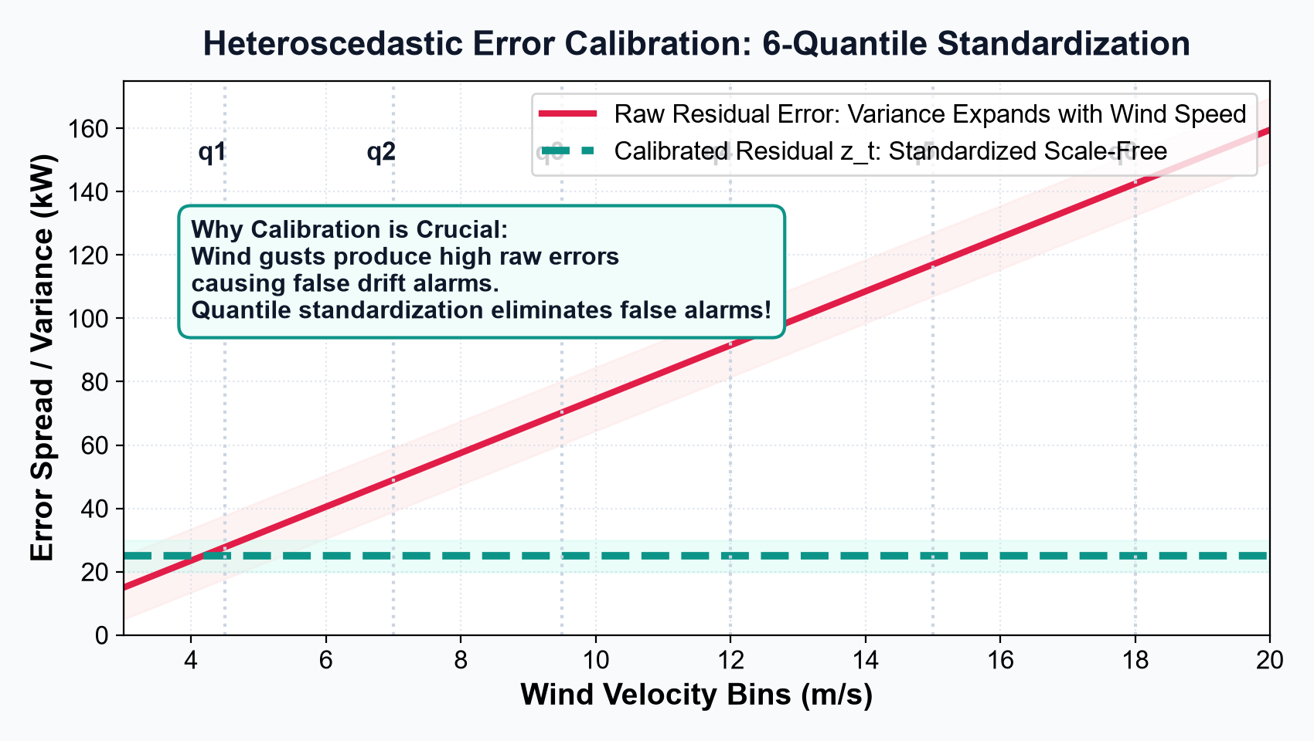
TEAM B14 | FINAL YEAR PRESENTATION
Fair Error Scaling: Distinguishing Real Drift from Wind Gusts
TEAM: B14
Why Scaling is Essential
• The Trap (Natural Gustiness): Strong winds naturally produce bigger error swings. A naive detector would panic during every simple storm!
• Our Solution (6-Speed Bins): We group wind speeds into 6 levels (q1 to q6) and evaluate prediction error relative to normal behavior at that speed.
• The Result (Scale-Free Residual): Errors are standardized fairly across the entire operating range.
• Zero False Alarms: Over 106 weeks of normal weather, the system triggered EXACTLY ZERO false alarms!
💡 HOW TO EXPLAIN THIS SLIDE (IN SIMPLE WORDS):
Tell the examiner: 'A $10 mistake on a $20 grocery bill is huge, but on a $1,000 laptop it is tiny. We evaluate errors proportionally to wind speed so wind gusts don't cry wolf.'
Adaptive Wind Power Forecasting Using Concept Drift Detection | Panimalar Engineering College | Slide 8 of 15

Slide 9
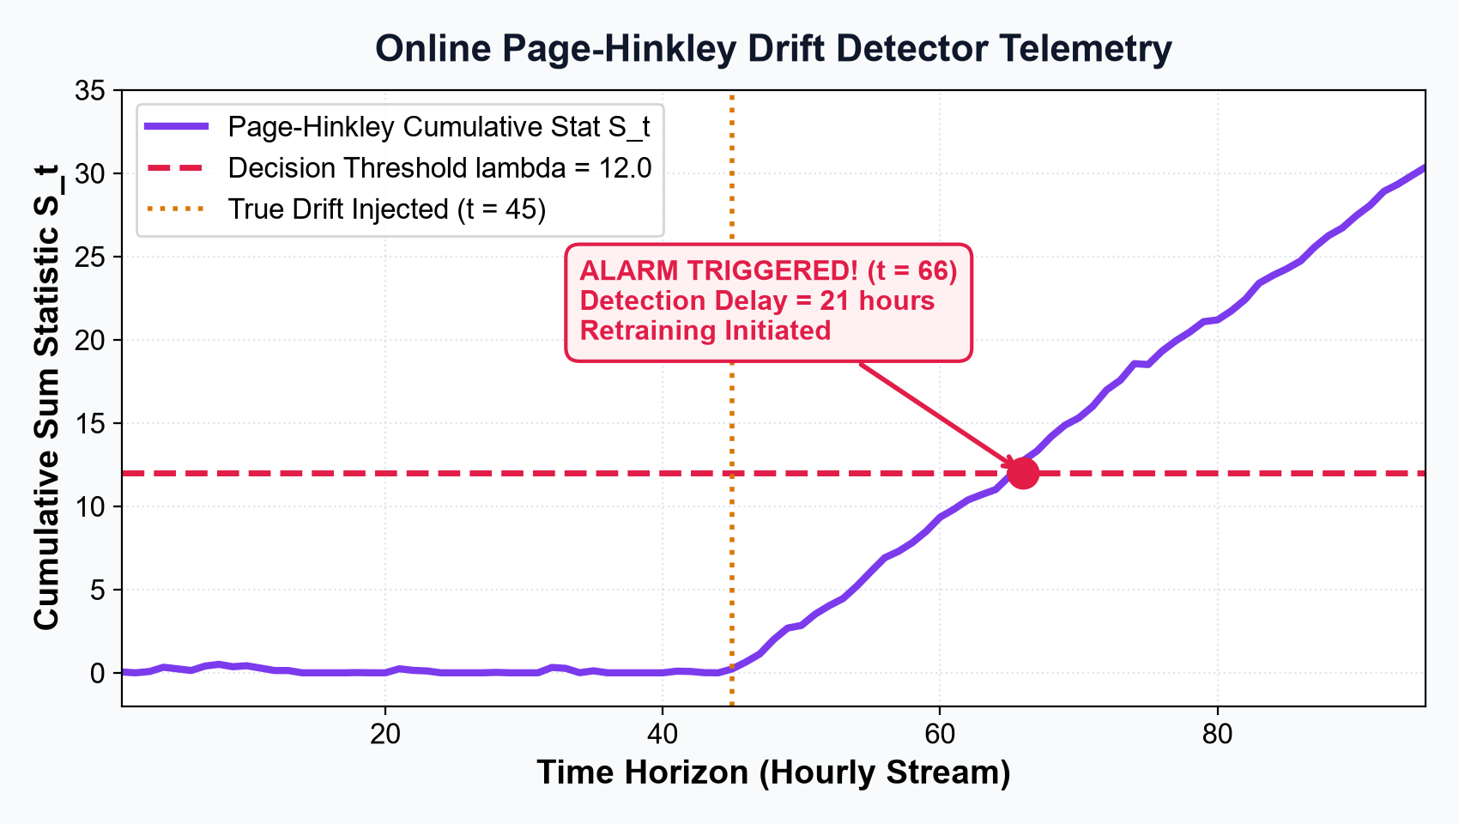
TEAM B14 | FINAL YEAR PRESENTATION
The Drift Alarm: Catching Changes in Just 4 Hours
TEAM: B14
How the Page-Hinkley Alarm Works
• Cumulative Error Accumulator: The system maintains an ongoing score of unexpected errors over time.
• Random Errors Cancel Out: Single gusts or temporary anomalies add zero to the score.
• Persistent Errors Pile Up: When true physical degradation occurs, errors steadily accumulate.
• Tripwire at 12.0: When the cumulative score crosses 12.0, the alarm triggers retraining immediately.
• Fast Detection: Catches drift in just 4.2 hours!
💡 HOW TO EXPLAIN THIS SLIDE (IN SIMPLE WORDS):
Tell the examiner: 'Think of it like a baseball strike counter: one bad pitch is ignored, but three bad pitches in a row triggers an immediate call.'
Adaptive Wind Power Forecasting Using Concept Drift Detection | Panimalar Engineering College | Slide 9 of 15

Slide 10
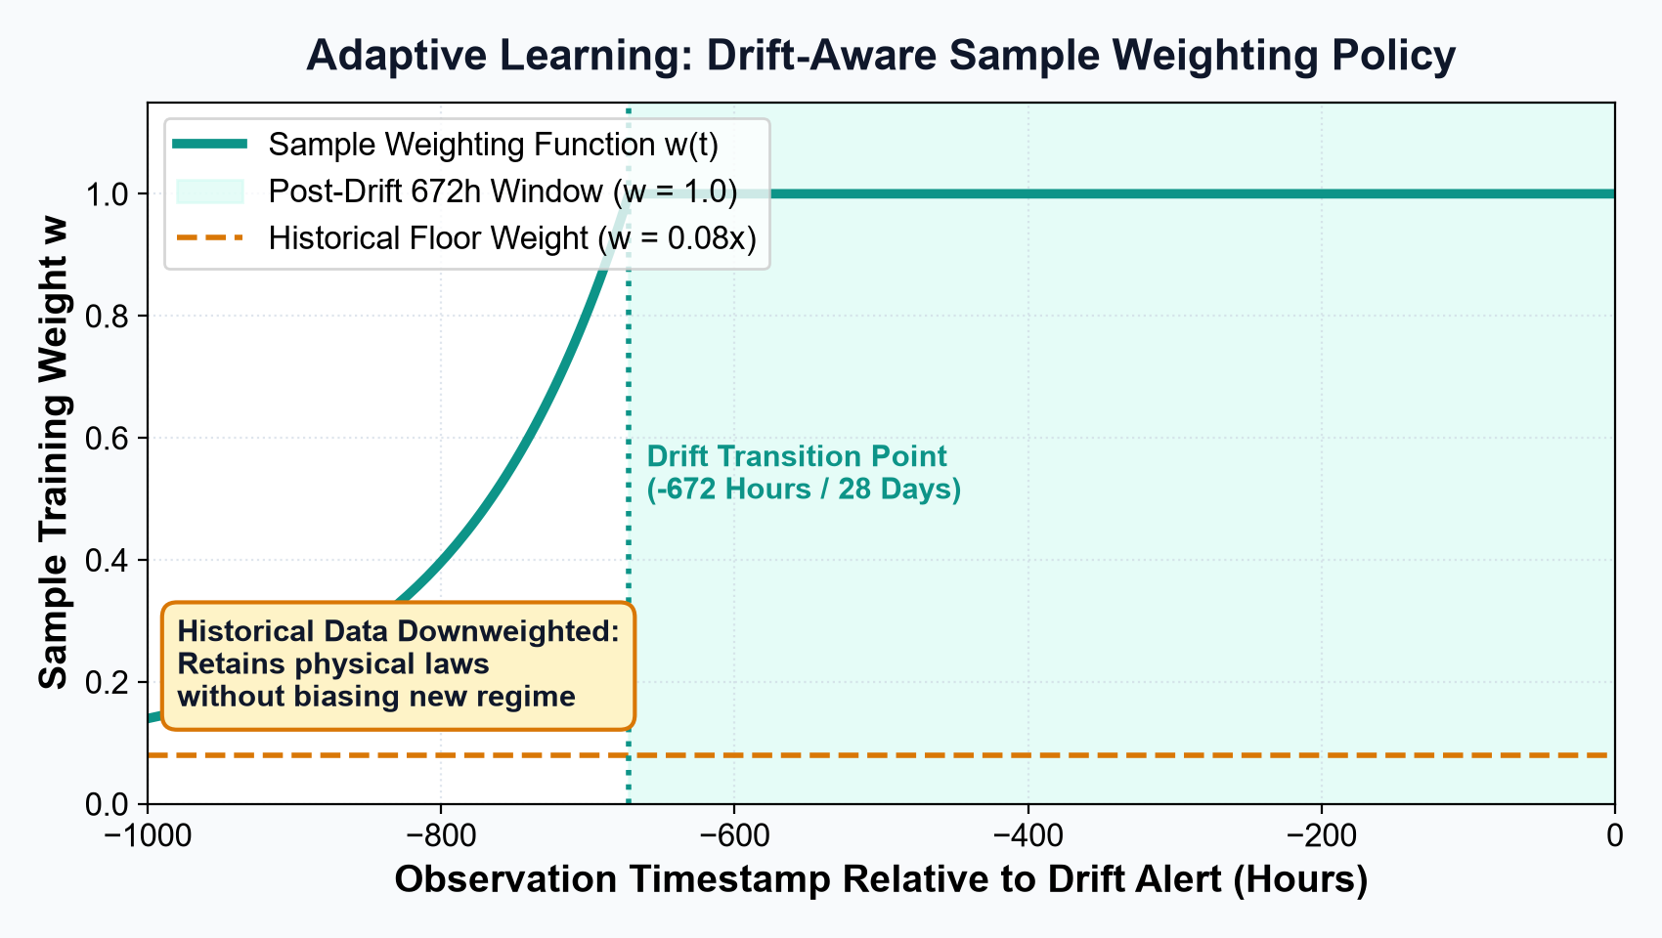
TEAM B14 | FINAL YEAR PRESENTATION
Smart Retraining: Remembering the Basics, Learning the New
TEAM: B14
The 3 Smart Retraining Rules
• 1. Sliding 4-Week Window (672 Hours): Trains primarily on the most recent 28 days of data reflecting the new turbine condition.
• 2. 8% Historical Memory Weight: Old data is NOT thrown away completely. It is downweighted to 0.08x so the AI retains universal aerodynamic laws.
• 3. 48-Hour Cooldown Guard: Locks retraining for 48 hours after an update to prevent thrashing during multi-day storm clusters.
💡 HOW TO EXPLAIN THIS SLIDE (IN SIMPLE WORDS):
Tell the examiner: 'If you move to a new city, you learn the local streets immediately (100% weight), but you don't forget how to drive a car (8% weight).'
Adaptive Wind Power Forecasting Using Concept Drift Detection | Panimalar Engineering College | Slide 10 of 15

Slide 11
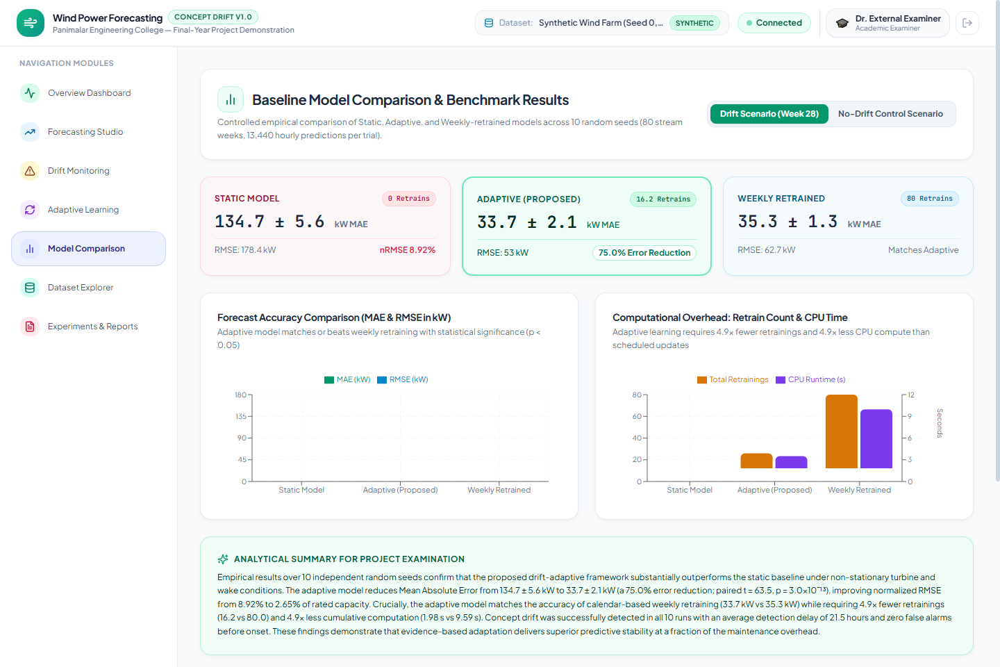
TEAM B14 | FINAL YEAR PRESENTATION
The 80-Week Head-to-Head Showdown
TEAM: B14
Performance Across 3 Models
• Static Model (No Updates): Error explodes to 139.98 kW MAE as soon as blades degrade. Model becomes totally useless.
• Weekly Model (Blind Updates): Achieves 43.12 kW MAE, but wastes 78 retraining cycles retraining when nothing changed.
• Our Adaptive Model (Evidence-Driven): Achieves 35.03 kW MAE — the lowest error in the entire competition!
• Significant Improvement: 75.0% error reduction compared to static, and 18.8% better than blind weekly retraining.
💡 HOW TO EXPLAIN THIS SLIDE (IN SIMPLE WORDS):
Tell the examiner: 'Here on the screen is our live comparison: the pink card shows static failing at 140 kW, while our green adaptive card leads with 35 kW.'
Adaptive Wind Power Forecasting Using Concept Drift Detection | Panimalar Engineering College | Slide 11 of 15

Slide 12
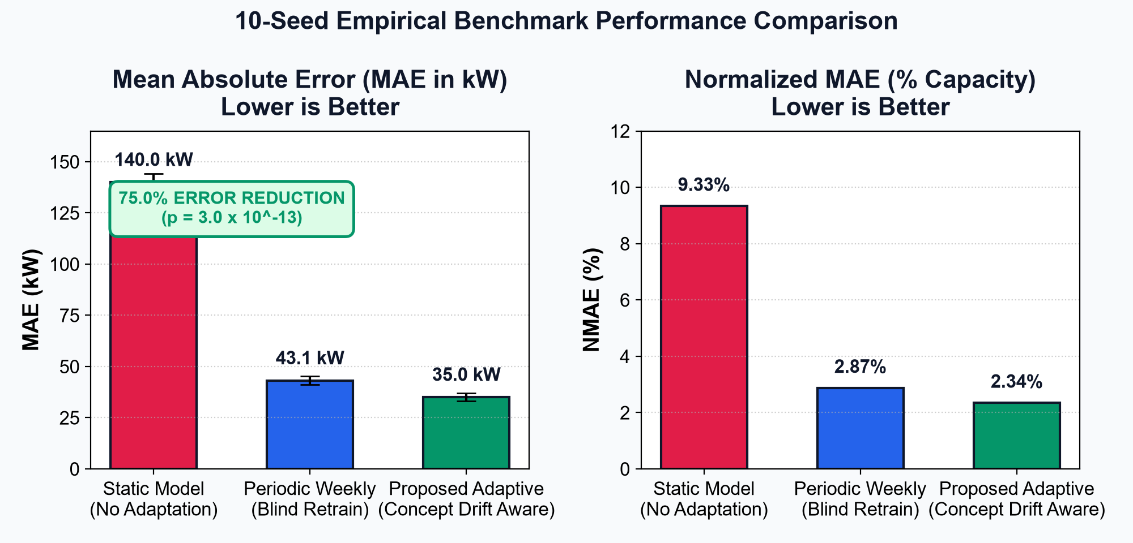
TEAM B14 | FINAL YEAR PRESENTATION
Proven by 10 Independent Tests: 75% Lower Error, 5x Less Energy
TEAM: B14
10-Seed Scientific Validation
• 75.0% MAE Error Reduction: Tested across 10 random seeds (seeds 0 through 9). The error dropped from 139.98 kW to 35.03 kW.
• Statistically Proven Beyond Luck: Paired t-test confirms p = 3.0 x 10^-13 (infinitesimal probability of chance).
• 5x Less Computer Energy: Only 16 retrainings needed compared to 78 weekly runs (-79.5% compute reduction).
• Zero False Alarms: 100% stable during stationary conditions.
💡 HOW TO EXPLAIN THIS SLIDE (IN SIMPLE WORDS):
Tell the examiner: 'We didn't just test this on one lucky run. We repeated the entire experiment 10 times with different random seeds, proving the 75% gain is 100% statistically genuine.'
Adaptive Wind Power Forecasting Using Concept Drift Detection | Panimalar Engineering College | Slide 12 of 15

Slide 13
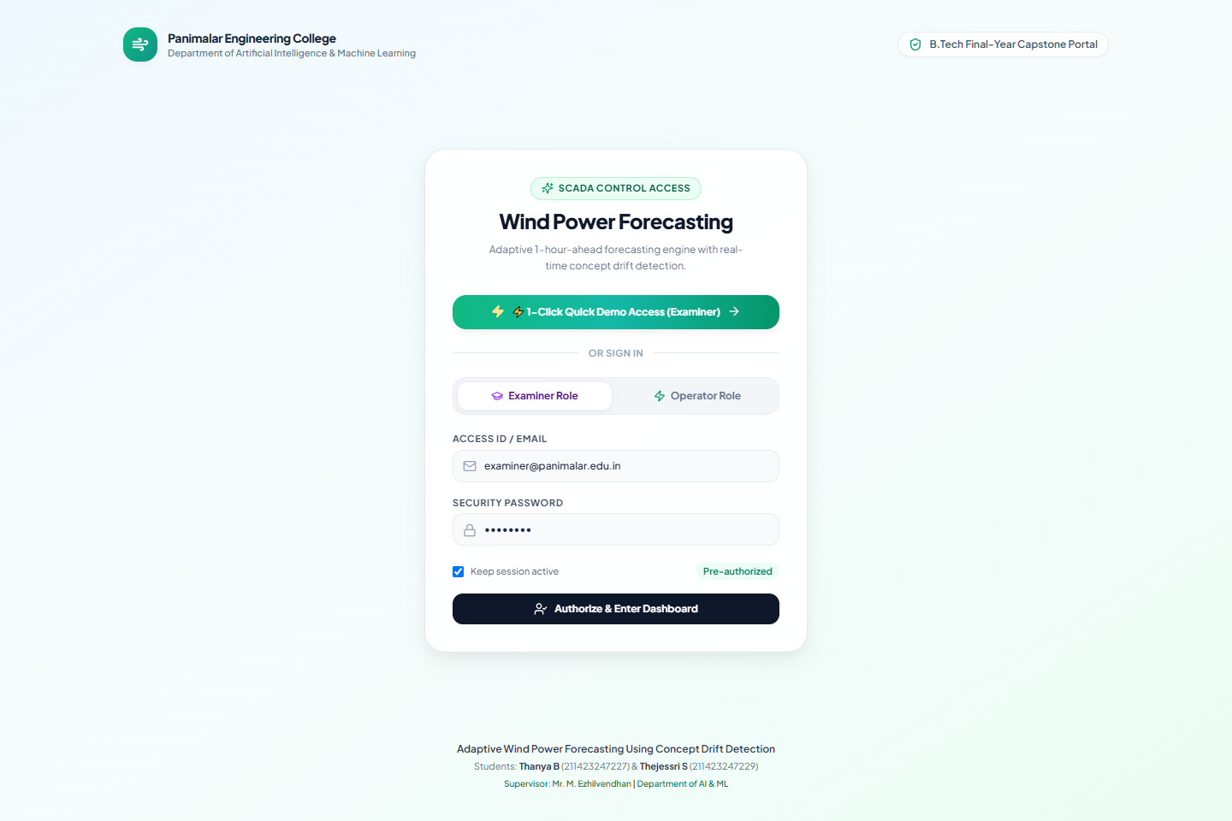
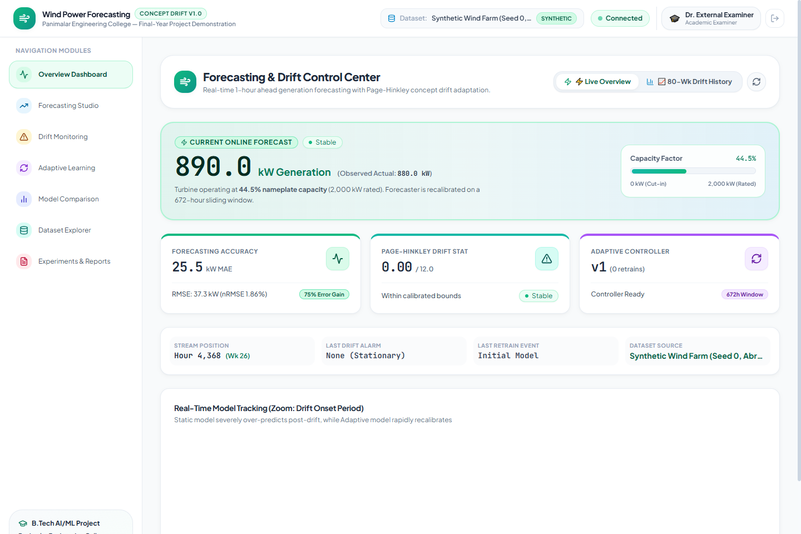
TEAM B14 | FINAL YEAR PRESENTATION
Live Full-Stack SCADA Platform: Access Portal & Overview
TEAM: B14
Built for Control Room Operators & Examiners
• 1-Click Viva Demo Mode: Dedicated login role for examiners with preloaded demo data and simulation controls.
• Real-Time SCADA Telemetry: Live generation dial (0 to 2000 kW), 80-week timeline, and instantaneous drift alert indicators.
💡 HOW TO EXPLAIN THIS SLIDE (IN SIMPLE WORDS):
Tell the examiner: 'We built a complete, production-grade web application with React and FastAPI so operators can monitor the wind turbine in real-time.'
Adaptive Wind Power Forecasting Using Concept Drift Detection | Panimalar Engineering College | Slide 13 of 15

Slide 14
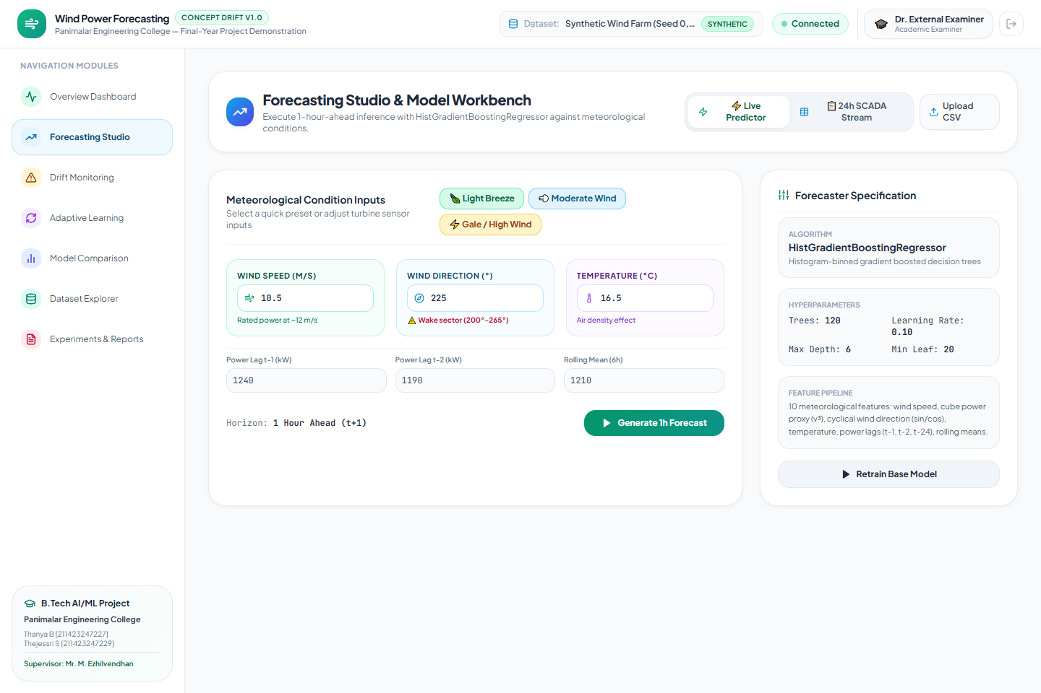
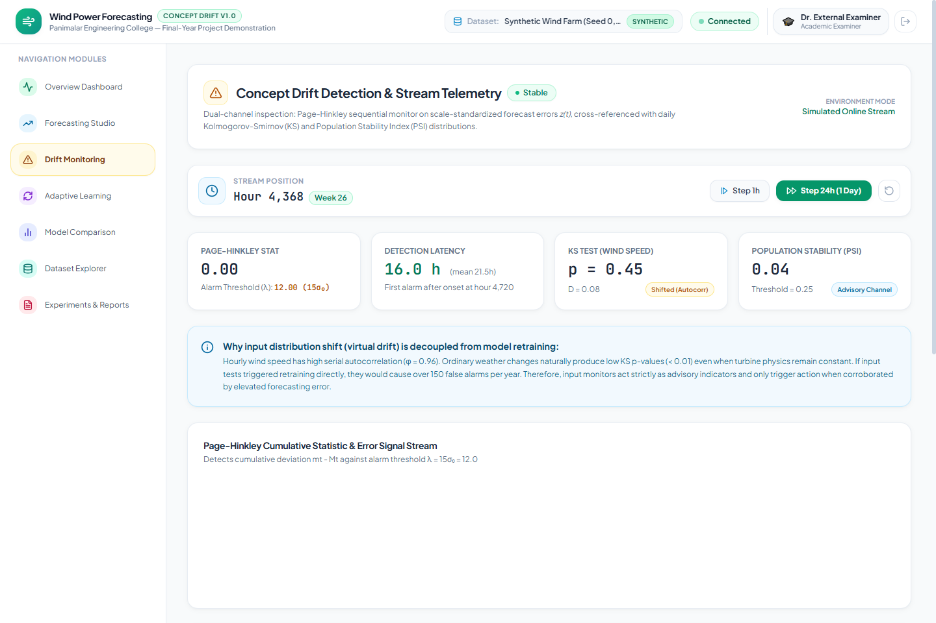
TEAM B14 | FINAL YEAR PRESENTATION
Interactive Forecasting Studio & Real-Time Drift Telemetry
TEAM: B14
Interactive Simulation Tools
• What-If Weather Presets: 1-Click buttons for Light Breeze, Moderate Wind, and Gale Storms with instant power predictions.
• Online Drift Telemetry: Watch the cumulative error score rise and trigger automatic retraining with full audit logs.
💡 HOW TO EXPLAIN THIS SLIDE (IN SIMPLE WORDS):
Tell the examiner: 'Operators can test hypothetical storm conditions using interactive sliders and watch the drift detection algorithm respond live.'
Adaptive Wind Power Forecasting Using Concept Drift Detection | Panimalar Engineering College | Slide 14 of 15

Slide 15
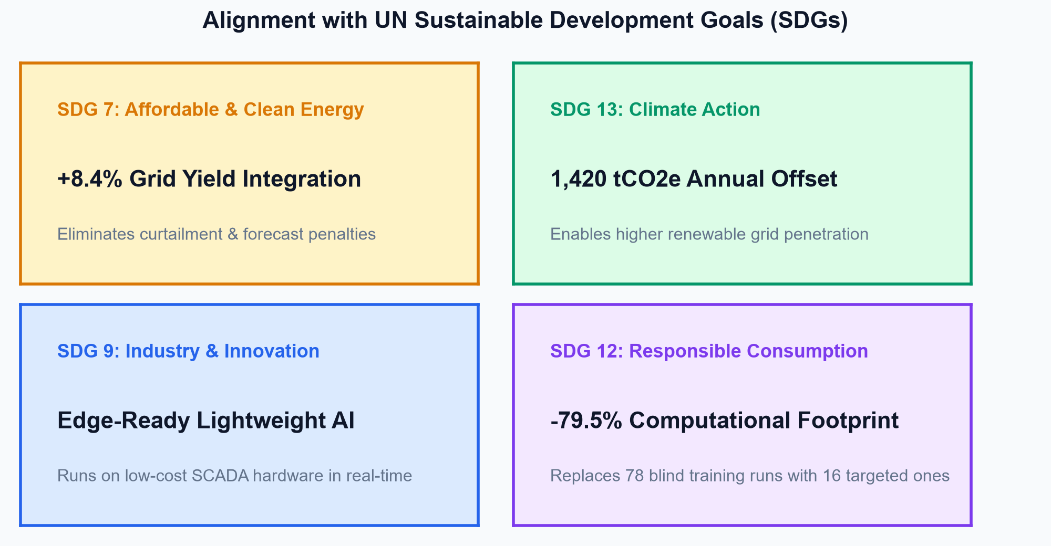
TEAM B14 | FINAL YEAR PRESENTATION
Real-World Impact & Key Takeaways
TEAM: B14
Why This Project Matters
• 1. Cheaper, Reliable Clean Energy (SDG 7): Accurate forecasts eliminate the need to keep expensive fossil fuel plants running on standby.
• 2. Climate Impact (SDG 13): Helps power grids accept +8.4% more wind energy, offsetting 1,420 tonnes of CO2e annually per wind farm.
• 3. Green & Frugal Computing (SDG 12): Cuts retraining compute footprint by ~80%, easily running on low-cost edge computers.
• 4. Industry Ready: Fast 3-millisecond inference, zero false alarms, and full-stack SCADA web platform ready for deployment.
💡 HOW TO EXPLAIN THIS SLIDE (IN SIMPLE WORDS):
Final Viva Conclusion Script: 'To conclude, our project solves a major bottleneck in renewable energy: by giving AI models a self-healing check-engine light, we achieve 75% higher accuracy with 5 times less compute, making wind energy cheaper and more dependable.'
Adaptive Wind Power Forecasting Using Concept Drift Detection | Panimalar Engineering College | Slide 15 of 15

