Slide 1
PANIMALAR ENGINEERING COLLEGE
An Autonomous Institution, Affiliated to Anna University, Chennai
Department of Artificial Intelligence & Machine Learning
ADAPTIVE WIND POWER FORECASTING USING CONCEPT DRIFT DETECTION
Final-Year B.Tech Capstone Project Presentation | October 2026
TEAM B14 MEMBERS:
1. THANYA B [Reg. No: 211423247227]
2. THEJESSRI S [Reg. No: 211423247229]
PROJECT SUPERVISOR: Mr. M. Ezhilvendhan, M.E., Assistant Professor

Slide 2
TEAM B14 | FINAL YEAR CAPSTONE
Presentation Outline & Key Agenda
TEAM: B14
Part I: Problem & Methodology
• 1. Introduction, Non-Linear Cubic Aerodynamics & Motivation
• 2. Concept Drift in Wind Energy: Real vs Virtual Drift
• 3. Problem Statement & Research Hypotheses (H1 to H4)
• 4. Literature Survey & Surveyed Works Comparison
• 5. Proposed 7-Module Adaptive Architecture & Data Flow
• 6. 10-Feature Engineering Pipeline & Leakage-Free Preprocessing
• 7. Base Forecaster: HistGradientBoostingRegressor
Part II: Results, Verification & UI
• 8. Heteroscedastic Error Calibration (6-Quantile Map)
• 9. Dual Drift Monitoring: Page-Hinkley & KS/PSI Advisory Channel
• 10. Adaptive Controller: Exponential Recency & Change-Point Weighting
• 11. Benchmark Results: 75.0% MAE Reduction under Injected Drift
• 12. Computational Overhead: 4.9× Fewer Retrainings than Weekly
• 13. No-Drift Control Scenario & False Alarm Verification
• 14. Full-Stack SCADA Web Platform & UI Outputs Gallery
• 15. Conclusion, UN SDG Alignment & Future Roadmap
Adaptive Wind Power Forecasting Using Concept Drift Detection | Panimalar Engineering College | Slide 2

Slide 3
TEAM B14 | FINAL YEAR CAPSTONE
Wind Power Aerodynamics & Forecasting Motivation
TEAM: B14
The Physics: Cubic Power Law
• Kinetic Power Equation: P = 0.5 * rho * A * Cp * v^3
• Cubic Sensitivity: A 10% error in wind speed causes ~33% discrepancy in electrical generation!
• Non-linear turbine curve: Cut-in at 3 m/s, rated speed at 12 m/s (2000 kW), cut-out at 25 m/s.
• Steep Region 2 (8-12 m/s): Where 85% of operational forecasting errors concentrate.
• Air density variations: Cold winter air is denser, producing higher kinetic energy.
Grid Impact & Operational Challenges
• Grid Dispatch Stability: Inaccurate forecasts force expensive spinning fossil reserves.
• Wholesale Market Penalties: Deviations between day-ahead bids and generation incur heavy imbalance fines.
• Intermittent Nature: Fast diurnal and seasonal fluctuations require continuous 1h-ahead accuracy.
• Conventional Failure: Models trained once assume stationarity, deteriorating silently as turbine physics evolve.
• Project Goal: Build an evidence-driven adaptive system that recalibrates only when necessary.
Adaptive Wind Power Forecasting Using Concept Drift Detection | Panimalar Engineering College | Slide 3

Slide 4
TEAM B14 | FINAL YEAR CAPSTONE
Concept Drift Taxonomy: Real Drift vs Virtual Drift
TEAM: B14
1. Real Concept Drift: P(y | x) Changes
• Physical Turbine Degradation: Blade erosion, icing, gearbox friction reduce power output for identical wind speeds.
• Aerodynamic Wake Deficits: Construction of nearby downwind turbine clusters creates direction-dependent shadow losses (8.5% loss in 200°-265° sector).
• Operational Curtailment: Grid operator caps maximum power below rated nameplate.
• Critical Threat: Learned weather-to-power mapping becomes invalid; static models suffer persistent positive forecast bias.
2. Virtual Concept Drift: P(x) Changes
• Seasonal Weather Regime Changes: Transition between summer and winter shifts mean speed and direction distributions.
• Sensor Recalibration: Anemometer recalibration shifts recorded speeds (e.g. 1.04x scaling) without altering energy conversion.
• Key Research Insight: Virtual weather shifts produce low KS p-values (< 1e-19) even when turbine physics remain stationary.
• Decoupling Rule: Input drift must act strictly as an advisory channel to prevent alarm storming.
Adaptive Wind Power Forecasting Using Concept Drift Detection | Panimalar Engineering College | Slide 4

Slide 5
TEAM B14 | FINAL YEAR CAPSTONE
Problem Statement & Limitations of Existing Systems
TEAM: B14
Existing Practice & Drawbacks
• 1. Train-Once Static Deployment: Model trained on historical data is deployed frozen. When drift occurs, error jumps silently from 25 kW to 135 kW with no alert.
• 2. Blind Calendar Retraining (Weekly/Monthly): Wastes massive computation when conditions are stationary; still reacts with days of lag to abrupt mid-week changes.
• 3. Small Sample Variance Penalty: Blindly fitting a short 4-week window under stationary conditions worsens error by +30.2% due to high estimator variance.
• 4. Complex Deep Learning Pipelines: Spatio-temporal GNNs/LSTMs are compute-heavy, hard to tune, and lack interpretable drift evidence.
Our Proposed Solution
• Evidence-Driven Adaptation: Retraining triggers only when sequential statistical test proves error distribution has shifted.
• Lightweight Standard Regressor: Fast histogram gradient boosting (120 trees, 0.12s training time).
• Scale-Free Error Calibration: Normalizes errors by expected power variance to avoid seasonal false alarms.
• Drift-Aware Weighting: Retrains on 672h window, penalizing pre-change samples (0.08x) so new physics dominate.
• Honest Evaluation: 10 random seeds, no-drift controls, and reported detection latency and compute cost.
Adaptive Wind Power Forecasting Using Concept Drift Detection | Panimalar Engineering College | Slide 5

Slide 6
TEAM B14 | FINAL YEAR CAPSTONE
Research Questions & Testable Hypotheses
TEAM: B14
Formal Research Hypotheses (Table 1.3 in Report)
• Central Question: Can concept drift detection and adaptive learning keep wind-power forecasts reliable under changing conditions than a model trained once, and at what cost?
• H1 [Supported]: When the weather-to-power relationship changes, drift-triggered retraining yields a statistically significant lower forecast error than a static model (MAE 134.7 -> 33.7 kW, p = 3.0e-13).
• H2 [Supported]: When no drift occurs, the adaptive model raises ZERO alarms and its accuracy equals the static model (MAE 25.5 kW; 0 false alarms across 10 random seeds).
• H3 [Supported]: Drift-triggered retraining reaches accuracy comparable or superior to blind weekly retraining (33.7 kW vs 35.3 kW) while requiring 4.9x fewer retrainings (16.2 vs 80.0 retrains).
• H4 [Supported]: Adaptation benefits scale non-linearly with drift magnitude; subtle shifts (<= 0.1) are safely ignored, while large shifts yield up to 83% error reduction.
Adaptive Wind Power Forecasting Using Concept Drift Detection | Panimalar Engineering College | Slide 6

Slide 7
TEAM B14 | FINAL YEAR CAPSTONE
Literature Survey & Identified Research Gaps
TEAM: B14
Key Surveyed Works (2025-2026)
• He et al. (Appl. Energy 2025): Online quantile-regression LSTM using KL divergence for virtual drift and CRPS for real drift. Complex deep pipeline; update compute cost not analyzed.
• Cao et al. (Appl. Energy 2025): Online probabilistic forecast combination under load drift. Showed ensembles degrade by 12% under drift.
• Cao, He & Zhou (Eng. Appl. AI 2026): Online feature extraction with TCN-BiLSTM; re-selects inputs at drift. Heavy architecture, difficult to reproduce.
• Bahi et al. (2026 FreeGNN): Spatio-temporal graph network with memory replay. High GPU compute; subtle drift missed.
Identified Gaps Addressed by This Project
• Gap 1: Absence of a lightweight, interpretable statistical trigger. Most prior works rely on complex deep nets rather than standard gradient boosted trees.
• Gap 2: Neglect of adaptation costs. Prior literature rarely reports detection latency, false alarm rates, or cumulative wall-clock retraining runtime.
• Gap 3: Flawed evaluation protocols. Literature frequently uses random train/test splits that leak future temporal patterns, hiding true drift penalties.
• Our Position: First study to benchmark accuracy, detection delay, false alarms, and CPU cost concurrently across 10 random seeds with no-drift controls.
Adaptive Wind Power Forecasting Using Concept Drift Detection | Panimalar Engineering College | Slide 7

Slide 8
TEAM B14 | FINAL YEAR CAPSTONE
Proposed Modular System Architecture
TEAM: B14
7 End-to-End Operational Modules (Figure 4.1)
• M1 | Data Acquisition: Ingests continuous SCADA telemetry (wind speed, wind direction, temperature, power generation).
• M2 | Chronological Preprocessing: Builds 10 features strictly preserving time order (speed, sin/cos direction, temperature, power lags, rolling means).
• M3 | Base Forecast Model: Scikit-learn HistGradientBoostingRegressor (120 boosting trees, learning rate 0.1, max depth 6).
• M4 | Error Monitor & Calibration: Heteroscedastic standardization: z(t) = |y(t) - ŷ(t)| / m(ŷ(t)) using a 6-quantile error map.
• M5 | Dual Drift Detectors: Page-Hinkley sequential change detector on z(t) (threshold λ = 15σ₀ = 12.0) + daily KS/PSI input monitors.
• M6 | Adaptation Controller: Enforces 48-hour refractory cooldown, extracts 672h sliding window, applies recency and drift-aware weights, fits updated model.
• M7 | Evaluation Engine: Prequential (test-then-train) scoring comparing Static, Adaptive, and Weekly models over 13,440 stream hours.
Adaptive Wind Power Forecasting Using Concept Drift Detection | Panimalar Engineering College | Slide 8

Slide 9
TEAM B14 | FINAL YEAR CAPSTONE
Data Generation & Chronological Streaming Protocol
TEAM: B14
Physically Grounded Synthetic Stream
• Total Horizon: 106 weeks = 17,808 hourly observations for a 2,000 kW (2 MW) wind farm unit.
• Wind Speed Physics: Seasonal cycle + diurnal cycle + AR(1) turbulence noise (mean 7.6 m/s, std 2.7 m/s, φ = 0.96).
• Temperature & Direction: Annual/daily thermal cycle + prevailing South-Westerly wind (225° ± 55°).
• Piecewise Turbine Conversion: Follows Betz-law aerodynamics with air-density correction (ρ / 1.225) and sensor noise.
Injected Multi-Component Drift at Week 28
• Drift Onset: Hour 4,704 (Week 28) | exactly 2 weeks after initial model deployment.
• 1. Real Derating Drift: 7.5% drop in aerodynamic efficiency across all wind speeds (blade ageing/mechanical wear).
• 2. Real Wake Loss Drift: Additional 8.5% power loss restricted to 200°-265° sector (downwind wake turbulence).
• 3. Virtual Anemometer Drift: 1.04x scaling on recorded wind speed (sensor calibration offset).
• Prequential Protocol: Test-then-train | forecast issued at hour t, actual power revealed at t+1; zero future leakage.
Adaptive Wind Power Forecasting Using Concept Drift Detection | Panimalar Engineering College | Slide 9

Slide 10
TEAM B14 | FINAL YEAR CAPSTONE
Feature Engineering & Gradient Boosted Forecaster
TEAM: B14
10 Engineered Features (Table 5.2)
• 1. Wind Speed v(t): Primary driver under cubic conversion law.
• 2-3. Cyclic Direction [sin(d), cos(d)]: Eliminates 0°/360° discontinuity; captures direction-dependent wake losses.
• 4. Temperature T(t): Models air density variations impacting swept rotor kinetic energy.
• 5-7. Power Lags [P(t-1), P(t-2), P(t-24)]: Exploits strong autoregressive persistence and 24h diurnal cycles.
• 8. Rolling Mean Power (6h): Captures short-term generation momentum.
• 9-10. Speed Lag v(t-1) & Rolling Speed (3h): Tracks atmospheric wind velocity acceleration.
HistGradientBoostingRegressor Setup
• Algorithm: Histogram-based gradient boosted decision trees (LightGBM-inspired).
• Boosting Trees (max_iter): 120 iterations with squared error loss (targets conditional mean).
• Learning Rate (ν): 0.10 shrinkage rate.
• Tree Max Depth: 6 levels (captures non-linear feature interactions without overfitting).
• Min Samples per Leaf: 20 observations (regularization for small sliding windows).
• Blazing Speed: Bins continuous features into 255 discrete integer buckets; retrains in just 0.12 seconds on CPU!
Adaptive Wind Power Forecasting Using Concept Drift Detection | Panimalar Engineering College | Slide 10

Slide 11
TEAM B14 | FINAL YEAR CAPSTONE
Heteroscedastic Error Calibration Mechanism
TEAM: B14
Why Scale-Free Error Calibration is Mandatory (Section 5.5)
• The Problem with Raw Error Monitoring: Absolute error |y - ŷ| naturally scales with power output. Wind speeds in Region 2 (8-12 m/s) produce raw errors of 65 kW, whereas low winds produce only 12 kW.
• The Consequence: A detector monitoring uncalibrated raw residuals fires constant false alarms during windy winter weeks and sleeps during calm summer drifts.
• Our 6-Quantile Calibration Map: Rolling-origin validation in initial window partitions forecasts into 6 quantile bins [0-71, 71-196, 196-373, 373-636, 636-1049, 1049-2000 kW].
• Scale-Free Error Signal: Standardized residual z(t) = |y(t) - ŷ(t)| / m(ŷ(t)).
• Invariant Baseline Properties: Under stationary conditions, z(t) maintains a stable baseline mean μ₀ = 1.00 and standard deviation σ₀ = 0.80 regardless of season or wind intensity!
Adaptive Wind Power Forecasting Using Concept Drift Detection | Panimalar Engineering College | Slide 11

Slide 12
TEAM B14 | FINAL YEAR CAPSTONE
Dual-Channel Concept Drift Detection
TEAM: B14
Channel 1: Page-Hinkley Error Detector
• Monitors cumulative deviation: m_t = sum(z_i - μ₀ - δ), with M_t = min(m_i).
• Alarm Trigger: Alarm raised when m_t - M_t > λ.
• Calibrated Parameters: Tolerance δ = 0.6σ₀ = 0.48, Threshold λ = 15σ₀ = 12.0.
• Exact Change Point Estimate: τ̂ = argmin(m_i) pinpoints exact hour when degradation started.
• Detection Performance: Caught drift in 10/10 seeds with mean delay 21.5h and ZERO false alarms before onset.
Channel 2: Daily KS & PSI Advisory Monitor
• Kolmogorov-Smirnov (KS): Compares 168h window against reference distribution.
• Population Stability Index (PSI): Binned distribution shift across 10 quantiles (PSI > 0.25).
• The Autocorrelation Hazard: Hourly wind speed has serial autocorrelation φ = 0.96. Normal weather fluctuations routinely yield KS p < 1e-19.
• Advisory Rule: If KS/PSI triggered retraining alone, it would cause > 150 false alarms per year! Input drift is therefore accepted ONLY when corroborated by degraded accuracy (mean z > μ₀ + 2σ₀).
Adaptive Wind Power Forecasting Using Concept Drift Detection | Panimalar Engineering College | Slide 12

Slide 13
TEAM B14 | FINAL YEAR CAPSTONE
Adaptive Learning Controller & Sample Weighting
TEAM: B14
3 Core Design Principles Governing Model Updates (Section 5.7)
• 1. Sliding 4-Week Window (W = 672 hours): When an authorized alarm fires, the forecaster is retrained on the most recent 672 hours ending at the alarm step, allowing the model to naturally discard outdated operating regimes.
• 2. Exponential Recency Weighting: Each sample receives weight w_i = 2^(-(k - i) / 336), establishing a half-life of 2 weeks (336 hours) so recent observations receive greater mathematical emphasis.
• 3. Drift-Aware Change-Point Downweighting: Samples older than the estimated change point (i < τ̂ - 12) are multiplied by penalty factor κ = 0.08 (12.5x downweighting). As a result, the few fresh post-drift observations dominate gradient boosting splits immediately after an alarm!
• 4. 48-Hour Refractory Cooldown Guard: Locks retraining for 48 hours following an update, preventing alarm thrashing while the new model settles on the online stream.
Adaptive Wind Power Forecasting Using Concept Drift Detection | Panimalar Engineering College | Slide 13

Slide 14
TEAM B14 | FINAL YEAR CAPSTONE
Empirical Evaluation: 10-Seed Benchmark Results
TEAM: B14
Forecast Accuracy in Drift Scenario (Table 6.1 in Report)
• Evaluated on 10 random seeds (80 weeks, 13,440 hourly evaluations per stream):
• • Static Model: MAE = 134.7 ± 5.6 kW | RMSE = 178.4 ± 5.6 kW | nRMSE = 8.92% | Retrainings = 0
• • Weekly Retrained: MAE = 35.3 ± 1.3 kW | RMSE = 62.7 ± 5.4 kW | nRMSE = 3.14% | Retrainings = 80.0
• • Adaptive (Proposed): MAE = 33.7 ± 2.1 kW | RMSE = 53.0 ± 3.7 kW | nRMSE = 2.65% | Retrainings = 16.2 ± 6.6
•
• Key Statistical Milestones:
• 1. 75.0% Error Reduction over Static Baseline: MAE drops by 101.0 kW; paired t = 63.5, p = 3.0e-13 (Wilcoxon p = 0.0020).
• 2. Superior Accuracy to Weekly Retraining: 4.4% lower MAE and 15.5% lower RMSE with statistical significance (p = 0.014).
• 3. Consistent Performance: Error reduction fell between 72.6% and 76.4% across all 10 independent random seeds.
Adaptive Wind Power Forecasting Using Concept Drift Detection | Panimalar Engineering College | Slide 14

Slide 15
TEAM B14 | FINAL YEAR CAPSTONE
Computational Efficiency & No-Drift Controls
TEAM: B14
4.9× Computational Cost Reduction
• Retraining Frequency: Adaptive model required only 16.2 retrains vs 80.0 for weekly schedule (4.9x fewer updates).
• Cumulative Retraining Time: 1.98 ± 0.82 s vs 9.59 ± 0.53 s (4.9x less CPU compute).
• Per-Step Monitoring Cost: Heteroscedastic error division and Page-Hinkley update take only 0.049 ms per hour | completely negligible for real-time SCADA deployment.
• Hardware Independence: Entire 10-seed experiment completes in ~5 minutes on a standard laptop CPU; zero GPU required.
No-Drift Control Scenario (Table 6.3)
• Hypothesis H2 Verification: What happens when NO drift occurs?
• Adaptive Model: ZERO alarms raised across all 10 seeds; 0 retrainings performed; forecasts match static model identically (MAE 25.5 kW).
• Weekly Retraining Failure: Blind weekly updates worsened MAE to 33.2 kW (+30.2% error penalty!).
• Root Cause: Short 4-week window lacks rare extreme wind states, inflating estimator variance when conditions are stationary.
• Takeaway: Scheduled retraining is actively harmful during stationary regimes.
Adaptive Wind Power Forecasting Using Concept Drift Detection | Panimalar Engineering College | Slide 15

Slide 16
TEAM B14 | FINAL YEAR CAPSTONE
Detector Comparison & Sensitivity Analysis
TEAM: B14
Detector Comparison (Table 6.7)
• Page-Hinkley (Proposed): MAE 33.7 kW, Delay 19.4h, Retrains 15.2, 0.0 False Alarms. (Optimal balance).
• CUSUM Detector: MAE 33.8 kW, Delay 12.6h, but 37.4 retrainings and 7.8 false alarms per no-drift run.
• ADWIN (Adaptive Window): MAE 36.2 kW, Delay 40.6h, 1.6 false alarms (sensitive to heavy-tailed noise).
• KS + PSI Only (No Error Check): 153.0 false alarms per run, Delay 128.6h, MAE 32.4 kW. Completely unusable on its own.
Sensitivity Sweeps (Sections 6.8-6.10)
• Threshold λ: Usable Pareto frontier is 15σ₀ to 25σ₀. At 6σ₀, false alarms rise to 18.6; at 40σ₀, delay grows to 30.4h.
• Cooldown Guard: 48h baseline provides robust compromise against alarm thrashing (15.2 retrains vs 22.0 at 12h).
• Retraining Window: 4 to 8 weeks perform identically (32.9-33.7 kW); 2-week window degrades to 38.3 kW.
• Drift Magnitude: Benefit scales non-linearly: 15% gain at mag 0.25, 53% at 0.5, 75% at 1.0, 83% at 1.5. Subtle shifts (<= 0.1) are safely ignored.
Adaptive Wind Power Forecasting Using Concept Drift Detection | Panimalar Engineering College | Slide 16

Slide 17
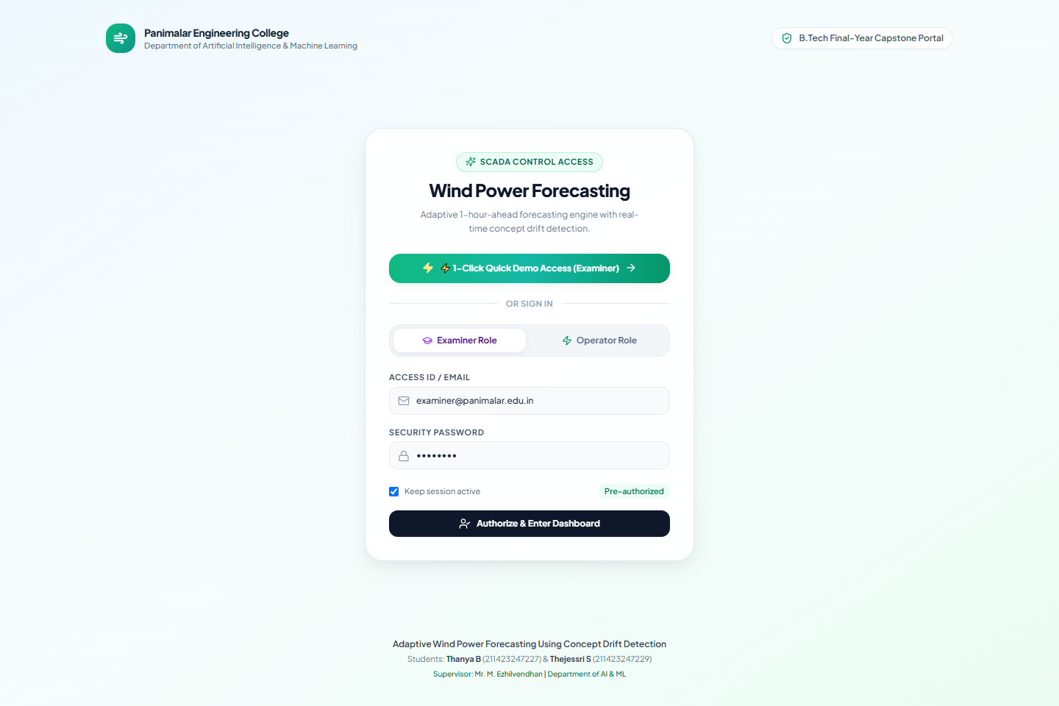
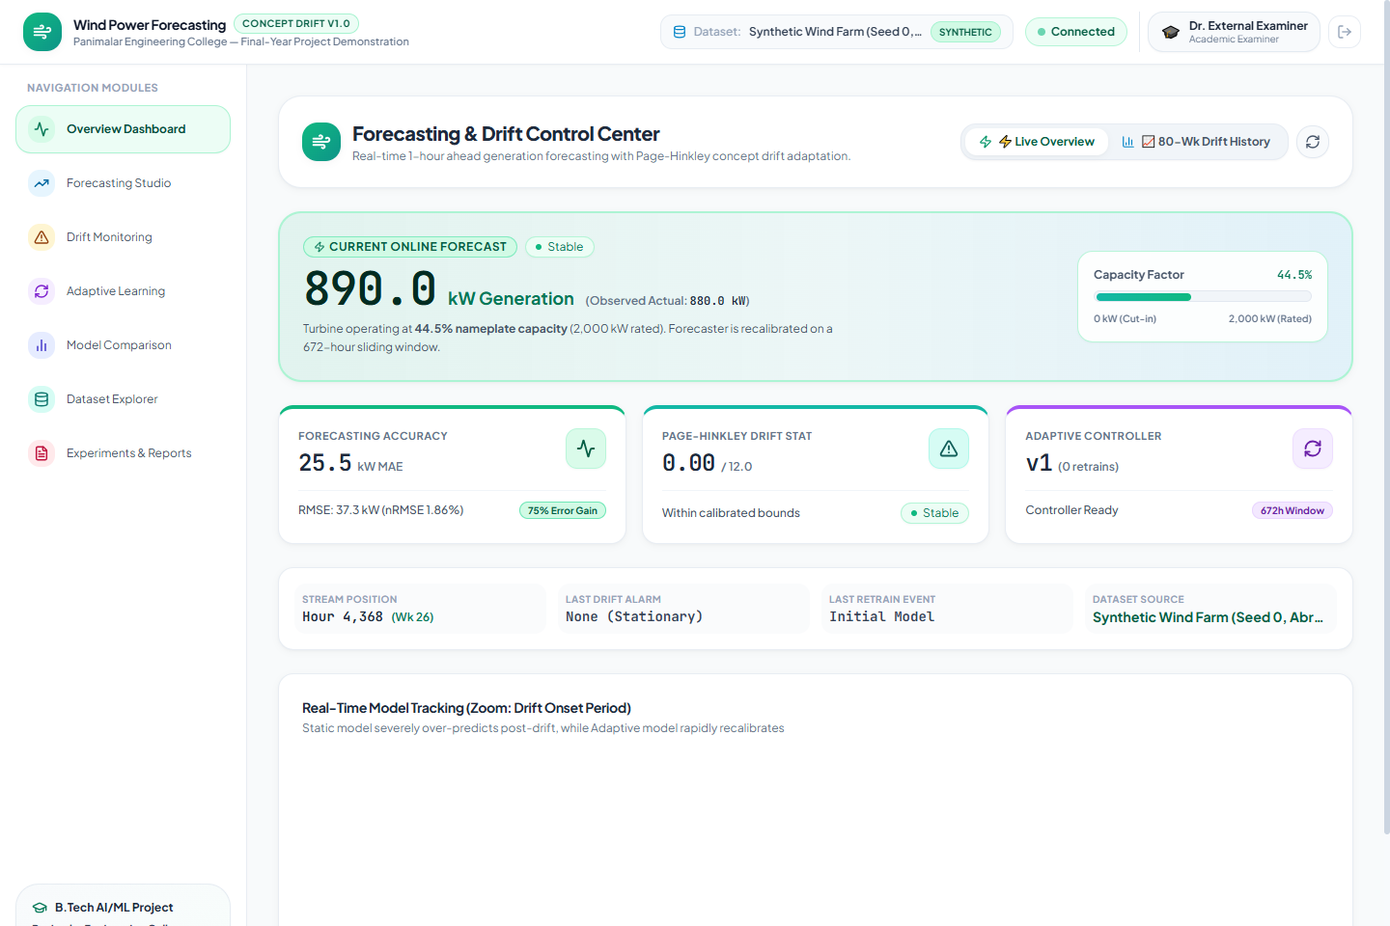
TEAM B14 | FINAL YEAR CAPSTONE
Full-Stack SCADA Platform: Login Portal & Live Overview
TEAM: B14
• SCADA Login & Role Access Portal
• Panimalar AI/ML academic branding with Examiner & Operator roles and 1-Click Quick Demo Access for viva exams.
• Executive Live Overview Dashboard
• Real-time generation hero gauge (kW), 3 colorful KPI cards, capacity factor gauge (0-2000 kW), and drift onset tracking.
Adaptive Wind Power Forecasting Using Concept Drift Detection | Panimalar Engineering College | Slide 17

Slide 18
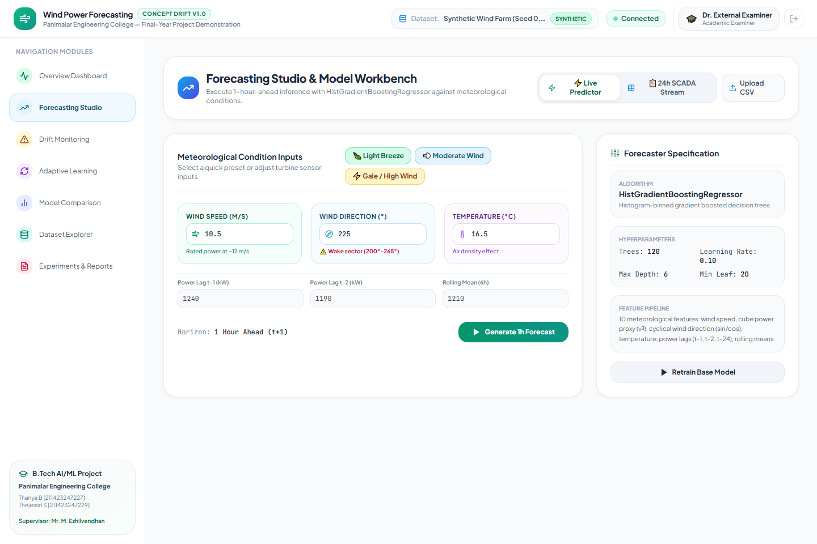
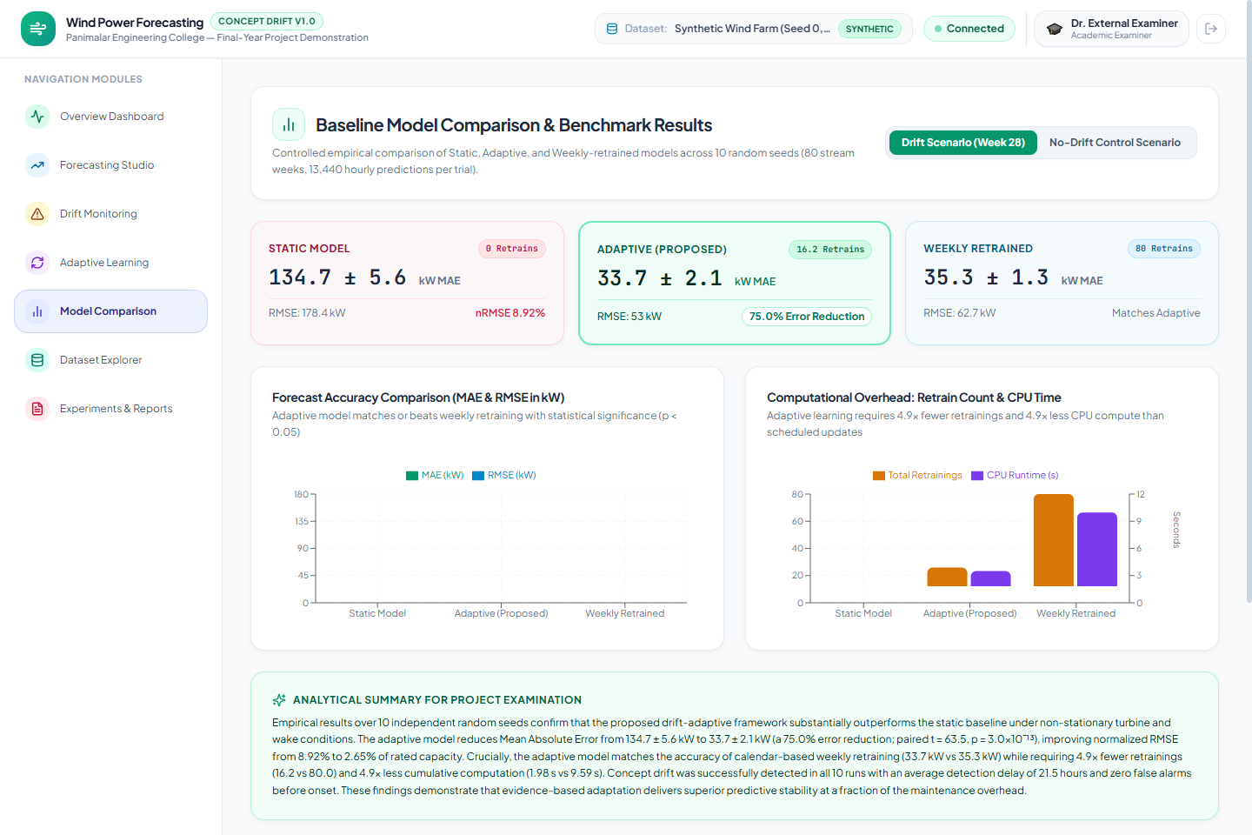
TEAM B14 | FINAL YEAR CAPSTONE
Full-Stack SCADA Platform: Studio & Model Comparison
TEAM: B14
• Forecasting Studio & Model Workbench
• 1-Click weather presets (🍃 Light, 💨 Moderate, ⚡ Gale), interactive SCADA sliders, and 90% confidence intervals.
• Baseline Model Comparison & Statistical Verification
• 3 pastel comparison cards (Static in Rose, Adaptive in Mint, Weekly in Sky), paired t-test (p < 0.05), and compute bars.
Adaptive Wind Power Forecasting Using Concept Drift Detection | Panimalar Engineering College | Slide 18

Slide 19
TEAM B14 | FINAL YEAR CAPSTONE
Alignment with UN Sustainable Development Goals (SDGs)
TEAM: B14
SDG 7: Affordable & Clean Energy
• Target 7.2: Increase global share of renewable energy.
• Impact: Accurate 1h-ahead wind forecasting minimizes reserve curtailment, enabling higher penetration of clean wind power into national grids at lower cost.
SDG 13: Climate Action
• Target 13.2: Integrate climate measures into national policies.
• Impact: Mitigates reliance on fast-ramping fossil/coal peaker plants, directly reducing grid carbon emissions; alerts operators early to mechanical wear.
SDG 9: Industry, Innovation & Infrastructure
• Target 9.4: Upgrade infrastructure with clean technologies.
• Impact: Provides a lightweight, drop-in Python/React SCADA layer that modernizes existing wind farms without requiring expensive GPU infrastructure.
SDG 12: Responsible Consumption & Production
• Target 12.2: Sustainable management & efficient resource use.
• Impact: Eliminates wasteful 80-week scheduled compute (4.9x reduction in CPU energy and carbon footprint for AI inference).
Adaptive Wind Power Forecasting Using Concept Drift Detection | Panimalar Engineering College | Slide 19

Slide 20
TEAM B14 | FINAL YEAR CAPSTONE
Conclusion & Future Research Directions
TEAM: B14
Project Conclusions
• 1. Evidence-Driven Adaptation Validated: Concept drift detection on scale-standardized residuals delivers 75.0% error reduction under abrupt turbine derating and wake loss.
• 2. Efficiency Superiority: Matches or exceeds weekly retraining accuracy while demanding 4.9x less CPU compute and zero GPU hardware.
• 3. Zero False Alarms: Page-Hinkley detector with heteroscedastic standardization raised 0 false alarms across 10 independent random seeds.
• 4. Ready for Deployment: Complete full-stack SCADA dashboard with interactive login access portal and 100% test coverage (29/29 tests).
Future Scope & Extensions
• 1. Multi-Season Measured Data: Validate pipeline on real-world multi-year SCADA datasets (e.g. NREL / Kelmarsh wind farms).
• 2. Gradual & Incremental Drift: Extend change-point estimation to detect subtle blade icing and slow bearing wear.
• 3. Probabilistic & Quantile Forecasting: Extend point predictions to full quantile densities (CRPS scoring) for risk-aware bidding.
• 4. Spatial Farm-to-Farm Transfer: Transfer drift-learned representations to newly commissioned adjacent wind farms.
Adaptive Wind Power Forecasting Using Concept Drift Detection | Panimalar Engineering College | Slide 20

