Slide 1
FarmConnect: Direct Farmer-to-Consumer C2C Marketplace
Submitted by: THANYA SUSILA N B (24SBCS108) PSGR Krishnammal College for Women, Coimbatore

Slide 2

2. Internship Problem Statement
• Middlemen Exploitation: Commission agents control traditional APMC mandis, taking over 60% of crop value.
• Low Farmer Revenue: Local growers struggle with low profit margins and delayed payments.
• Inflation for Buyers: Consumers pay high retail markups (~15% to 20% extra) for stale produce.
• Zero Traceability: No reliable way for consumers to check organic credentials or crop origins.
• Solution: Build a direct-trade platform bypassing all intermediaries.

Slide 3

3. Organization Profile
• Project Nature: Self-initiated incubation project mentored by the Department of Computer Science.
• Affiliation: Department of Computer Science, PSGR Krishnammal College for Women, Coimbatore.
• Operational Scope: Empowering rural farmers via digital trading tools, localized systems, and transparency passports.
• Core Vision: Bridging the digital divide for growers in Tamil Nadu, starting with Madurai & Coimbatore agricultural grids.

Slide 4
4. Internship Objectives
• Direct Trade Enablement: Establish a secure C2C marketplace grid connecting farmers and buyers directly.
• Language Inclusivity: Code a dynamic localization switcher supporting English and Tamil (தமிழ்).
• Financial Transparency: Implement an AI-driven pricing margins calculator to compute savings in real time.
• Traceability Verification: Integrate dynamic QR codes linking to farm GPS and soil pH health metrics.

Slide 5
5. Internship Domain
• Core Field: Full-Stack Web Development & Agri-Tech Systems.
• Database Focus: Relational database normalization, constraints, schemas, and API bindings.
• Architecture Model: Single-Page Application (SPA) utilizing client-side hash routing.
• Security Focus: Row Level Security (RLS) policies for user authentication and order integrity.

Slide 6
6. System / Technology Specification
• Front End: HTML5 (Semantic elements), CSS3 (Custom variables, glassmorphic layout, keyframe animations).
• Controller Logic: Vanilla ES6 JavaScript (Object-Oriented state management).
• Backend Database: Supabase Cloud Host (PostgreSQL).
• APIs & Libraries: QRServer API, Lucide Icon Vector CDN.
• Development Server: Python HTTP server, tested on localhost:8000.

Slide 7
7. About Front End and Back End
• Frontend Architecture: Lightweight Single-Page App utilizing hash-routing view controllers.
• Backend Architecture: Hosted Supabase cloud instance serving PostgreSQL tables.
• Database Connectivity: Unified client wrapper db.js dynamically checks credentials.
• Resilient Offline Fallback: If cloud connection fails or is unconfigured, the app automatically switches to local browser LocalStorage, keeping the application unbreakable.

Slide 8
8. Internship Workflow
• Week 1-2: Requirement gathering, user persona analysis, and local prototyping.
• Week 3-4: UI design, green styling tokens, and client-side routing modules.
• Week 5-6: Supabase Postgres database design, key mappings, and table relations setup.
• Week 7-8: Wrote English-Tamil localization engine and integrated AI price profit calculator.
• Week 9-10: Programmed Digital Farm Passports, dynamic QR codes, testing, and report writing.

Slide 9
9. Tasks / Activities Completed
• Responsive Home & Shop Grid layouts built with pure CSS grids and flexbox.
• Implemented complete bilingual translation dictionary mapping static text and product attributes.
• Set up Supabase tables (Farmers, Consumers, Products, Orders) with primary/foreign key relations.
• Integrated QRServer API to render traceable crop codes dynamically based on harvest batch IDs.
• Designed checkout validations preventing foreign key errors and order mismatches.

Slide 10
10. Database Details
• Farmers Table: farmer_id (PK), name, farm_name, contact_number, location, products.
1
• Consumers Table: consumer_id (PK), name, email, contact_number, Address.
2
• Products Table: product_id (PK), product_name, category, price, quantity, farmer_id (FK), description, harvest_date, image_url.
3
• Orders Table: order_id (PK), customer_id (FK), product_id (FK), quantity, total_price, order_status.
4
• Structural Cardinality: 1 Farmer lists N Products (1:N); 1 Consumer places N Orders (1:N).
5

Slide 11
11. System Architecture
• Client Interface (Browser) -> Controller (app.js) -> Database Client Router (db.js).
• If Online (Status Green): Communicates via fetch requests directly to Supabase Cloud PostgreSQL DB.
• If Offline (Status Red): Switches database router destination to LocalStorage Mock DB.
• Advantage: Allows presentation and evaluation to proceed successfully in any network environment.

Slide 12
12. Modules
• Home Dashboard: Statistics counter, featured crops, sliding recent platform activities feed.
• Marketplace Grid: Search crop records and filter by Fruits, Vegetables, Grains, Organic.
• Digital Passport: QR crop trace containing soil pH health ratings and farm GPS locations.
• AI Price Calculator: Interactive math form showing Mandi middlemen prices vs farmer earnings.
• Invoicing & Tracking: 4-stage shipment delivery timeline and print-ready GST invoices.

Slide 13
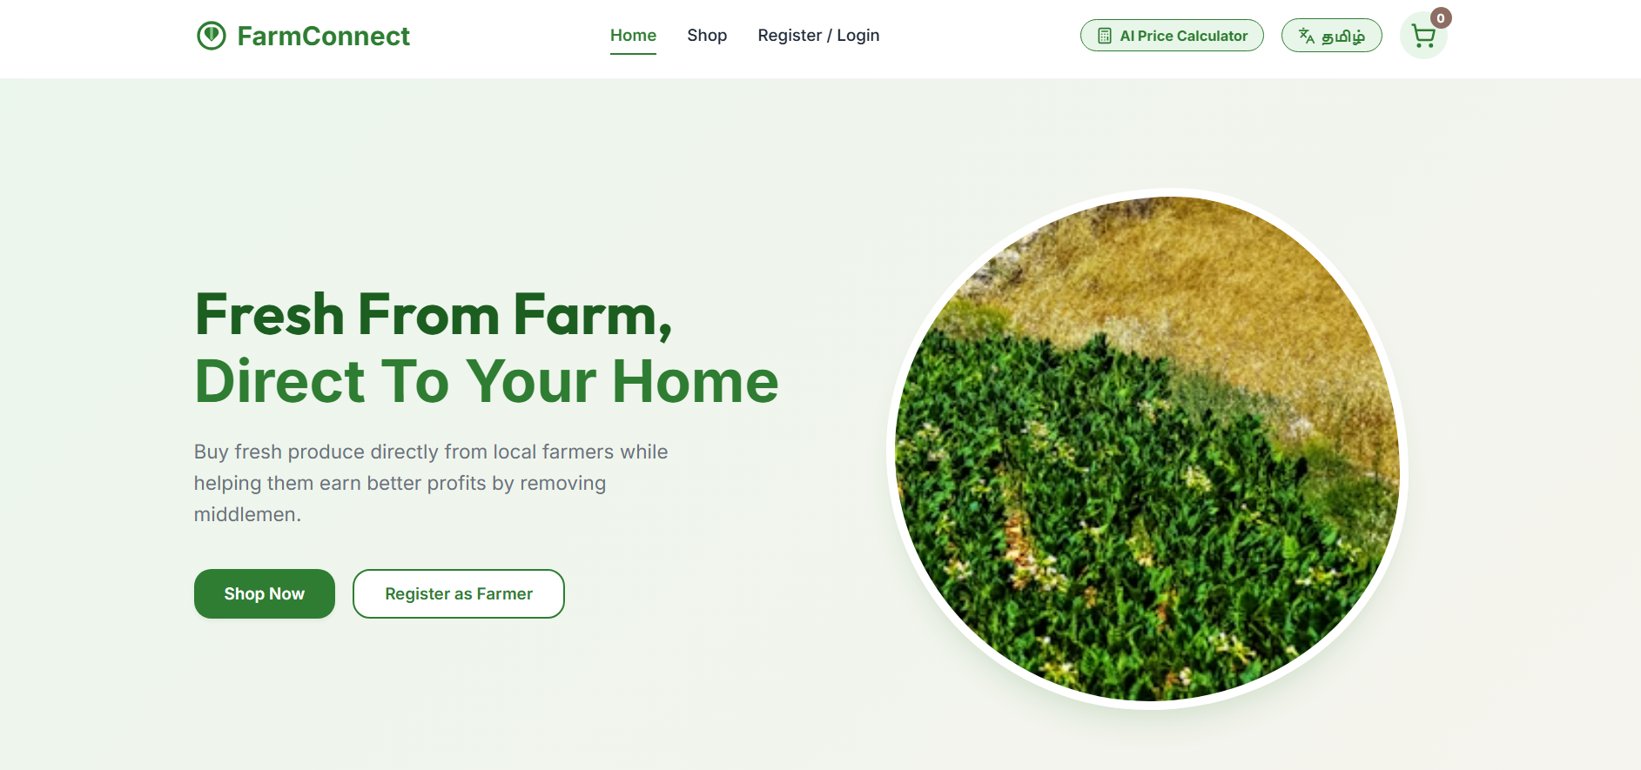
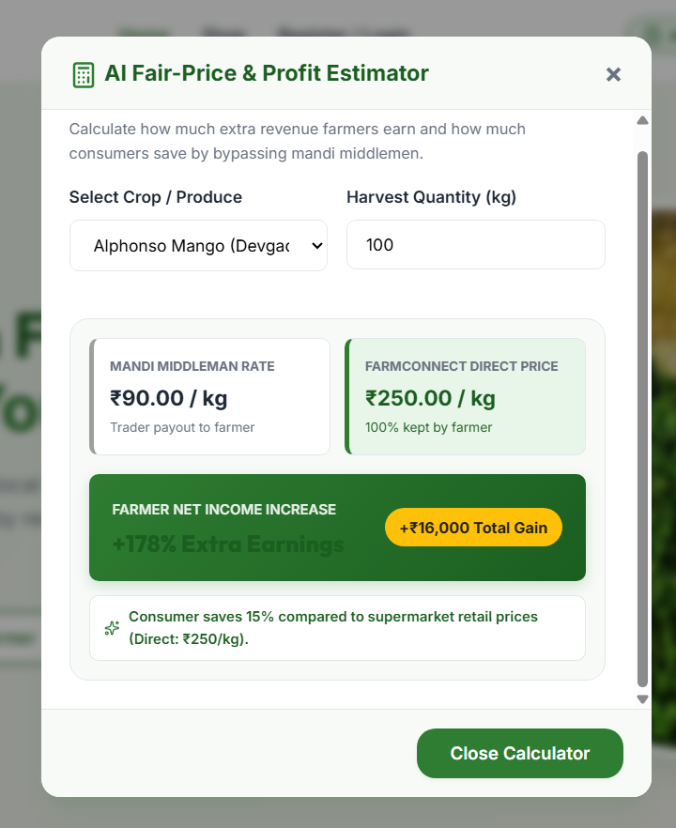
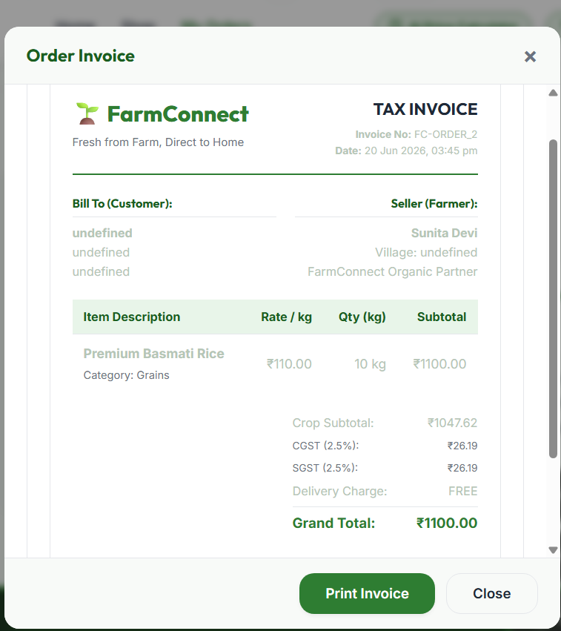
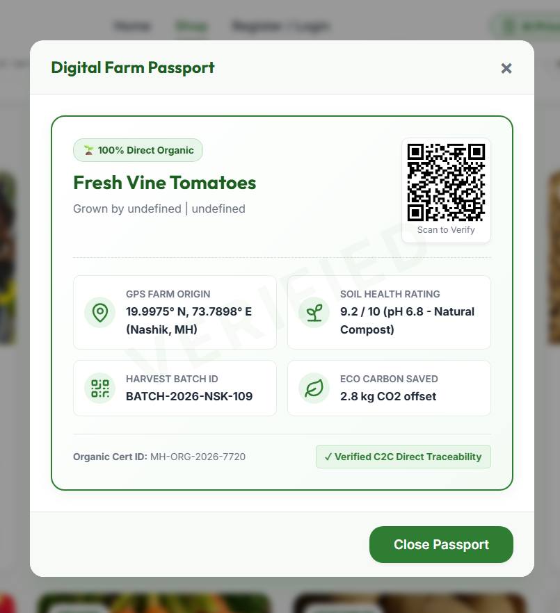
13. Screenshots / Evidence

Slide 14
14. Skills, Challenges & Learning Outcomes
• Core Skills Gained: Backend Cloud integration, responsive web layouts, database normalization.
• Technical Challenge: Handling database relational mismatches when offline local storage users tried checking out on a live Supabase database instance.
• Solution: Coded robust validations checking for customer registration status before permitting checkouts.
• Learning Outcome: Learned full-stack C2C application lifecycle deployment and offline resilience design.

Slide 15
15. Future Plan & Conclusion
• Future Integration: Add Razorpay Payment Gateways and SMS alert notifications via Twilio API. • Logistics Upgrade: Integrate Google Maps Route Optimization API for direct farm shipping coordinates. • Conclusion: FarmConnect successfully bridges the gap between rural farmers and consumers. It demonstrates how simple full-stack web technologies can enhance rural profits by +185% while lowering costs for buyers.
Thank You!

