Slide 1
SPM FINAL PRESENTATION
G3T8
Andrew, Jiahui, Jiaxin, Zhenhui, Thao

Slide 2

Content
Schedule
Bug Metrics
Git
Others

Slide 3
Schedule

Slide 4
Schedule - Planned vs Actual
Iteration | Main function | Planned hour | Actual hour | Explanation
1 | Login functions Bootstrap | 64.5 | 76.1 | Longer debugging session than expected
2 | Bidding functions | 60.0 | 48.5 | Didn’t do testing and debugging as planned
3 | Clearing logics | 54.5 | 53.5 | We followed the planned schedule and things went smoothly
4 | Debugging and testing | 32 | 33.25 | We followed the planned schedule and things went smoothly
Schedule
Bug Metrics
Git
Others

Slide 5
Schedule
Did you drop any functionalities, implement any additional functionalities, and/or use any frameworks or external libraries?
NO
Schedule
Bug Metrics
Git
Others

Slide 6
Breakdown of work - Pair Programming
Weeks | PP 1 | PP 2 | PP 3
5-7 | Zhenhui & Jiaxin | Thao & Jiahui
7-9 | Zhenhui & Jiahui | Jiaxin & Andrew | Thao & Andrew
9-11 | Jiaxin & Zhenhui | Andrew & Thao
11-13 | Zhenhui & Thao | Jiahui & Andrew
Schedule
Bug Metrics
Git
Others

Slide 7
Breakdown of work - Programming tasks allocation
Andrew | Jiahui | Jiaxin | Zhenhui | Thao
Starting and clearing rounds feature View bidding result JSON web services | Admin feature Bid for a section feature Drop bid feature | Login feature Starting and clearing rounds feature Drop section feature | Login feature Bid for a section feature Drop bid feature Drop section feature Bid status (JSON) | Admin feature View bidding result JSON web services
Schedule
Bug Metrics
Git
Others

Slide 8
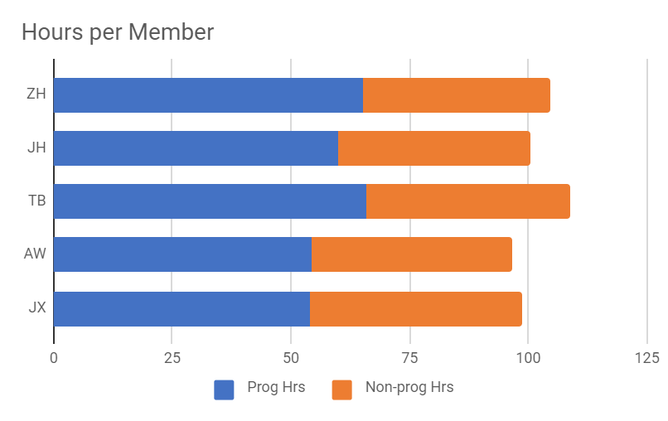
Breakdown of work
 | Jiaxin | Andrew | Thao | Jiahui | Zhenhui
Programming hours | 54 | 54.5 | 65.85 | 60.1 | 65.25
Non-programming hours | 44.75 | 42 | 43 | 40.5 | 39.5
Schedule
Bug Metrics
Git
Others

Slide 9
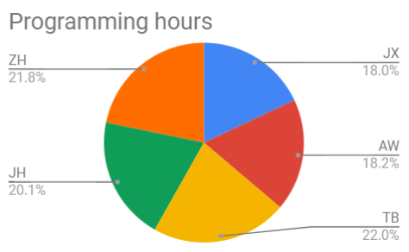
Breakdown of work - Programming hours
Schedule
Bug Metrics
Git
Others

Slide 10
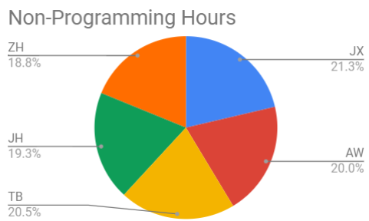
Breakdown of work - Non-Programming hours
Schedule
Bug Metrics
Git
Others

Slide 11
Schedule - Challenges
Problem: Did not update DUs on time
Solution: Remind each other and remind the project manager for the update
Problem: Unplanned situation
Solution: Ask the project manager to arrange for sessions when we face unexpected problems
Problem: Unable to finish and test the feature on time
Solution: Used iterative time boxing to push the feature to the next iteration
Schedule
Bug Metrics
Git
Others

Slide 12
Bug Metrics

Slide 13
Bug metric - Values over time
*For iteration 2, there is no recorded bug because we did not do testing
Iteration | 1 | 3 | 4
Bug metric points | 51 | 37 | 58
Schedule
Bug Metrics
Git
Others

Slide 14
Bug metrics - Usage
We used the bug metrics to help us to identify the severity of the bug.
When the accumulated bug metric points exceeds 10, we will ask the PM to arrange for a debugging session
Schedule
Bug Metrics
Git
Others

Slide 15
Bug metric - Follow up actions
Number | Bug | Severity | Follow up actions
1 | Failed opening required autoload.php breakdown for login page | High | Asked for help from the other PP group
2 | Unexpected parsed error for one member’s laptop when importing sampledata.zip in the bootstrap | High | WAMP is outdated and the latest version was downloaded
3 | Require_once(Bid.php) is not existing in the project\app\login page\model\common.php | High | Our file structure is messy and the autoload function in login common.php does not contain bid.php which is contained in the include.php in another folder. We created a Bid.php in project\app\login page\model
Schedule
Bug Metrics
Git
Others

Slide 16
Bug metrics - Challenges
Always face conflict while editing the bug metric because team members will edit at the same time
For some of the bugs, we misinterpreted the severity of the bug
Schedule
Bug Metrics
Git
Others

Slide 17
GIT

Slide 18
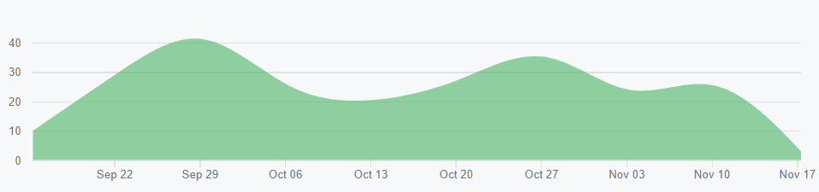
Git
Overall commitment
Schedule
Bug Metrics
Git
Others

Slide 19
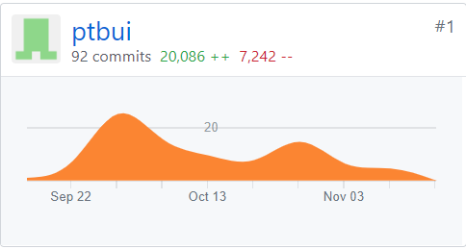
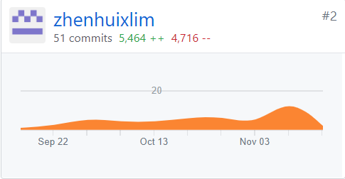
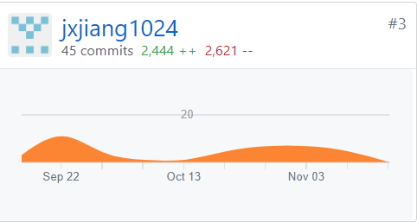
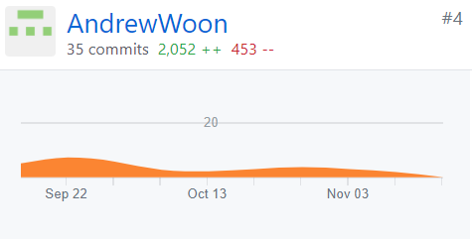
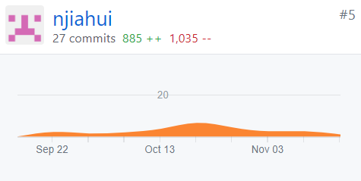
Git - Breakdown
Thao
Zhen hui
Jia Xin
Andrew
Jia Hui
Schedule
Bug Metrics
Git
Others

Slide 20
Others

Slide 21


Takeaways
Adapt to changes (rotation of PP, client requirements)
Manage unexpected situation (debugging) and overcome challenges
Importance of scheduling in project
Useful tools - Github, Scheduling, Minutes, AWS
Communication is key
Team spirit is very important
Have fun !
Schedule
Bug Metrics
Git
Others

Slide 22
Team conflict
During a debugging session, as Jiaxin and Thao are editing the same file (bug metric) at the same time due to the lack of communication, a clash were resulted.
Jiaxin accidentally merged the branch and the works Thao edited that afternoon were lost. Luckly, our team googled and found a way to revert the change and get the changes back. After this incident, we are much more careful while editing the files.
Schedule
Bug Metrics
Git
Others

Slide 23

Interesting facts
Jia Hui
Was once Zhen Hui’s senior back in their Primary School
Jia Xin
Huge fan of Doraemon and Naruto!
Andrew
Bubble tea lover. Drinks bubble tea everyday, sometimes up to 3 cups a day!
Zhen Hui
Has a brother currently studying in SMU SIS Year 2 too!
Thao
Only watches Korean Drama with male lead older than her
Schedule
Bug Metrics
Git
Others

Slide 24
END OF PRESENTATION
THANK YOU !
:)

