Slide 1





SPM G3T8
Andrew | Thao | Jia Xin | Jia Hui | Zhen Hui

Slide 2


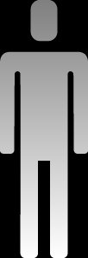
1.
Functionalities

Slide 3
1. Functionalities
Do you plan to drop any functionalities?
We are not going to drop any functionalities
Do you plan to add any functionalities?
Course Search Function
Student Schedule*
Exam Schedule*

Slide 4
Do you plan to use any PHP frameworks?
No !

Slide 5
Did you manage to finish login + 1 functionality?
YES !
Notes:
Have yet to integration features

Slide 6
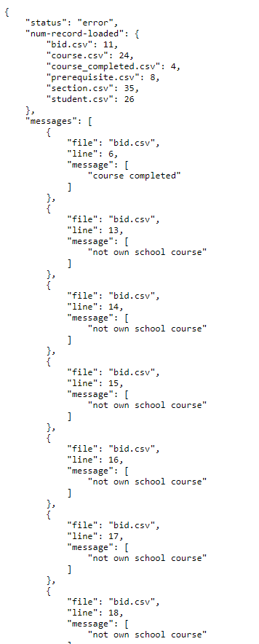
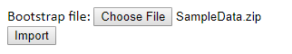
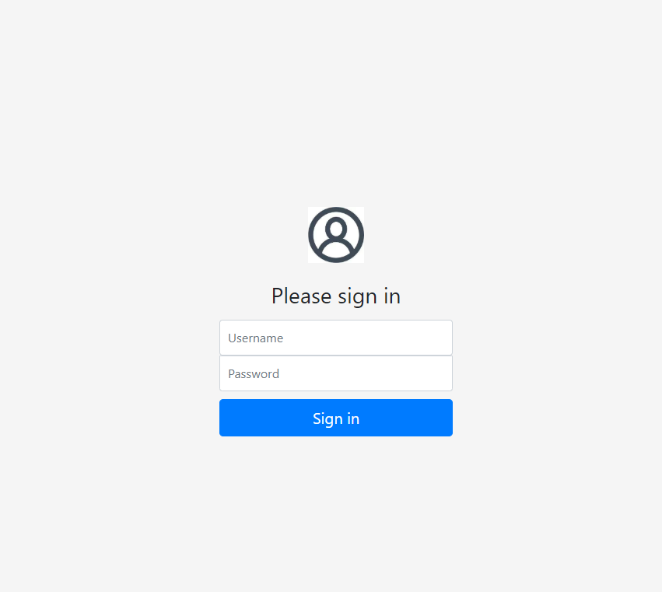
What functionalities have you finished?
Login
Bootstrap

Slide 7
What is the IP address & admin password for your cloud deployment?
IP: 3.1.101.8
Admin password: Hello123

Slide 8





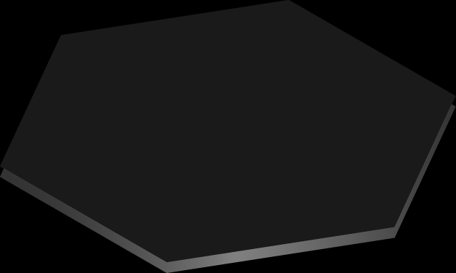


2. Schedule

Slide 9
Iterations
1
2
3
4
5
18/9 – 2/10
3/10 – 16/10
17/10 – 30/10
31/10 – 13/11
14/11 – 20/11

Slide 10

Iteration 1 (18/9 – 2/10)
Plan Project (PM + inputs from everyone)
Login Feature (JX – ZH)
Admin Features – bootstrap (TB-JH)
Create Test Plan (everyone)
Create Test Cases (everyone)
Run Test Case (everyone)
Debug Sessions (pair programming teams)
Prepare for PM Review (everyone)
Deploy to cloud (TB-JX)
DU (PM)
PM Review (everyone)
It.1 debrief (PM)

Slide 11
Iteration 2 (3/10 – 16/10)
Starting and clearing rounds Feature
Bid for a Section Feature
Drop Bid Feature
Integration
AWS Integration
Update Test Case (Everyone)
Run Test cases (Everyone)
Planned Debug Time (Pair Programming Teams)
DU (PM)
Prepare for Application Demo and Progress update (Everyone)
Application Demo and Progress update (Everyone)
It.2 Debrief (PM)
(Pair Programming Teams)

Slide 12
Iteration 3 (17/10 – 30/10)
Drop a section Feature
View Bidding Results
Integration
Update Test Cases (Everyone)
Run Test Cases (Everyone)
Planned Debugging Time (Pair Programming Teams)
UI Design (Pair Programming Teams)
DU (PM)
Prepare for UAT (Everyone)
UAT (Everyone)
It.3 Debrief (PM)
(Pair Programming Teams)

Slide 13
Iteration 4 (31/10 – 13/11)
Fix Problems from UAT (Pair Programming Teams)
Improve on UI Design (Pair Programming Teams)
Update Test Cases (Everyone)
Run Test Cases (Everyone)
Planned Debugging Time (Pair Programming Teams)
Prepare Final Presentation Slides (Everyone)
DU (PM)

Slide 14
Iteration 5 (14/11 – 20/11)
DU (PM)
Presentation Rehearsal (Everyone)
Submission of Slides (Everyone)
Final Presentation (Everyone)

Slide 15
Critical path Iter.1
13 | 2 | 14
Submission of Project slides
13 | 0 | 14
1 | 1 | 1
Plan the project
1 | 5 | 6
7 | 1 | 7
Create Test Plan
7 | 0 | 7
13 | 1 | 13
Deploy to Cloud
13 | 0 | 13
1 | 6 | 6
Login Feature
1 | 0 | 6
7 | 1 | 7
Create Test Cases
7 | 0 | 7
8 | 3 | 10
Planned Debugging Time
8 | 0 | 10
11 | 2 | 12
Prepare for PM Review
11 | 0 | 12
14 | 1 | 14
PM Review
14 | 0 | 14
1 | 6 | 6
Admin Feature
1 | 0 | 6
7 | 1 | 7
Run Test Cases
7 | 0 | 7
14 | 1 | 14
Iteration 1 Debrief
14 | 0 | 14
1 | 14 | 14
Daily DU
1 | 0 | 14

Slide 16
Critical path Iter.2
1 | 4 | 4
Clearing rounds feature (round 1)
1 | 0 | 4
5 | 1 | 5
Clearing rounds feature (round 2)
5 | 0 | 5
9 | 1 | 9
Integration
9 | 0 | 9
6 | 3 | 8
Drop bid feature
6 | 0 | 8
10 | 4 | 13
Debugging time
10 | 0 | 13
1 | 4 | 4
Bid for a section feature (round 1)
1 | 0 | 4
5 | 1 | 5
Bid for a section feature (round 2)
5 | 0 | 5
9 | 1 | 9
AWS integration
9 | 0 | 9
14 | 1 | 14
Application demo and progress update
14 | 0 | 14
1 | 5 | 5
Criteria for bidding
1 | 0 | 5
9 | 1 | 9
Update test cases
9 | 0 | 9
10 | 4 | 13
Prepare for Application Demo and Progress Update
10 | 0 | 13
14 | 1 | 14
Iteration 2 debrief
14 | 0 | 14
1 | 14 | 14
Daily Update
1 | 0 | 14
9 | 1 | 9
Run test cases
9 | 0 | 9

Slide 17
Critical path Iter.3
1 | 1 | 1
Drop a Section Feature
1 | 0 | 1
14 | 1 | 14
UAT
14 | 0 | 14
5 | 3 | 7
Planned Debugging Time
5 | 0 | 7
2 | 1 | 2
Integrate
2 | 0 | 2
3 | 1 | 3
Update Test Cases
3 | 0 | 3
4 | 1 | 4
Run Test Cases
4 | 0 | 4
8 | 1 | 8
UI Design
8 | 0 | 8
9 | 5 | 13
Prepare for UAT
9 | 0 | 13
1 | 1 | 1
View Bidding Results
1 | 0 | 1
14 | 1 | 14
Iteration 3 Debrief
14 | 0 | 14
1 | 14 | 14
Daily DU
1 | 0 | 14

Slide 18
Critical path Iter.4
1 | 1 | 1
Fix problems from UAT
1 | 0 | 1
8 | 7 | 14
Final presentation slides
8 | 0 | 14
2 | 3 | 4
Improve on UI design
2 | 0 | 4
5 | 1 | 5
Update test cases
5 | 0 | 5
6 | 1 | 6
Run test cases
6 | 0 | 6
7 | 1 | 7
Debugging time
7 | 0 | 7
1 | 14 | 14
Daily update
1 | 0 | 14

Slide 19
Critical path Iter.5
1 | 6 | 6
Presentation Rehearsal
1 | 0 | 6
1 | 4 | 4
Submission of Slides
1 | 0 | 4
7 | 1 | 7
Final Presentation
7 | 0 | 7
1 | 4 | 4
Daily DU
1 | 0 | 4

Slide 20
3. Bug Metrics

Slide 21
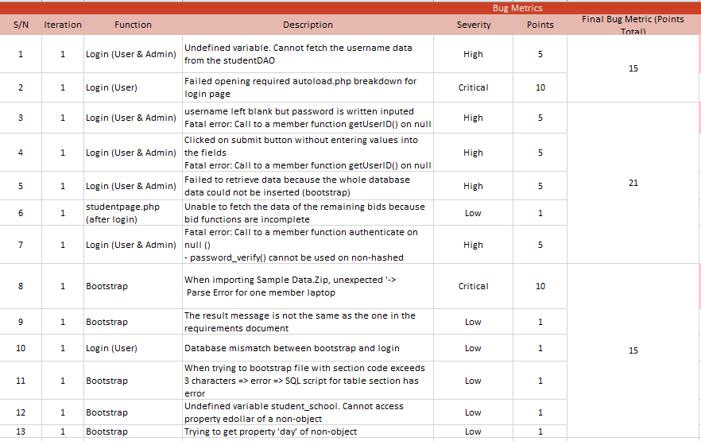
Bug Metrics
Total No. Of Bugs: 13
Bugs No. Range | Total Points
1 - 2 | 15
3 - 7 | 21
8 - 12 | 15
Action Taken: Stop task, schedule for debugging session for 8 hours with the responsible pair programmer (this includes asking for help from friends)

Slide 22
4. Roles & Responsibilities

Slide 23
Roles & Responsibilities
Rotation
Weeks | Project Manager
5 - 7 | Andrew
7 - 9 | Thao
9 - 11 | Jiaxin
11 - 13 | Jia Hui
14 | Zhen Hui

Slide 24
5. Pair Programming

Slide 25
Pair Programming
Weeks | Pair Programmer 1 | Pair Programmer 2
5-7 | Zhen Hui, Jiaxin | Thao, Jia Hui
7-9 | Zhen Hui, Andrew | Jiaxin, Jia Hui
9-11 | Thao, Andrew | Zhen Hui, Jia Hui
11-13 | Andrew, Jiaxin | Thao, Zhen Hui

Slide 26

THANK YOU !

