Slide 1





SPM G3T8
Andrew | Thao | Jia Xin | Jia Hui | Zhen Hui

Slide 2



1.
Functionalities

Slide 3
1. Functionalities
Do you plan to drop any functionalities?
We are not going to drop any functionalities
Do you plan to add any functionalities?
No

Slide 4
Do you plan to use any PHP frameworks?
No !

Slide 5
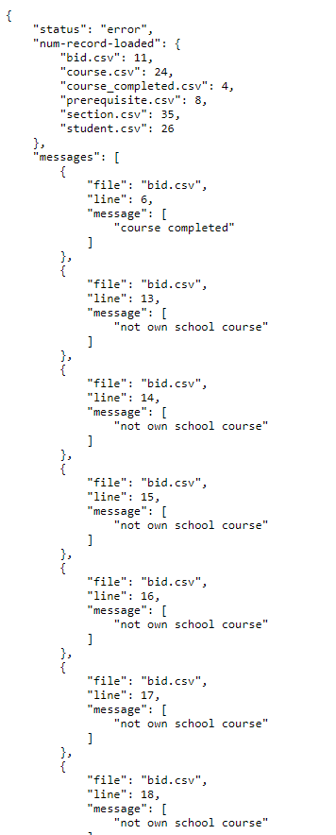
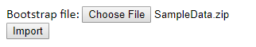
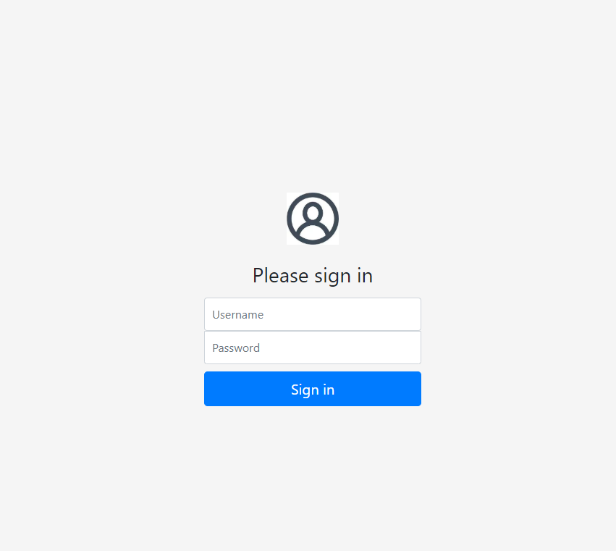
What functionalities have you finished?
Login
Bootstrap

Slide 6
What functionalities have you finished? *
Start and clear round
Bid for a section
Drop bid for student

Slide 7
What is the IP address & admin password for your cloud deployment?
IP: 3.1.101.8
Admin password: Hello123

Slide 8








2. Schedule

Slide 9
Iterations
1
2
3
4
5
18/9 – 2/10
3/10 – 16/10
17/10 – 30/10
31/10 – 13/11
14/11 – 20/11

Slide 10

Iteration 1 (18/9 – 2/10)
Plan Project (PM + inputs from everyone)
Login Feature (JX – ZH)
Admin Features – bootstrap (TB-JH)
Create Test Plan (everyone)
Create Test Cases (everyone)
Run Test Case (everyone)
Debug Sessions (pair programming teams)
Prepare for PM Review (everyone)
Deploy to cloud (TB-JX)
DU (PM)
PM Review (everyone)
It.1 debrief (PM)

Slide 11
Iteration 2 (3/10 – 16/10)*
Plan for Iter2 (Everyone)
Starting and clearing rounds Feature
Bid for a Section Feature
Drop Bid Feature
Integration
AWS Integration
Update Test Case (Everyone)
Run Test cases (Everyone)
Planned Debug Time (Pair Programming Teams)
DU (PM)
Prepare for Application Demo and Progress update (Everyone)
Application Demo and Progress update (Everyone)
It.2 Debrief (PM)
(Pair Programming Teams)

Slide 12
Iteration 3 (17/10 – 30/10)*
Plan for Iter3
Remaining tasks in Iter2
Drop a section Feature
View Bidding Results
Integration
Update Test Cases (Everyone)
Run Test Cases (Everyone)
Planned Debugging Time (Pair Programming Teams)
UI Design (Pair Programming Teams)
DU (PM)
Prepare for UAT (Everyone)
UAT (Everyone)
It.3 Debrief (PM)
(Pair Programming Teams)

Slide 13
Iteration 4 (31/10 – 13/11)
Fix Problems from UAT (Pair Programming Teams)
Improve on UI Design (Pair Programming Teams)
Update Test Cases (Everyone)
Run Test Cases (Everyone)
Planned Debugging Time (Pair Programming Teams)
Prepare Final Presentation Slides (Everyone)
DU (PM)

Slide 14
Iteration 5 (14/11 – 20/11)
DU (PM)
Presentation Rehearsal (Everyone)
Submission of Slides (Everyone)
Final Presentation (Everyone)

Slide 15
Critical path Iter.1
13 | 2 | 14
Submission of Project slides
13 | 0 | 14
1 | 1 | 1
Plan the project
1 | 5 | 6
7 | 1 | 7
Create Test Plan
7 | 0 | 7
13 | 1 | 13
Deploy to Cloud
13 | 0 | 13
1 | 6 | 6
Login Feature
1 | 0 | 6
7 | 1 | 7
Create Test Cases
7 | 0 | 7
8 | 3 | 10
Planned Debugging Time
8 | 0 | 10
11 | 2 | 12
Prepare for PM Review
11 | 0 | 12
14 | 1 | 14
PM Review
14 | 0 | 14
1 | 6 | 6
Admin Feature
1 | 0 | 6
7 | 1 | 7
Run Test Cases
7 | 0 | 7
14 | 1 | 14
Iteration 1 Debrief
14 | 0 | 14
1 | 14 | 14
Daily DU
1 | 0 | 14

Slide 16
Critical path Iter.2*
Buffer time: 2 days
11 | 1 | 11
Integration
11 | 0 | 11
14 | 1 | 14
Submission of Slides
14 | 0 | 14
2 | 5 | 6
Clearing rounds feature (round 1)
3 | 1 | 7
7 | 2 | 8
Clearing rounds feature (round 2)
8 | 1 | 9
11 | 1 | 11
AWS integration
11 | 0 | 11
12 | 2 | 13
Prepare for Application Demo and Progress Update
12 | 0 | 13
10 | 1 | 10
Drop bid feature
10 | 0 | 10
1 | 1 | 1
Plan Iter 2
1 | 0 | 1
14 | 1 | 14
Iteration 2 debrief
14 | 0 | 14
2 | 5 | 6
Bid for a section feature (round 1)
2 | 0 | 6
7 | 3 | 9
Bid for a section feature (round 2)
7 | 0 | 9
11 | 1 | 11
Update test cases
11 | 0 | 11
12 | 2 | 13
Debugging time
12 | 0 | 13
14 | 1 | 14
Application demo and progress update
14 | 0 | 14
11 | 1 | 11
Run test cases
11 | 0 | 11
1 | 14 | 14
Daily Update
1 | 0 | 14

Slide 17
Critical path Iter.3*
8 | 1 | 8
Integrate
8 | 0 | 8
Buffer time: 1 days
2 | 2 | 3
Integration for Iter2 function
2 | 0 | 3
6 | 2 | 7
Drop a Section Feature
6 | 0 | 7
14 | 1 | 14
UAT
14 | 0 | 14
8 | 1 | 8
AWS integration
8 | 0 | 8
2 | 2 | 3
AWS integration for Iter2’s function
2 | 0 | 3
4 | 2 | 5
Debug Time
4 | 0 | 5
9 | 3 | 11
Planned Debugging Time
9 | 0 | 11
12 | 1 | 12
UI Design
12 | 0 | 12
13 | 1 | 13
Prepare for UAT
13 | 0 | 13
1 | 1 | 1
Plan for Iter3
1 | 0 | 1
6 | 1 | 6
View Bidding Results
7 | 1 | 7
8 | 1 | 8
Update Test Cases
8 | 0 | 8
14 | 1 | 14
Iteration 3 Debrief
14 | 0 | 14
2 | 2 | 3
Run test cases
2 | 0 | 3
1 | 14 | 14
Daily DU
1 | 0 | 14
8 | 1 | 8
Run Test Cases
8 | 0 | 8

Slide 18
Critical path Iter.4
12 | 3 | 14
Final presentation slides
12 | 0 | 14
1 | 3 | 3
Fix problems from UAT
3 | 0 | 3
4 | 2 | 5
Improve on UI design
4 | 0 | 5
6 | 1 | 6
Update test cases
6 | 0 | 6
7 | 1 | 7
Run test cases
7 | 0 | 7
8 | 4 | 11
Debugging time
8 | 0 | 11
1 | 14 | 14
Daily update
1 | 0 | 14

Slide 19
Critical path Iter.5
1 | 6 | 6
Presentation Rehearsal
1 | 0 | 6
1 | 4 | 4
Submission of Slides
1 | 0 | 4
7 | 1 | 7
Final Presentation
7 | 0 | 7
1 | 4 | 4
Daily DU
1 | 0 | 4

Slide 20
3. Bug Metrics

Slide 21
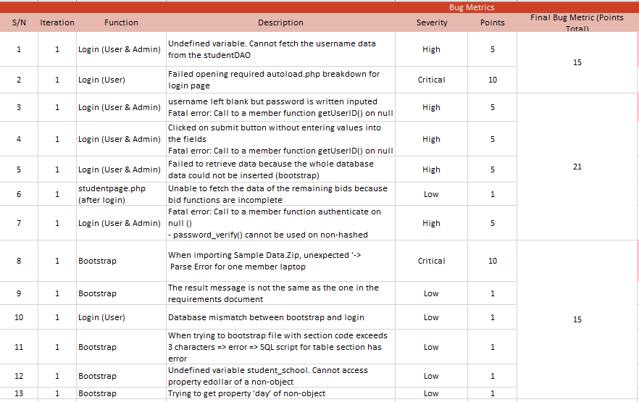
Bug Metrics
Iter1
Total No. Of Bugs: 13
Bugs No. Range | Total Points
1 - 2 | 15
3 - 7 | 21
8 - 12 | 15
Action Taken: Stop task, schedule for debugging session for 8 hours with the responsible pair programmer (this includes asking for help from friends)

Slide 22
Bug Metrics*
Iter2
Total No. Of Bugs: 0 as of now

Slide 23
4. Roles & Responsibilities

Slide 24
Roles & Responsibilities*
Rotation
Weeks | Project Manager
5 - 7 | Andrew
7 - 9 | Thao
9 - 11 | Jia Hui
11 - 13 | Jiaxin
14 | Zhen Hui

Slide 25
5. Pair Programming

Slide 26
Pair Programming*
Weeks | Pair Programmer 1 | Pair Programmer 2 | Pair programmer 3
5-7 | Zhen Hui, Jiaxin | Thao, Jia Hui
7-9 | Zhen Hui, Jiahui | Jiaxin, Andrew | Thao, Andrew
9-11 | Thao, Jiaxin | Andrew, Zhen Hui
11-13 | Zhen Hui, Thao | Jia Hui, Andrew

Slide 27

THANK YOU !

