Slide 1
Advanced Topics in Software Systems Project work 03.11.2021
Name: Thao Phung
Email: thao.phungduc@aalto.fi
University: Aalto University

Slide 2
Scenario / Case Study
Monitoring data drift for end-to-end ML models
Why?
Data drift logging to extract useful interpretation
Find connection between drifts and model performance
Various challenges in complexity of ML models, processes, monitoring
Goal
Monitor real-time performance and affect of drifts on ML accuracy

Slide 3
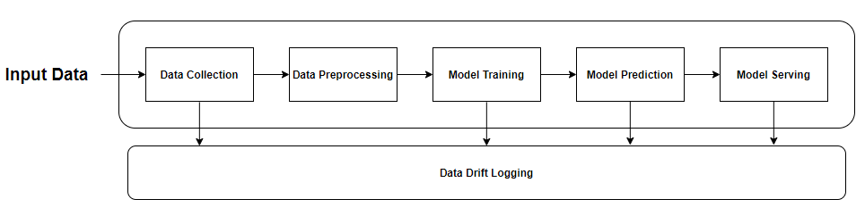
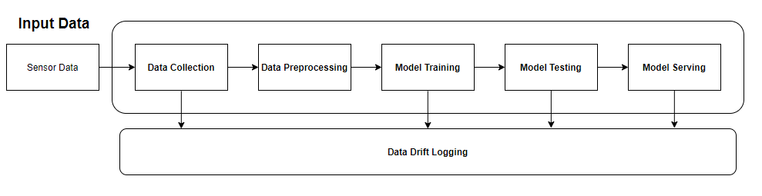
System Diagram

Slide 4
Key Components
Data Drift Detection (Data Collection)
skmultiflow: ADWIN, KSWIN, HDDM_A
Data Storage
InfluxDB
Experiment Management
MLFlow
Model Explanation
SHAP, LIME
Monitoring Platform
Chronograf

Slide 5
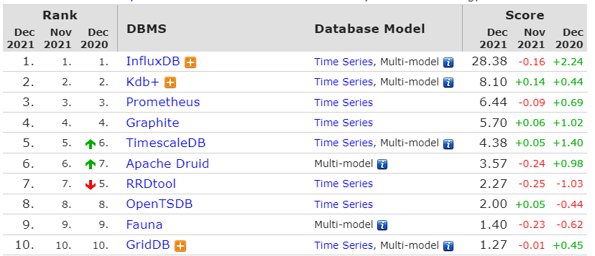
Time-series Database - InfluxDB
Source: https://db-engines.com/en/ranking/time+series+dbms

Slide 6
Key values in chosen DB
Pros:
Use custom data model, NoSQL, non-relational database
Simplicity
Compatible with different tools
Fast insert & query operations
Cons:
The data model is rigid and limited data types
Cannot change without rewriting the data
Cannot create additional indexes, update metadata, and enforce data validation

Slide 7
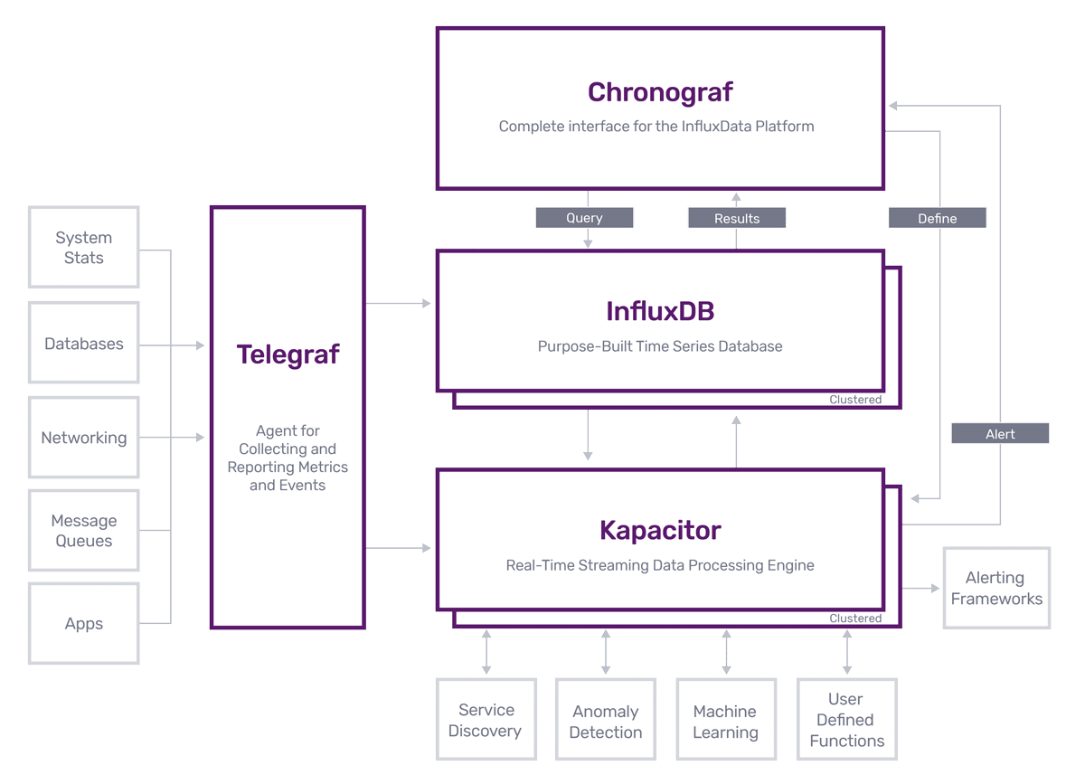
Component Interconnection
Chronograf
+ Monitoring events
InfluxDB
+ Storing events
Telegraf
+ Collecting events
Kapacitor
+ Processing stream/batch events

Slide 8
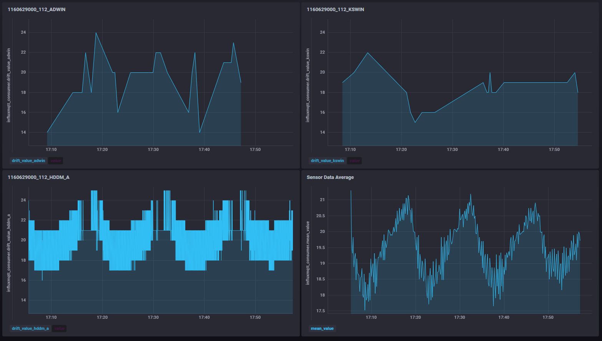
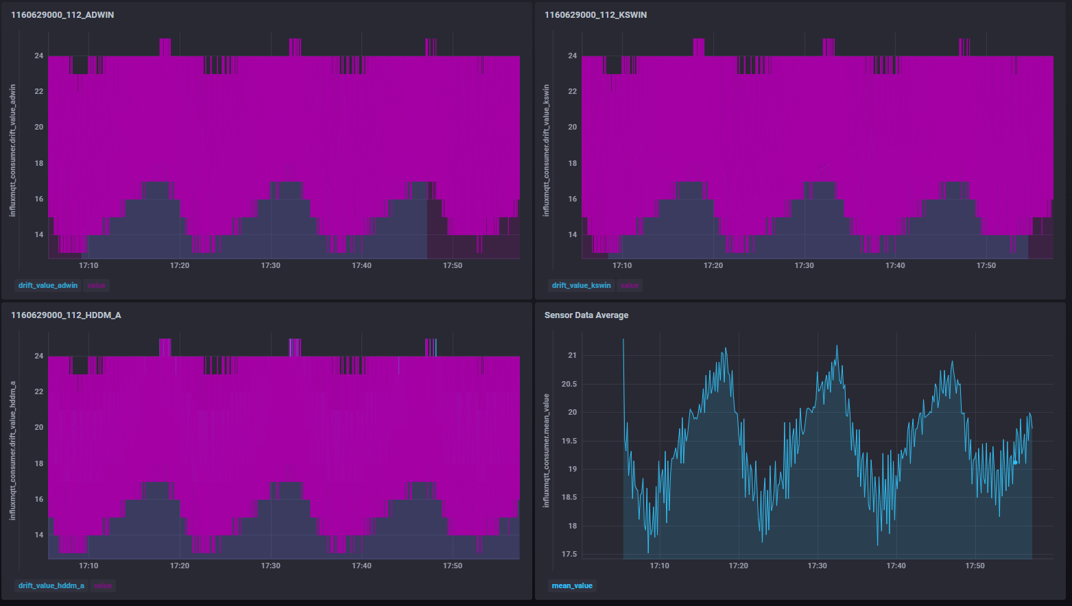
Drift Monitoring

Slide 9
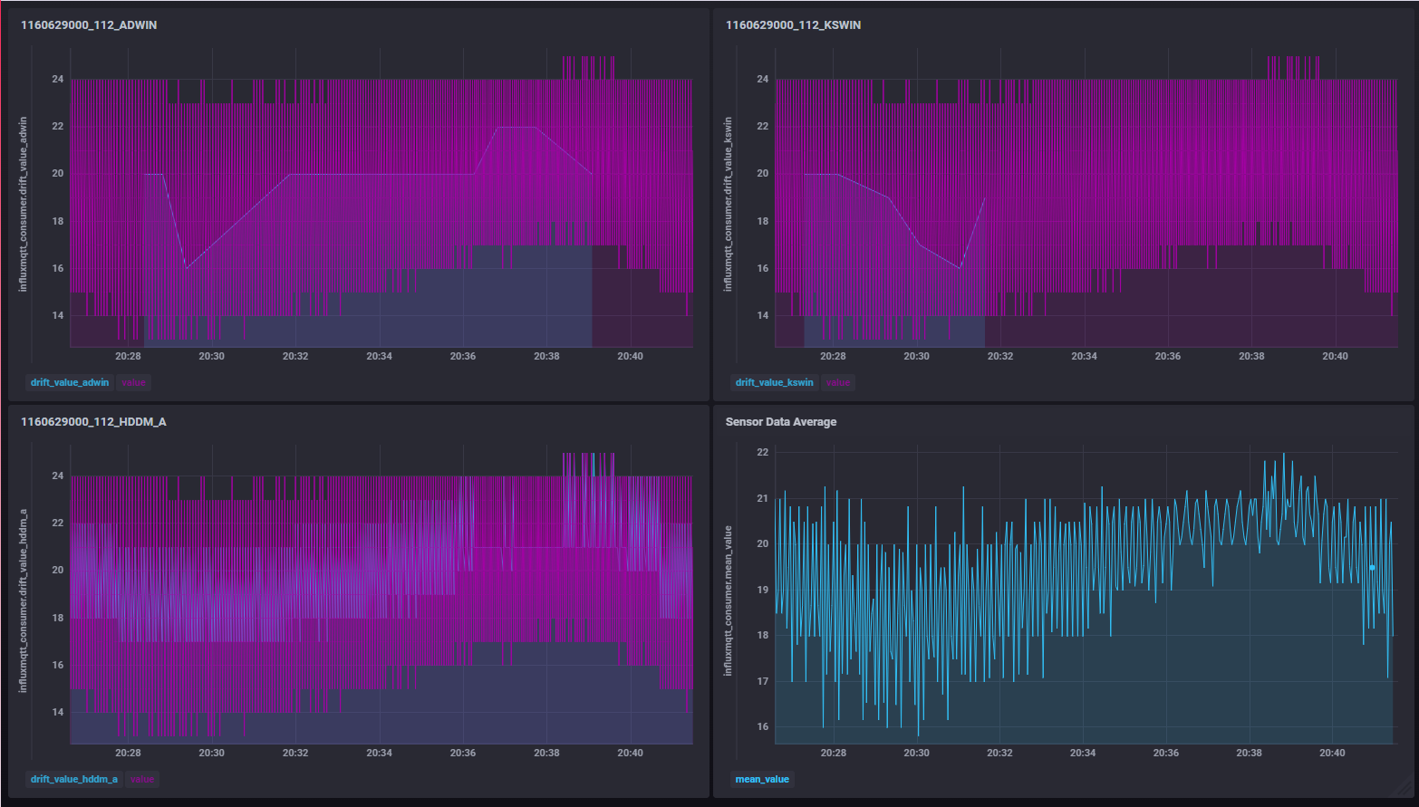
Drift Monitoring

Slide 10
Problems & Future Improvement
Problems in extracting LSTM explanation using SHAP values
Need implement KS test on training datasets and stored in metadata
Keep tracking performance of serving models and display into monitoring dashboard

Slide 11
Thank You!
Any Questions?

Slide 12
Methodology
The prototype may include drift detection in these phases:
Collecting statistics when fetching from data stream
Pre-processing & apply feature engineering to data
Applying statistical testing to datasets used for training
Computing difference of feature attributions for model prediction
Deploying & logging drifts throughout end-to-end pipelines
Analyze dependence between drifts and model performance

Slide 13
Challenges
+ How to maintain data drift in one system?
+ Where to store all these data and how to extract them into representation?
+ Is it possible to make useful link between them?
+ Can perform drift detection with large scale of data?
+ Which relevant information should be captured from drifts?

Slide 14
Possible solutions
+ Orchestration tool for workflows: Apache Airflow
+ Drift detection for stream data collection: skmultiflow
+ Model training: alibi-detect (KS test), Evidently
+ Model prediction: Feature Importance, SHAP, Lime, DeepSHAP
+ Tracking ML experiments: MLFlow
Notes:
+ Prediction monitoring: Prometheus

