Slide 2
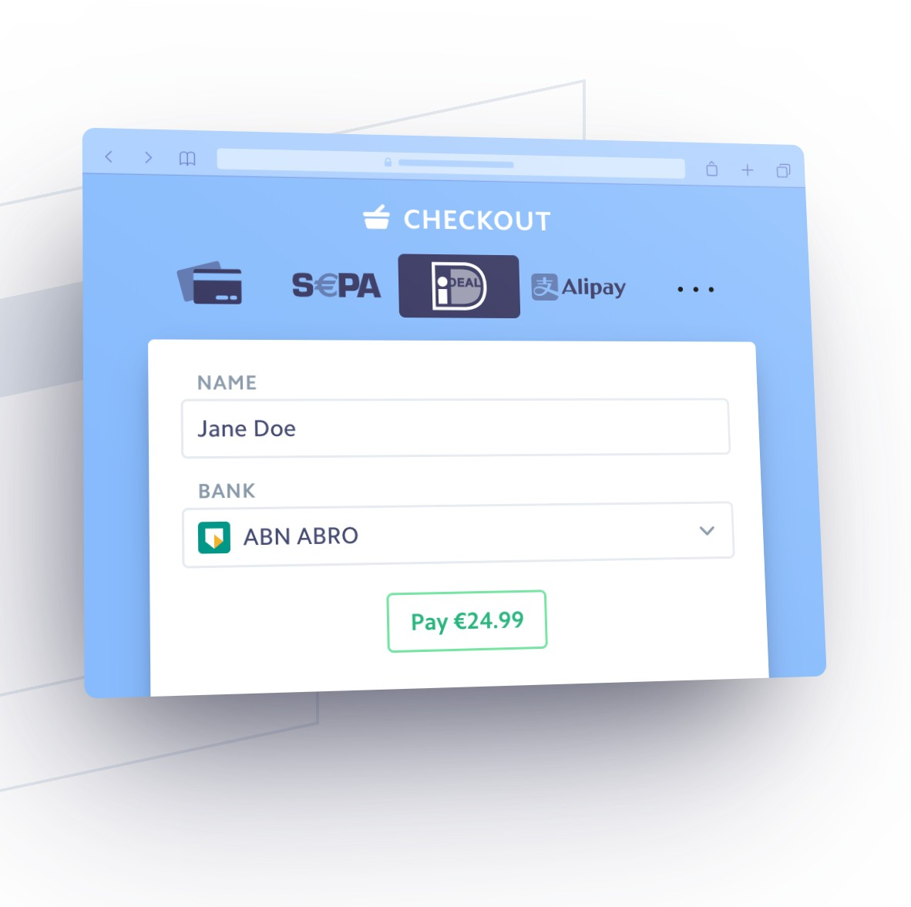
Problems
1. Categorize merchants with limited data that only contains merchant id, time and transaction amount
2. Define churn, identify already churn, predict churn in active user data

Slide 3


High Level Flow of Project
Problem 1
RFM
Segmentation
Data
Preparation
Data
Wrangling
Categorize
merchants
Match
Clusters
K-Means
HDBSACNCAN

Slide 4
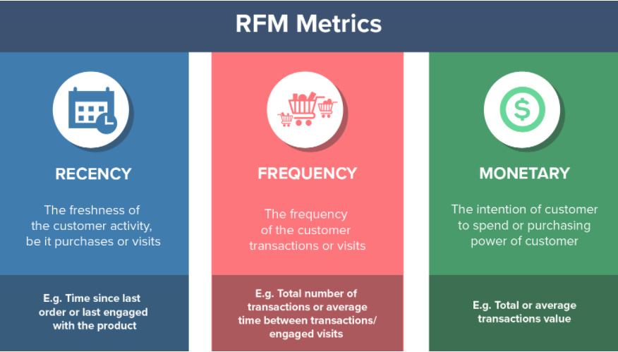
Solution

Slide 5
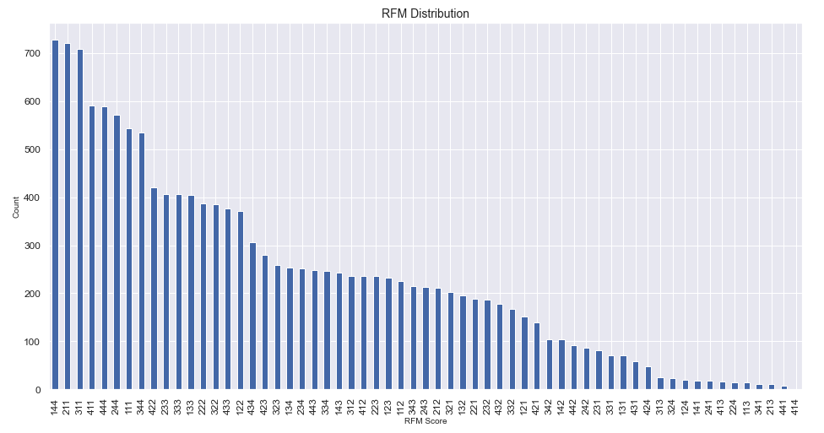
Using quartile method to assign categories for merchant

Slide 6
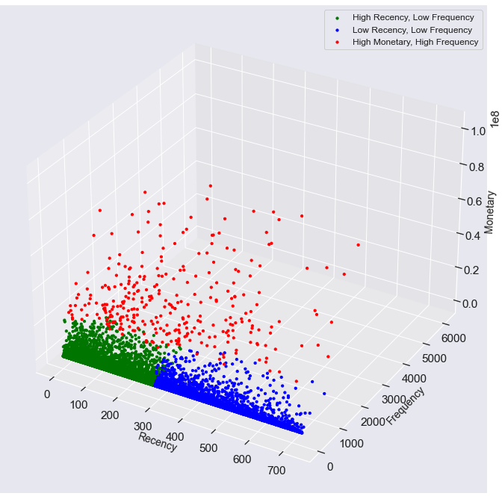
K-Means Clustering
Requires feature standardization
Segment the merchants based on recency and monetary
Does not capture many of the high monetary merchants
Contains noise

Slide 7
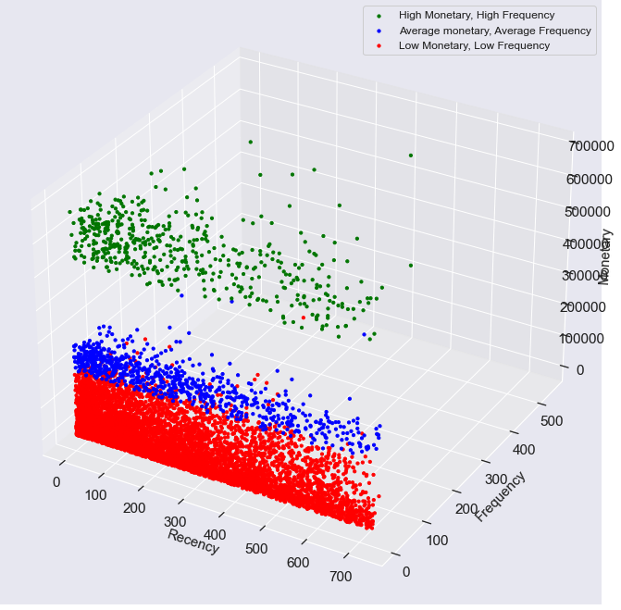
HDBSCAN Clustering
Fit the data better than
K-Means
Segment the merchants based on monetary and frequency
Automatically remove noise

Slide 8
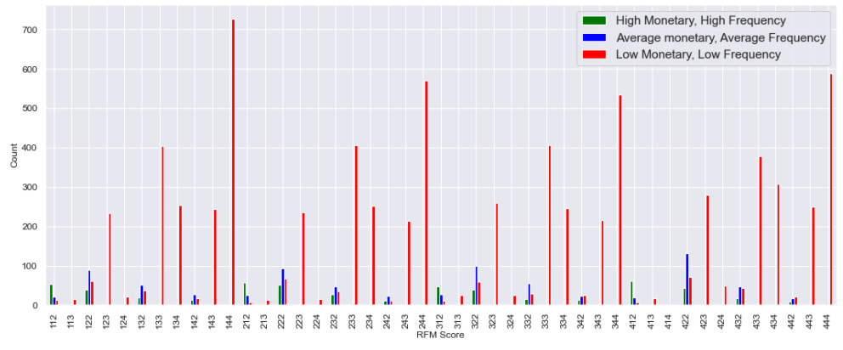
Match HDBSCAN clusters with RFM segments

Slide 9
Problem 2
High Level Flow of Project
Identify
Churn
Logistic
Regression Model
Resampling
data
Improve
the model
Match
Clusters
Predict churn
on active user
dataset

Slide 10
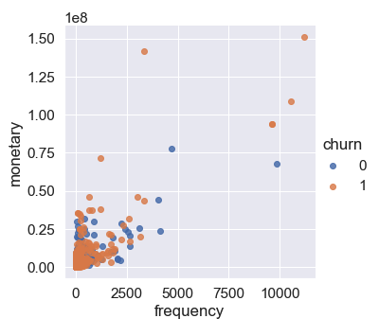
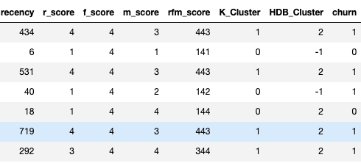
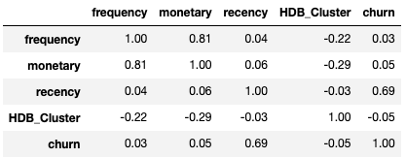
Churn: recency > 30 No apparent relationship between churn and any features other than recency

Slide 11
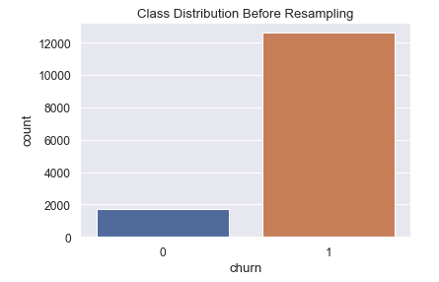
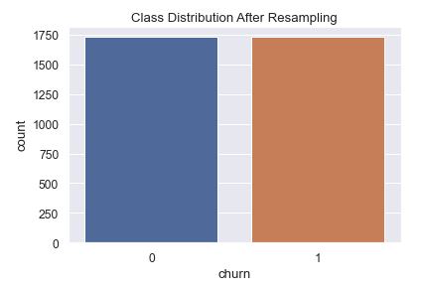
Resampling

Slide 12

Accuracy: 0.9754 Precision: 0.9967
Logistic Regression
Hyperparameter
Tuning
Accuracy: 0.5159 Precision: 0.4916

Slide 13
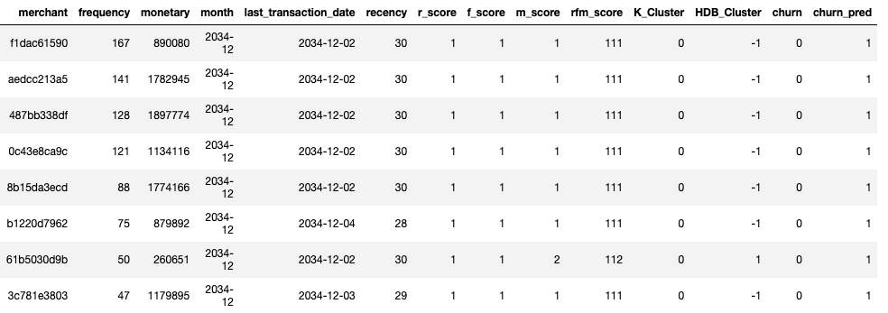
List of predicted churns from active user data

Slide 14

Thank you

