Slide 1
Spring

Slide 2
Mục lục
Architecture
Spring Core
Spring MVC
Spring Boot

Slide 3
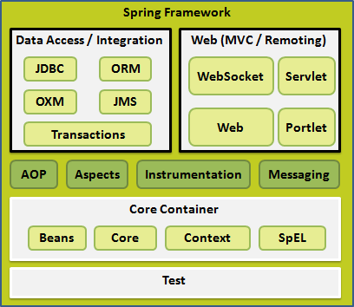
Architecture Spring Framework
Core Container
Core module: IoC & Dependency Injection
Beans module : BeanFactory
Context module : ApplicationContext
SpEL module

Slide 4
Spring Core
IoC Container
Beans
Dependency Injection

Slide 5
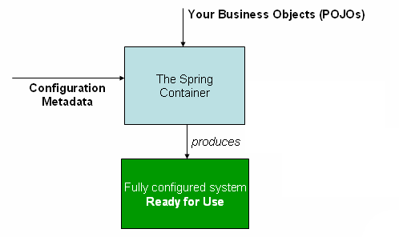
IoC Container
POJOs: (plain old Java object) các đối tượng Java thuần túy
Configuration Metadata: XML, Annotations, Java code

Slide 6
Beans
Bean Definition: name, class, contructor-arg, autowiring mode, properties, init-method, destroy-method, scope
Autowiring mode: no, byName, byType, contructor, autodetect
Bean Scope: singleton, prototype, request, session, application, websocket
Bean Life Cycle:

Slide 7
Dependency Injection
Constructor-based
Setter-based

Slide 8
Configure metadata
XML
Annotation Base Configure
Java Base Configure

Slide 9
Spring MVC

Slide 10
Spring Boot

