Slide 1
Spring

Slide 2
Mục lục
Architecture
Spring Core
Spring MVC
Spring Boot

Slide 3
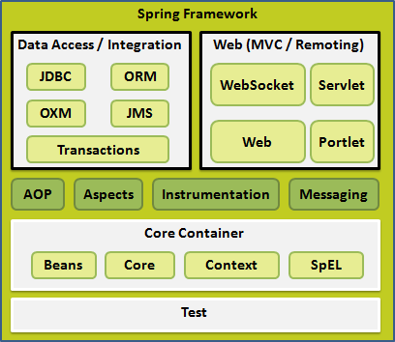
Architecture Spring Framework
Core Container
Core module: IoC & Dependency Injection
Beans module : BeanFactory
Context module : ApplicationContext
SpEL module

Slide 4
Spring Core
IoC Container
Beans
Dependency Injection

Slide 5
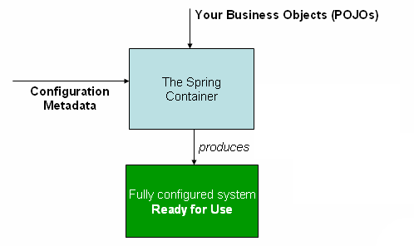
IoC Container
POJOs: (plain old Java object) các đối tượng Java thuần túy
Configuration Metadata: XML, Annotations, Java code

Slide 6
Beans
Bean Definition: xml, annotation, java code
Bean Scope: singleton, prototype, request, session, application, websocket
Bean Life Cycle:
Init-method
destroy-method:
AbstractApplicationContext context -> context .registerShutdownHook()

Slide 7
Beans Difinition
XML
<bean>
name, class, contructor-arg, properties, init-method, destroy-method, scope
Autowire: No, byType, byName, contructor, autodetect
<property>
<constructor-arg>
Annotation Base Configure:
thêm cấu hình trong xml configure: <context:annotation-config/>, trong <beans …>
@Required: thực hiên trên các property setter method
@Autowired: trên contructor, properties, property setter method, non-setter method
@Autowired(required=false): mặc định yêu cầu required
Cố gắng thực hiện autowiring byType trước
@Qualifier:
Java Base Configure

Slide 8
Dependency Injection
Constructor-based: <constructor-arg name=“…” value||ref=“…” />
Setter-based: <property name=“…” value||ref=“…” />

Slide 9
Spring MVC

Slide 10
Spring Boot

