Slide 1
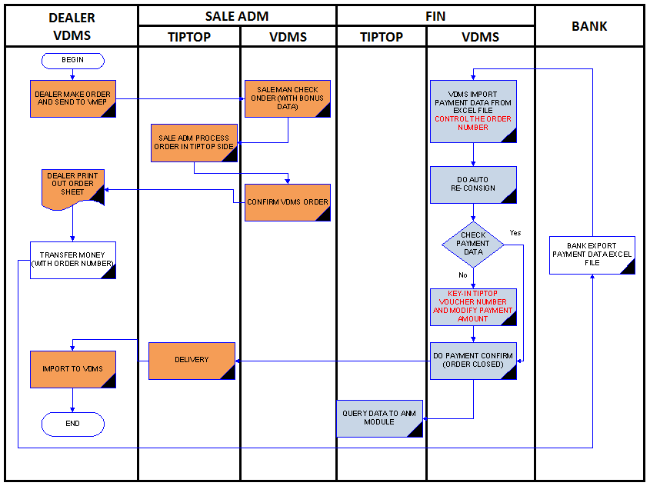
Original Flow

Slide 2
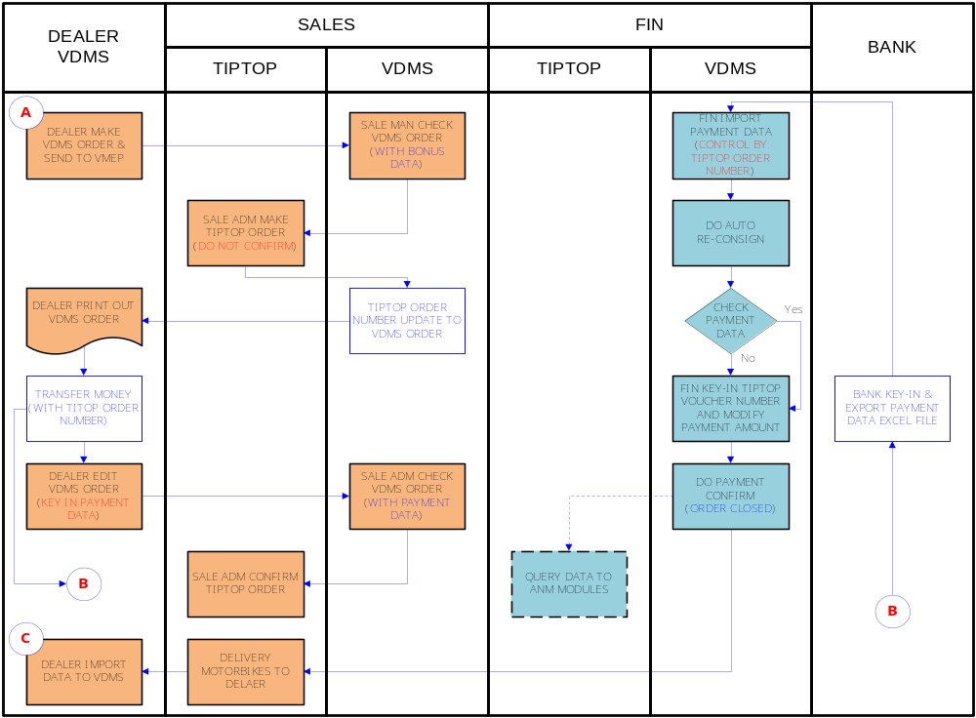
Detail of South Flow

Slide 3
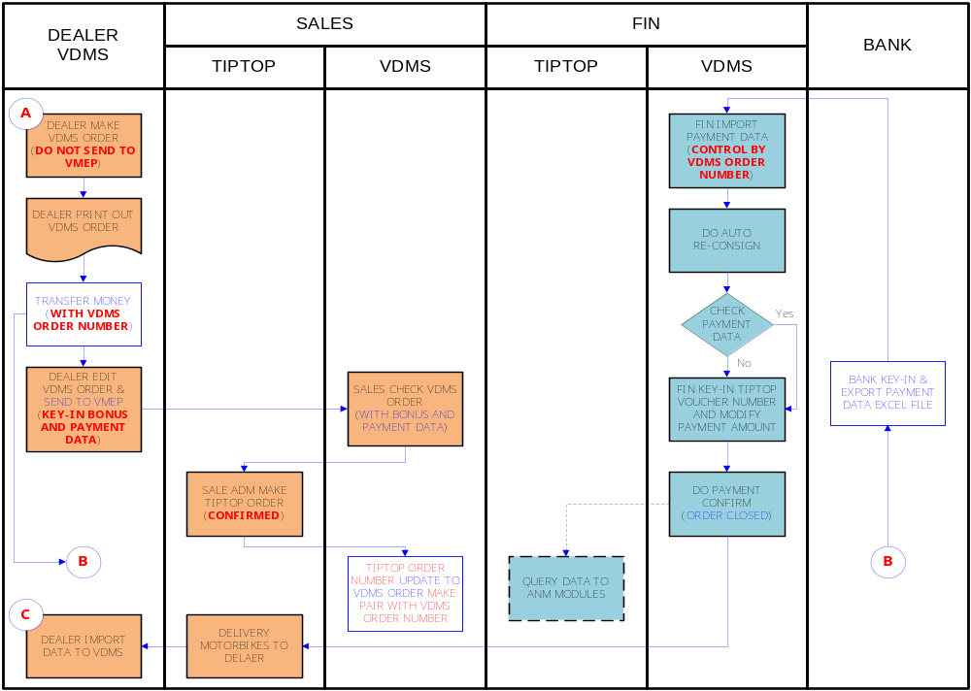
Detail of North Flow
Notes:
Save?
Is key-inned data of dealer required
Payment dealer – payment fin
Reconsign: get data from which payment source
Tiptop voucher
Add bonus

