Slide 1
GACS-7101-002 Advance Data Structures and Algorithms
THE MAXIMUM SUBARRAY PROBLEM
THAO NGUYEN
3104047

Slide 2
CONTENTS
1
THE MAXIMUM SUBARRAY PROBLEM
2
THE DIVIDE AND CONQUER SOLUTION
3
IMPLEMENT
4
EVALUATION

Slide 3
THE MAXIMUM SUBARRAY PROBLEM
The maximum subarray problem is finding the contiguous elements that has the largest sum
Example
[5, 7, 2, 11, 4] → ?
Sum: 29
If all the elements of array have positive numbers, the maximum subarray is sum of entire array

Slide 4
THE MAXIMUM SUBARRAY PROBLEM
Example
[-8, -2, -6, -4, -1, -5] → ?
Sum: -1
If all the elements of array have negative numbers, the maximum subarray is the smallest absolute value
[-2, -5, 6, -2, -3, 1, 5, -6] → ?
[-2, -5, 6, -2, -3, 1, 5, -6]
If all the elements of array have both positive and numbers, the maximum subarray is the contiguous elements that has the largest sum.
Sum is : 7

Slide 5

THE DIVIDE AND CONQUER SOLUTION
Alogrithm
Divide the array into two subarrays that has equal size as possible
Find maximum subarray on the left recursively
Find maximum subarray on the right recursively
Find maximum subarray that crosses the midpoint
Return the largest sum of three sums above
URL: Cormen, Leiserson, Rivest and Stein, Introduction to Algorithms, 2nd Edition, 3rd Edition, The MIT Press, 2009.

Slide 6
THE DIVIDE AND CONQUER SOLUTION
Example
[-2, -5, 6, -2, -3, 1, 5, -6]

Slide 7












THE DIVIDE AND CONQUER SOLUTION
-2 | -5 | 6 | -2 | -3 | 1 | 5 | -6
7
6
6
-1
6
-2
6
1
5
-2
-2
-1
-2
-7
-5
6
4
-3
1
5
-6

Slide 8
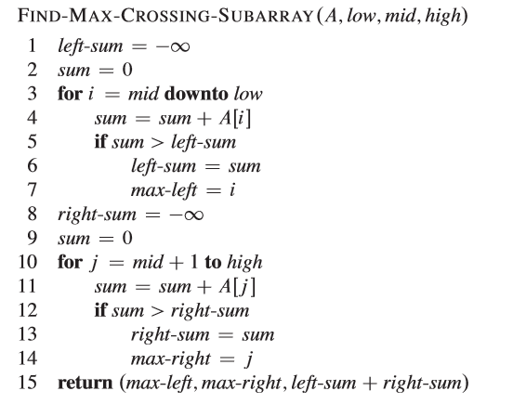
THE DIVIDE AND CONQUER SOLUTION
Alogrithm

Slide 9
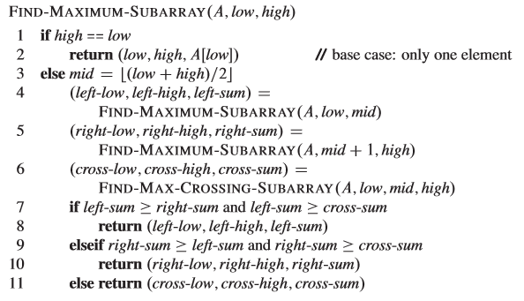
THE DIVIDE AND CONQUER SOLUTION
Alogrithm

Slide 10
IMPLEMENT
Java

Slide 11
EVALUATION
T(n)=

Slide 12
EVALUATION
Line 1, 2, 3:
Line 4,5:
Line 6:
Line 7 – 11:
Notes:
Line 1,2,3 take constant time

Slide 13



EVALUATION

Slide 14
References
Cormen, Leiserson, Rivest and Stein, Introduction to Algorithms, 2nd Edition, 3rd Edition, The MIT Press, 2009.
https://en.wikipedia.org/wiki/Maximum_subarray_problem

Slide 15
Q&A
Thank You!

