Slide 1
PAPER CITATION GRAPHS
Thành viên:
Nguyễn Thu Thảo
Đào Thị Hồng Nhung
Lê Thu Hiền
Nguyễn Bá Đăng Khôi

Slide 2
INTRODUCTION
Problem:
The volume of scientific publications doubling every 12 years over the past century
-> Automatically classify each publication’s areas and topics (about 7 classes: )
=> PREDICTION TASK:
The task is to predict the 7 subject areas of arXiv CS paper
r.

Slide 3
CONTENT
Features input/output
Result of the best model
Compare result and explain metrics
Notes:
Có thêm mục thuyết trình về model ví dụ: lý thuyết, công thức toán, tại sao model này lại ưu việt hơn so với các model khác

Slide 4
1.
FEATURES DETAIL

Slide 5
DATA OVERVIEW
The Cora dataset consists of 2708 scientific publications classified into one of seven classes. The citation network consists of 5429 links. Each publication in the dataset is described by a 0/1-valued word vector indicating the absence/presence of the corresponding word from the dictionary. The dictionary consists of 1433 unique words.
Node
Each node is an academic publications.
Edge
Citation relationships between the papers.

Slide 6
Classes of Dataset
Neural Network
Genetic Algorithms
Probabilistic Methods
Theory
Case Based
Reinforcement Learning
Rule Learning

Slide 7
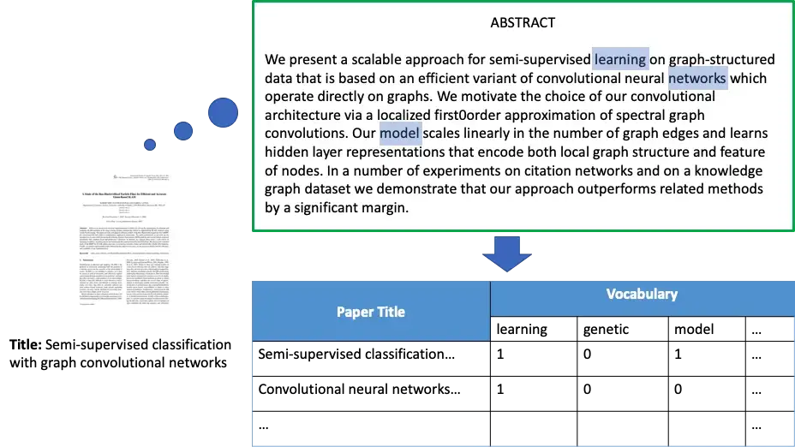
The Bag-of-Word model for two paper in Cora

Slide 8
2.
RESULT OF THE BEST MODEL

Slide 9
RESULT AND COMPARISON
MODEL | GCN | GAT | GraphSAGE
Accuracy | 83.15% | 77% | 80.6%

Slide 10
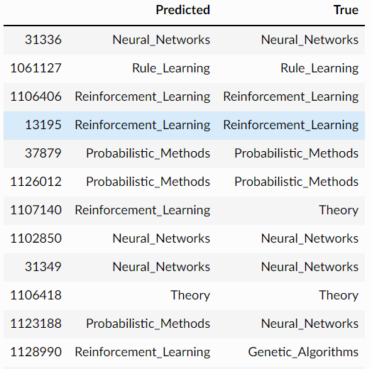
Predictions After Training

Slide 11
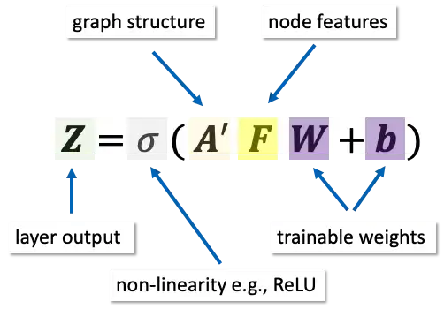
MODEL ARCHITECTURE OF GCN

Slide 12
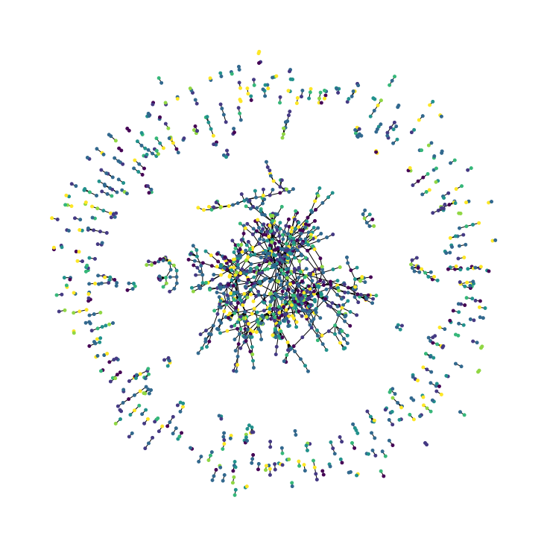
The Citation Graph

Slide 13
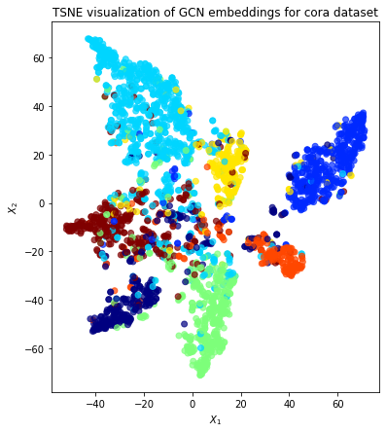

Slide 14
83.15%
Good clustering
100%
The best results achieved by the GCN model
When using TSNE visualize GCN embeddings
Try hard!

Slide 15

THANKS
FOR LISTENING!

