Slide 1

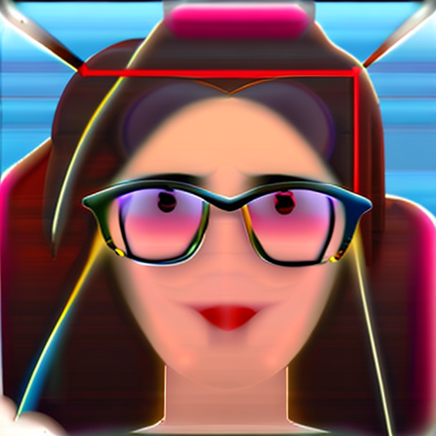

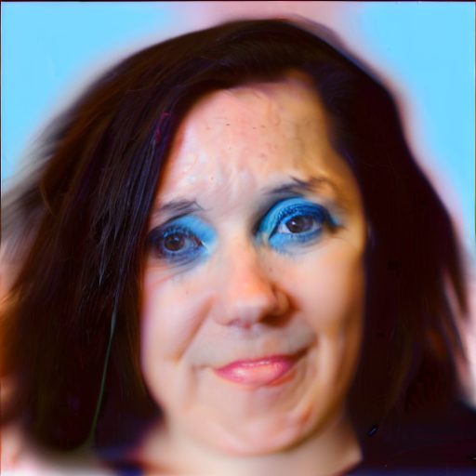
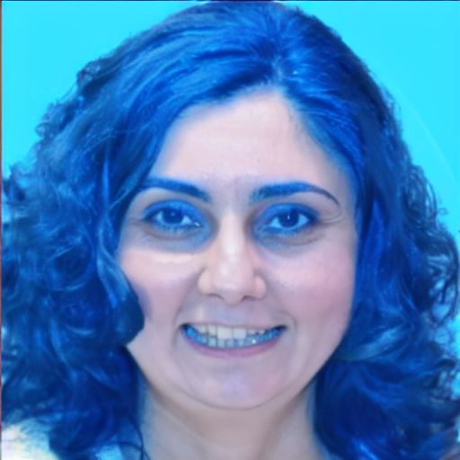

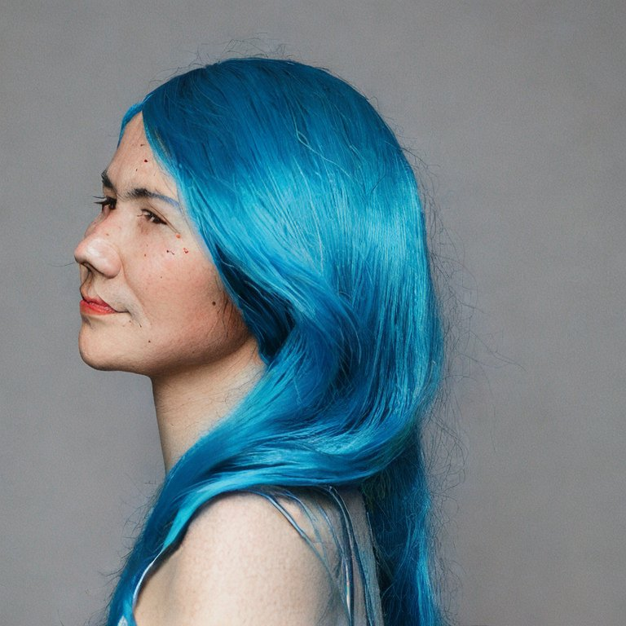
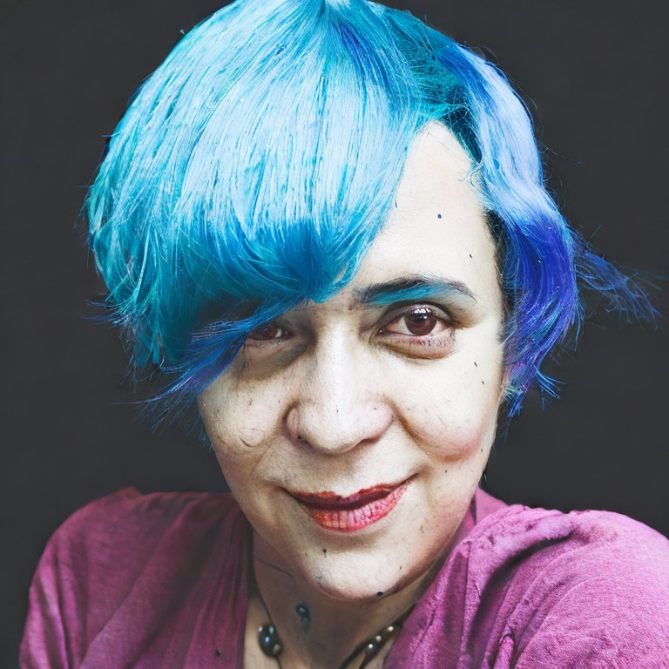
a. Image-guided Stable Diffusion Models
+ “glasses”
+ “blue hair”
Img2Img
InstructPix2Pix
b. (Original) Stable Diffusion
“A photo of a woman with blue hair”

