Slide 1

GRAPE: Handling Missing Data using Graph Representation Learning
Rabin Thapa
Instructor: Dr. Alina Lazar

Slide 2
Outline
Missing Data: a hidden problem
Reasons
Scope
Consequences
Existing methods in handling missing data
Limitations in those methods
GRAPE Framework
Experimental Setup for data imputation
Performance of GRAPE
Comparison with other models

Slide 3
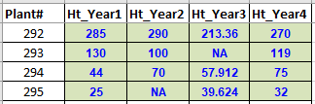
Missing Data Problem
Missing Data: unrecorded data value for a variable in an observation
Scope
Computational biology, Finance, Economics, Survey research
Why does it occur?
Various reasons (missing samples, respondents refusing to answer, …)
Missing data in Ecology

Slide 4
Missing Data Problem
Consequences – values missing not at random
Reduces statistical power
Probability of rejecting a null hypothesis when it is false
Bias in estimation of parameters
Values missing in pattern might affect statistic of interest
Reduce representativeness of samples
If values are not missing at random, some samples are under-represented
May complicate further analysis
Like Pairwise deletion does

Slide 5
Methods to Handle Missing Data
Listwise or case deletion
Might eliminate big chunk of data
Pairwise deletion
Might lead to correlation matrix that is not positive definite
Mean substitution
Regression Imputation
Expectation Maximization
Takes too long to converge
Machine Learning Algorithms
}
No novel information added
Underestimate standard errors
- Example: GRAPE

Slide 6
GRAPE Framework
Graph-based framework to solve missing data problem
A bipartite graph is constructed from missing feature values
O and F: two partite sets of nodes
Observed values are viewed as weighted edges
Solves tasks using Graph Neural Networks (GNN) inspired by GraphSAGE
Feature imputation: edge-level prediction task
Label prediction: node-level prediction task

Slide 7
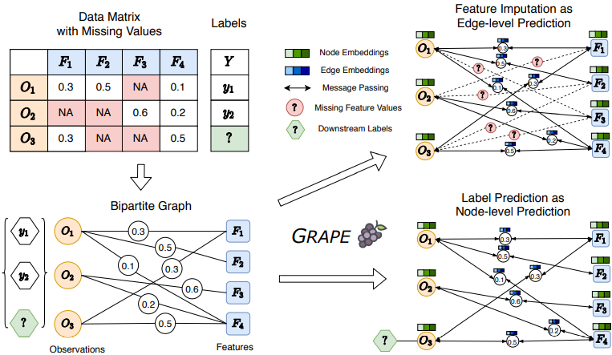
GRAPE: a concise view

Slide 8
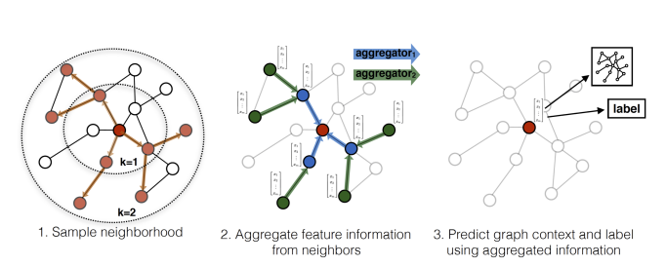
Graph Neural Network
Illustration of GraphSAGE sample and aggregate approach

Slide 9
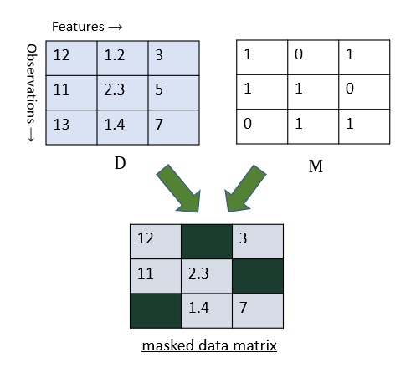
Experiment I: GRAPE Configurations
20000 epochs
Activation: RELU
Feature Imputation
3-layer GNN with 64-hidden units
Data matrix: D ∈ ℝ^{n × m}
Mask matrix: M ∈ {0,1}^{n × m}
Missing rate: P(M_{ij} = 0) = r_{miss}
Test metric
root mean square error (rmse)
Label prediction
2-layer GNN with 16-hidden units
Labels randomly split into
70% - training set
30% - test set

Slide 10
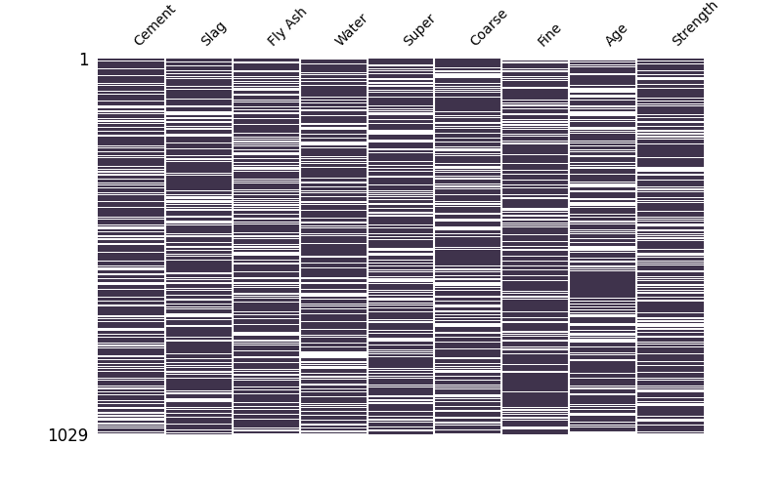
Experiment I: Datasets
7 datasets from UCI Machine Learning Repository
Datasets are fully observed
So, missing values are randomly introduced
Concrete
Power
Energy
Kin8nm
Yacht
Naval
housing
Masked data matrix (concrete) with missing rate 0.3

Slide 11
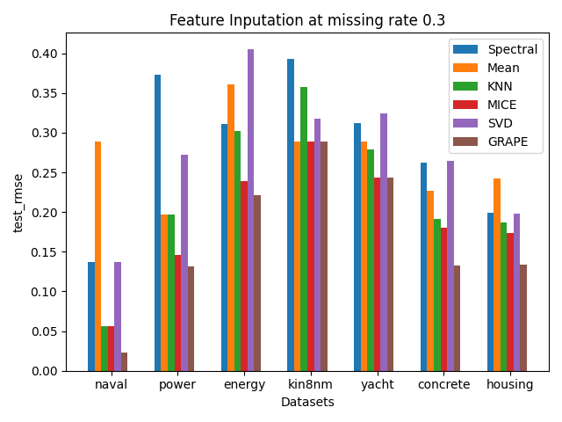
Experiment I: Feature Imputation at missing rate = 0.3
Baseline models:
Spectral Regularization Algorithm
Mean imputation
K-Nearest Neighbors
Multivariate Imputation by Chained Equations
Iterative SVD
GRAPE gives 12% lower average rmse than the best baseline model (MICE)

Slide 12
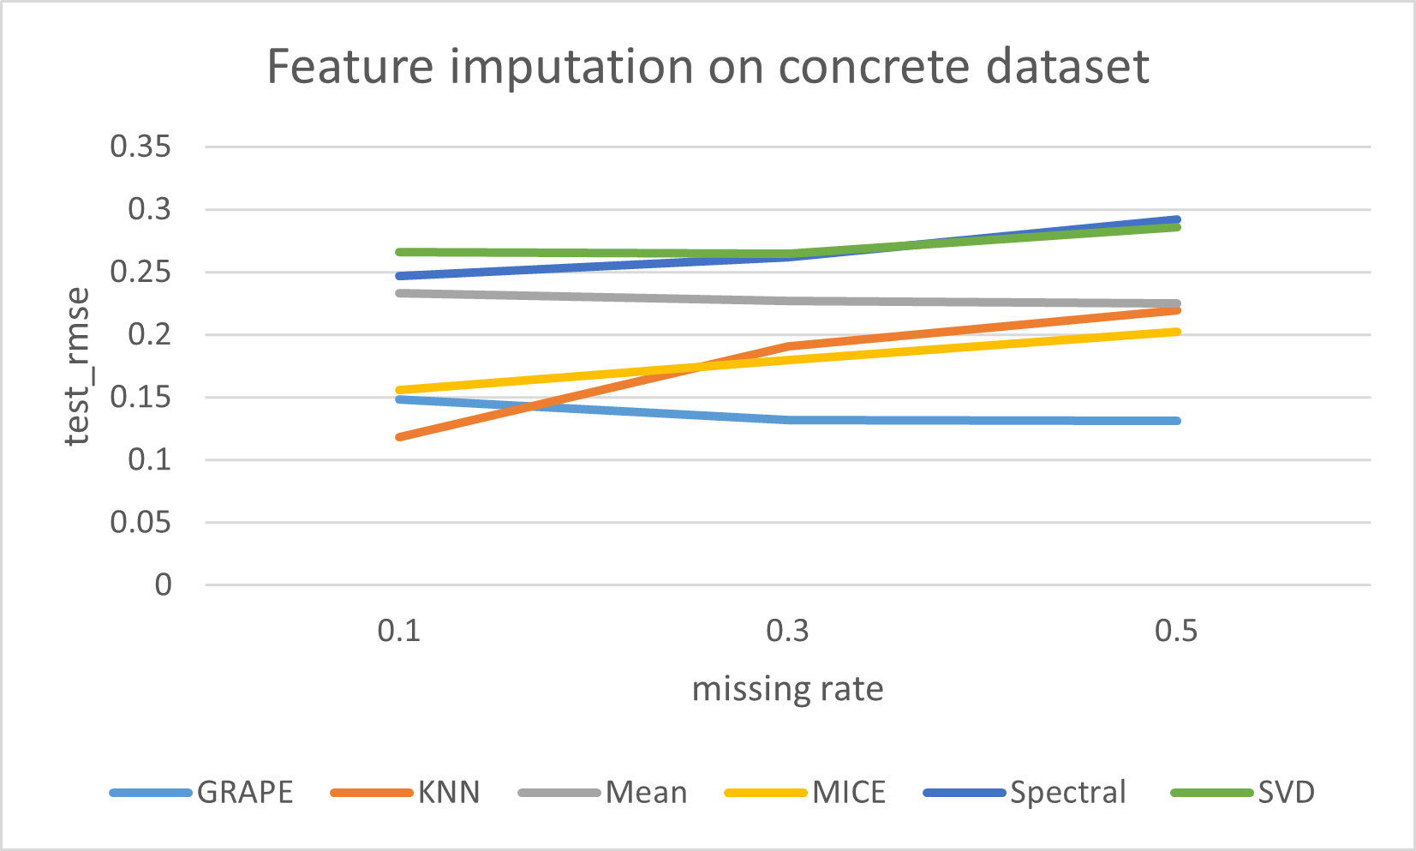
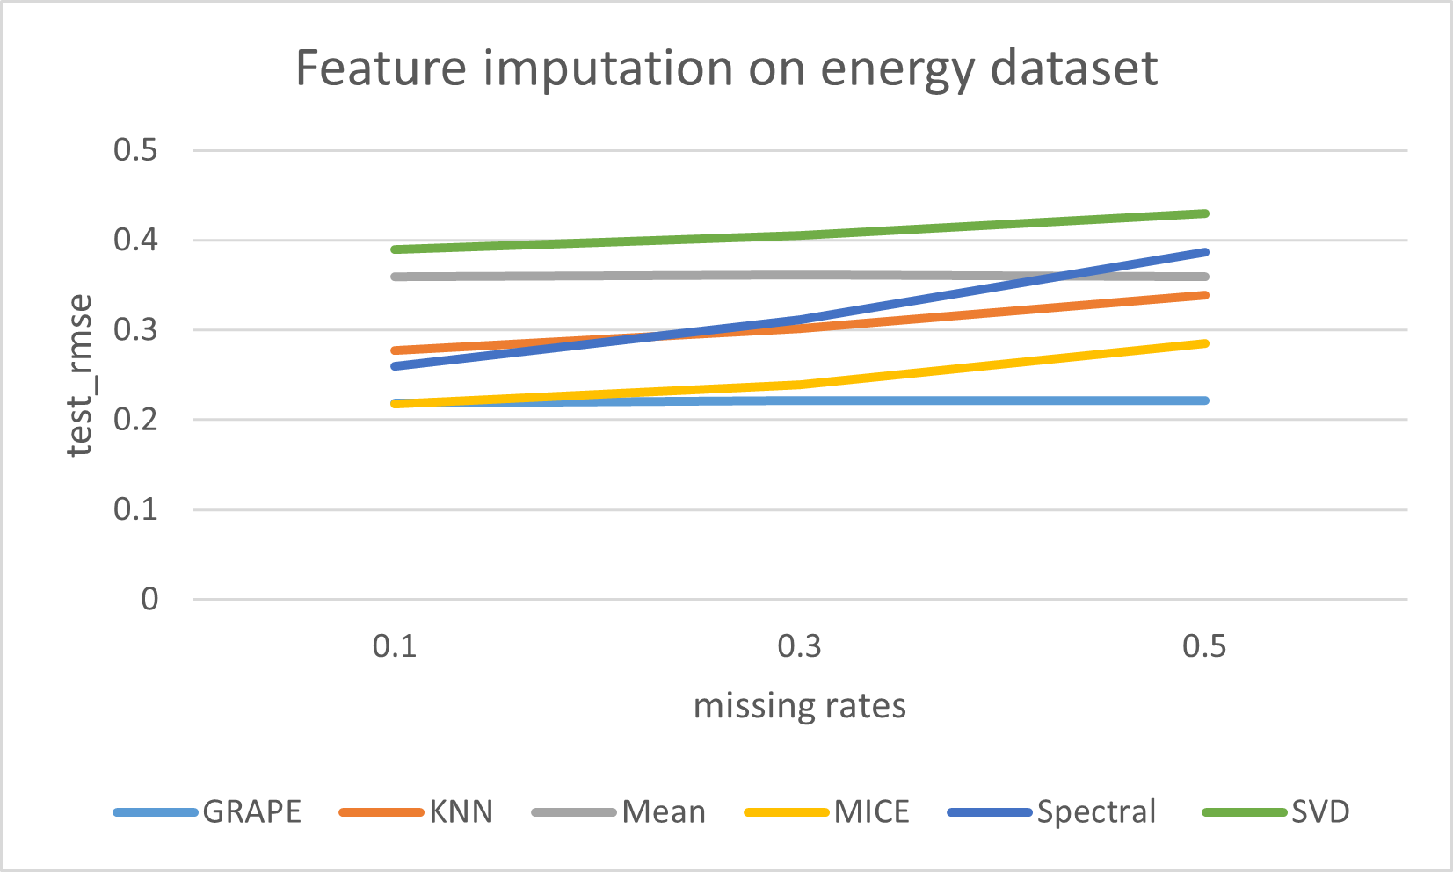
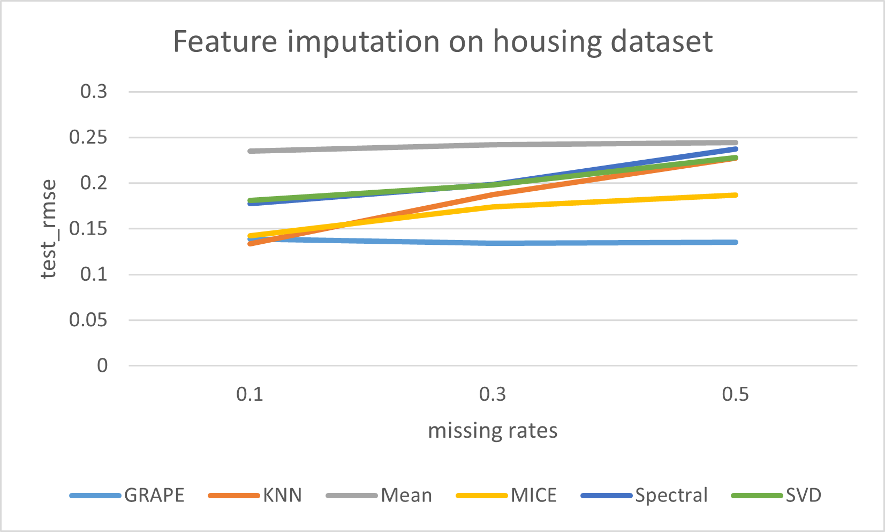
Experiment I: Feature Imputation at different missing rates
concrete
energy
housing

Slide 13
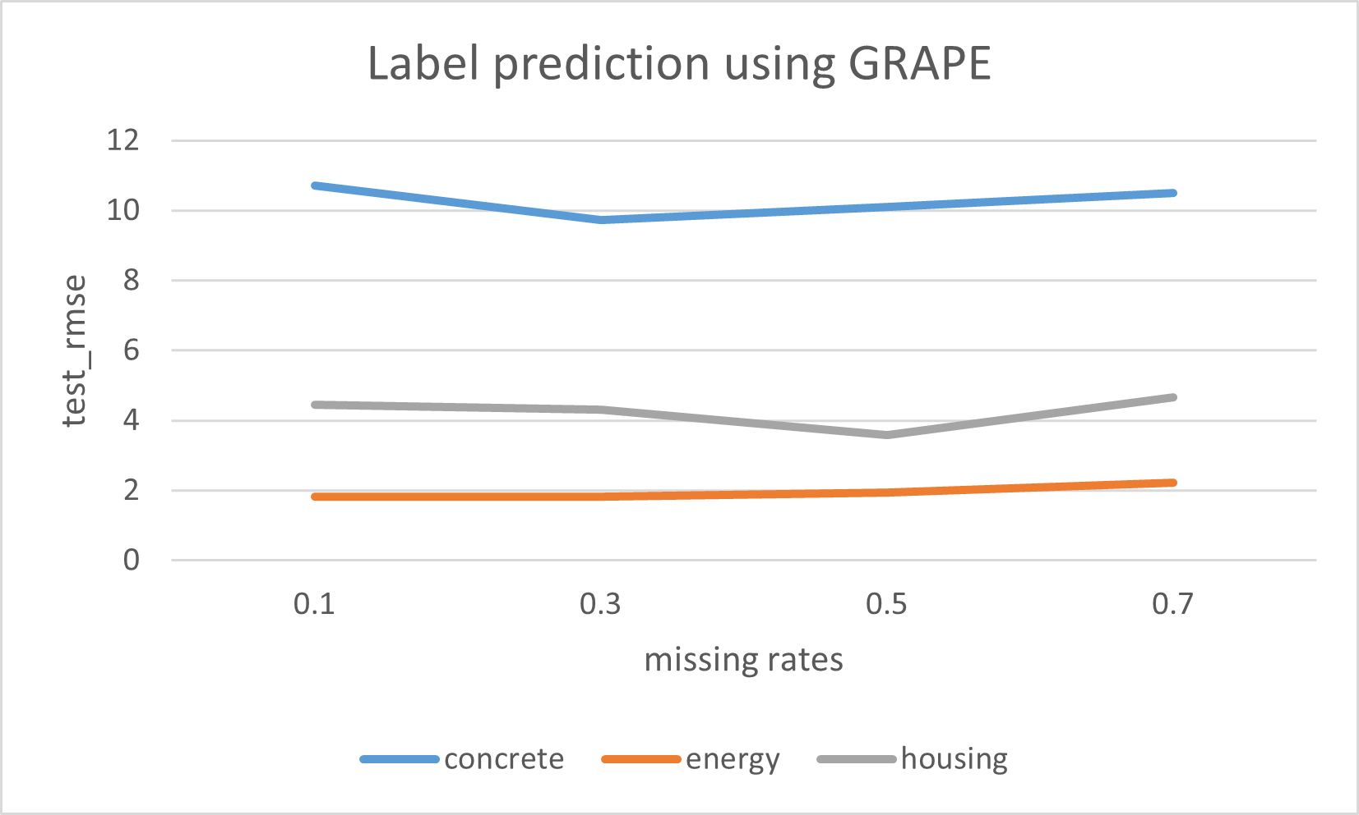
Experiment I: Label prediction using GRAPE
Shows GRAPE’s robustness against different missing data levels
Better handling of data (known and missing values are embedded in graph)
End-to-end training

Slide 14

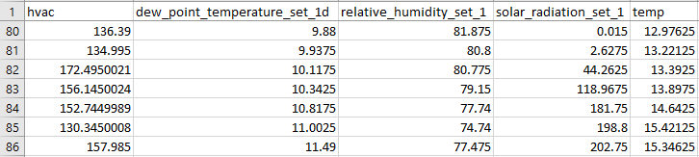
Experiment II
6000 epochs
Activation: RELU
Dataset
Time-series data (hvac dataset)
Obtained from Lawrence Berkeley National Lab (LBNL)
5000 rows, 5 columns
LBNL Building 59
A snippet of hvac dataset

Slide 15
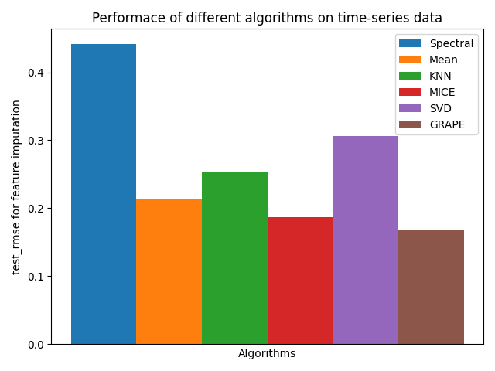
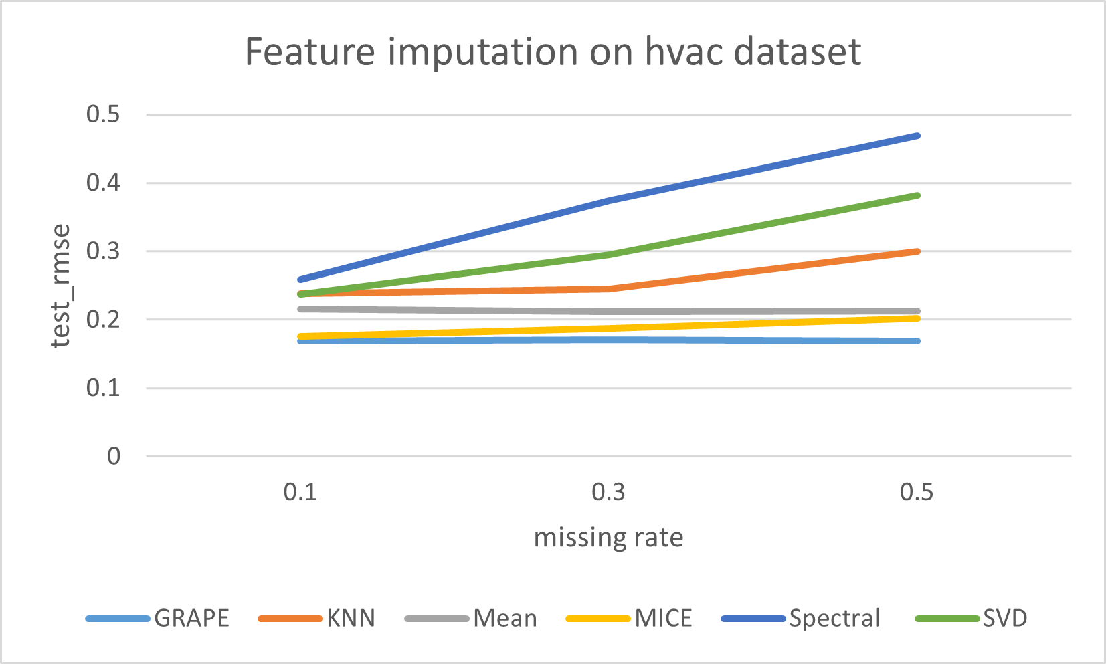
Experiment II: Feature Imputation on timeseries data
Feature imputation at missing rate 0.3
Feature imputation at different missing rates

Slide 16
Conclusion
GRAPE: graph-based approach to handle missing data
Feature Imputation: Edge-level prediction
Label Prediction: Node-level prediction
Experiment I
GRAPE performed better than baselines in feature imputation
GRAPE predicted labels consistently
Experiment II
GRAPE imputed timeseries data

Slide 17
Acknowledgements
Dr. Alina Lazar
Ohio Super Computing Center
UCI Machine Learning Repository
Lawrence Berkeley National Laboratory

Slide 18
References
Anesthesiol, K. J. A. (2013, May 1). The prevention and handling of the missing data. PubMed Central (PMC). https://www.ncbi.nlm.nih.gov/pmc/articles/PMC3668100
W. Hamilton, Z. Ying, and J. Leskovec. Inductive representation learning on large graphs. In Advances in Neural Information Processing Systems (NeurIPS), 2017.
Jiaxuan You, Xiaobai Ma, et.al. Handling Missing Data with Graph Representation Learning. Jiaxuan You, Xiaobai Ma, et.al. Neural Information Processing Systems (NeurIPS), 2020
Shutterstock. (2021). Purple grapes illustration isolated on white background [Image]. Shutterstock. https://www.shutterstock.com/image-vector/purple-grapes-illustration-isolated-on-white-1388695448
SSPS. (n.d.). Missing data: the hidden problem. Https://Www.Bauer.Uh.Edu/. Retrieved February 2021, from https://www.bauer.uh.edu/jhess/documents/2.pdf

Slide 19
GRAPE: Handling Missing Data using Graph Representation Learning
Rabin Thapa
Instructor: Dr. Alina Lazar

