Slide 1


FUSTAL MANAGEMENT SYSTEM
Achyut Thapa (52)
Aadarsha Thapa (51)
Prajwol Manandhar (32)
B.E.Computer Engineering
Kathmandu University

Slide 2
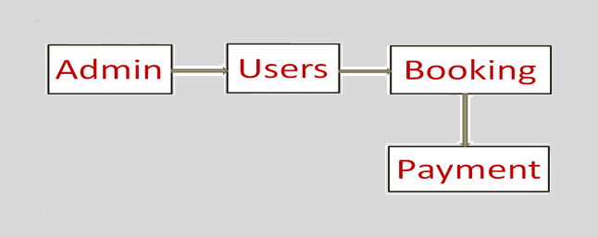
Agenda

Slide 3
Introduction
What is Futsal Management System?
● Futsal Management System is an application software developed in order to replace the existing futsal'’s register system.
● It has very interactive GUI, easier in billing system and efficient recording history of futsal.
●So, it makes futsal management systematic and efficient to use.

Slide 4
Objectives
To save the time of Futsal owners and players
To make the Futsal billing system easy
To grab the attention of players
Systematic and effective storing of Futsal databases

Slide 5
Features
Addition of multiple admins and users
Registration systems for teams and players
View information of every team and players
Stopwatch for managing time of gameplay
Billing system for Futsal and canteen

Slide 6


Tools Used
For Front-End:
Python
Tkinter
For Back-End:
MySQL
phpMyAdmin

Slide 7
Tkinter
Tkinter is an inbuilt python module used to create GUI
applications
Easy implementation of Tk widgets as Python classes
Features : Lightweight module, simpler, efficient and portability

Slide 8
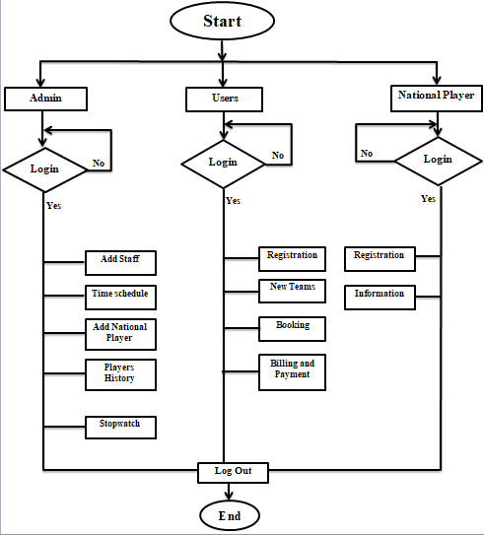
Flow Chart

Slide 9
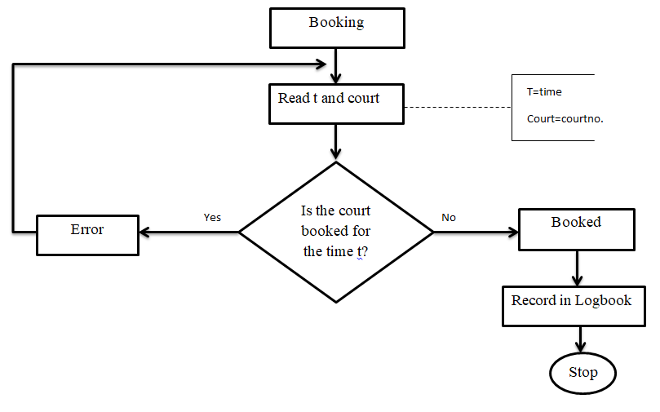
Booking Process

Slide 10
Limitations
No player feedback system
It cannot be used on mobile platforms
No online bill-payment methods
No feature of checking currently playing team and their information

Slide 11
Future Enhancements
Making GUI more interactive and user-friendly
Online bill payment system
Court-booking Online and SMS reminder system
Addition of Player feedback system
Implementation on mobile platforms

Slide 12
PROJECT DEMONSTRATION

Slide 13
THANK YOU !

