Slide 1
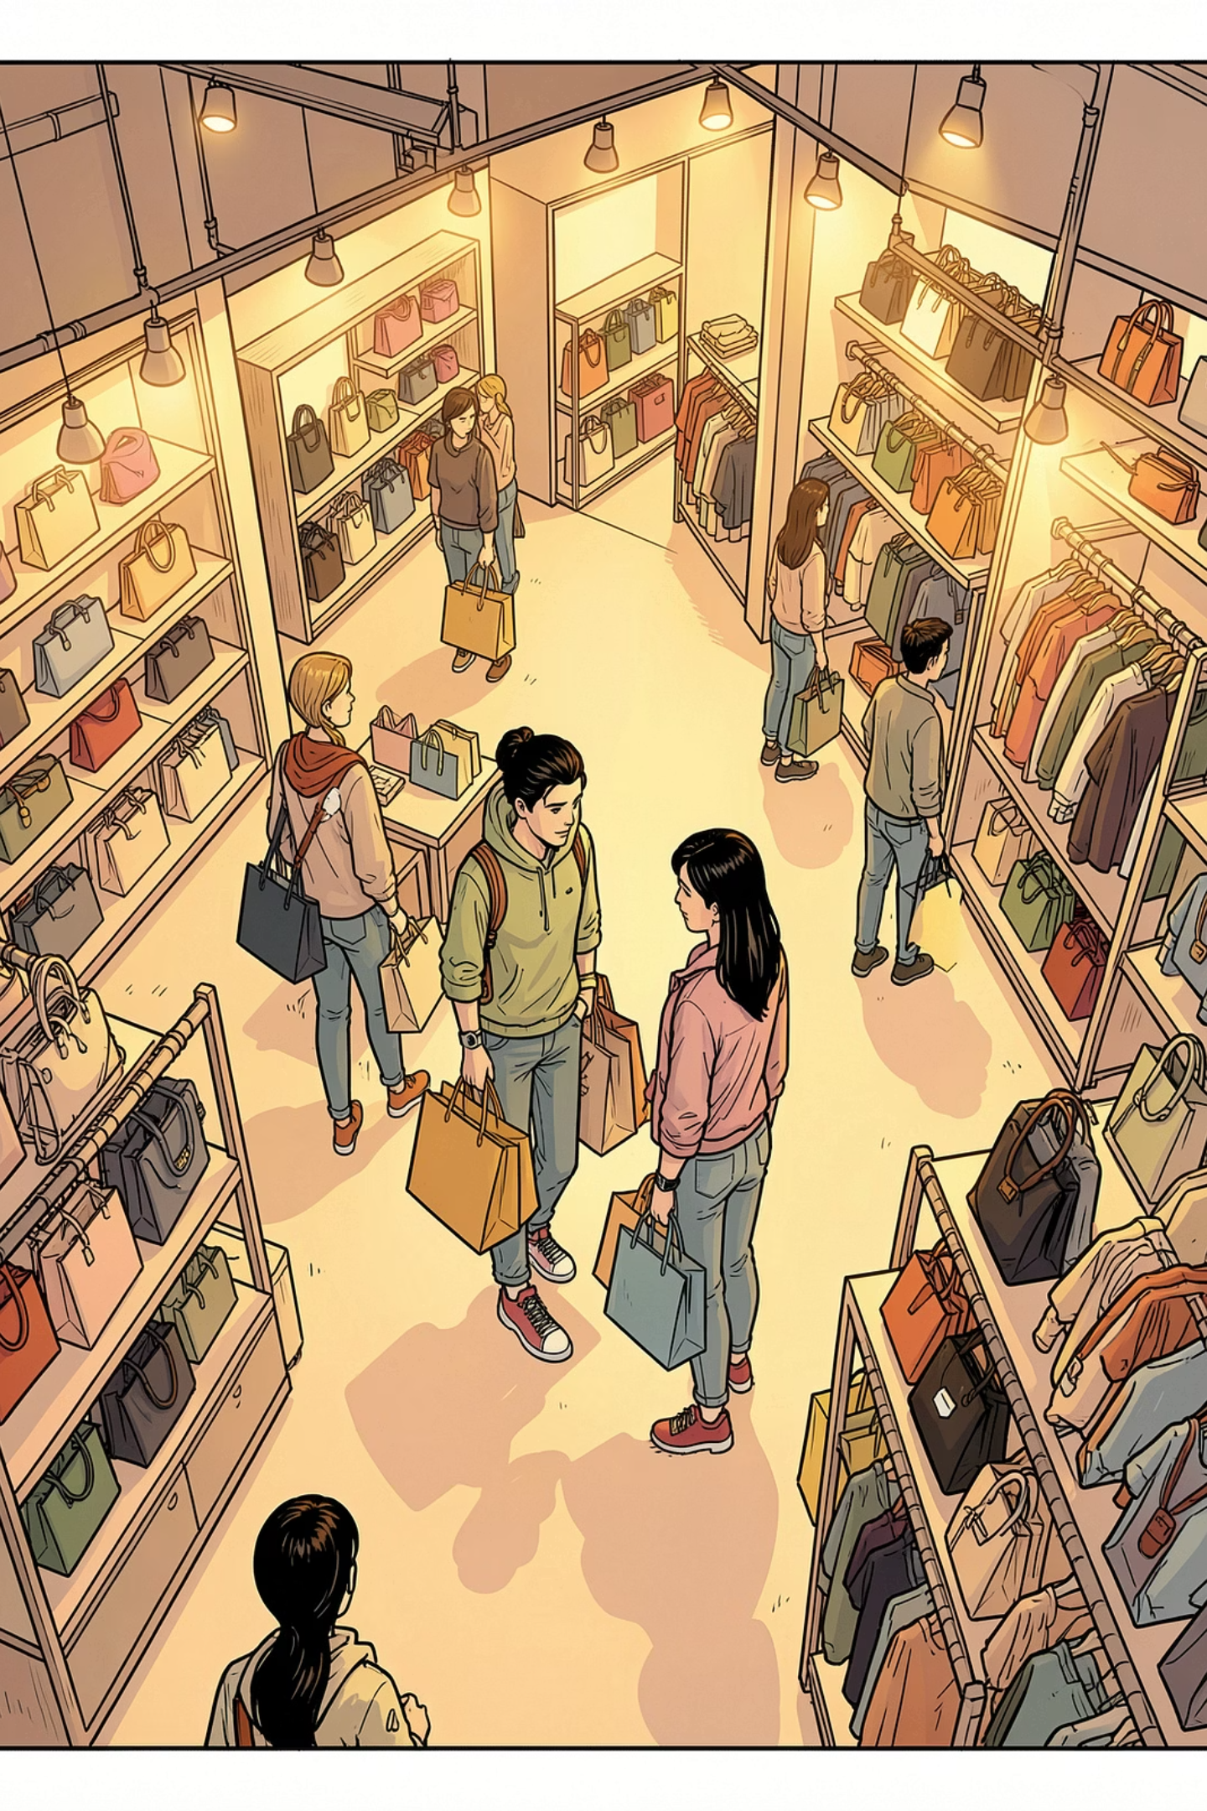
Customer Shopping Behavior Analysis
Uncovering spending patterns, customer segments, and product preferences from 3,900 transactions

Slide 2
Dataset at a Glance
3,900
18
Purchases
Features
37
$59.76
Missing Ratings
Avg. Purchase
Features span demographics, purchase details, and shopping behavior — including age, gender, subscription status, and discount usage.

Slide 3


Data Preparation in Python
Clean & Standardize
Imputed missing ratings; renamed columns to snake_case
Feature Engineering
Created age_group and purchase_frequency_days columns
Database Integration
Loaded cleaned data into PostgreSQL for SQL analysis

Slide 4
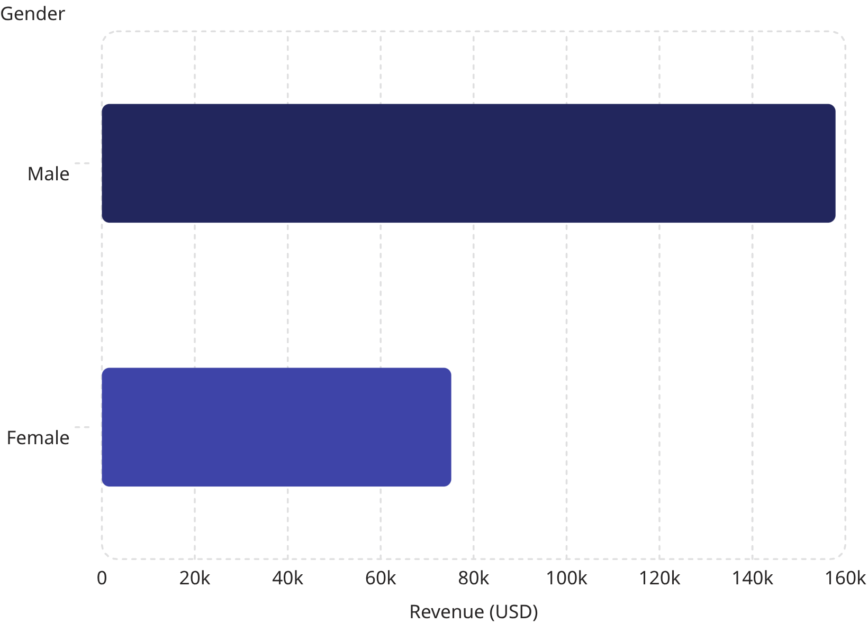

Revenue by Gender
Key Insight
Male customers generated 2.1× more revenue than female customers — a significant gap to explore in targeting strategy.
Male: $157,890 · Female: $75,191

Slide 5
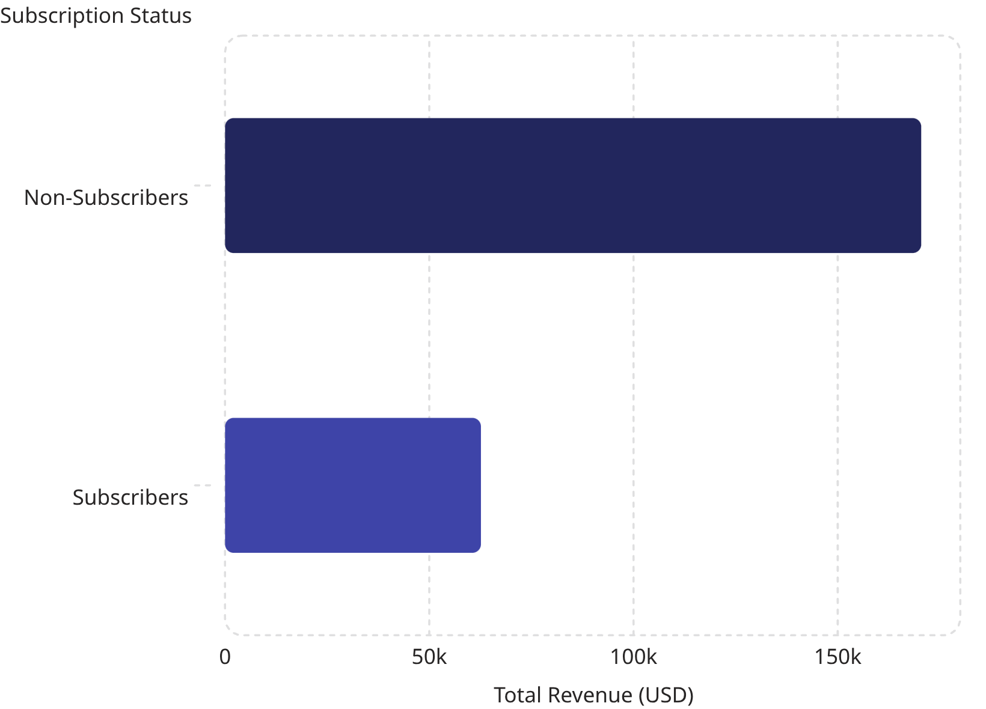

Subscribers vs. Non-Subscribers
Revenue Breakdown
Non-subscribers drive 73% of total revenue despite similar average spend.
Non-subscribers: 2,847 customers, $170,436 revenue
Subscribers: 1,053 customers, $62,645 revenue
Avg spend nearly identical: $59.49 vs $59.87

Slide 6
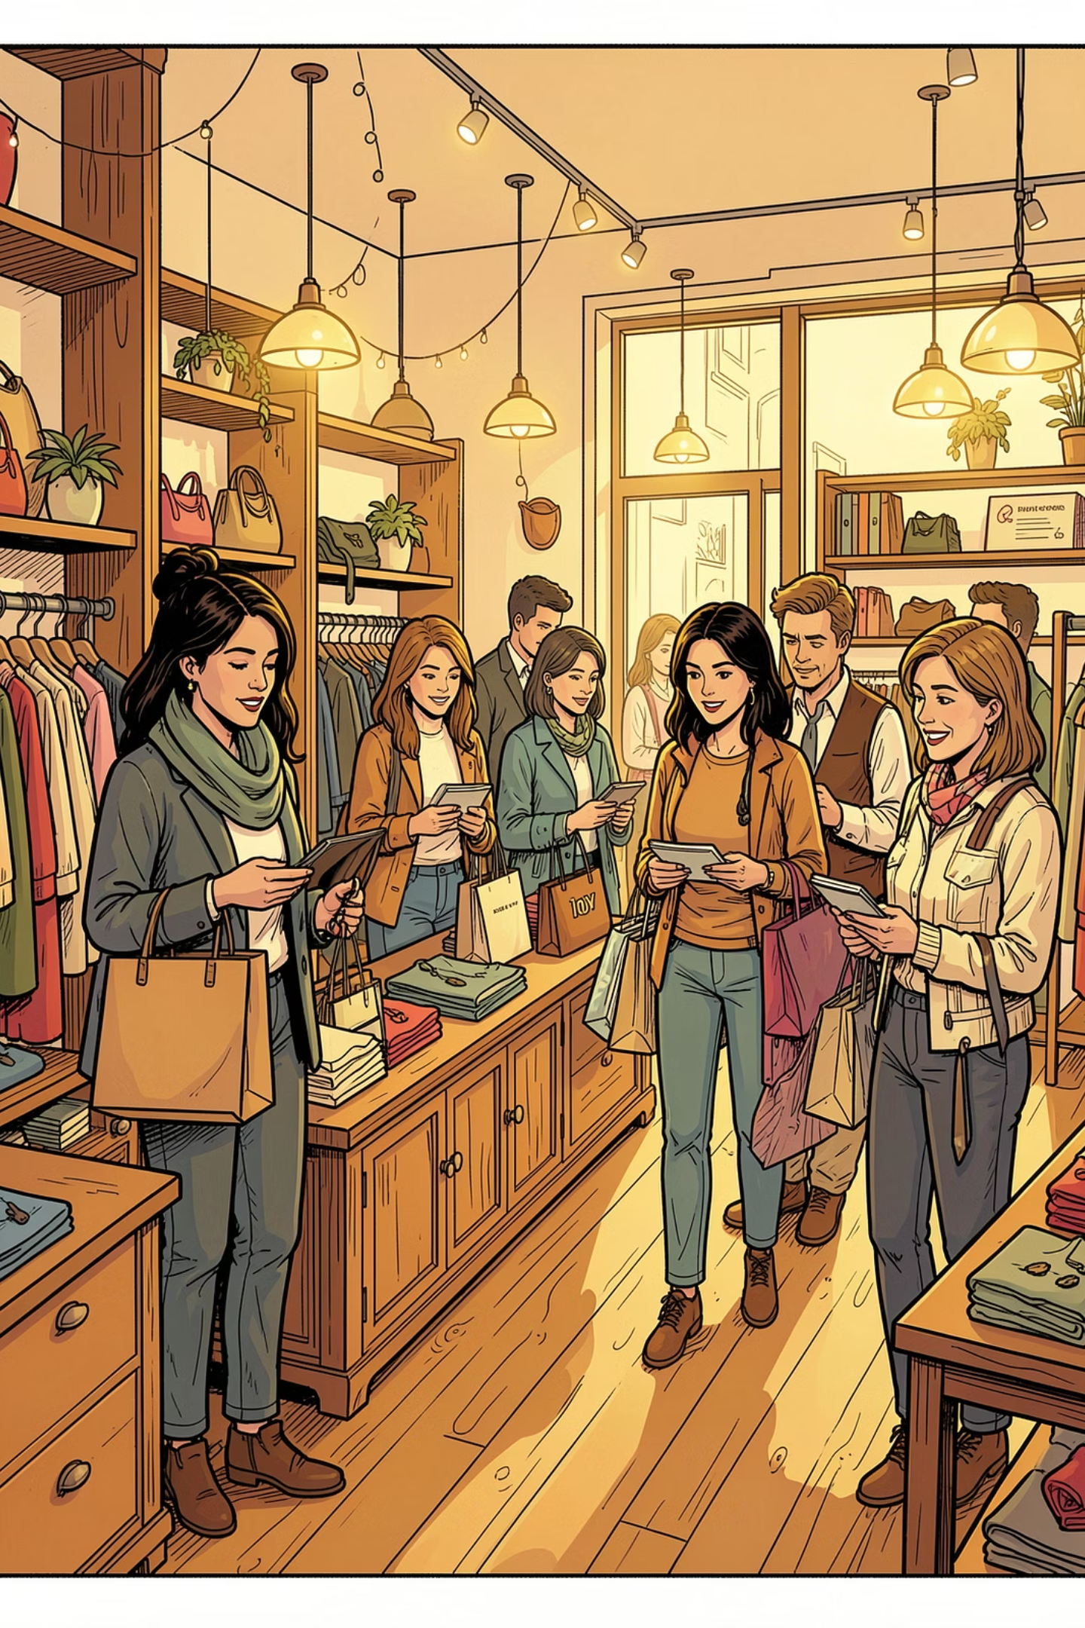
Customer Segmentation
Loyal
Returning
3,116 customers — the dominant segment
701 customers — growth opportunity
New
83 customers — smallest segment

Slide 7
Top Products & Categories
Top 5 by Review Rating
Top Products per Category
Accessories: Jewelry, Sunglasses, Belt
Clothing: Blouse, Pants, Shirt
Footwear: Sandals, Shoes, Sneakers
Outerwear: Jacket, Coat
Product
Avg Rating
Gloves
3.86
Sandals
3.84
Boots
3.82
Hat
3.80
Skirt
3.78

Slide 8
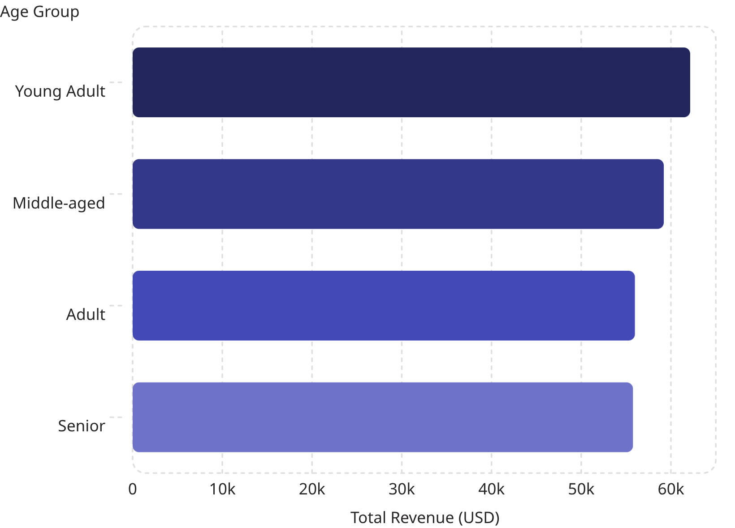
Revenue by Age Group
Even Distribution
Revenue is relatively balanced across age groups, with Young Adults leading slightly.
Young Adults: $62,143 · Seniors: $55,763

Slide 9
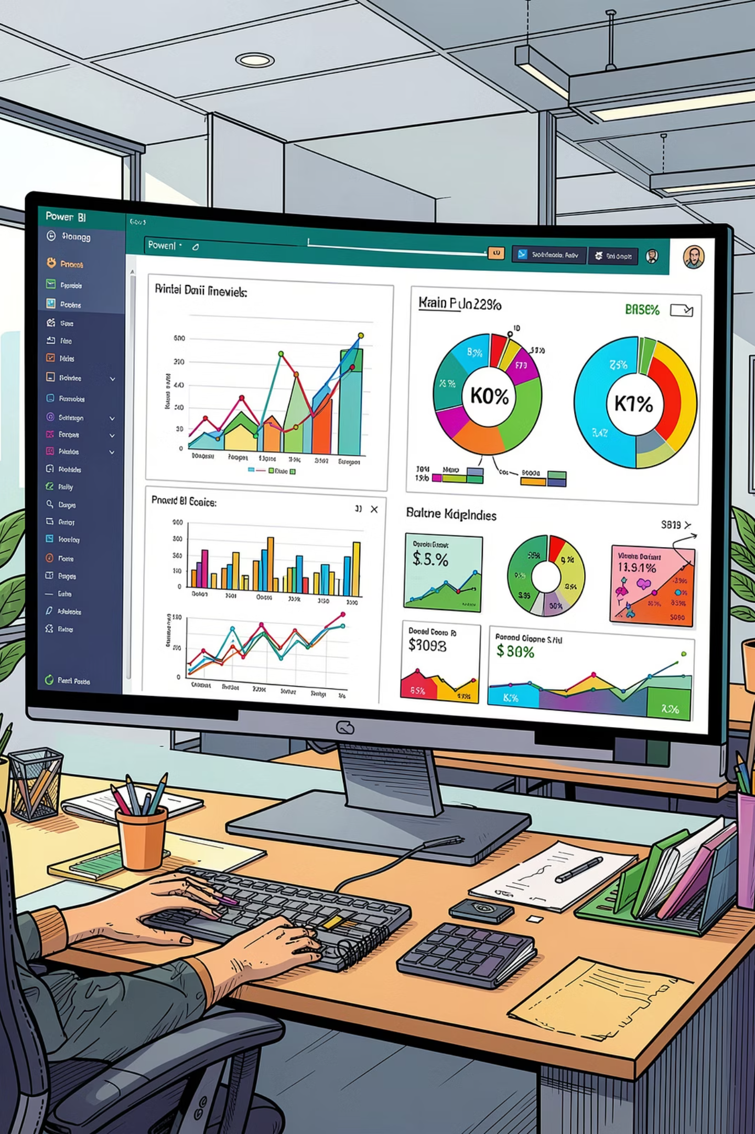
Power BI Dashboard
Interactive Filters
Subscription, Gender, Category, Shipping Type
Key Visuals
Revenue by Category & Age Group, Sales charts
Subscription Split
27% subscribers vs 73% non-subscribers

Slide 10
Business Recommendations
Boost Subscriptions
Loyalty Programs
Review Discount Policy
Promote exclusive subscriber benefits
Reward repeat buyers to grow the "Loyal" segment
Balance sales boosts with margin control
Product Positioning
Targeted Marketing
Highlight top-rated, best-selling products in campaigns
Focus on high-revenue age groups and express-shipping users

