Slide 1
Inheritance
One of the most important concepts in object-oriented programming is that of inheritance.
Allows us to define a class in terms of another class, which makes it easier to create and maintain an application.
This also provides an opportunity to reuse the code functionality and fast implementation time.

Slide 2
Inheritance
When creating a class, instead of writing completely new data members and member functions, the programmer can designate that the new class should inherit the members of an existing class.
This existing class is called the base class, and the new class is referred to as the derived class.

Slide 3
Base & Derived Classes
A class can be derived from more than one classes, which means it can inherit data and functions from multiple base classes. To define a derived class, we use a class derivation list to specify the base class(es). A class derivation list names one or more base classes and has the form:

Slide 4
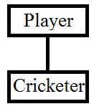
Single Inheritance
A
Base Class (Super Class)
B
Derived Class (Sub Class)

Slide 5
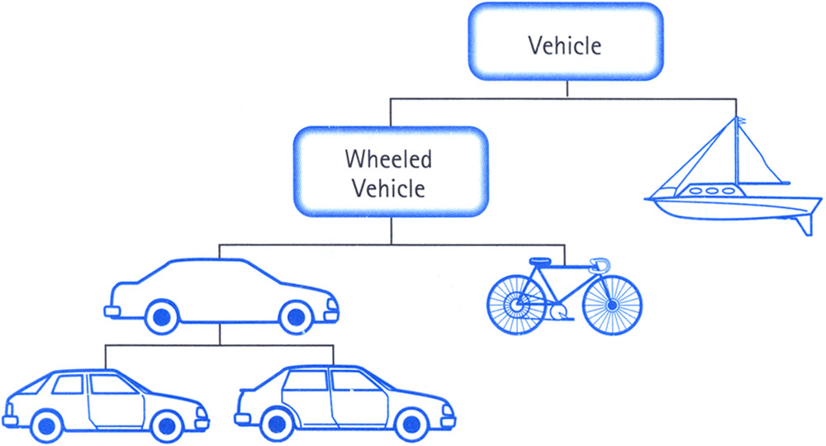
Multi-Level Inheritance
A
AnimalType
B
MammalType
Car
DogType
C

Slide 6
Multiple Inheritance
A
B
HouseType
BoatType
C
HouseBoatType

Slide 7
Hierarchical Inheritance
A
MobilePhoneType
B
C
D
AndroidType
IOSType
WindowsType

Slide 8
Hybrid Inheritance
A
AnimalType
B
C
HorseType
BirdType
D
PegasusType

Slide 9
C++ program to implement Hybrid Inheritance
Hybrid Inheritance is a method where one or more types of inheritance are combined together and used.
#include<iostream>
using namespace std;
class arithmetic
{
protected:
int num1, num2;
public:
void getdata()
{
cout<<"For Addition:";
cout<<"\nEnter the first number: ";
cin>>num1;
cout<<"\nEnter the second number: ";
cin>>num2;
}
};
arithmetic
B
C
D

Slide 10
C++ program to implement Hybrid Inheritance
Hybrid Inheritance is a method where one or more types of inheritance are combined together and used.
arithmetic
class myplus :public arithmetic
{
protected:
int sum;
public:
void add()
{
sum = num1 + num2;
}
};
plus
C
D

Slide 11
C++ program to implement Hybrid Inheritance
Hybrid Inheritance is a method where one or more types of inheritance are combined together and used.
arithmetic
class myminus
{
protected:
int n1, n2, diff;
public:
void sub()
{
cout << "\nFor Subtraction:";
cout << "\nEnter the first number: ";
cin >> n1;
cout << "\nEnter the second number: ";
cin >> n2;
diff = n1 - n2;
}
};
plus
minus
D

Slide 12
C++ program to implement Hybrid Inheritance
Hybrid Inheritance is a method where one or more types of inheritance are combined together and used.
arithmetic
class result :public myplus, public myminus
{
public:
void display()
{
cout << "\nSum of " << num1 << " and " << num2 << "= " << sum;
cout << "\nDifference of " << n1 << " and " << n2 << "= " << diff;
}
};
plus
minus
result

Slide 13
C++ program to implement Hybrid Inheritance
Hybrid Inheritance is a method where one or more types of inheritance are combined together and used.
arithmetic
void main()
{
result z;
z.getdata();
z.add();
z.sub();
z.display();
system("pause");
//getch();
}
plus
minus
result

Slide 14
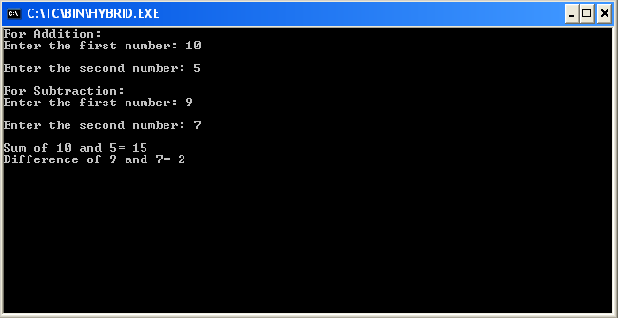
C++ program to implement Hybrid Inheritance
Hybrid Inheritance is a method where one or more types of inheritance are combined together and used.
arithmetic
plus
minus
result

