Slide 1
C++ Overloading (Function and Operator)
C++ allows you to specify more than one definition for a function name or an operator in the same scope, which is called function overloading and operator overloading respectively.
The process of selecting the most appropriate overloaded function or operator is called overload resolution.
Operators are treated like functions in C++
Operators have operands (parameters) and return types

Slide 2
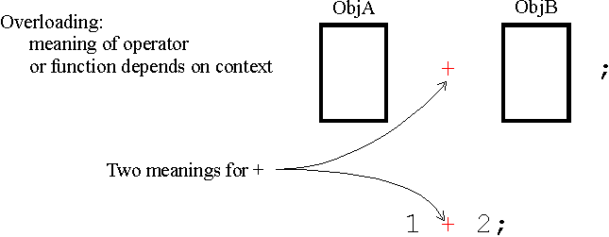
C++ Overloading (Function and Operator)
C++ compiler determines which function/operator to call based on the type, number and order or the arguments.
For example, many math functions/operators are overloaded for different numeric types

Slide 3
C++ Overloading (Function and Operator)
Some operators can not be overloaded:
:: - Scope resolution operator
. – member selection operator
Syntax errors:
void someFunction (int x, float y);
int someFunction (int x, float y);

Slide 4
Function overloading :
#include <iostream>
using namespace std;
class printData
{
public:
void print(int i)
{
cout << "Printing int: " << i << endl;
}
void print(double f)
{
cout << "Printing float: " << f << endl;
}
void print(char* c)
{
cout << "Printing character: " << c << endl;
}
};
int main(void)
{
printData pd; // Call print to print integer
pd.print(5); // Call print to print float
pd.print(500.263); // Call print to print character
pd.print("Hello C++");
return 0;
}
The definition of each overloaded function must differ from each other by the types and/or the number of arguments in the argument list.

Slide 5
Function overloading :
#include <iostream>
using namespace std;
class printData
{
public:
void print(int i)
{
cout << "Printing int: " << i << endl;
}
void print(double f)
{
cout << "Printing float: " << f << endl;
}
void print(char* c)
{
cout << "Printing character: " << c << endl;
}
};
int main(void)
{
printData pd; // Call print to print integer
pd.print(5); // Call print to print float
pd.print(500.263); // Call print to print character
pd.print("Hello C++");
return 0;
}
The definition of each overloaded function must differ from each other by the types and/or the number of arguments in the argument list.
Printing int: 5
Printing float: 500.263
Printing character: Hello C++

Slide 6
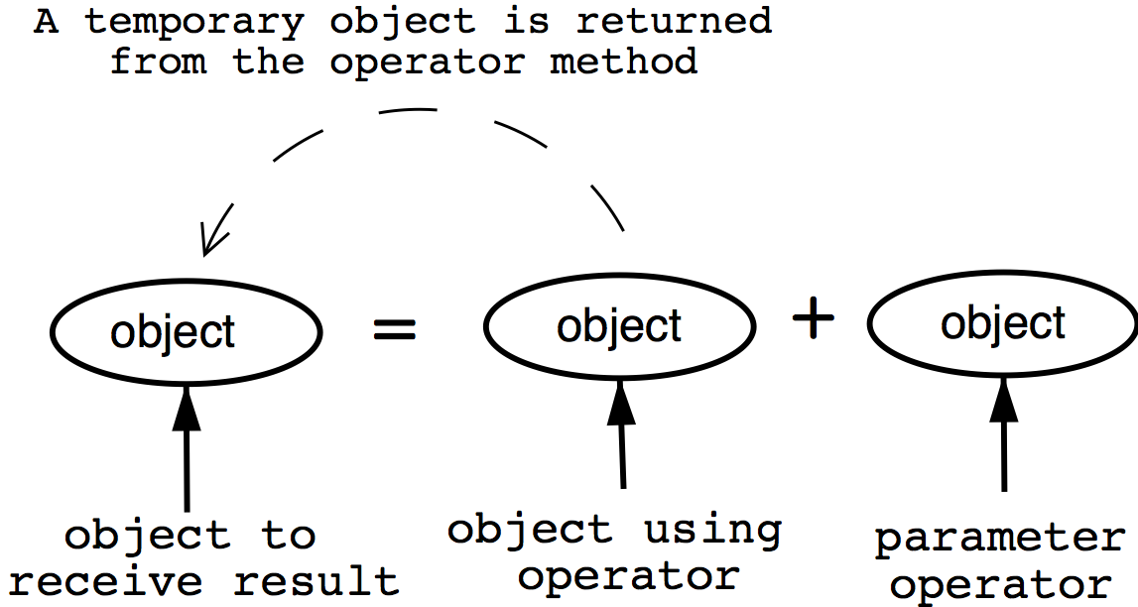
Operator overloading:
You can redefine or overload most of the built-in operators available in C++.
Thus a programmer can use operator overloading with user-defined types as well.

Slide 7
Operator overloading:
Overloaded operators are functions with special names the keyword operator followed by the symbol for the operator being defined.
Like any other function, an overloaded operator has a return type and a parameter list.
box1 = box2 + box3;
Box operator+(const Box&);

Slide 8
Box operator+(const Box&);
The statement above declares the addition operator that can be used to add two Box objects and returns final Box object. Most overloaded operators may be defined as ordinary non-member functions or as class member functions.
In case we define above function as non-member function of a class then we would have to pass two arguments for each operand as follows:
Box operator+(const Box&, const Box&);

Slide 9
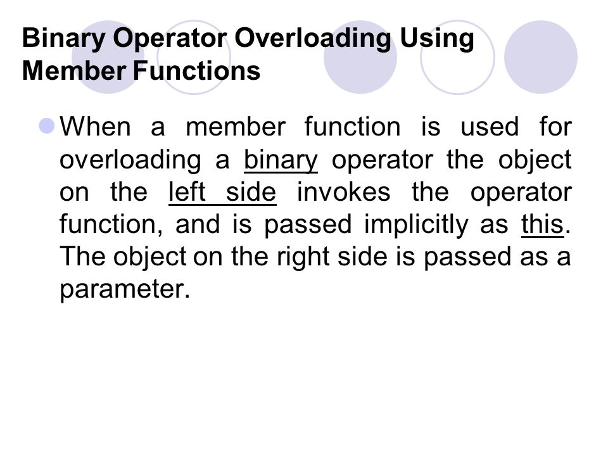
Operator overloading:
#include <iostream>
using namespace std;
class Box
{
public: double
getVolume(void){
return length * breadth * height;
}
void setLength( double len ){
length = len;
}
void setBreadth( double bre ){
breadth = bre;
}
void setHeight( double hei ){
height = hei;
}
// Overload + operator to add two Box objects. Box
operator+(const Box& b){
Box box;
box.length = this->length + b.length;
box.breadth = this->breadth + b.breadth;
box.height = this->height + b.height;
return box;
}
private:
double length; // Length of a box
double breadth; // Breadth of a box
double height; // Height of a box
};
Here is the example to show the concept of operator overloading using a member function.

Slide 10
Operator overloading:
// Main function for the program
int main( )
{
Box Box1; // Declare Box1 of type
Box Box Box2; // Declare Box2 of type Box
Box Box3; // Declare Box3 of type Box
double volume = 0.0; // Store the volume of a box here
// box 1 specification
Box1.setLength(6.0);
Box1.setBreadth(7.0);
Box1.setHeight(5.0);
// box 2 specification
Box2.setLength(12.0);
Box2.setBreadth(13.0);
Box2.setHeight(10.0);
// volume of box 1
volume = Box1.getVolume();
cout << "Volume of Box1 : " << volume <<endl;
// volume of box 2
volume = Box2.getVolume();
cout << "Volume of Box2 : " << volume <<endl;
// Add two object as follows:
Box3 = Box1 + Box2;
// volume of box 3
volume = Box3.getVolume();
cout << "Volume of Box3 : " << volume <<endl;
return 0;
}
Here is the example to show the concept of operator overloading using a member function. The following is the output of this code:
Volume of Box1 : 210
Volume of Box2 : 1560
Volume of Box3 : 5400

Slide 11
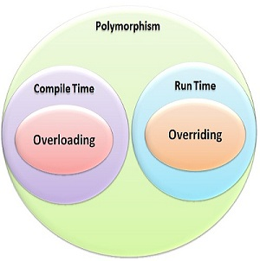
Polymorphism in C++
The word polymorphism means having many forms. Typically, polymorphism occurs when there is a hierarchy of classes and they are related by inheritance.
Overriding is a concept used in inheritance which involves a base class implementation of a method. Then in a subclass, you would make another implementation of the method.

Slide 12
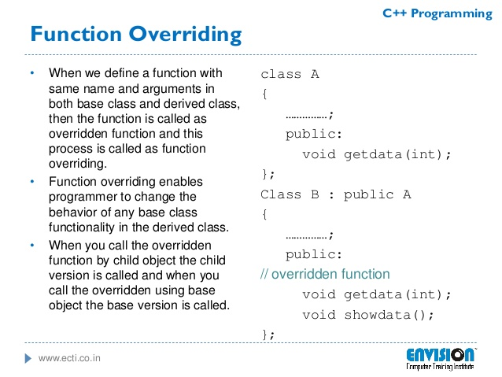

Slide 13
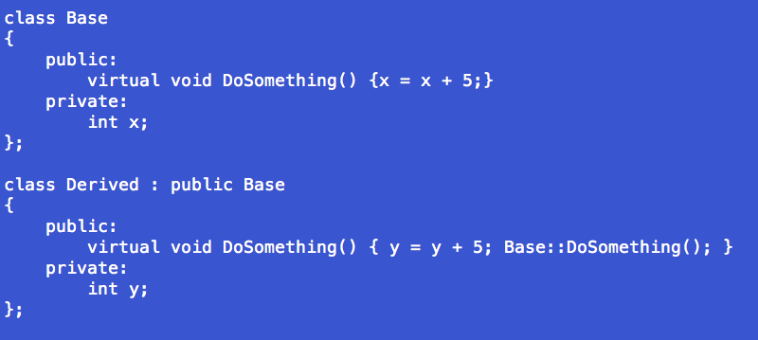
Function overriding: another example
Here you can see that the derived class overrides the base class method DoSomething to have its own implementation where it adds to its variable, and then invokes the parent version of the function by calling Base::DoSomething() so that the x variable gets incremented as well. The virtual keyword is used to that the class variable can figure out which version of the method to call at runtime.

Slide 14
