Slide 1
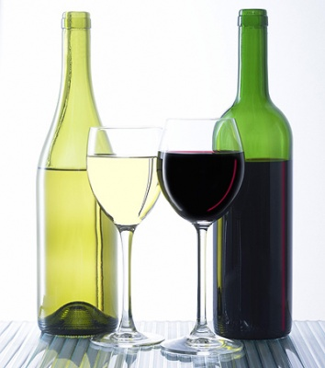
Version 2.0
Weka Assignment 3
(Put your name here)
When completed, submit this assignment to
the associated D2L Weka Tutorial 2 dropbox.
Weka Assignment 3

Slide 2
Your task for this assignment: Design a simple, low-cost sensor that can distinguish between red wine and white wine.
Your sensor must correctly distinguish between red and white wine for at least 95% of the samples in a set of 6497 test samples of red and white wine.
Your technology is capable of sensing the following wine attributes:
- Fixed acidity - Free sulphur dioxide
- Volatile acidity - Total sulphur dioxide
- Citric acid - Sulphates
- Residual sugar - pH
- Chlorides - Alcohol
- Density
To keep your sensor cheap and simple, you need to sense as few of these attributes as possible to meet the 95% requirement.
Question: Which attributes should your sensor be capable of measuring?
Weka Assignment 3

Slide 3
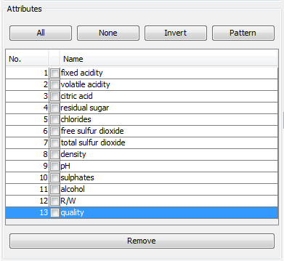
Go to www.technologyforge.net/Datasets and download WineQuality.zip.
Unzip the folder and read WineQuality.pdf.
Open the WineQuality.arff file in Weka, and remove the quality attribute, which you will not need for this assignment.
Run J48 with default set-up to see what kind of percent correct classification results you get using all attributes.
Remove attributes to find the minimum
number of attributes needed to meet
the 95% correct classification requirement.
Remove
Weka Assignment 3

Slide 4
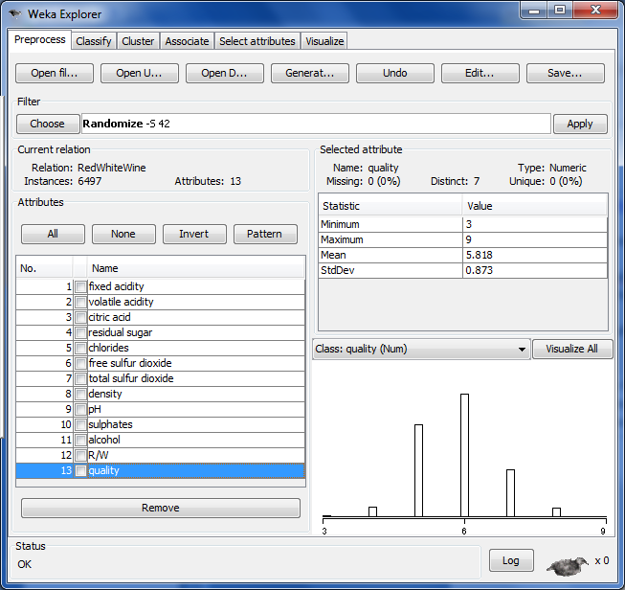
Use these buttons to simplify the task of removing attributes
You can use these buttons to simplify the task of removing attributes
Weka Assignment 3

Slide 5
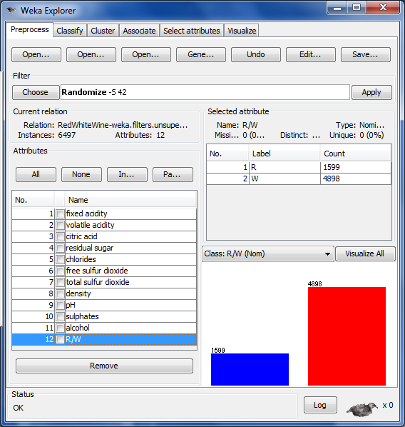
(Paste a screenshot showing your minimum attribute set here)
Weka Assignment 3

Slide 6
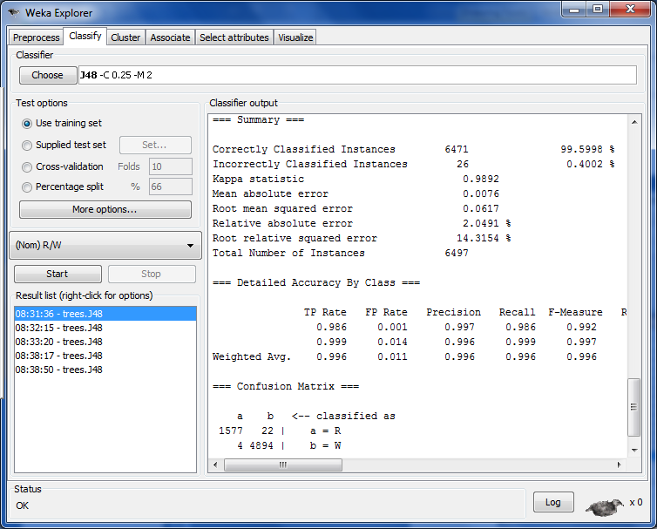
(Paste a screenshot showing your results for your minimum attribute set here)
Weka Assignment 3

