Slide 1
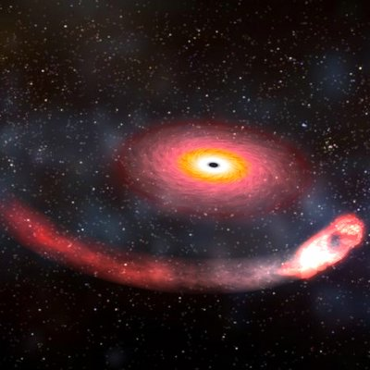
Version 2.0
Weka
Assignment 4
(Put your name here)
When completed, submit this assignment to
the associated D2L Weka Tutorial 2 dropbox.
Weka Assignment 4

Slide 2
Goal of this assignment: Use clustering and classification to develop rules for distinguishing between different types of gamma ray bursts.
Go to www.technologyforge.net/Datasets, download GammaRayBursts.zip, and read the .pdf file.
According to this article http://www.internationalreporter.com/News-736/nasa-solves-gamma-ray-burst-mystery.html , scientists have determined that there are two different sources of gamma ray bursts.
You figure that the best way for you to be promoted to tenured full professor of astronomy at Springfield Community College is to score some big publicity coup, so you decide to try and prove that there are not two but actually three different types of gamma ray bursts.
So what you want to do is first cluster the dataset into three clusters, then develop rules for distinguishing among the clusters using the attributes in the dataset.
But wait! There’s more!
Weka Assignment 4

Slide 3
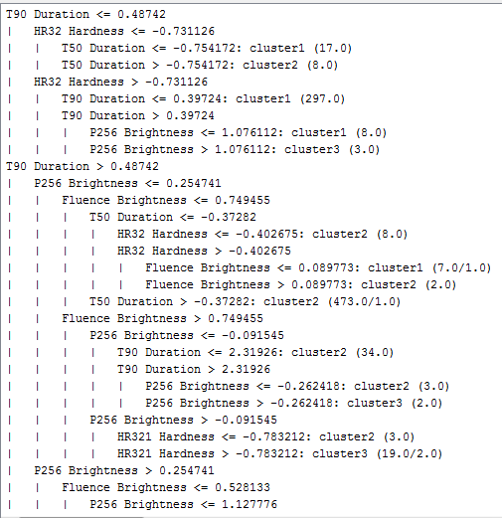
Your astronomical buddies are skeptical of this whole data mining thing, so will not accept a rule set like this.
You need to present your findings as a decision tree with only two attributes and three leaves, one for each of your clusters.
Att. 1
Cluster 1
Att. 2
Cluster 2
Cluster 3
Weka Assignment 4

Slide 4
Your strategy:
Standardize the dataset.
Use SimpleKMeans and AddCluster to create 3 clusters.
Use J48 and minNumObj to create a tree with two attributes and three leaves, as shown below.
Repeat 2 and 3 using just the two attributes used in your decision tree.
Provide the results from Step 4 only, as designated on the following slides.
Att. 1
Cluster 1
Att. 2
Cluster 2
Cluster 3
Weka Assignment 4

Slide 5
(Put “Visualize cluster assignments” here, with your two selected attributes as the axes)
Weka Assignment 4

Slide 6
(Put “Visualize tree” for the rules created using your two attributes here)
Weka Assignment 4

