Slide 1
Version 2.0
Weka Assignment 1
NITESH SINGH
Weka Assignment 1

Slide 2
The purpose of this assignment is to verify that you have Weka installed and running.
Go to www.technologyforge.net/Datasets and download WineCultivars.zip.
Unzip the folder and read WineCultivars.pdf.
Convert WineCultivars.xls file to .csv format and save as WineCultivarsX.csv (for safety sake, do not overwrite WineCultivars.csv file included in the .zip folder),
Open WineCultivars.csv in Weka Explorer.
Save as WineCultivarsX.arff (do not overwrite WineCultivars.arff).
Using the “Visualize All” button, display histograms of all attributes on one screen.
Take a screen shot and paste it onto the following slide.
Weka Assignment 1

Slide 3
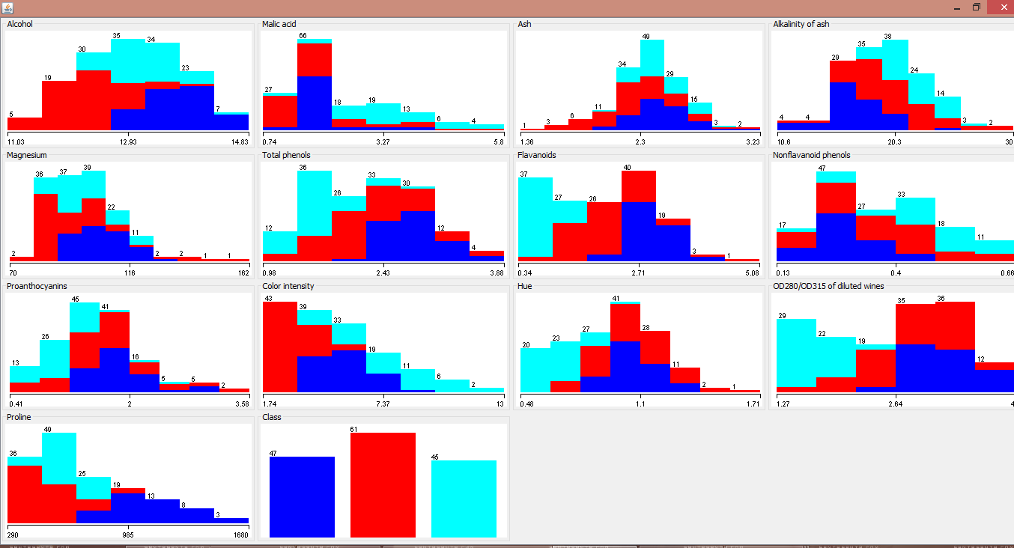
(Paste your screen shot here)
Weka Assignment 1

