Slide 1
Version 2.0
Weka
Assignment 2
Nitesh Singh
Weka Assignment 2

Slide 2
The purpose of this assignment is to make sure that you can perform discretization and scaling functions using Weka filters.
Assignment Part 1 – Scaling:
Start Weka Explorer and open the WineCultivarsX.arff file that you saved in Weka Assignment 1.
Normalize the dataset
Using the “Visualize all” button, paste a screenshot of all the attribute histograms on the following designated slide.
Using all the default settings, apply the J48 classifier to the dataset.
Cut and paste a screenshot of the resulting confusion matrix on the following designated slide.
Weka Assignment 2

Slide 3
Assignment Part 2 – Discretization:
Discretize the dataset using 12 bins and equal frequency binning.
Using the “Visualize all” button, paste a screenshot of all the attribute histograms on the following designated slide.
Using the default settings apply the J48 classifier to the dataset.
Cut and paste a screenshot of the resulting confusion matrix on the following designated slide.
Weka Assignment 2

Slide 4
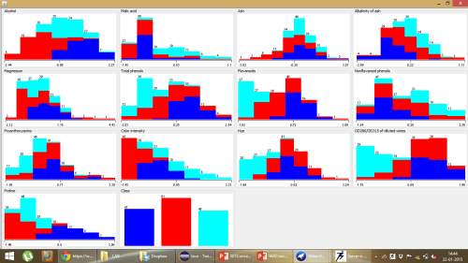
(Paste “Visualize All” histograms for normalized dataset here)
Weka Assignment 2

Slide 5
(Paste confusion matrix for J48 classification of normalized dataset here)
=== Confusion Matrix ===
a b c <-- classified as
42 5 0 | a = A
1 59 1 | b = B
1 4 40 | c = C
Weka Assignment 2

Slide 6
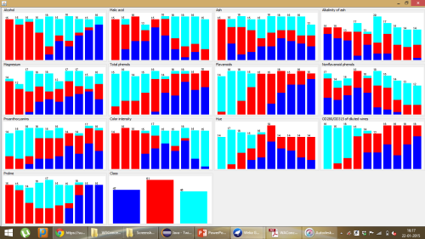
(Paste “Visualize All” histograms for discretized dataset here)
Equal Frequency
Weka Assignment 2

Slide 7
(Paste confusion matrix for J48 classification of discretized dataset here)
=== Confusion Matrix ===
a b c <-- classified as
43 4 0 | a = A
9 46 6 | b = B
0 5 40 | c = C
Weka Assignment 2

