Slide 1
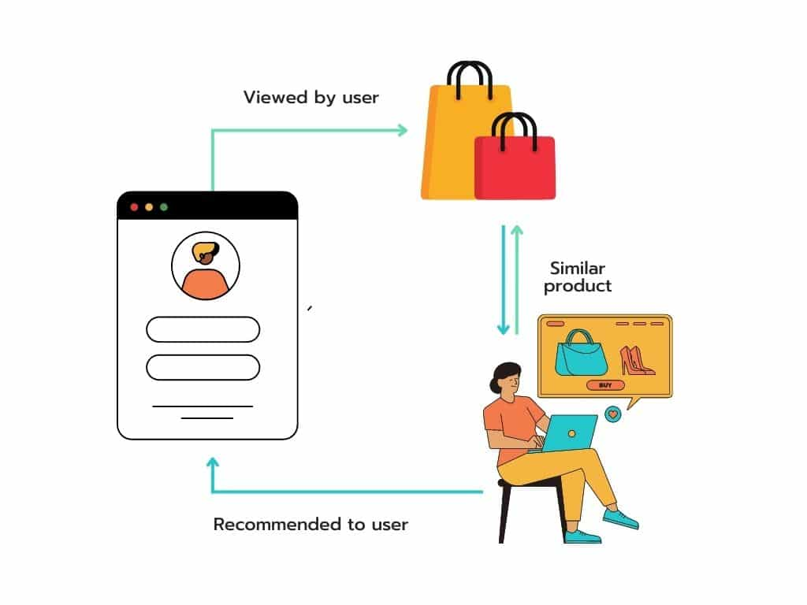
Fashion Products Recommender

Slide 2
Sujan Thapa
Team Members
Raman Chaudhary
Project Supervisor:
Dipraj Kayastha
Anish Chaudhary

Slide 3
Contents
Introduction
Problem Statement
Objectives
Flowchart
Tools & Technologies
Dataset description
Block Diagram
Algorithm Used
Testing of system
SCORE Analysis
Design Model
Challenges Faced
Scope
Future Enhancement
Conclusion

Slide 4
Introduction
A Fashion Products Recommender is a system that uses machine learning to suggest similar products based on input images.
In our project, We leverage neural networks to analyze fashion images and employ a nearest neighbor algorithm to generate personalized recommendations.

Slide 5
Problem Statement
With vast range of product options, decision-making in fashion becomes challenging.
Fashion retailers encourage customers to explore their full product range, which isn't possible in physical stores.

Slide 6
Objectives
To build a system which recommend products based on similar users interests.
To leverage visual features from input images & suggest fashion products with similar styles.

Slide 7
Flowchart

Slide 8
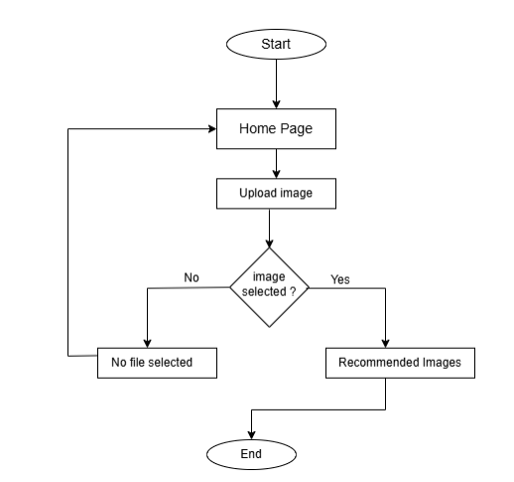

Slide 9
Tools & Technologies
Frontend : HTML, CSS
Backend: Python & its libraries, Django
Development Environment: Jupyter Notebook, VS Code
Architecture: MVT (model-view-template)
Hardware Requirements: processor (i3 or higher) ,
RAM (minimum 8gb),
storage (minimum 128gb).

Slide 10
Dataset Description
Dataset source: Kaggle
Dataset details: dataset included over 10,000 image samples representing various categories of fashion products.

Slide 11
Block Diagram

Slide 12
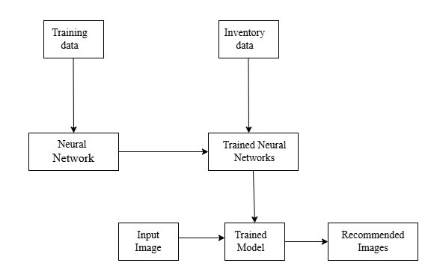

Slide 13
Algorithm Used
ResNet50
ResNet50 is a common neural network architecture used for deep learning computer vision applications like object detection and image segmentation. It can contain a large number of convolutional layers. It is used in our project for feature extraction of images.
k-Nearest Neighbors (k-NN)
K-Nearest Neighbor is one of the simplest Machine Learning algorithms based on Supervised Learning technique. It is used to identify similar images based on their features.

Slide 14
Testing of System
White Box Testing
Test I: Image Features Extraction
Result: The features from all the datasets are extracted successfully, preparing them for model training
Test II: Dumping the extracted features to train model
Result : Two machine learning models are successfully trained and ready for use.
Test III: Uploaded image to be saved in directory
Result: Saved Successfully

Slide 15
Testing of System
Black Box Testing
Test I: Empty file upload field
Result: Pop-up a message to select a file first
Test II: File selected and uploaded successfully
Result: Uploaded image and recommendations are displayed

Slide 16
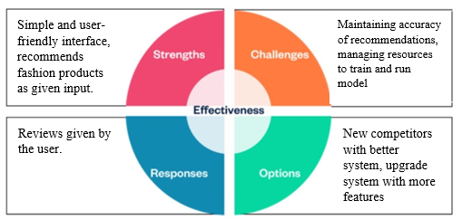
SCORE Analysis

Slide 17
Design Model

Slide 18
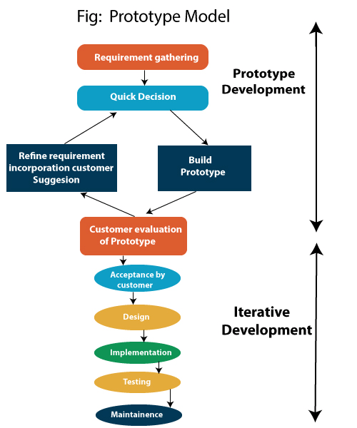

Slide 19
Challenges Faced
Challenge
Computational Resource Constraints: Limited computational resources failed during training of model using larger datasets.
Solution
Dataset Optimization: To mitigate resource limitations, we utilized a smaller, more manageable dataset, which might have impacted the model's overall performance.

Slide 20
Scope
Image-Based Recommendations: Empower users to find fashion inspiration by uploading images and receiving tailored product suggestions.
Visual Search Integration: Enhance the shopping experience by allowing users to search for products using images, simplifying the process of finding desired items.
Improved Sales Performance: Boost sales by helping customers discover new products and complete purchases more efficiently.

Slide 21
Future Enhancement
Expanded Fashion Preferences: Incorporate a broader range of styles and trends, including personalized recommendations based on user history, social media, and seasonal influences.
Enhanced User Experience: Introduce a virtual try-on feature to allow users to visualize how different clothing items would look on them.

Slide 22
Conclusion
The Fashion Product Recommender successfully integrates machine learning and web development to address real-world fashion challenges.
The system's user-friendly interface, efficient feature processing, and scalable architecture contribute to its overall success.
The project demonstrates the potential of combining machine learning and web development technologies to create innovative solutions in the fashion industry.

Slide 23
Thank You

Slide 24
Demo

Slide 25
Any Questions…

