Slide 1
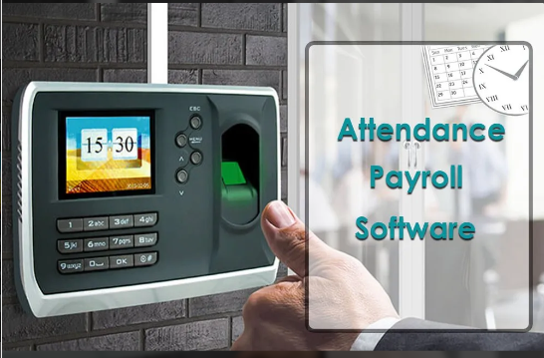
Attendance Payroll Management System
System

Slide 2
Sujan Thapa
Team Members
Raman Chaudhary
Project Supervisor:
Suman Dhital
Anish Chaudhary

Slide 3
Contents
Introduction
Problem Statement
Objectives
Flowchart
Tools & Technologies
ER Diagram
SCORE Analysis
Testing of system
Design Model
DFD
Scope
Future Enhancement
Conclusion

Slide 4
Introduction
APMS is a system used to streamline and manage employee payments according to their attendance.
It tracks the employees attendance and calculates total payment based on their working hours, calculates & deducts the tax automatically.
Different interface for admin and employee.
So, it will be fruitful to use as fully developed website for the attendance.

Slide 5
Problem Statement
Organizations are facing lot of challenges for effectively managing employee attendance and payroll.
Manual and file based recording of data is time consuming & prone to errors.
Available commercial systems in the market are much expensive.

Slide 6
Objectives
To manage attendance and calculate payments for employees.
To develop user friendly interface.

Slide 7
Flowchart

Slide 8
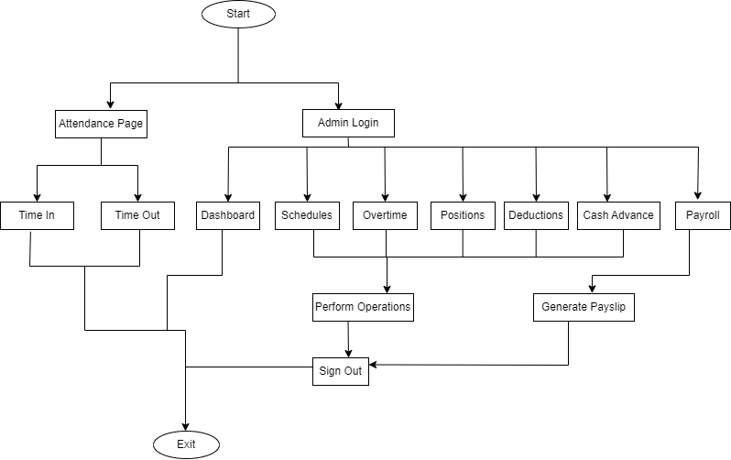

Slide 9
Tools & Technologies
Frontend : HTML, CSS, JS, Bootstrap
Backend: PHP, MySQL, XAMPP Apache Server
Hardware Requirements: processor (i3 or higher) ,
RAM (minimum 2gb),
storage (minimum 128gb).

Slide 10
ER Diagram

Slide 11
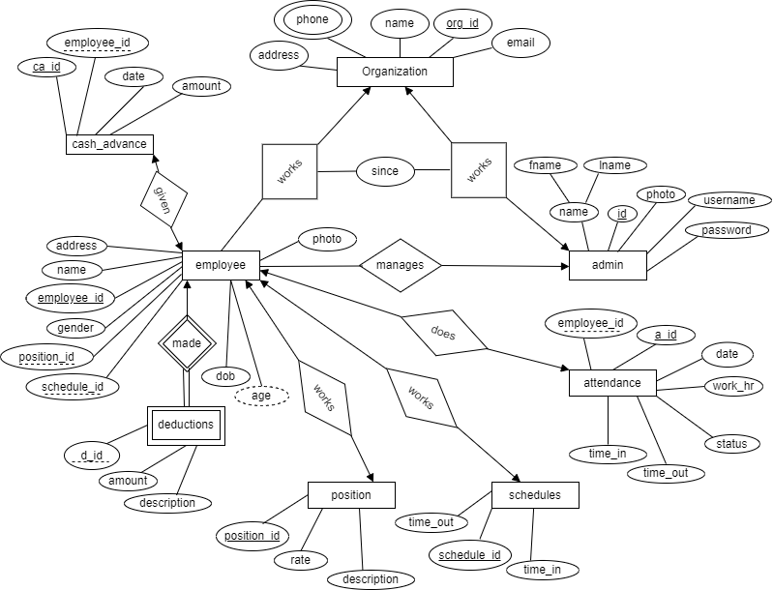

Slide 12
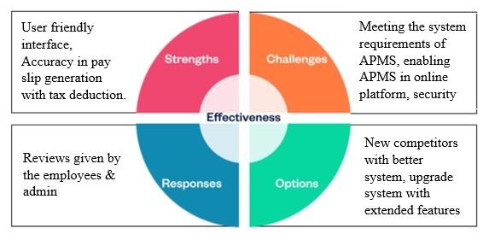
SCORE Analysis

Slide 13
Testing of System
White Box Testing
Test I: Employee addition functionality
Case 1: All fields with correct input.
Case 2: Some fields are not filled correctly (empty input, contact number less than 10 digits)
Test II: Cash advance functionality
Case 1: All fields are with correct input.
Case 2: Employee id is null and amount is entered.
Case 3: Employee id is valid and amount is null.

Slide 14
Testing of System
Black Box Testing
Test I: Admin login
Case 1: Positive test with valid credentials.
Case 2: Negative test with invalid username.
Case 3: Negative test with invalid password
Test II: Attendance (Time in , Time out)
Case 1: Positive test with valid ID.
Case 2: Negative test with invalid ID.

Slide 15
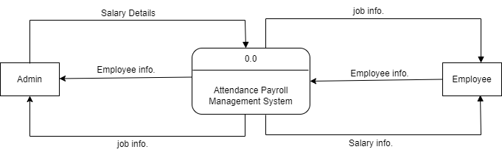
DFD
Fig: Level 0 dfd

Slide 16
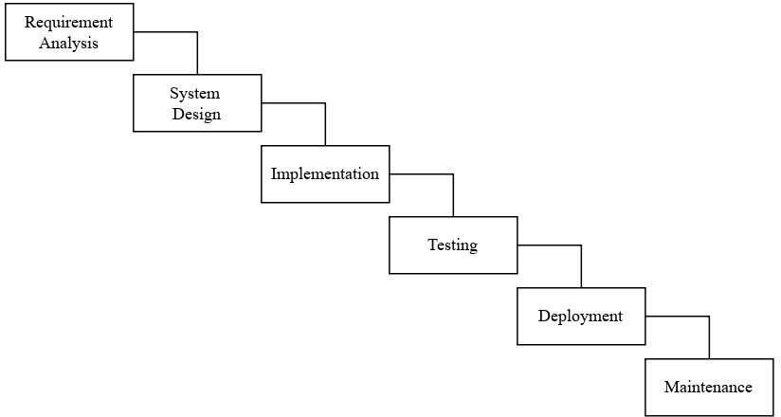
Design Model
Fig: Waterfall Model

Slide 17
Scope
Our project aids small organizations with affordable, user-friendly system.
This system tracks time to accurately calculate working hours.
This system has capability of processing attendance payroll and scheduling employees.

Slide 18
Future Enhancement
As our aim is to develop the “Human Resource Management System” so, We will enhance this system into a comprehensive HRMS with essential features.
Payment gateway will be integrated along with third party integrations.
Biometrics will be integrated in attendance.

Slide 19
Conclusion
Gives comprehensive solution to improve attendance management, employee records keeping, & payroll management.
Reduces the wastage of time.
Mobilizes day to day workflow in organization.

Slide 20
Thank You

Slide 21
Demo

Slide 22
Any Questions…

