Slide 1
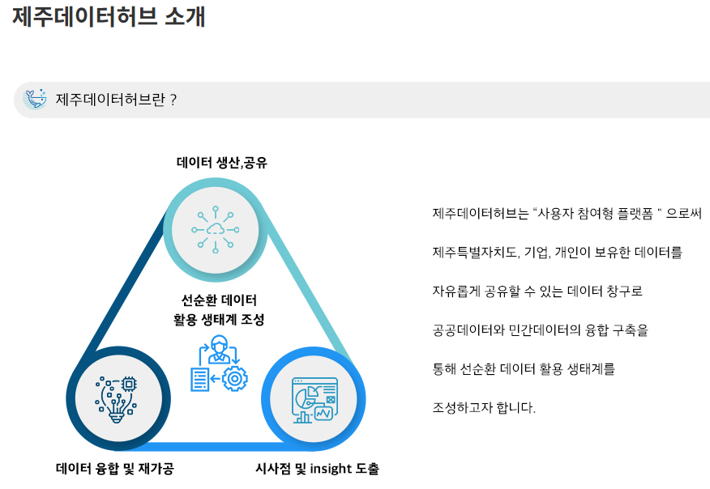
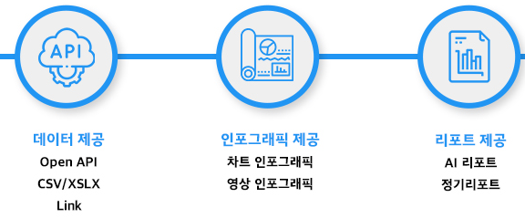
JejuDataHub(1/3)

Slide 2
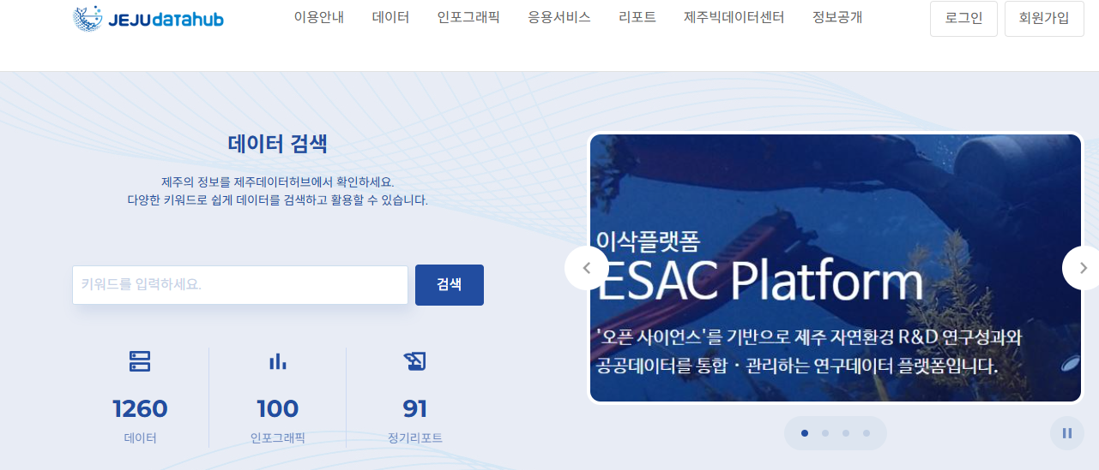
JejuDataHub(2/3)
https://jejudatahub.net/

Slide 3
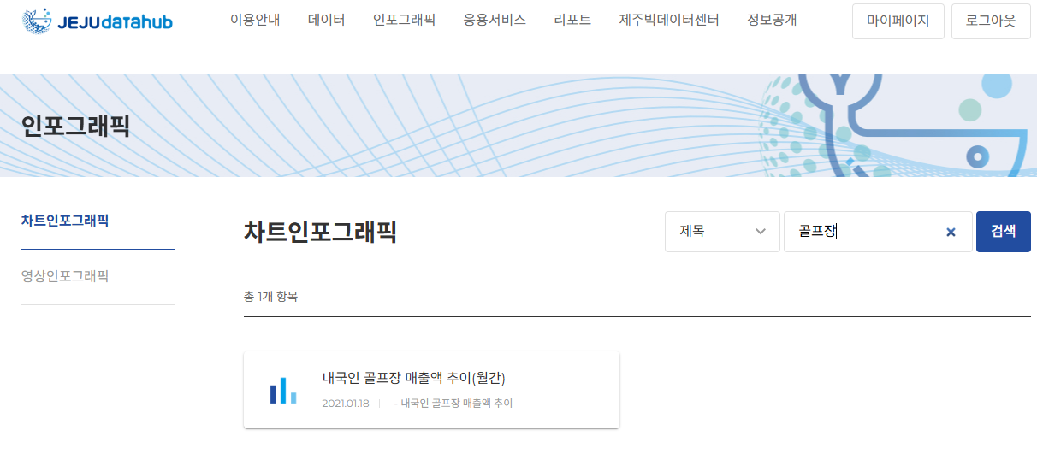
JejuDataHub(3/3)
https://jejudatahub.net/

Slide 4
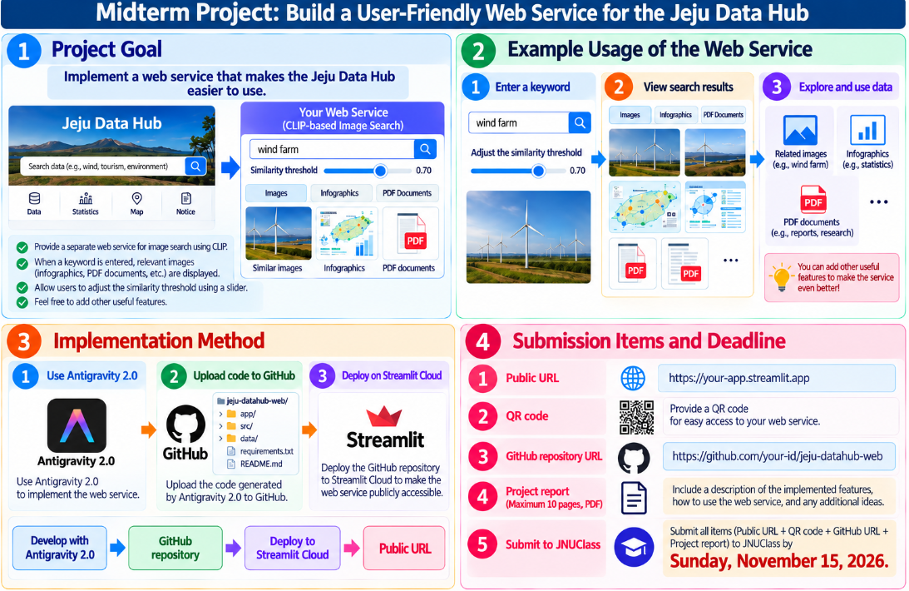
Midterm Exam Replacement Assignment(1/4)

Slide 5
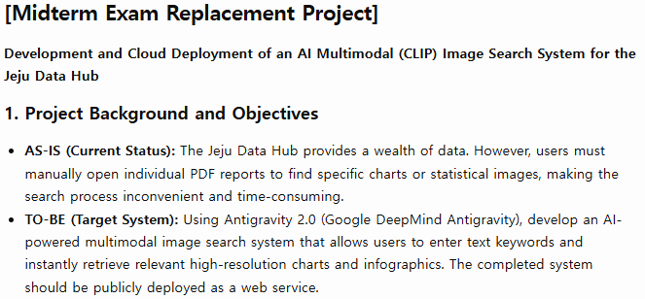
Midterm Exam Replacement Assignment(2/4)

Slide 6
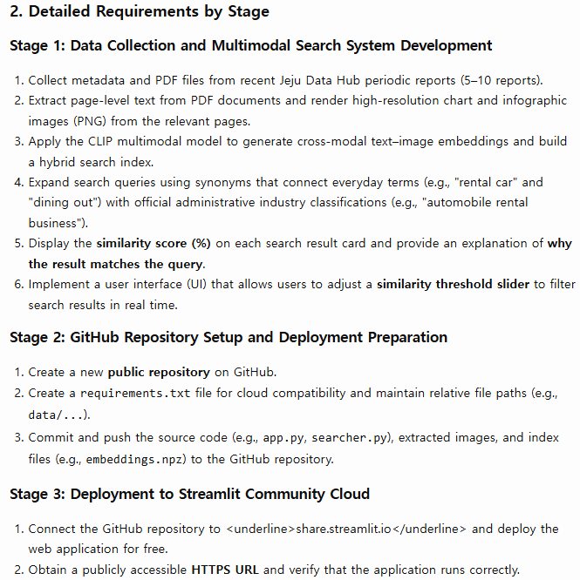

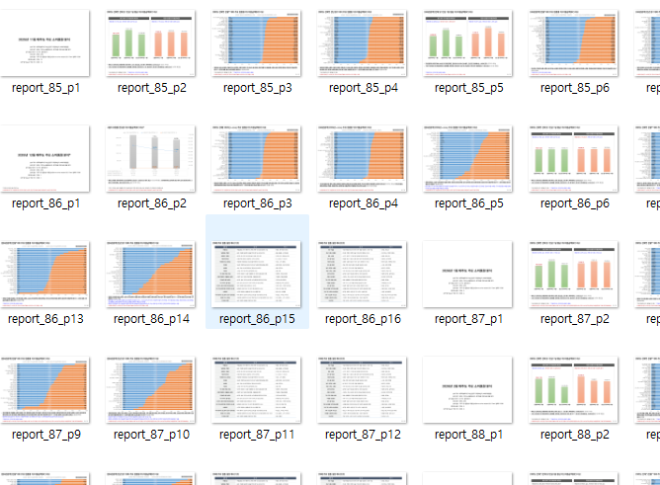
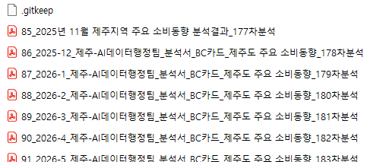
Midterm Exam Replacement Assignment(3/4)

Slide 7
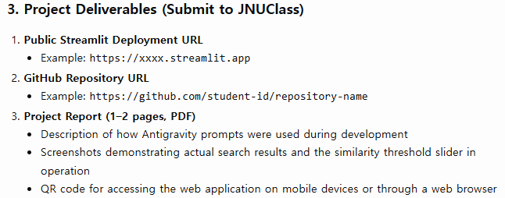

Midterm Exam Replacement Assignment(4/4)

Slide 8
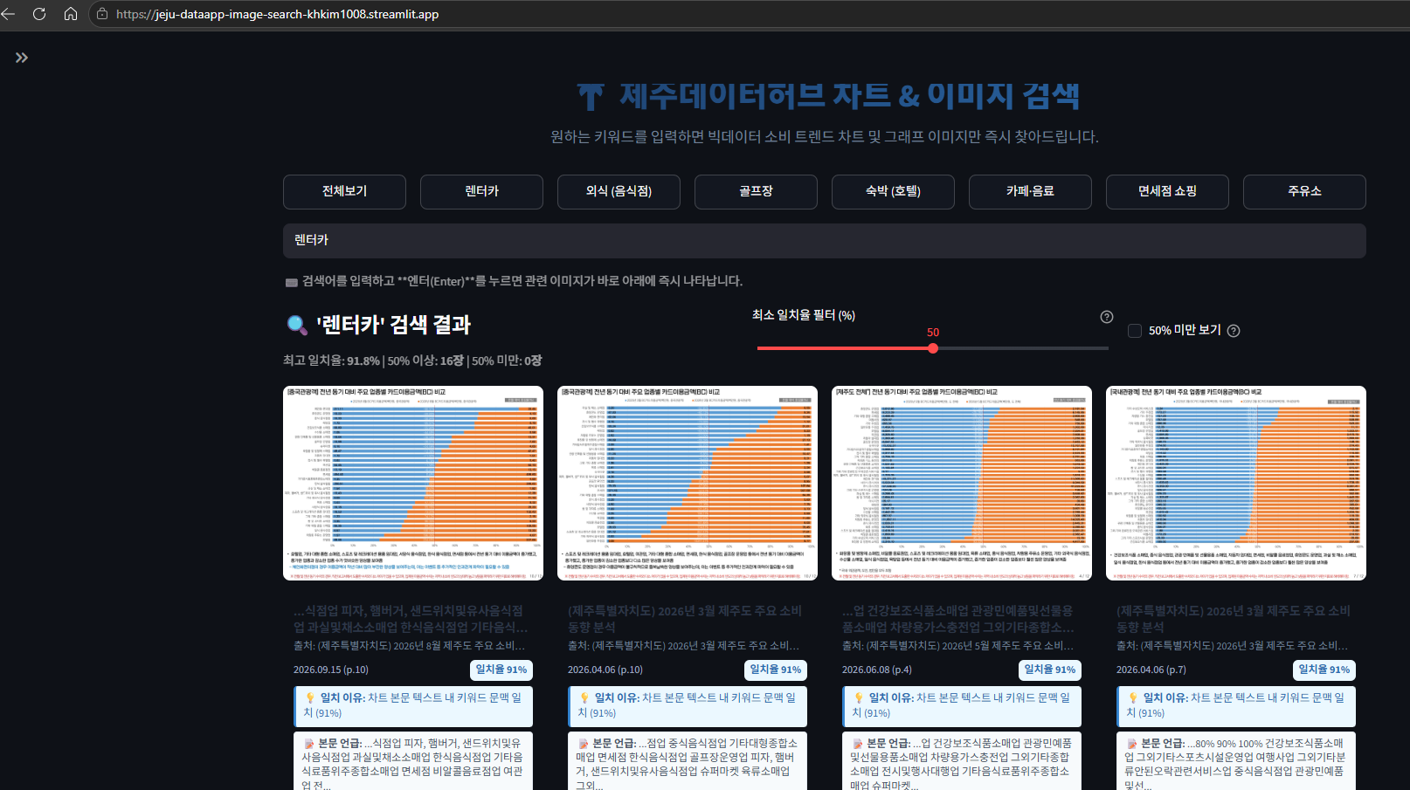
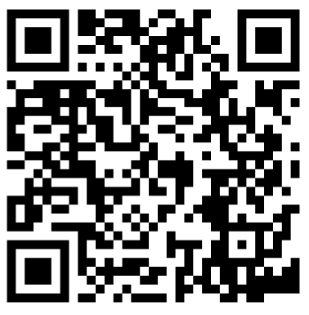
System Implementation Example(1/5)
https://jeju-dataapp-image-search-khkim1008.streamlit.app/

Slide 9
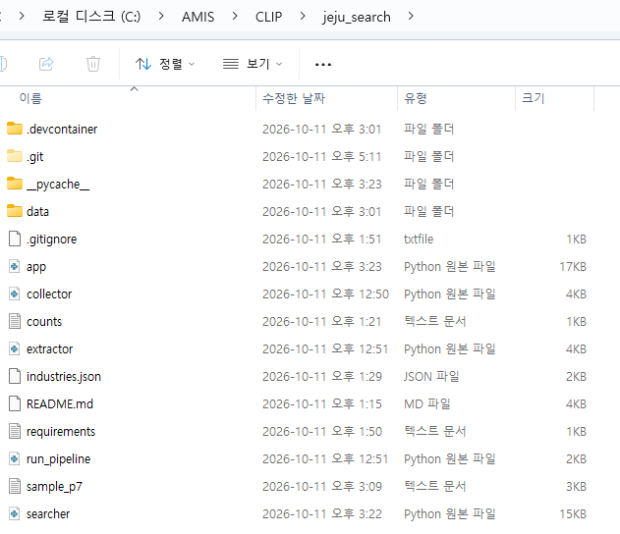
System Implementation Example(2/5)

Slide 10
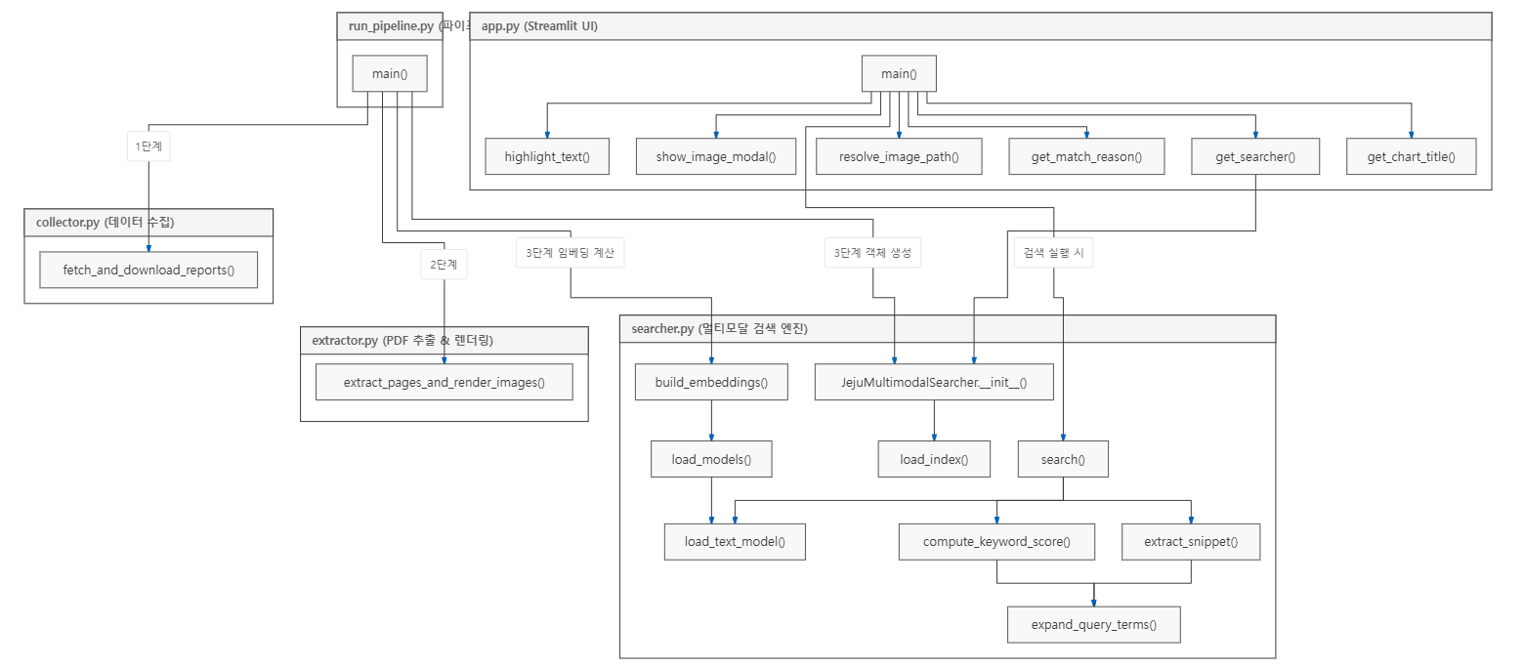
System Implementation Example(3/5)

Slide 11
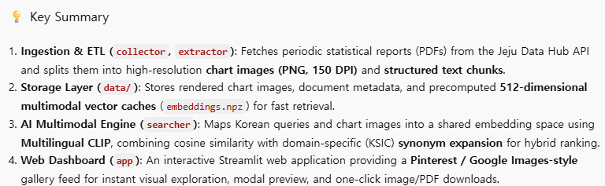
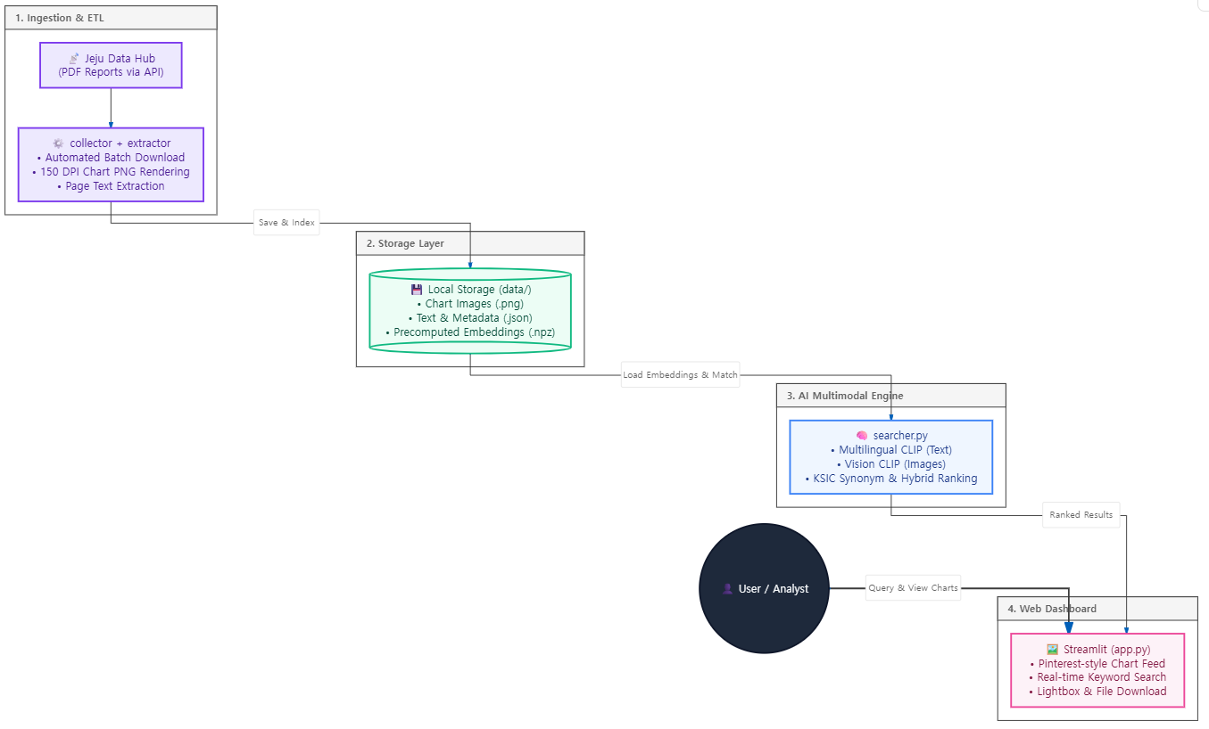
System Implementation Example(4/5)

Slide 12
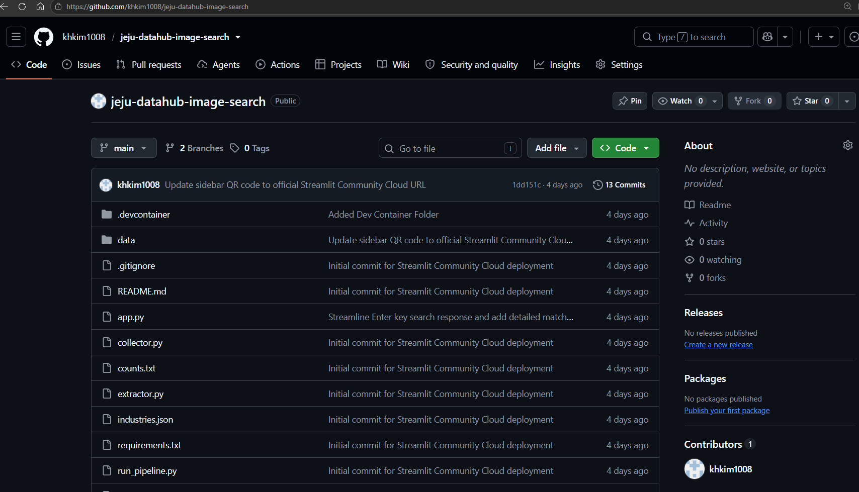
System Implementation Example(5/5)

