Slide 1
RAG Framework
Assignment
Overview of RAG
LangChain
Llamaindex

Slide 2
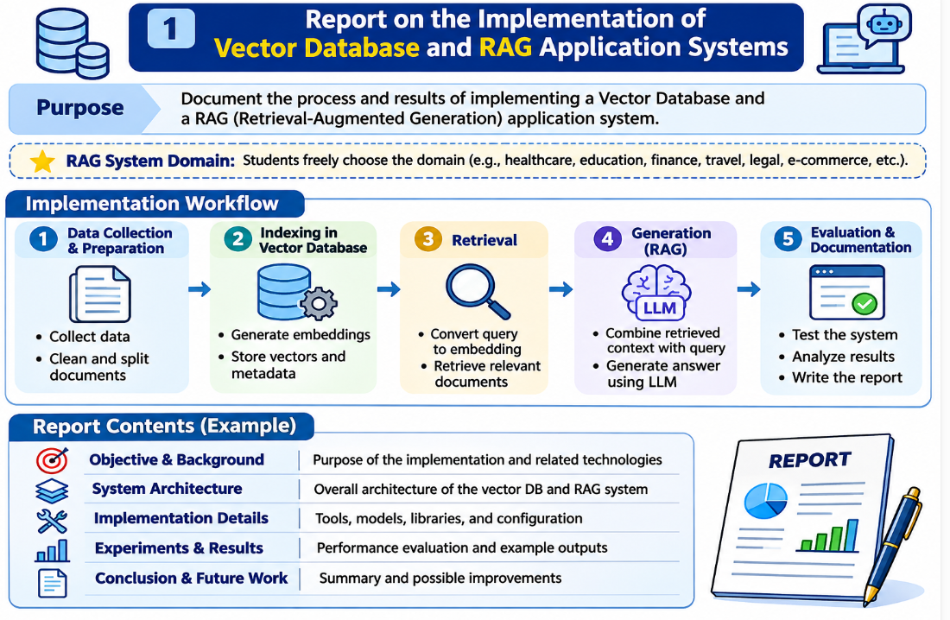
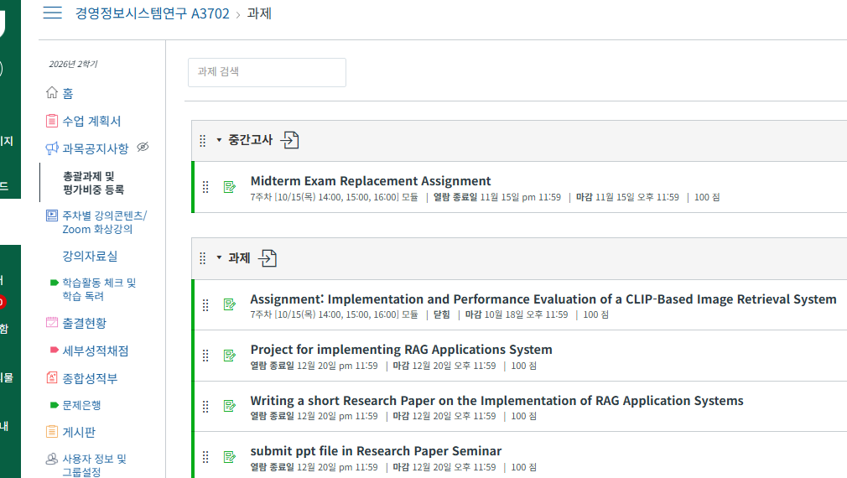
Assignment (1/3)
JNUClass
Submit to JNUClass
by December 20.

Slide 3
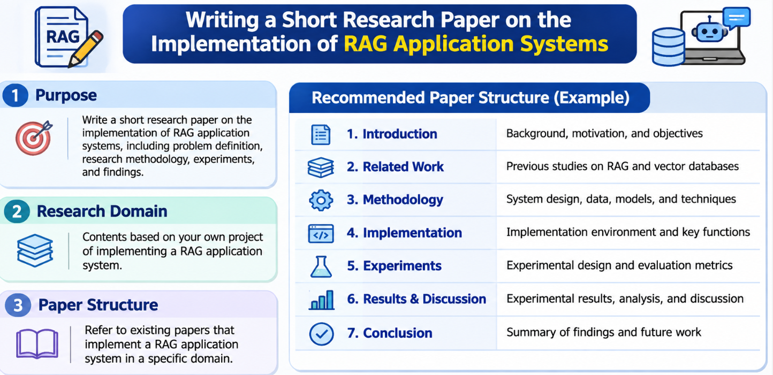
Assignment (2/3)
JNUClass
Submit to JNUClass
by December 20.

Slide 4
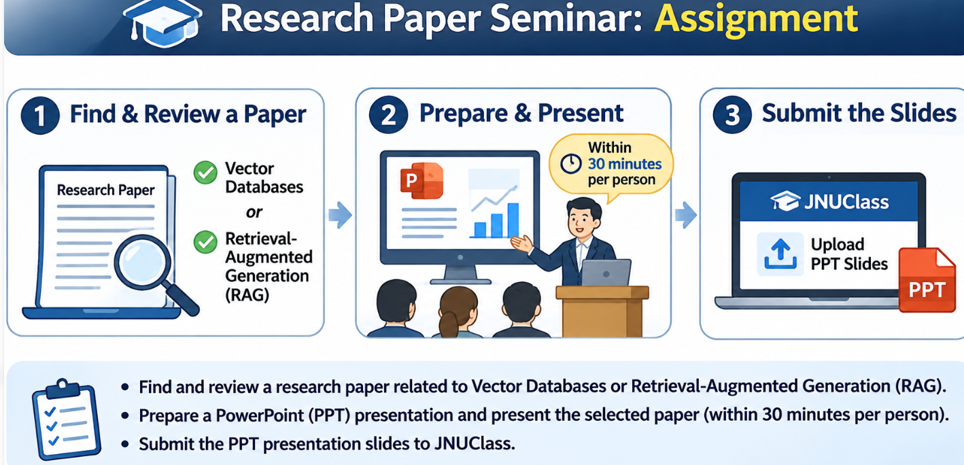
Assignment (3/3)
JNUClass
Submit to JNUClass
by December 20.

Slide 5
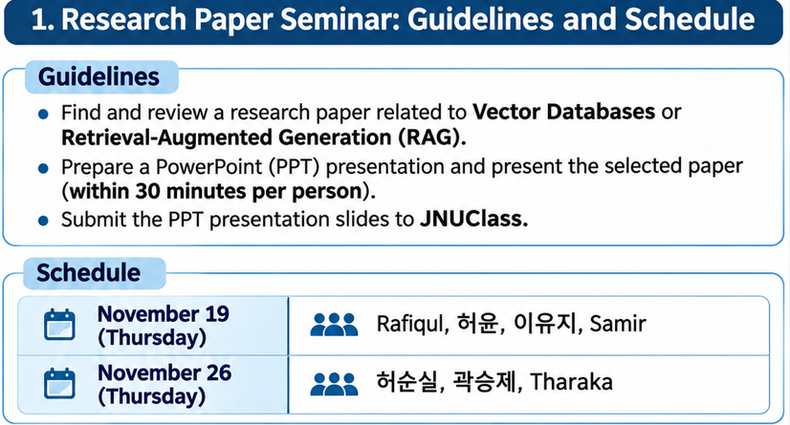
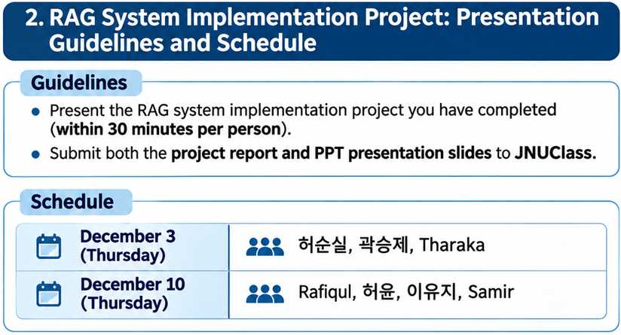
Seminar Schedule and Guidelines

Slide 6
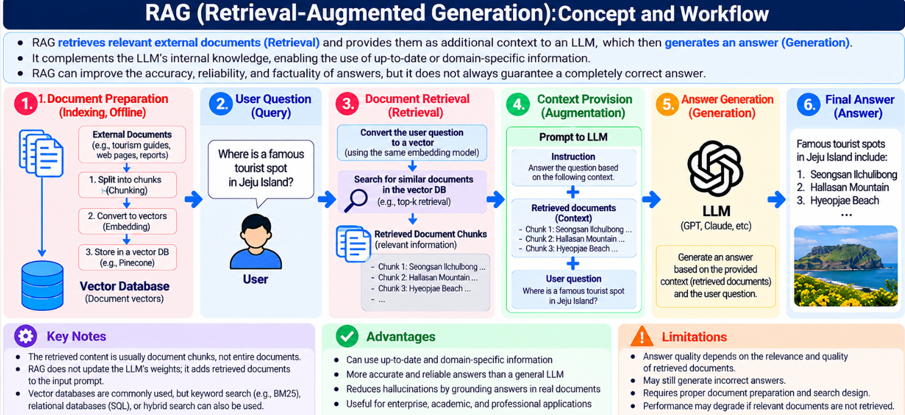
Overview of RAG (1/5)

Slide 7
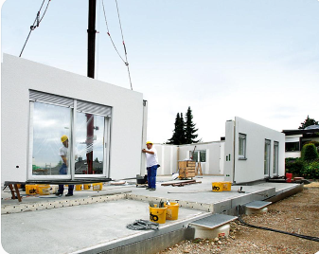
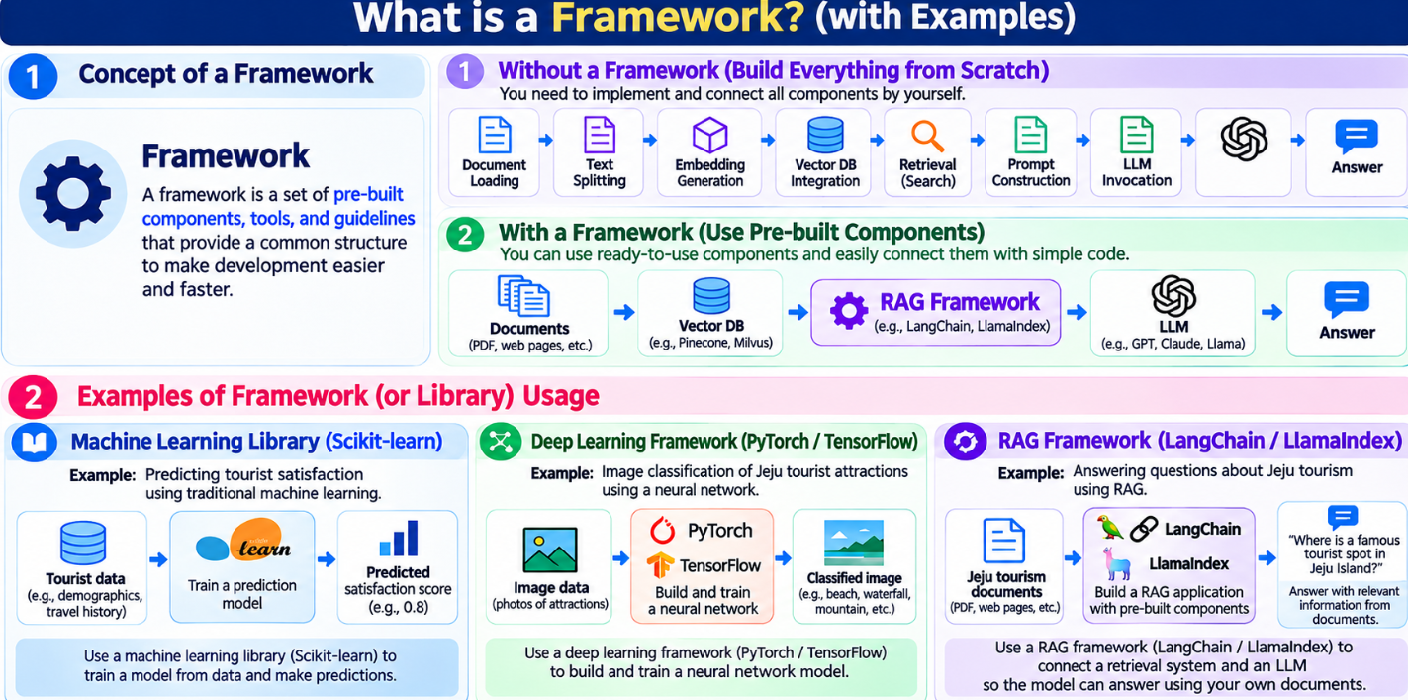
Overview of RAG (2/5)

Slide 8
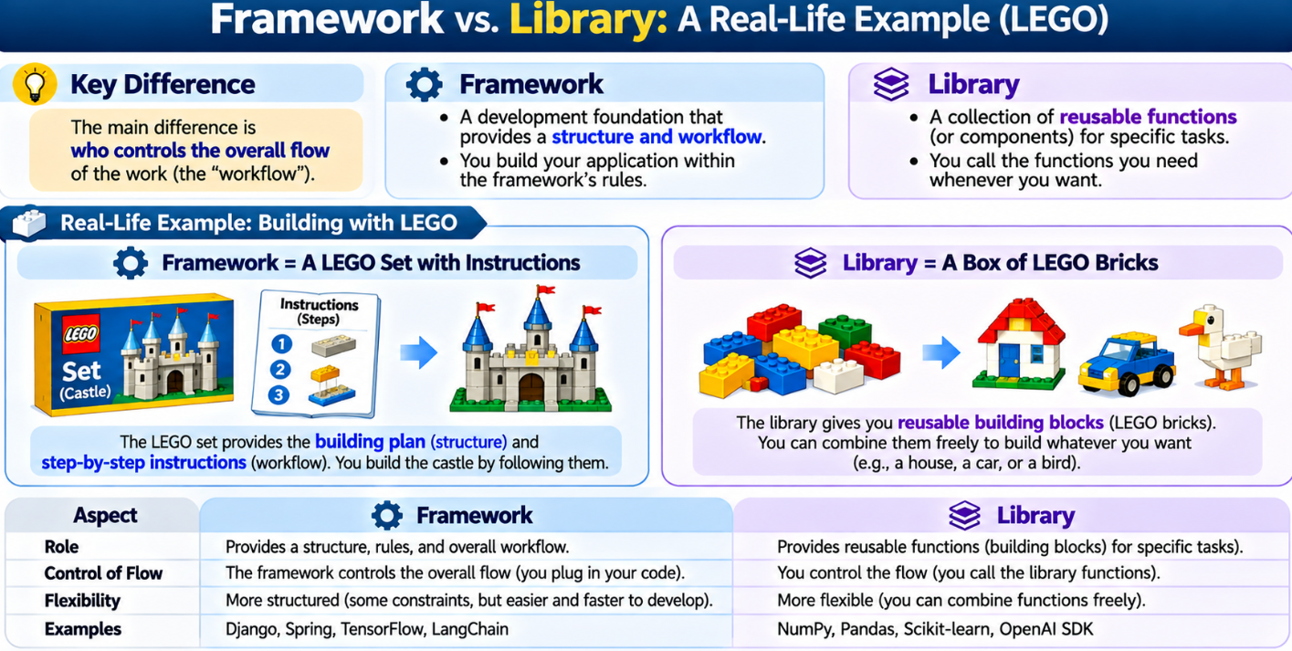
Overview of RAG (3/5)

Slide 9
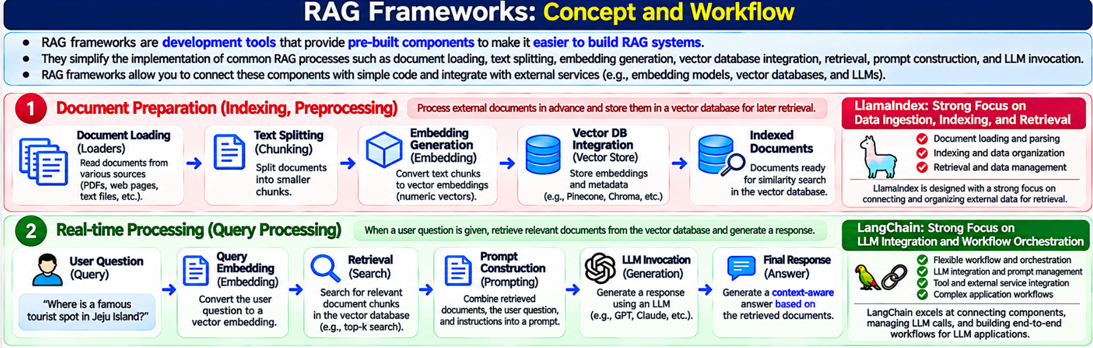
Overview of RAG (4/5)

Slide 10
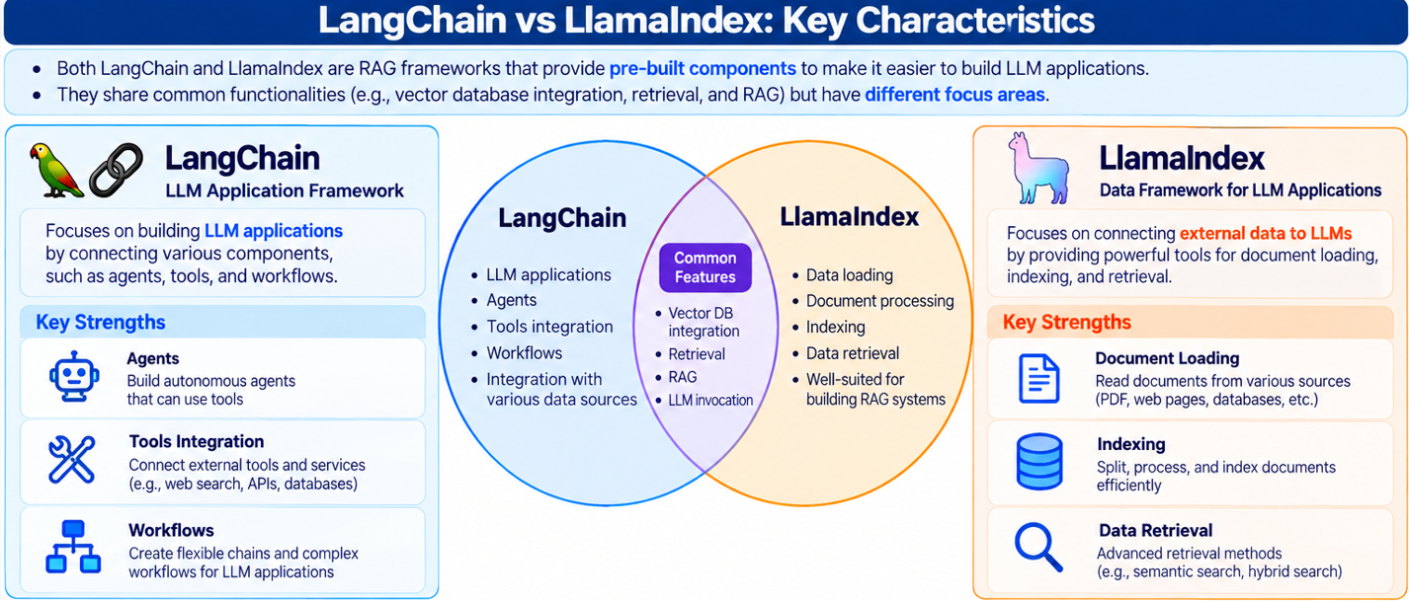
Overview of RAG (5/5)

Slide 11
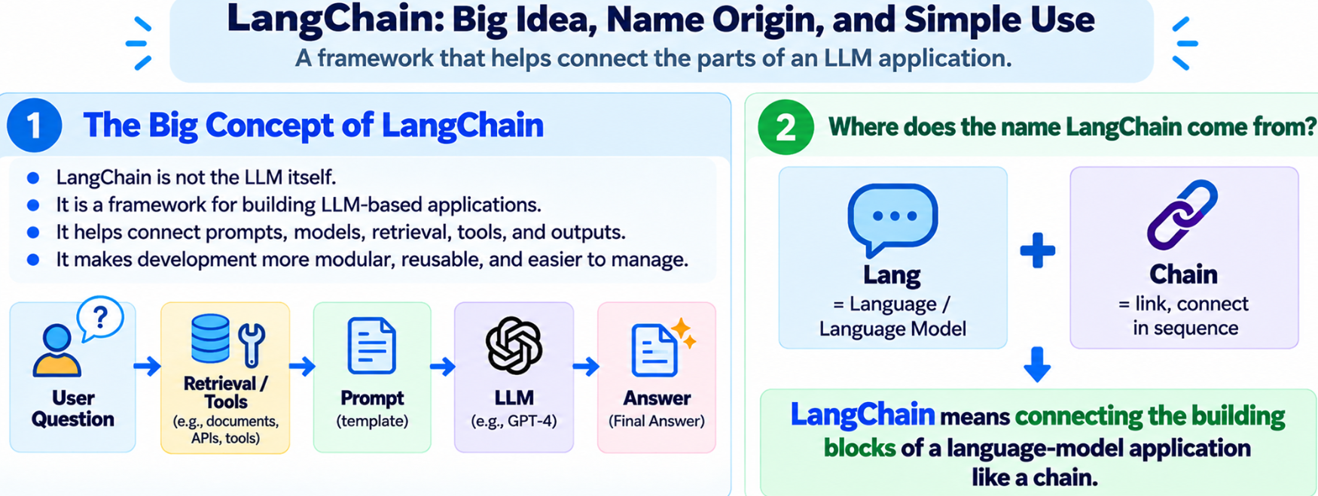
LangChain(1/9)

Slide 12
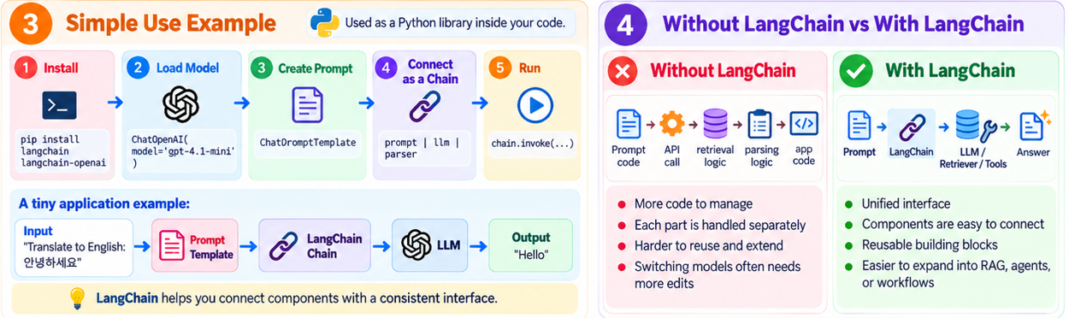
LangChain(2/9)

Slide 13
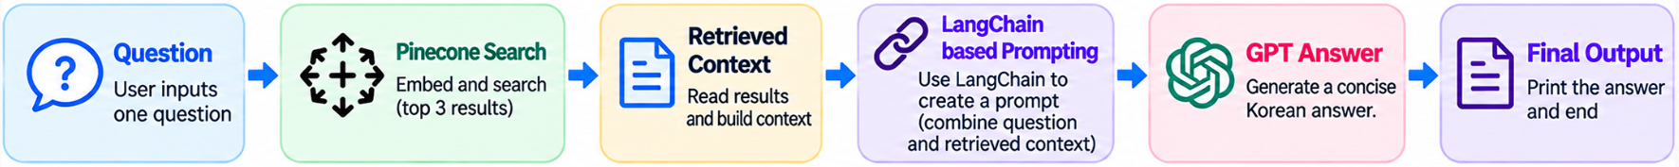
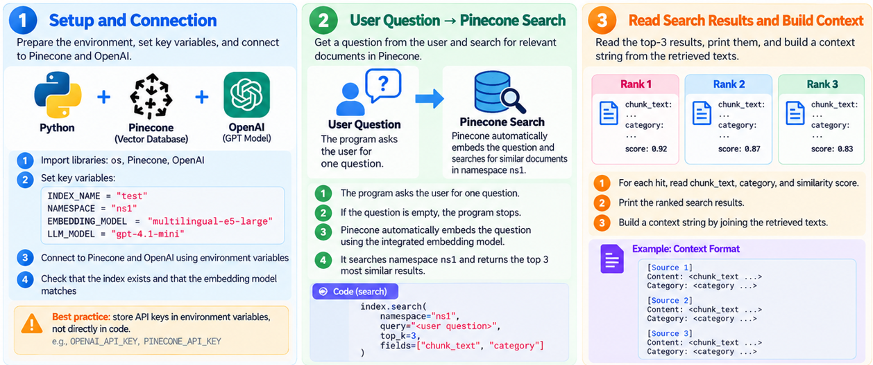
LangChain(3/9)
An example of using LangChain for prompting after vector database search

Slide 14
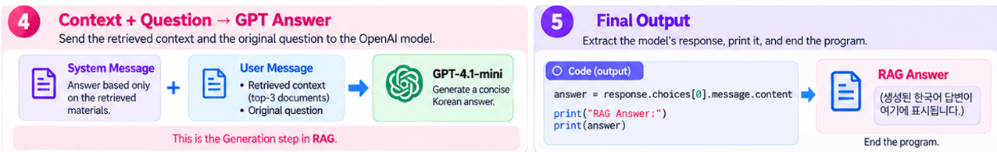
LangChain(4/9)
An example of using LangChain for prompting after vector database search

Slide 15
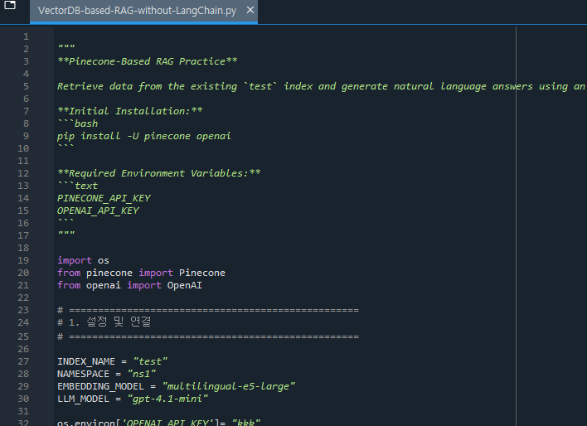
LangChain(5/9)
An Python code example of vector database searching, prompting and answering without LangChain

Slide 16
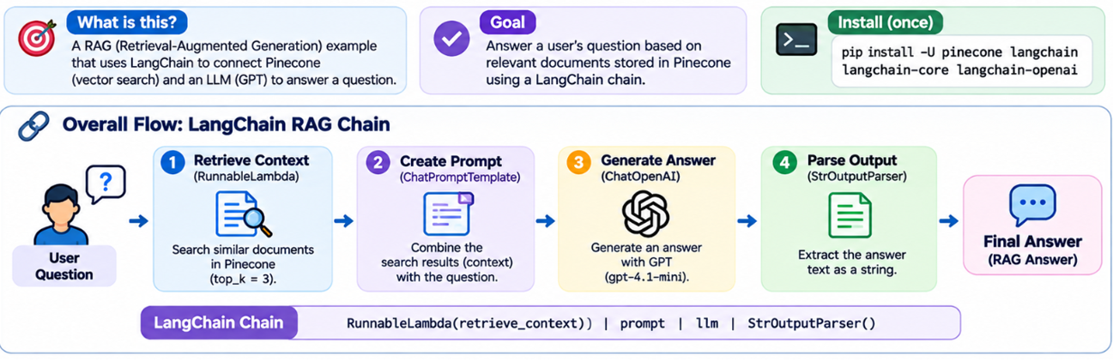
LangChain(6/9)
An example of using LangChain for vector database searching, prompting and answering

Slide 17
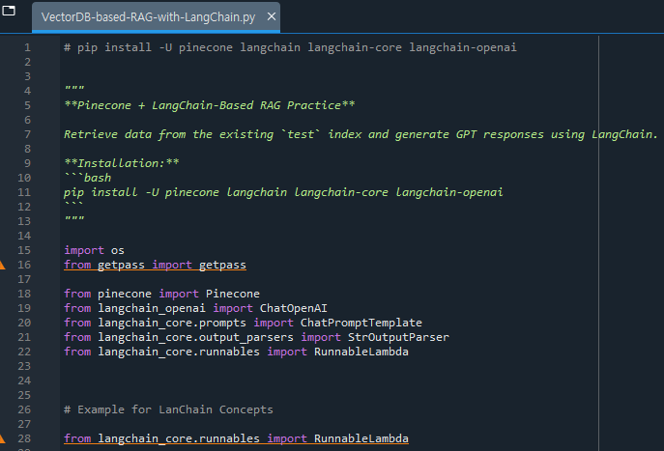
LangChain(7/9)
An Python code example of using LangChain for vector database searching, prompting and answering

Slide 18
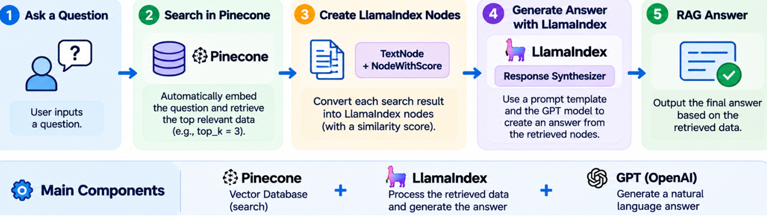
LangChain(8/9)
An example of using LlamaIndex for prompting after vector database search

Slide 19
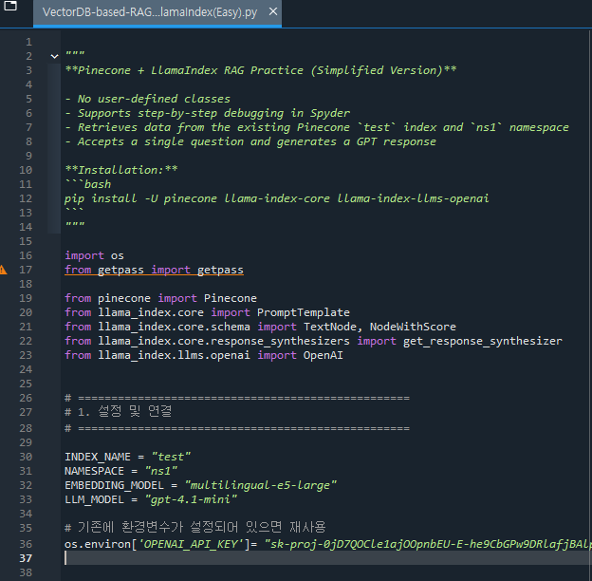
LangChain(9/9)

Slide 20
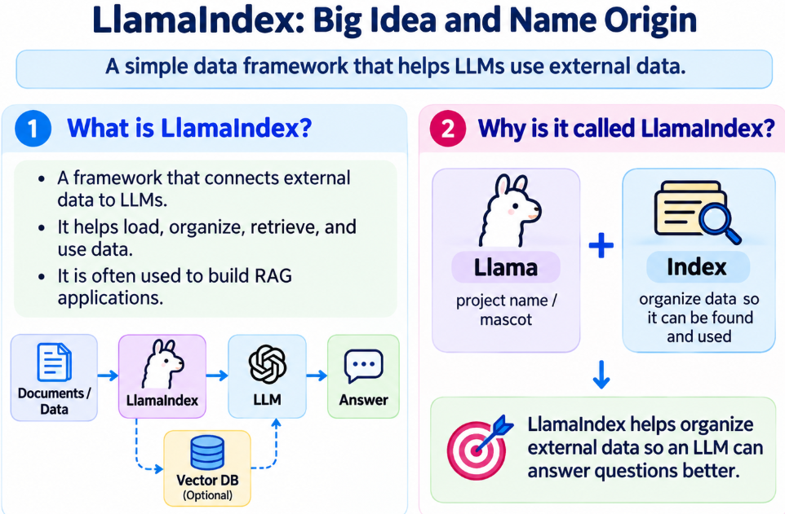
LlamaIndex(1/6)

Slide 21
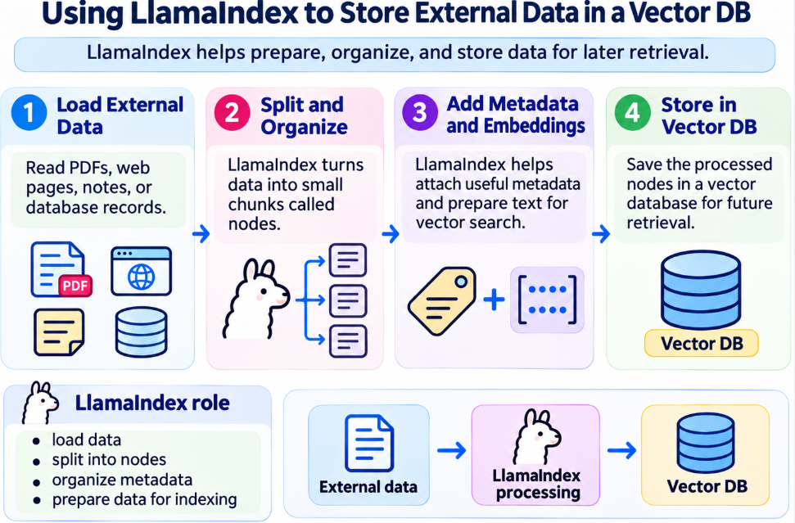
LlamaIndex(2/6)

Slide 22
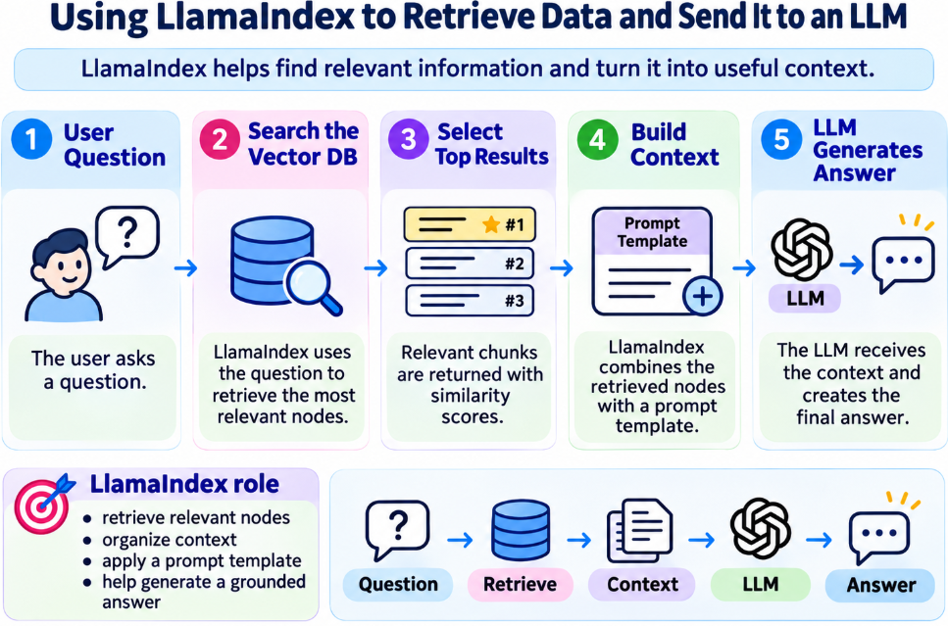
LlamaIndex(3/6)

Slide 23
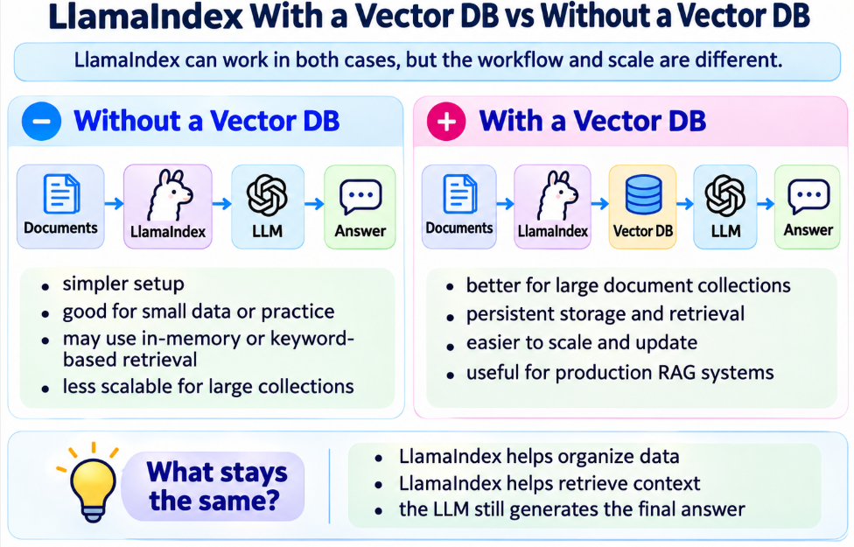
LlamaIndex(4/6)

Slide 24
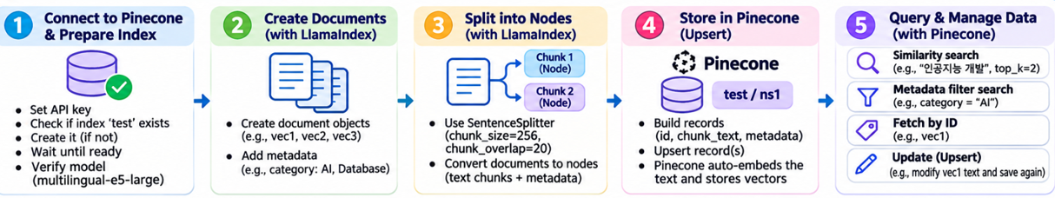
LlamaIndex(5/6)

Slide 25
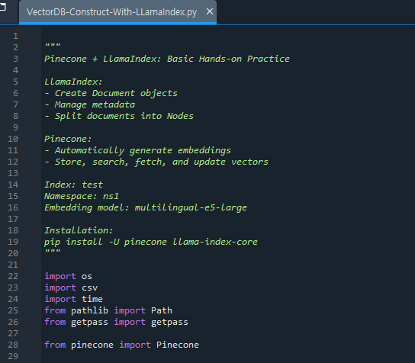
LlamaIndex(6/6)

Slide 26
감사합니다.

