Slide 1
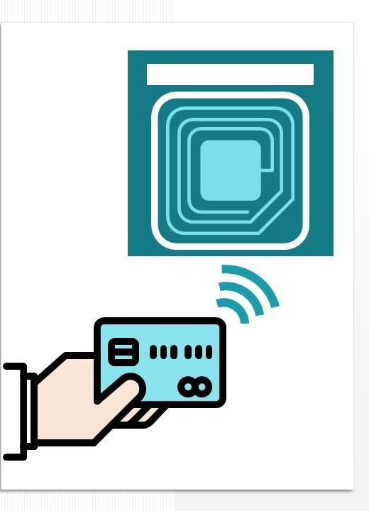
ATTENDANCE SYSTEM USING RFID
Under the guidance of
Sk. Althaf
Assistant Professor(Ph.D)
Presented by:
K. Tharak Prabath
Notes:
NOTE:
To change the image on this slide, select the picture and delete it. Then click the Pictures icon in the placeholder to insert your own image.

Slide 2
Contents
Abstract
Introduction
Components
Block Diagram
Circuit diagram and program
Working
Advantages
Disadvantages
Applications
Conclusion
Future Scope

Slide 3
Abstract
RFID technology is an automatic wireless identification system that works by the help of two components: a card and a reader. Using the RFID technology, the traditional system of taking attendance can be completely transformed to be more in line with strides in digitalization. This system will help the authorities manage the attendance system in a more methodical, efficient and time saving manner. The proposed system has been implemented through a prototype that has proved the effectiveness of the concept in easing of taking attendance as a result of the automation due to the use of the RFID technology.

Slide 4
Introduction
In modern educational institutions accurate and timely attendance tracking is crucial for ensuring efficient operations and it may be prone to errors or manipulations.
The Radio Frequency Identification (RFID) attendance system is used to capture and record the student attendance records.
RFID utilizes the electromagnetic fields to automatically identify track tags attached to the objects.
This system helps to simplifying the attendance tracking in a simple and automated process.
Each person is provided with an RFID tag that contains the unique identifier.
When their RFID tag is scanned, they are instructed in the LCD display to make them allow and also a green LED light also glow.

Slide 5
Components
Arduino UNO
Arduino UNO is a microcontroller based board on the ATmega328P.
RFID module
Radio Frequency Identification (RFID) is a technology that uses the electromagnetic fields to identify automatically and track the tags attached to objects.
RFID tag
RFID tags are a type of tracking system that uses the smart barcodes in-order to identify the items.
Bread board
Bread board is used for building temporary circuits.
Jumper wires
Jumper wire is a conducting a wire that is used to transfer electrical signals between two points in a circuit.
LCD Display
Liquid Crystal Display (LCD) are super-thin technology display screens that are generally used in the Laptops, TV’s, Cell phones etc.
Resistors
Resistors are simply used to oppose the flow of current or to reduce the current flow.
LED lights
Light Emitting Diode (LED) is a semi-conductor device that is emits the light when an electrical current flows through it.

Slide 6
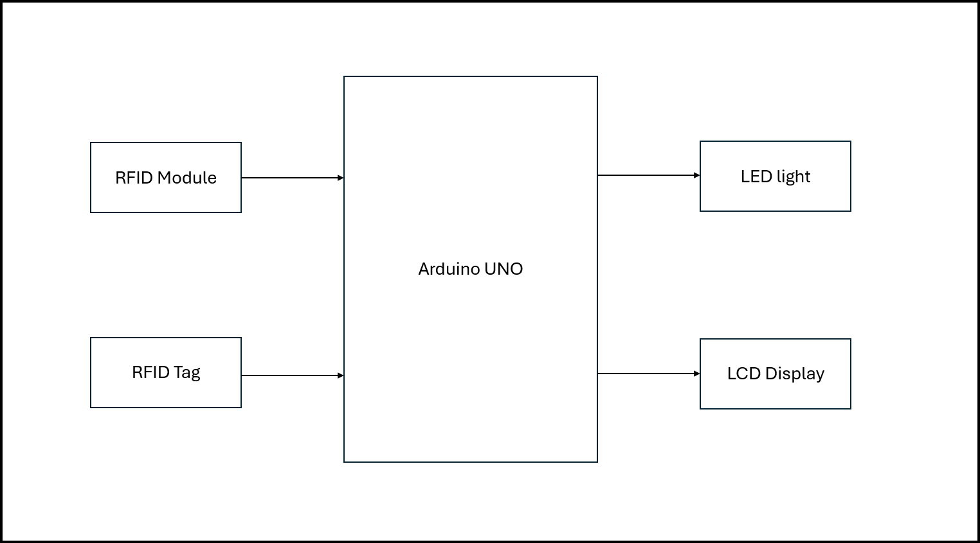
Block Diagram

Slide 7
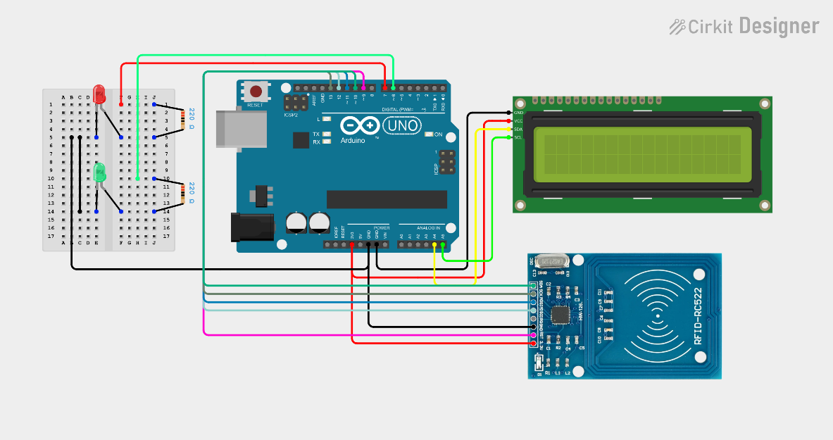
Circuit and Program
#include <SPI.h>
#include <MFRC522.h>
#include <Wire.h>
#include <LiquidCrystal_I2C.h>
#define SS_PIN 10
#define RST_PIN 9
#define LED_DENIED_PIN 7
#define LED_ACCESS_PIN 6
LiquidCrystal_I2C lcd(0x3F,16,2);
MFRC522 mfrc522(SS_PIN, RST_PIN); // Instance of the class
int code[] = {32,154,149,117}; //This is the stored UID (Unlock Card)
int codeRead = 0;
String uidString;
Fig: Circuit Diagram of RFID based attendance system

Slide 8
void setup() {
Serial.begin(9600);
SPI.begin(); // Init SPI bus
mfrc522.PCD_Init(); // Init MFRC522
Serial.println("Arduino RFID reading UID");
pinMode( LED_DENIED_PIN , OUTPUT);
pinMode( LED_ACCESS_PIN , OUTPUT);
lcd.init();
// Print a message to the LCD.
lcd.backlight();
lcd.setCursor(0,0);
lcd.print("Show your card:)");
}

Slide 9
void loop() {
if ( mfrc522.PICC_IsNewCardPresent())
{
if ( mfrc522.PICC_ReadCardSerial())
{
lcd.clear();
Serial.print("Tag UID:");
lcd.setCursor(0,0);
lcd.print("Tag UID:");
lcd.setCursor(0,1);
for (byte i = 0; i < mfrc522.uid.size; i++) {
Serial.print(mfrc522.uid.uidByte[i] < 0x10 ? " 0" : " ");
Serial.print(mfrc522.uid.uidByte[i], HEX);
lcd.print(mfrc522.uid.uidByte[i] < 0x10 ? " 0" : " ");
lcd.print(mfrc522.uid.uidByte[i], HEX);
// lcd.print(" ");
}
Serial.println();
int i = 0;
boolean match = true;

Slide 10
while(i<mfrc522.uid.size)
{
if(!(int(mfrc522.uid.uidByte[i]) == int(code[i])))
{
match = false;
}
i++;
}
delay(3000);
lcd.clear();
lcd.setCursor(0,0);
if(match)
{
digitalWrite( LED_ACCESS_PIN , HIGH);
lcd.print("Authorized access");
}else{
digitalWrite( LED_DENIED_PIN , HIGH);
lcd.print(" Access denied ");
Serial.println("\nUnknown Card");
}

Slide 11
Serial.println("============================");
mfrc522.PICC_HaltA();
delay(3000);
reset_state();
}
}
}
void reset_state()
{
lcd.clear();
lcd.setCursor(0,0);
lcd.print("Show your card:)");
digitalWrite( LED_ACCESS_PIN , LOW);
digitalWrite( LED_DENIED_PIN , LOW);
}

Slide 12
Working
There is a coil present in the tag or card and it generates the electromagnetic field which couple into the coil on the RFID tag.
RFID card is detected by the reader module if it is in the range of 10cm.
After detects the card or tag it checks that is original or fake.
When we scanned an original tag then it displays the “Authorized Access”.
A Green LED light also starts to glow to indicate the “Authorized Access”.
If it scan a fake tag, then it automatically displays that “Access Denied”.
A Red LED light also starts to glow to indicate the “Wrong tag scanned”.
By having the LED’s, we can simply know that whether the scanned tag is original or fake.

Slide 13
Advantages
Accuracy :
Minimizes human error, ensuring accurate and reliable attendance records.
Efficiency :
Automates the attendance process, saving time and effort.
Automatic Process :
The system automates the attendance process, reducing manual effort and time.
Fast Response :
When the tag is scanned, the response in the LCD display is fast.

Slide 14
Disadvantages
Tag Durability:
RFID tags, especially those attached to physical objects, can be susceptible to damage or wear and tear, which may affect their functionality.
Interference:
External factors like electromagnetic interference can disrupt the system's performance.
Initial Investment Cost:
Implementing an RFID system requires an initial investment in RFID readers, tags, and the necessary infrastructure.

Slide 15
Applications
Educational Institutions:
Tracking student attendance, monitoring library usage, and managing inventory.
Car Parking:
This system can also be used in the car parking areas that is used to know the how many cars are entered and how many are leaving.
Access Control:
This system is used to control the access the number of people entering to the institute or any offices.

Slide 16
Conclusion
The RFID-based attendance system represents a significant advancement over traditional manual methods of attendance tracking. By leveraging Radio Frequency Identification (RFID) technology, this system offers a highly efficient, accurate, and automated way to monitor the students attendance in the educational institutions.
The implementation of an RFID-based attendance system presents a significant advancement in the management of attendance records. By automating the attendance process, it minimizes human errors and administrative burdens, ensuring reliable and timely data collection.
The RFID-based attendance system is a robust and scalable solution that aligns with the evolving needs of modern organizations.

Slide 17
Future Scope
Information will directly added to the data-base
The data will store directly to the excel spread-sheet when the tag is scanned.
Enhanced Security
The security for the information or records of attendance will store safely.
Removing of Tag
The electromagnetic coil which was present in the tag will remove and it will add to the college ID card. So there will no need to carry the tag.
Biometric scan may available
To reduce the unauthorized scan we can implement the biometric. By this, we can able to make an fingerprint instead of carrying the college ID.

Slide 18
Thank You…

