Slide 1




DIGITAL PROTOPOLIO
STUDENT NAME: E.THARANI
REGISTER NO :2422k2190
NMID:A64AD3838485C9A8AB64795EF6A859D5 DEPARTMENT: BSC.CS
COLLEGE :PURATCHI THALAIVI AMMA ARTS AND SCIENCE COLLEGE
1

Slide 2
PROJECT TITLE
CREATE PROTOPOLIO
2

Slide 3
AGENDA
1.Problem Statement 2.Project Overview
3.End Users
4.Tools and Technologies 5.Portfolio design and Layout 6.Features and Functionality 7.Results and Screenshots 8.Conclusion 9.Github Link
3

Slide 4
PROBLEM STATEMENT
"Our investment portfolio is underperforming and lacks diversification, increasing risk and potential losses. We need to optimize our portfolio to achieve financial goals while minimizing risk."
4

Slide 5
PROJECT OVER VIEW
"Optimize investment portfolio to achieve financial goals while minimizing risk. Analyze current portfolio, develop customized strategy, and implement optimized portfolio for improved performance and reduced risk
5

Slide 6
WHO ARE END USER
Individual investors
- Financial advisors - Wealth managers - Institutional investors These users utilize portfolios to track performance, make informed decisions, and manage risk.
6

Slide 7
TOOLS AND TECHNOLOGY
Html : structure ( pages, section) Java :styling ( color, reponsiveness, layouts) Css:interactivity (nagativation menu, animation, form validation)
7

Slide 8
PROFOLIO DESIGN AND LAYOUT
*Clean and minimalistic design* - *Easy navigation* - *Showcasing projects and works* - *Consistent typography and color scheme* - *Responsive design for mobile and desktop*
8

Slide 9
FEATURES AND FUNCTIONALITY
- *Projectshowcase*
- *Responsive design* - *Easy navigation* - *Customization options* - *Performance tracking* (for investment portfolios)
9

Slide 10
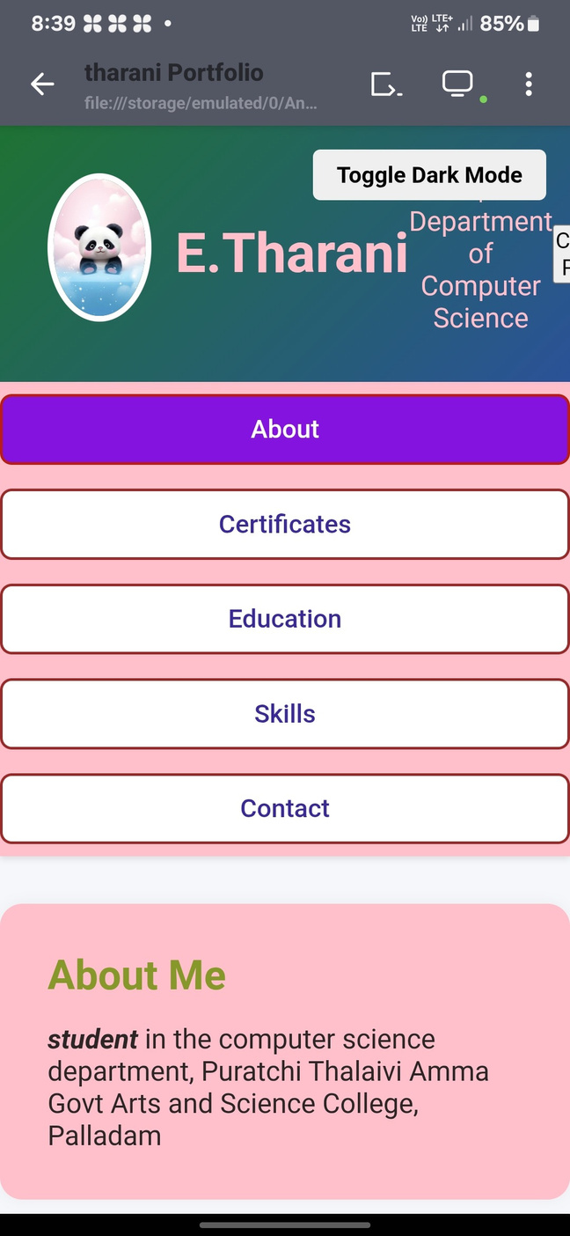
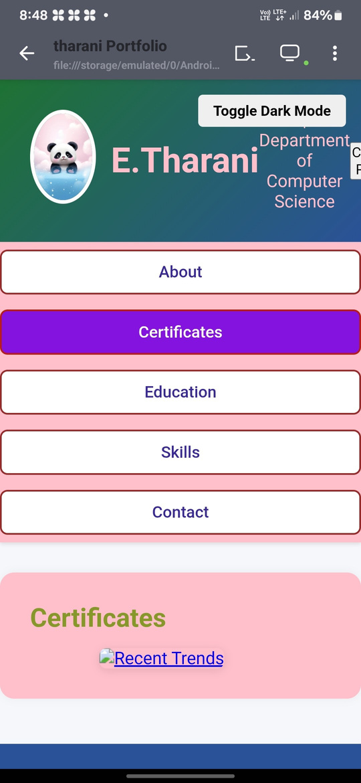
RESULTS AND SCREENSHORTS
10

Slide 11
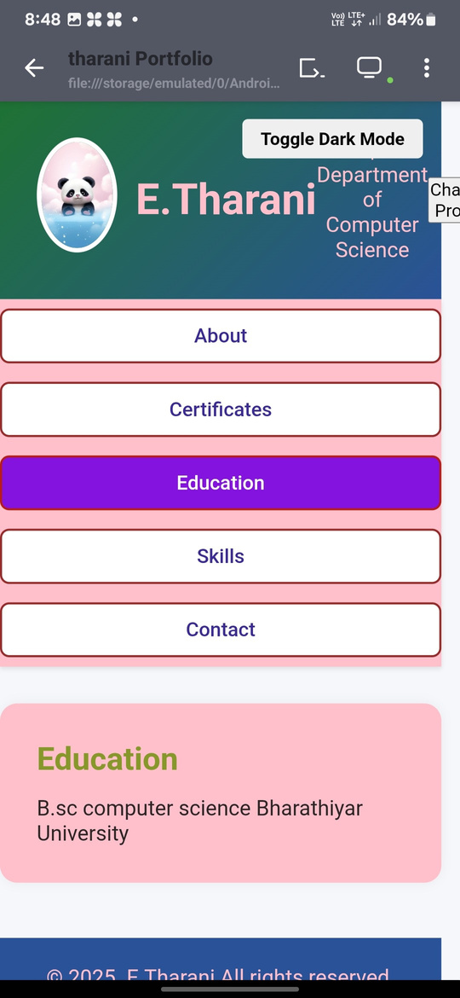
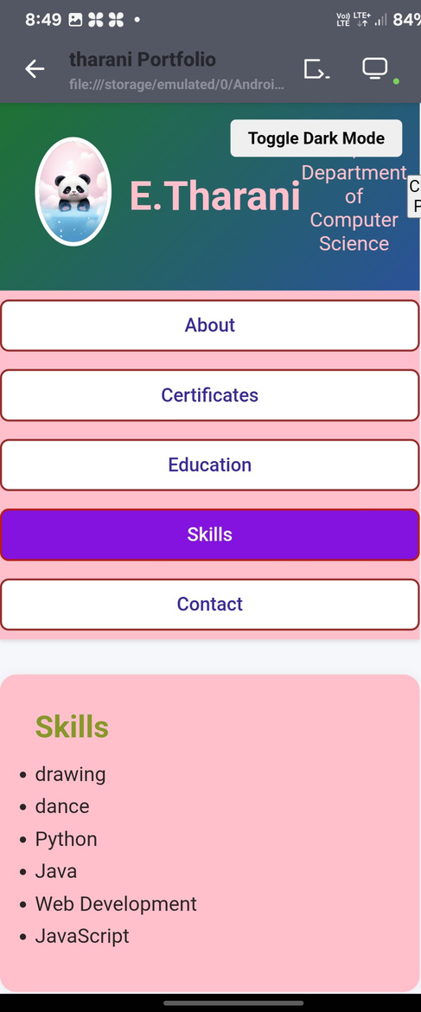
RESULTS AND SCREENSHOT

Slide 12
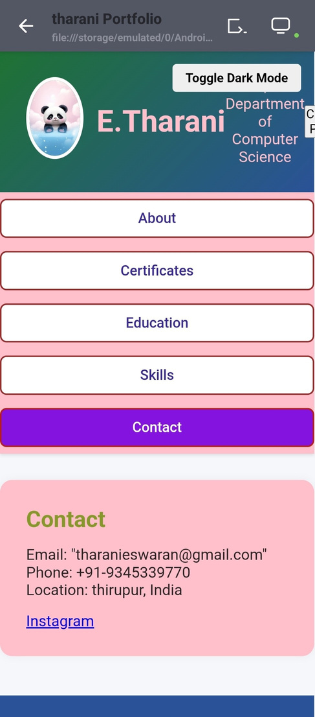
RESULTS AND SCREENSHOT

Slide 13
CONCULSION
A well-crafted portfolio effectively showcases skills, experience, and accomplishments, helping individuals or businesses stand out and achieve their goals. It's a powerful tool for career advancement, investment management, or personal branding.A well-crafted portfolio effectively showcases skills, experience, and accomplishments, helping individuals or businesses stand out and achieve their goals. It's a powerful tool for career
advancement, investment management, or personal brandin11g.

Slide 14
THANK YOU
12

