Slide 1

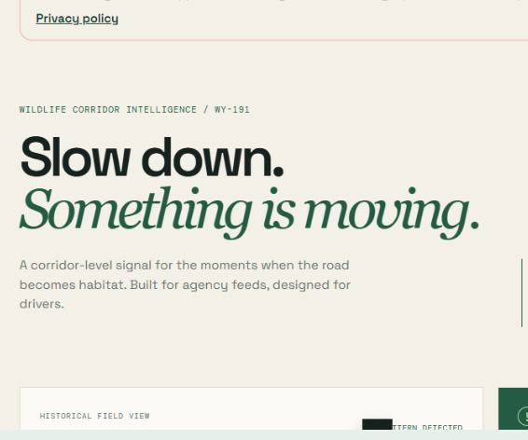
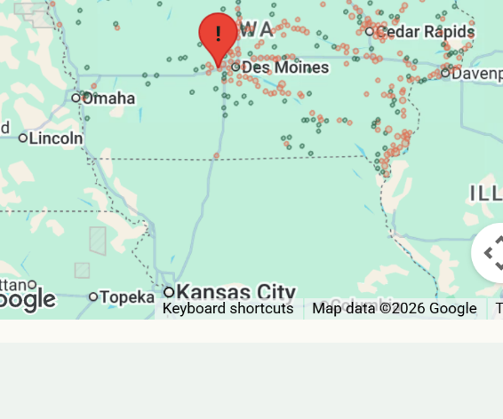
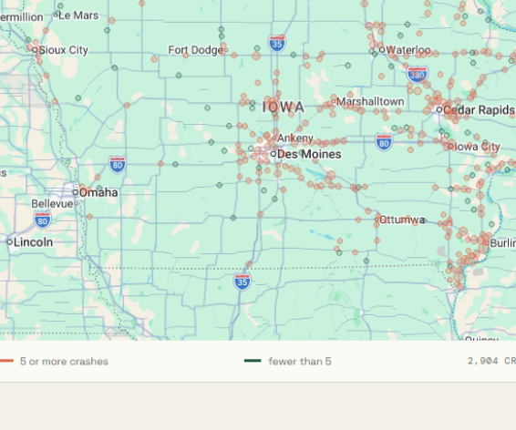
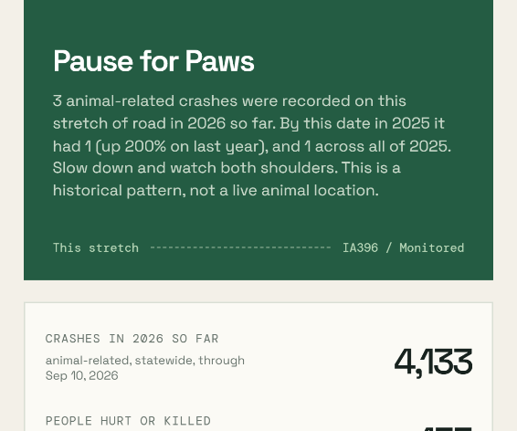

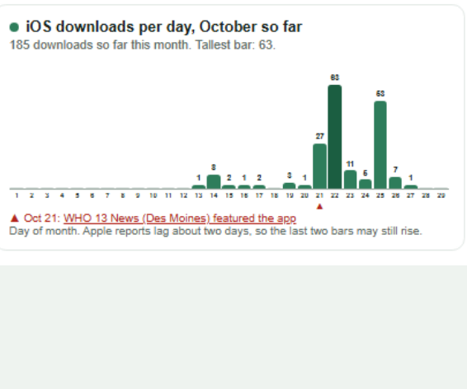
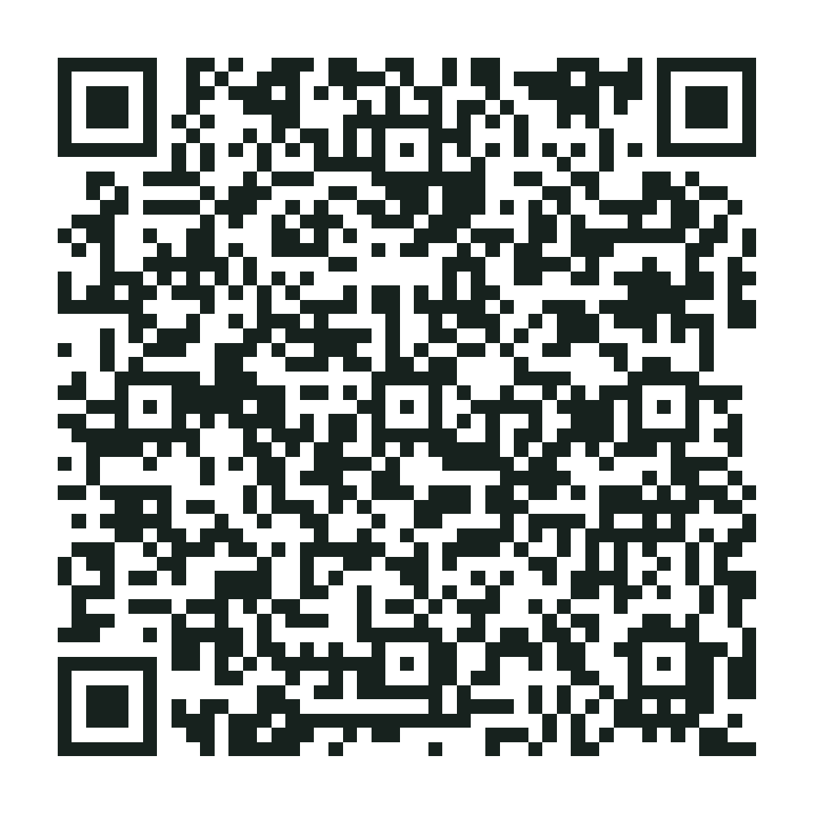
From a rough idea to a live app: how prompting works
Now on the App Store!
Pause for Paws, built by The Blizzards #67350, a Waukee middle school student team
iPhone: live now. Android: in testing.
1
2
3
4
5
6
▶
▶
▶
▶
▶
Our first prototype, Aug 23
The map on the phone
Real Iowa DOT crashes, live
The driver message
Approved Oct 13
Daily downloads, WHO 13 flagged
AUG 29
SEP 5 TO 7
SEP 12
SEP 14 TO 26
OCT 2 TO 13
OCT 21 ONWARD
Start rough
Make it personal
Make it real
Listen and improve
Make it store-ready
Keep it true
WE ASKED
“Warn drivers when they near a road where animals cross.”
WE ASKED
“Put it on a phone and alert me when I am close.”
WE ASKED
“Use real crash data and put it online.”
WE ASKED
“Make it useful, and fix what testers found.”
WE ASKED
“Add an icon, a privacy policy and store screenshots.”
WE ASKED
“Keep it accurate and show how it is doing.”
WE GOT
A first map with 3 sample corridors and practice data.
WE GOT
An Android app, a location button, background alerts, a simpler map.
WE GOT
Iowa DOT data and a live website, pauseforpawsusa.org.
WE GOT
ZIP search, year compare, voice alerts, an on/off switch, a fence cost tool.
WE GOT
App Store approval on Oct 13 and a public iPhone app.
WE GOT
WHO 13 News featured the app on Oct 21, and drivers keep downloading it.
Four prompt-engineering lessons from our journey
1. Start rough, then refine
One change per prompt. Each answer shows what to ask next.
2. Give context and limits
Who it is for, what data to use, and what we must not claim.
3. Test with real people
Testers asked for an on/off switch and a test alert, so we added them.
4. Check the AI’s work
We found 152 repeated crash records and 22 phantom corridors, then asked for fixes.
Scan to get the free iPhone app
Data: Iowa DOT crash data
Notes:
Talking points for students
1. Say: this app started as a rough idea on Aug 29. Ask the room: what would you ask an AI first?
2. For each step, cover the green WE ASKED box and let students guess what the app did next, then reveal WE GOT.
3. Point out the pictures: step 1 is our real first prototype, step 3 is the live map with real Iowa DOT crashes.
4. Lesson 4: the AI can be wrong. We found 152 repeated crash records and 22 phantom corridors by checking its work, then asked for fixes.
5. Finish with the QR code: students can scan it to install the free iPhone app. Clicking the QR, the live map picture or the App Store picture opens the link in slideshow mode.
The prompts on the slide are written in plain words. The team's very first prompt is not saved in the project history.

