Slide 1

SOVEREIGN AI · PERSONAL SECRETARY
Omnitrix
A local AI secretary that remembers, plans and acts, only with your OK.
Brain: engram
Track 1 · Sovereign AI
MSRIT Hackathon

Slide 2
Storing is easy. Judging is hard.
Your work lives in email, meetings and notes. Today's AI memory tools get the small judgements wrong.
97.8%
41%
7.5%
of Mem0 memories were junk
of Graphiti facts invalidated
of queries leaked private data
audit of 10,134 memories
~3,950 facts; 3 of 4 audited were wrong
even careful local + cloud (PAPILLON)
Remember this? Did it change? Should it be sent? Thousands of small judgements a day.
Omnitrix · MSRIT Hackathon · Track 1 Sovereign AI
02

Slide 3

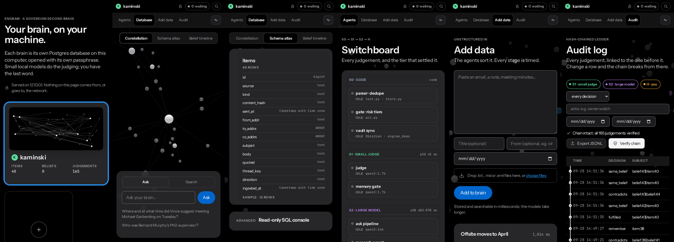
Our answer: a personal AI you own
01
02
03
04
05
Personal AI
Locally hosted
Fine-tuned LLM
Society of LLMs
Second brain
learns how you judge
zero cloud calls
a 1.7B trained on you
fast small, slow large, and you
memory with its sources
S0 Code
S1 Small judge
S2 14B model
H You
Omnitrix · MSRIT Hackathon · Track 1 Sovereign AI
03

Slide 4

The brain and its society of agents
YOUR LAPTOP · LOCAL ONLY · ZERO CLOUD CALLS
Sources
THE BRAIN
You
engram
Email
Meetings
Notes
Add data
Web app
Watch (Herald)
Obsidian vault
MCP tools
S0
Code
S1
1.7B judge
S2
14B model
H
You
Every judgement → one hash-chained ledger
7 ROLES ON ONE PIPELINE 22 planned agents → 7 roles
Librarian
Researcher
Memory
Planner
Operator
Guardian
Herald
Diplomat (demo)
Postgres 17 + pgvector items · chunks · beliefs · judgements · labels · people · plan_entries · herald_cards
Omnitrix · MSRIT Hackathon · Track 1 Sovereign AI
04

Slide 5

A judge trained on you, a watch that asks you
FINE-TUNING THE LLM
HERALD · KOTLIN WEAR OS APP
Your behaviour
replies, filing
Labels
5,958
LoRA on the Mac
54 min
The judge
934 MB
The ledger
every decision
1 The gate pauses an action
Approve?
email.reply_email
2 Long-poll over Wi-Fi, no cloud push
your taps become new labels
Accuracy on held-out conversations (%)
reply “Got it, thank you!” to sofia
3 The watch buzzes
Deny
Approve
4 You tap → the ledger
mDNS + HMAC
19 s pause → tap
Whisper ~0.5 s
Galaxy Watch 5 · Wear OS 5 · Kotlin + Compose · direct Wi-Fi to the Mac, no phone app
Omnitrix · MSRIT Hackathon · Track 1 Sovereign AI
05

Slide 6
Impact and benefits
MARKET
PRIVATE
PERSONALISED
SIMPLIFIED
0
96.6%
7 roles
TAM $3.4B
personal AI assistants, 2025
cloud calls: every model and store on your laptop
judge trained on you (14B: 95.5%)
one pipeline, one tap on the watch
SAM ~$340M
assumed 10%: privacy-first
TIME
COST
ACCURACY
807 → 255 s
934 MB
40.0% → 6.7%
SOM
~$3.4M
memory gate on 60 emails
judge, 3–5× faster, no API bills
harmful actions, through the gate
TAM: Research and Markets (2026), $19.63B by 2030. SAM, SOM (1% of SAM in 3 years): our assumptions.
Omnitrix · MSRIT Hackathon · Track 1 Sovereign AI
06

Slide 7
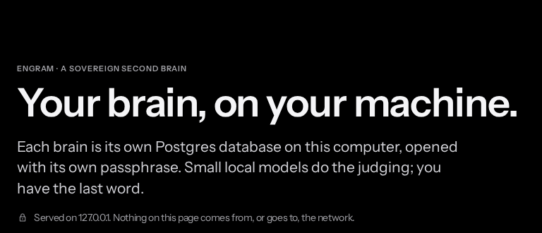
Feasible today, on one laptop
COMPUTE
BRAIN LATENCY (log scale)
PRIVACY
24 GB
• Zero cloud calls
• Hash-chained ledger of every decision
• DPDP-ready: 1-year logs, 72-hour breach reports
one MacBook Pro (M5 Pro)
934 MB
Penalties up to ₹250 crore
the 4-bit judge
54 min
LoRA training, 18 GB peak
Viable: it runs today on hardware the owner already has.
Omnitrix · MSRIT Hackathon · Track 1 Sovereign AI
07

Slide 8
References we built on
1 Kim et al., multi-agent scaling across 180 configurations, arXiv:2512.08296
2 Cemri et al., MAST: why multi-agent systems fail, arXiv:2503.13657
3 Zheng et al., persona prompts don't improve accuracy, arXiv:2311.10054
4 NATURAL PLAN, arXiv:2406.04520
5 Solver-checked LLM planning (10% → 93.9%), arXiv:2404.11891
6 NVIDIA, Small Language Models are the Future of Agentic AI, arXiv:2506.02153
7 PAPILLON (NAACL 2025): local + cloud delegation leaks 7.5%
8 Mem0 memory audit (mem0 #4573); Graphiti invalidation report (graphiti #1728)
9 India, Digital Personal Data Protection Rules, 2025
10 Datasets: EnronQA (CC BY 4.0), WorkBench (MIT), QMSum / AMI
11 Models and tools: Qwen3-1.7B, Qwen3-14B, Whisper large-v3-turbo, MLX, Ollama, PostgreSQL + pgvector, OR-Tools CP-SAT
12 Research and Markets, Personal AI Assistant Market Report 2026 (TAM)
Omnitrix · MSRIT Hackathon · Track 1 Sovereign AI
08

Slide 9

Thank you
Your brain, on your machine.
github.com/tharanirmal/omnitrix
TODO: team contact
Repo
Contact
Omnitrix · MSRIT Hackathon · Track 1 Sovereign AI
09

