Slide 1

Omnitrix
A local AI secretary that remembers, plans and acts, only with your OK.
Brain: engram
Track 1 · Sovereign AI
MSRIT Hackathon

Slide 2
Storing is easy. Judging is hard.
Promises and decisions hide in your email. Today's memory tools store junk, or judge silently.
97.8%
41%
7.5%
of Mem0 memories were junk
of Graphiti facts invalidated
of queries leaked private data
32-day audit of 10,134 memories
small-model judge, ~3,950 facts; 3 of 4 audited were wrong
careful local + cloud split (PAPILLON)
The hard part is the thousands of small judgements: remember this? did it change? send it?
Omnitrix · MSRIT Hackathon · Track 1 Sovereign AI
02

Slide 3

One laptop. One brain. Seven roles.
YOUR LAPTOP · LOCAL ONLY · ZERO CLOUD CALLS
THE BRAIN
Sources
engram
You
Email
Meetings
Notes
Add data
Web app
Watch (Herald)
Obsidian vault
MCP tools
S0
Code
S1
Small judge
S2
14B model
H
You
Every decision → one hash-chained ledger
7 ROLES ON ONE PIPELINE (22 planned agents → 7)
Librarian
Researcher
Memory
Planner
Operator
Guardian
Herald
Omnitrix · MSRIT Hackathon · Track 1 Sovereign AI
03

Slide 4

A 1.7B trained on you beats a 14B that isn't
S0 code → S1 small judge → S2 14B → You
54 min
of training, on this laptop
5,958
labels from the owner's own behaviour
3–5×
faster than the 14B
Omnitrix · MSRIT Hackathon · Track 1 Sovereign AI
04

Slide 5

Checked answers. Gated actions.
ANSWERS CHECKED
ACTIONS GATED
84% vs 6%
40.0% → 6.7%
right when the small judge vouches, vs when it doesn't
harmful side effects, 60 fresh sandbox tasks
• AUROC 0.92
• 70% correct on 100 held-out questions
• Code sets the risk · the 14B checks intent · you approve
• 0.62 owner prompts per task (approve-all: 0.97)
A small model may raise suspicion, never grant permission.
Omnitrix · MSRIT Hackathon · Track 1 Sovereign AI
05

Slide 6
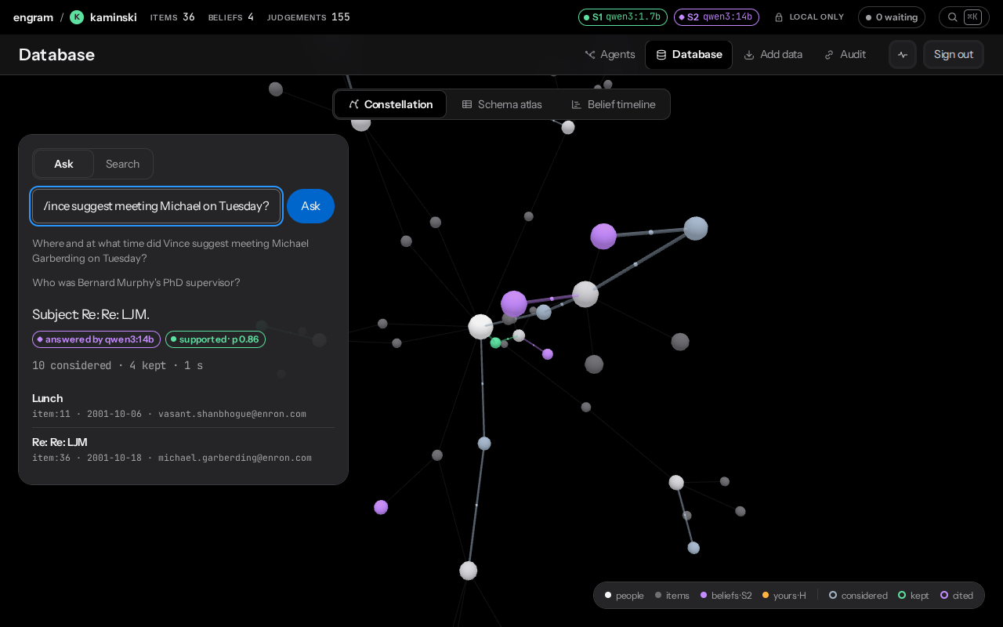
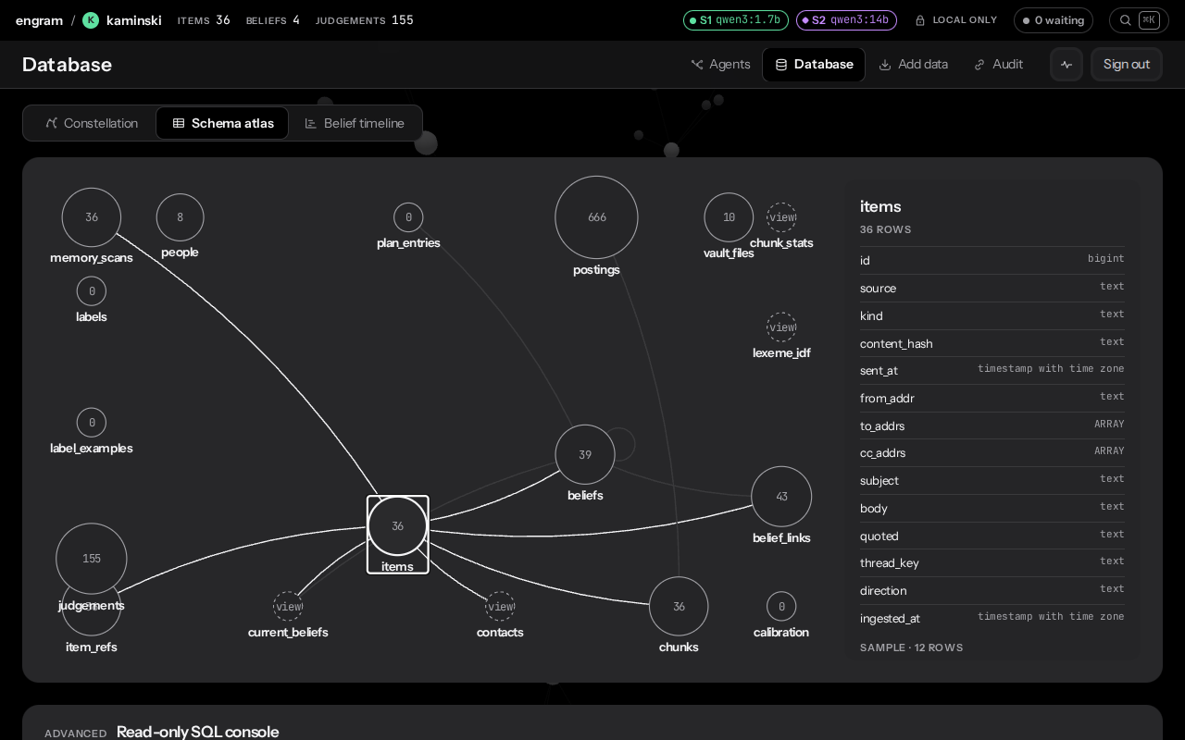
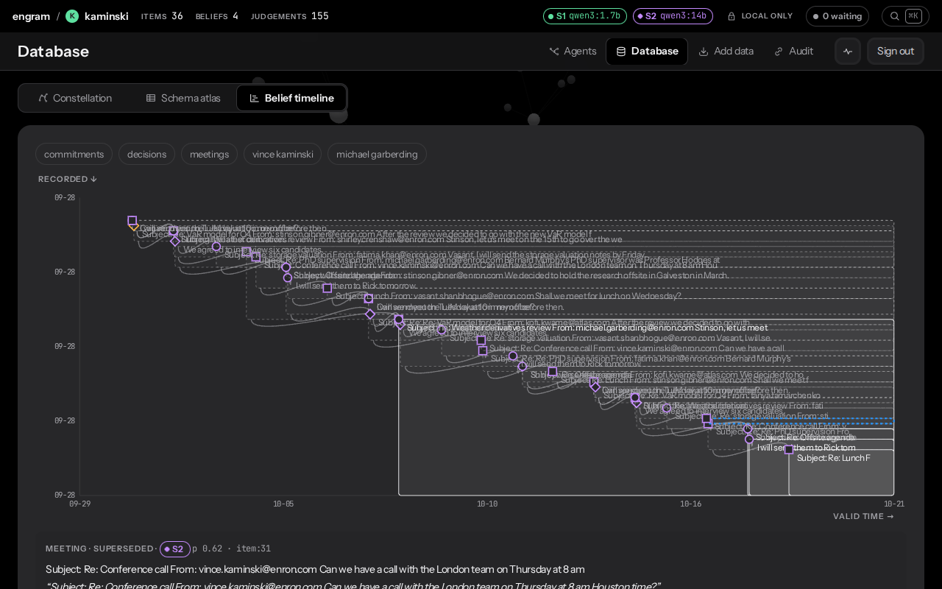
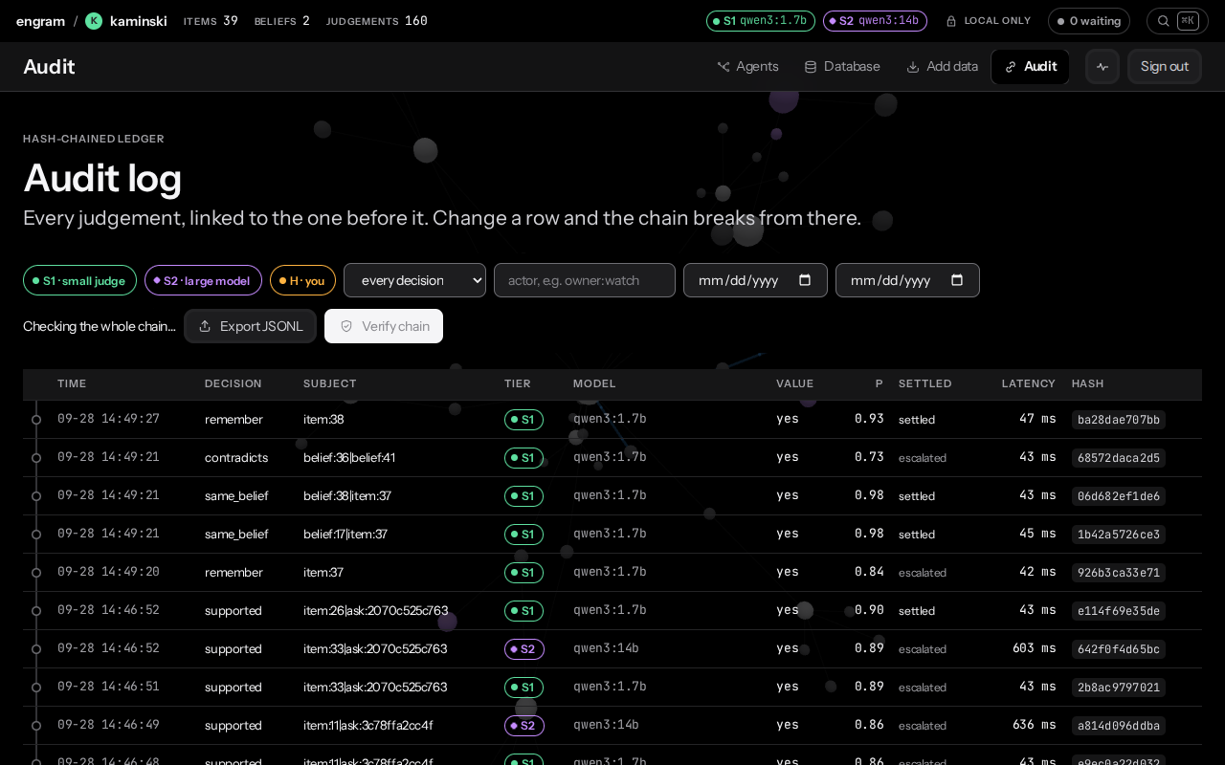
What you see
Approve?
email.reply_email
reply “Got it, thank you!” to sofia
Deny
Approve
Ask: answers with their sources
The brain as a 3D map, and SQL
The watch (Herald)
Approve on your wrist · ask by voice · reminders
Ledgered 19 s after the gate paused
Belief timeline: what changed, and when
Audit: every decision, chain verified
Omnitrix · MSRIT Hackathon · Track 1 Sovereign AI
06

Slide 7
Sovereign by design. New as a combination.
ZERO CLOUD CALLS
TOOL
HOW IT WORKS
WHERE IT BREAKS
1
Postgres + pgvector, on the Mac
Mem0
ADD-only memory; local server sunset (Jul 2026)
97.8% junk in a 10,134-memory audit
2
Ollama + MLX models, on the Mac
Graphiti
a small-model judge updates facts
invalidated 41% of ~3,950 facts, silently
3
Watch → Mac over local Wi-Fi
4
Every decision in a hash-chained ledger
GBrain
Postgres memory; LLM features hosted by default
no per-decision confidence
India's DPDP Rules
Omnitrix
calibrated local judge + ledger, all on your laptop
limits measured: see slide 8
1-year access logs · 72-hour breach reports · penalties up to ₹250 crore
Omnitrix · MSRIT Hackathon · Track 1 Sovereign AI
07

Slide 8
Demo, limits, next
DEMO · 5 MINUTES
LIMITS (MEASURED)
NEXT
1 Sign in to the kaminski brain
2 Ask: “Where and at what time did Vince suggest meeting Michael Garberding on Tuesday?”
3 Add an email with a promise → it becomes a belief
4 Act: “Forward my most recent email from fatima to kofi” → the watch buzzes → approve
5 Audit: newest ledger row is owner:watch → Verify chain
• “Will they reply?” is 60.1%, so it stays a suggestion
• “Worth remembering?” gate: 72% (AUROC 0.80)
• The watch uses plain HTTP on the LAN
• Bluetooth on → the watch drops Wi-Fi when asleep
• Adapter v2: + remember, meeting_request, fulfilled, contradicts
• A learned “buzz now or later?” from your taps
• TLS pinned at pairing
Built this week: 7,414 lines Python · 3,047 front end · 985 Kotlin · 15 SQL migrations · 113 tests
Omnitrix · MSRIT Hackathon · Track 1 Sovereign AI
08

