Slide 1
SOVEREIGN AI · PERSONAL SECRETARY
Omnitrix
A local AI secretary that remembers, plans, and acts — only with your OK.
ENGINE
EVENT
FOOTPRINT
engram — sovereign local brain
MSRIT Hackathon · Track 1: Sovereign AI
100% local · zero cloud calls

Slide 2
02 · WHY OMNITRIX
Storing Data is Easy. Making Judgements is Hard.
Why today's memory tools fail at long-term personal memory
TODAY'S MEMORY TOOLS
OMNITRIX SOVEREIGN ARCHITECTURE
Store first, judge never
Judge first, locally
● Mem0: 97.8% of 10,134 audited memories were junk
● Graphiti: a small-model judge invalidated 41% of ~3,950 facts, silently
● Local + cloud splits still leak private data on 7.5% of queries
● Fine-tuned local System 1 (1.7B) makes the fast micro-judgements
● System 2 (14B) takes complex reasoning and drafting
● A human-in-the-loop gate before any action, with zero cloud calls
The hard part isn't storing things. It's the thousands of small judgements.
Omnitrix · MSRIT Hackathon · Track 1 Sovereign AI
02

Slide 3
03 · SYSTEM ARCHITECTURE
One Laptop. One Brain. Seven Roles.
ENGRAM · THE BRAIN
INPUT
S0
S1
S2
H
LEDGER
Sources
Code filter
Small judge
14B model
Your approval
Audit ledger
Email · Notes · Meetings
Parse, dedupe, dates, rules
Fine-tuned 1.7B, one token
The unsure middle, all writing
Herald watch or web app
Hash-chained, every decision
7 FUNCTIONAL ROLES ON ONE PIPELINE
Librarian
Researcher
Memory
Planner
Operator
Guardian
Herald
Ingests and files everything
Answers with cited sources
Keeps promises and decisions
Plans your day with a solver
Acts in your tools
Gates every action
Reaches you on the watch
Omnitrix · MSRIT Hackathon · Track 1 Sovereign AI
03

Slide 4
04 · LOCAL MODEL PERFORMANCE
A 1.7B Fine-Tuned Model Beats a 14B General Model
54 min
5,958
3–5×
Local LoRA training
Behavioural labels
Faster than the 14B
on the Mac with MLX, peak 18 GB
from the owner's own replies and filing, and EnronQA answers
zero-shot, on the same decisions
WHY A SMALL LOCAL JUDGE WINS
We fine-tune skills, never facts: knowledge stays in local Postgres, where it can be cited and deleted.
Trained on four decisions, the fine-tuned 1.7B beats the zero-shot 14B on every one: supported? 96.6% vs 95.5% · relevant? 90.9% vs 87.5% · will reply? 60.1% vs 55.4% · folder 52.7% vs 47.9%.
Fused and quantized to 4-bit it is a 934 MB model, 2.9× faster again with no loss in accuracy.
Omnitrix · MSRIT Hackathon · Track 1 Sovereign AI
04

Slide 5
05 · VERIFICATION & GATED SAFETY
Checked Answers. Gated Actions.
ANSWERS CHECKED
ACTIONS GATED
84% vs 6%
40.0% → 6.7%
right when the small judge vouches vs when it doesn't
harmful side effects on 60 fresh sandbox tasks
● AUROC 0.92 on 100 held-out questions
● The local judge checks each answer against the emails it cites
● 0.62 owner prompts per task (approve-all: 0.97)
● Code sets the risk · the 14B checks intent · you approve
● Herald on Wear OS: approved on the wrist, ledgered 19 s after the gate paused
A small model may raise suspicion, never grant permission.
Omnitrix · MSRIT Hackathon · Track 1 Sovereign AI
05

Slide 6
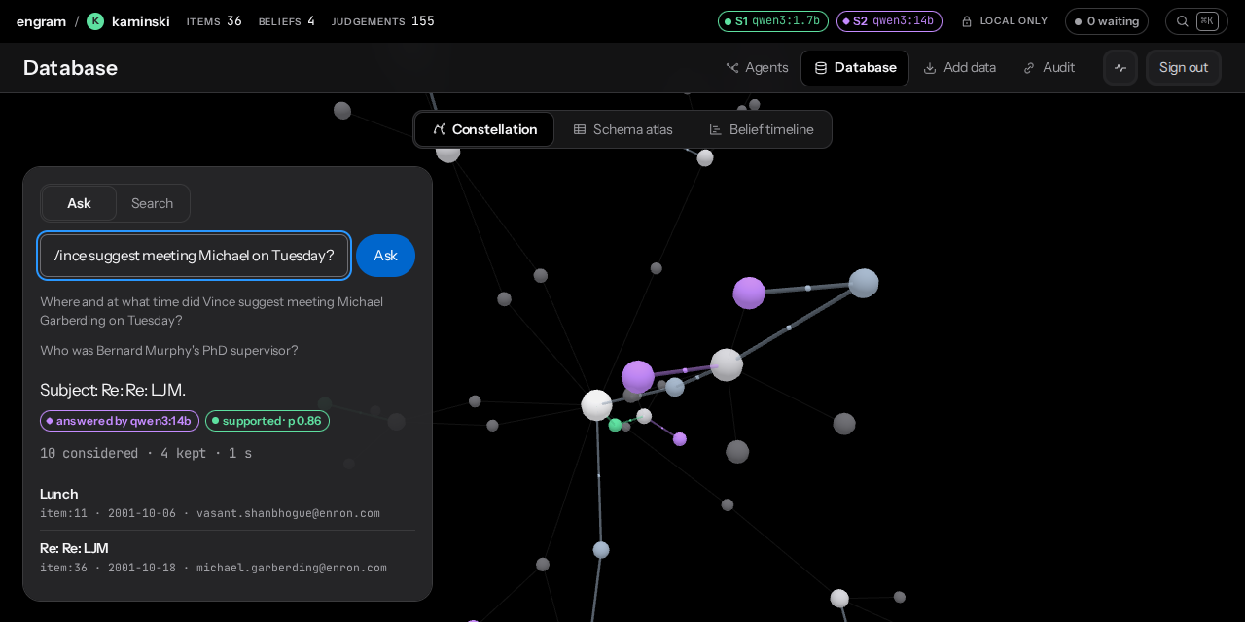
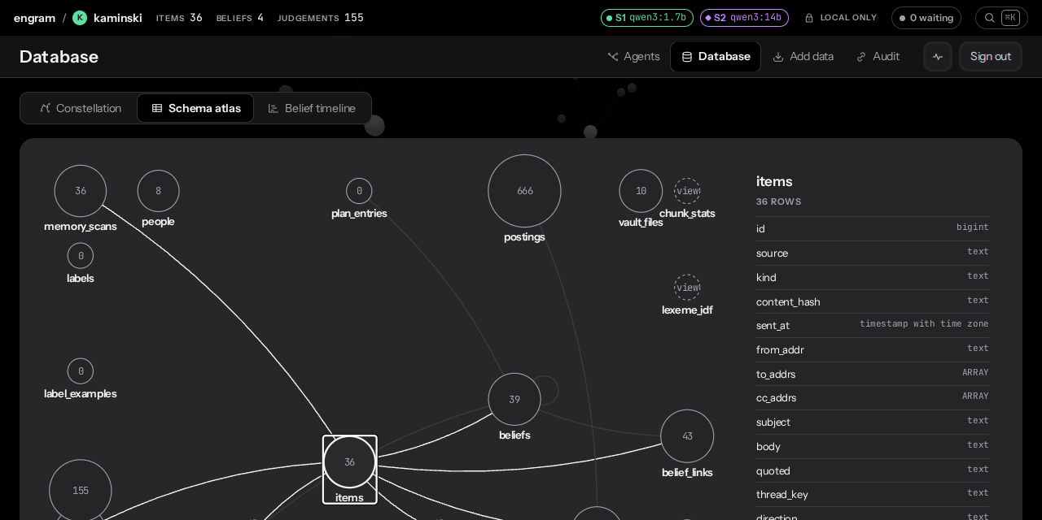
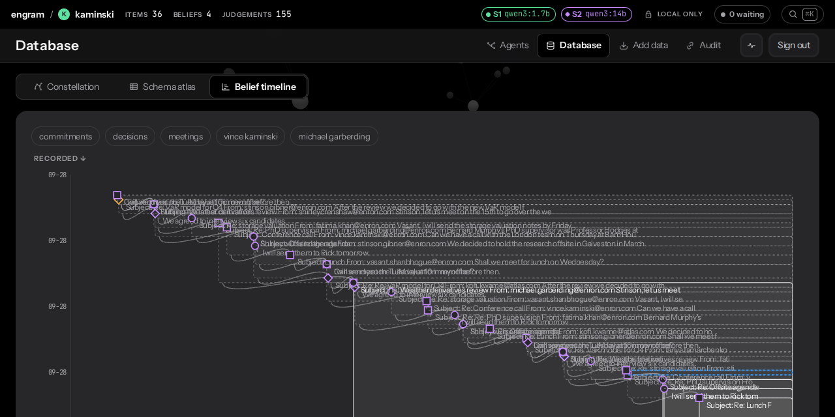
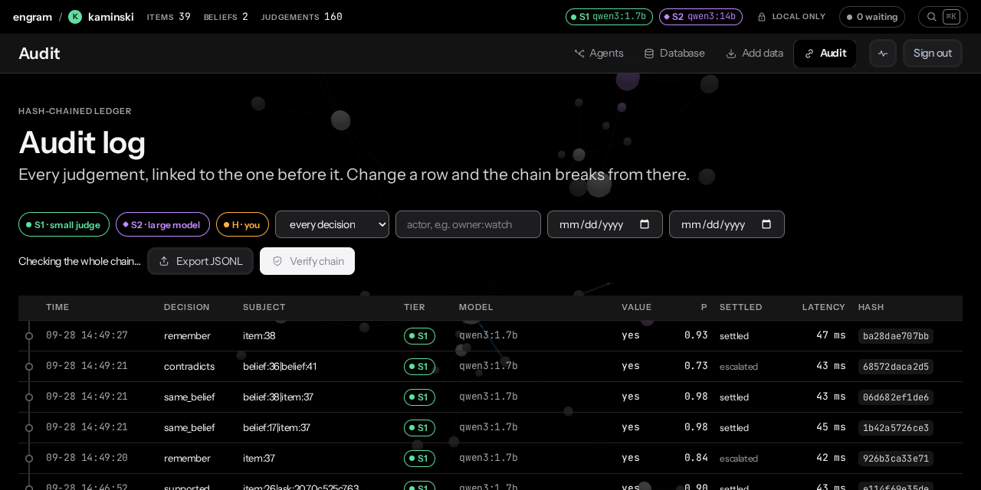
06 · WHAT YOU SEE
Interface Showcase
Local web dashboard, constellation map and cryptographic ledger
Constellation Graph (3D Memory Map)
Schema Atlas & SQL Inspector
Bitemporal Belief Timeline
Tamper-Evident Cryptographic Audit Log
Omnitrix · MSRIT Hackathon · Track 1 Sovereign AI
06

Slide 7
07 · SOVEREIGN BY DESIGN
Sovereign by Design. Ready for DPDP.
India's DPDP Rules: 1-year access logs · 72-hour breach reports · penalties up to ₹250 crore
01
02
03
04
Postgres + pgvector local storage
Ollama + MLX local runtime
Direct Wi-Fi Wear OS connection
Hash-chained audit ledger
TOOL | METHODOLOGY | KNOWN VULNERABILITY / LIMITATION | OMNITRIX ADVANTAGE
Mem0 | ADD-only memory; local server sunset (Jul 2026) | 97.8% junk in a 10,134-memory audit | Small-judge write gate: 151 → 36 beliefs on 60 emails
Graphiti | A small-model judge updates facts | Invalidated 41% of ~3,950 facts, silently | Contradictions are shown to you, never silently retired
GBrain | Postgres memory; LLM features hosted by default | No per-decision confidence | A calibrated probability on every decision, in the ledger
Omnitrix | Fine-tuned local judge + 14B + hash-chained ledger | Measured weak spot: the “worth remembering?” gate is 72% | All local; every decision auditable
Omnitrix · MSRIT Hackathon · Track 1 Sovereign AI
07

Slide 8
08 · DEMO, LIMITS, NEXT
Five Minutes Live. Every Limit Measured.
DEMO · 5 MINUTES
LIMITS (MEASURED)
NEXT
1 Sign in to the kaminski brain
2 Ask: “Where and at what time did Vince suggest meeting Michael Garberding on Tuesday?”
3 Add an email with a promise → it becomes a belief
4 Act: “Forward my most recent email from fatima to kofi” → the watch buzzes → approve
5 Audit: the newest ledger row is owner:watch → Verify chain
● “Will they reply?” is 60.1%, so it stays a suggestion
● The “worth remembering?” gate: 72% (AUROC 0.80)
● The watch uses plain HTTP on the LAN
● Bluetooth on → the watch drops Wi-Fi when asleep
● Adapter v2: + remember, meeting_request, fulfilled, contradicts
● A learned “buzz now or later?” from your taps
● TLS pinned at pairing
Built this week: 7,414 lines Python · 3,047 front end · 985 Kotlin · 15 SQL migrations · 113 tests
Omnitrix · MSRIT Hackathon · Track 1 Sovereign AI
08

