Slide 1
Digital Portfolio
STUDENT NAME:
REGISTER NO AND NMID:
DEPARTMENT:
COLLEGE: COLLEGE/ UNIVERSITY

Slide 2
PROJECT TITLE
Digital Learning Showcase Platform

Slide 3


AGENDA
Problem Statement
Project Overview
End Users
Tools and Technologies
Portfolio design and Layout
Features and Functionality
Results and Screenshots
Conclusion
Github Link
3/21/2024 Annual Review

Slide 4

PROBLEM STATEMENT
Students often struggle to organize their online learning journey and projects in one place. Employers and peers also find it difficult to view a candidate’s learning achievements quickly.

Slide 5

PROJECT OVERVIEW
The E-Learning Portfolio Website provides a centralized platform where learners can showcase their completed courses, skills, and projects in an attractive and responsive format.

Slide 6

WHO ARE THE END USERS?
Students – to display their academic/professional learning.
Job Seekers – to share a structured learning journey with recruiters.
Teachers/Mentors – to track student learning progress.

Slide 7

TOOLS AND TECHNIQUES
Frontend: HTML5, CSS3, JavaScript
Design: Responsive grid layout (CSS Grid/Flexbox)
Deployment: GitHub Pages (or any web hosting)

Slide 8
POTFOLIO DESIGN AND LAYOUT
Responsive grid-based design
Clean, professional color scheme (green/white)
Interactive course cards with hover animations
Footer with author information
8

Slide 9
FEATURES AND FUNCTIONALITY
Dynamic course cards generated using JavaScript
Hover effects and animations for better user experience
Enroll button with interactivity (alerts, modals, or redirection)
Scalable for adding new courses easily

Slide 10
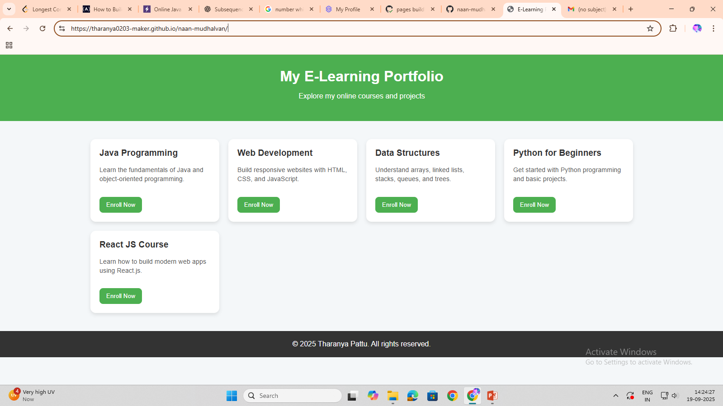

RESULTS AND SCREENSHOTS
3/21/2024 Annual Review
10

Slide 11
CONCLUSION
The project demonstrates how simple web technologies can be used to build an effective and professional-looking digital portfolio for showcasing e-learning progress. It can be extended with backend integration for real enrollments.
11

