Slide 1
— ENGINEERING BRIEFING
Sonar Auto-Fix Agent
An autonomous ADK agent that remediates SonarQube findings file by file — verifying every change against a real build before it ever counts as done.
Google ADK
Gemini
SonarQube
Java · Maven / Gradle
sonar_autofix_agent
internal build & verification tooling
01 / 16

Slide 2
— 01 — WHY THIS AGENT
Sonar tells you what's wrong.
Nobody has time to fix it in order.
VOLUME
Findings scale past manual triage
831 issues on one real Java project analyzed this run, 44 on another. Reviewing and prioritizing each by hand doesn't scale with codebase size or team bandwidth.
CONSISTENCY
Judgment calls vary by engineer
Two people fix the same “hardcoded credential” finding two different ways. Neither is wrong — but neither is auditable against a single standard either.
RISK
A fix can silently break the build
A one-line “safe” change can break a test suite in a way nobody notices until CI runs — or later. Verification is usually an afterthought, not a gate.
The agent exists to make remediation fast, ordered, and self-verifying — closing the highest-severity findings first, and never treating a fix as complete until the real build says so.
02 / 16

Slide 3
— 02 — WHAT IT DOES
Fixes a project toward a rating, not a lower issue count
01 Fetches SonarQube issues and Security Hotspots for a project — local path or GitHub URL.
02 Prioritizes Security → Reliability → Security Hotspots → Maintainability, grouped by file — every in-scope issue in a file is resolved before moving on.
03 Targets ratings Security/Reliability → A means zero open issues down to Minor/Low. Maintainability → A means the technical-debt ratio is at or under 5%.
04 Verifies every fix compiles, then verifies the full build and test suite at regular checkpoints — before anything is treated as final.
05 Commits per file, checkpoints every few files, and re-scans Sonar to catch regressions the local build wouldn't see.
06 Reports final ratings and, if configured, pushes the fix branch — nothing reaches a shared branch unverified.
03 / 16

Slide 4
— 03 — HOW IT WORKS
One LLM call. Everything else is a deterministic decision.
fix_llm_agent is the only model call in the entire graph — it generates a unified diff for one file's issues, nothing more. Prioritization, cluster classification, diff application, build verification, checkpoint gating, and revert/bisection are all plain BaseAgent classes reading and writing session state.
This is enforced by the object graph itself, not a convention someone can forget — a deterministic step physically cannot improvise a different orchestration path the way a model call could.
WHERE THE MODEL IS KEPT OUT ENTIRELY
Deterministic pre-pass
A handful of rules with one unambiguous mechanical fix — e.g. wiring an explicit AWS credentials provider — are resolved by pattern match before the file ever reaches a prompt. No LLM call, no ambiguity, no variance.
04 / 16

Slide 5
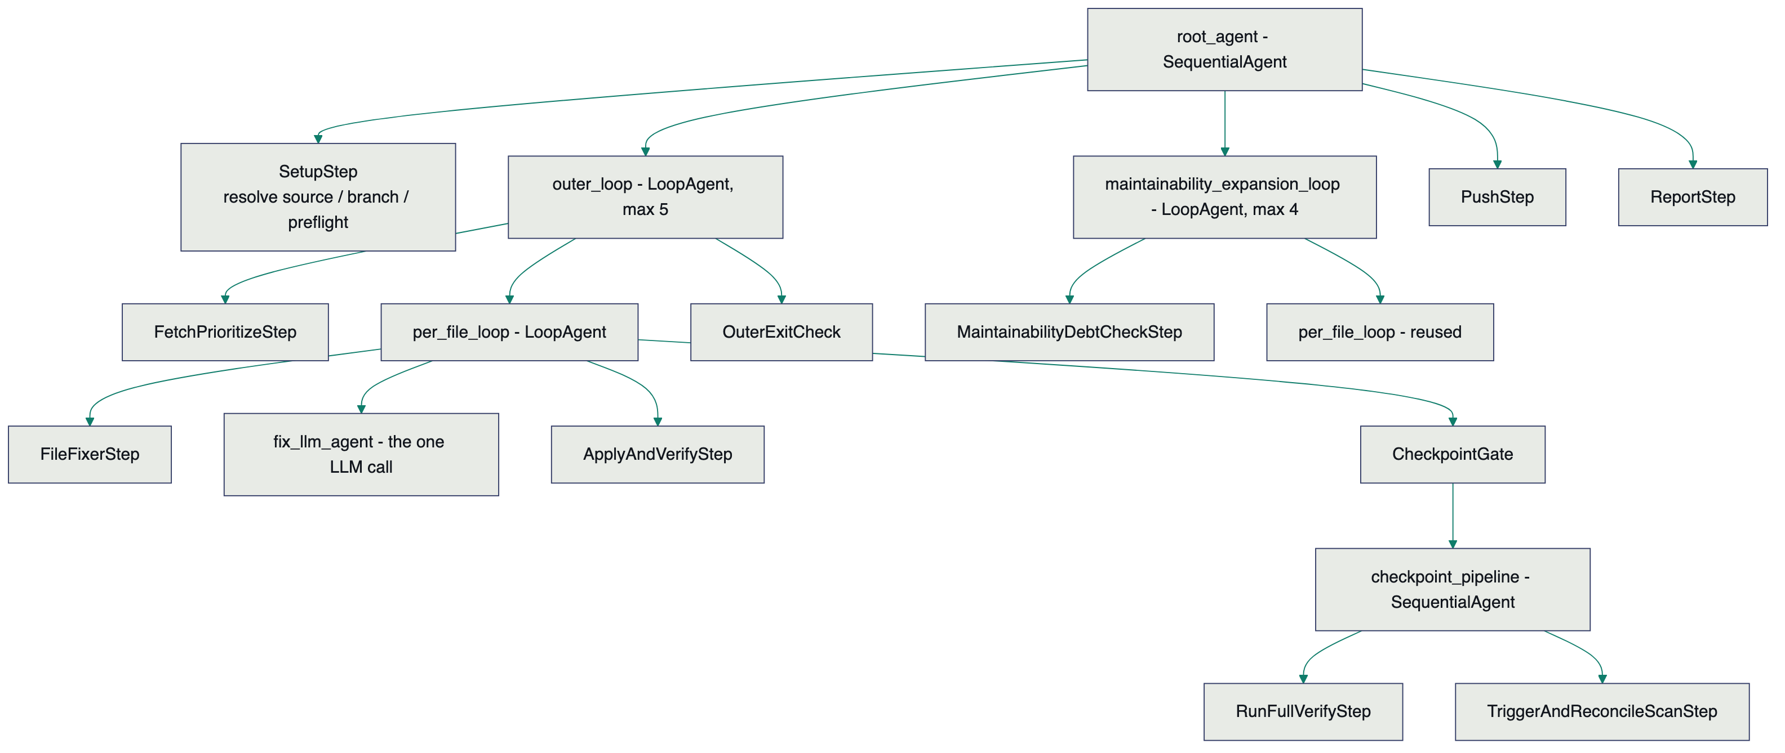
— 04 — ARCHITECTURE
Agent composition
Every box below outer_loop / maintainability_expansion_loop is a plain BaseAgent. fix_llm_agent is the single LlmAgent in the graph.
05 / 16

Slide 6
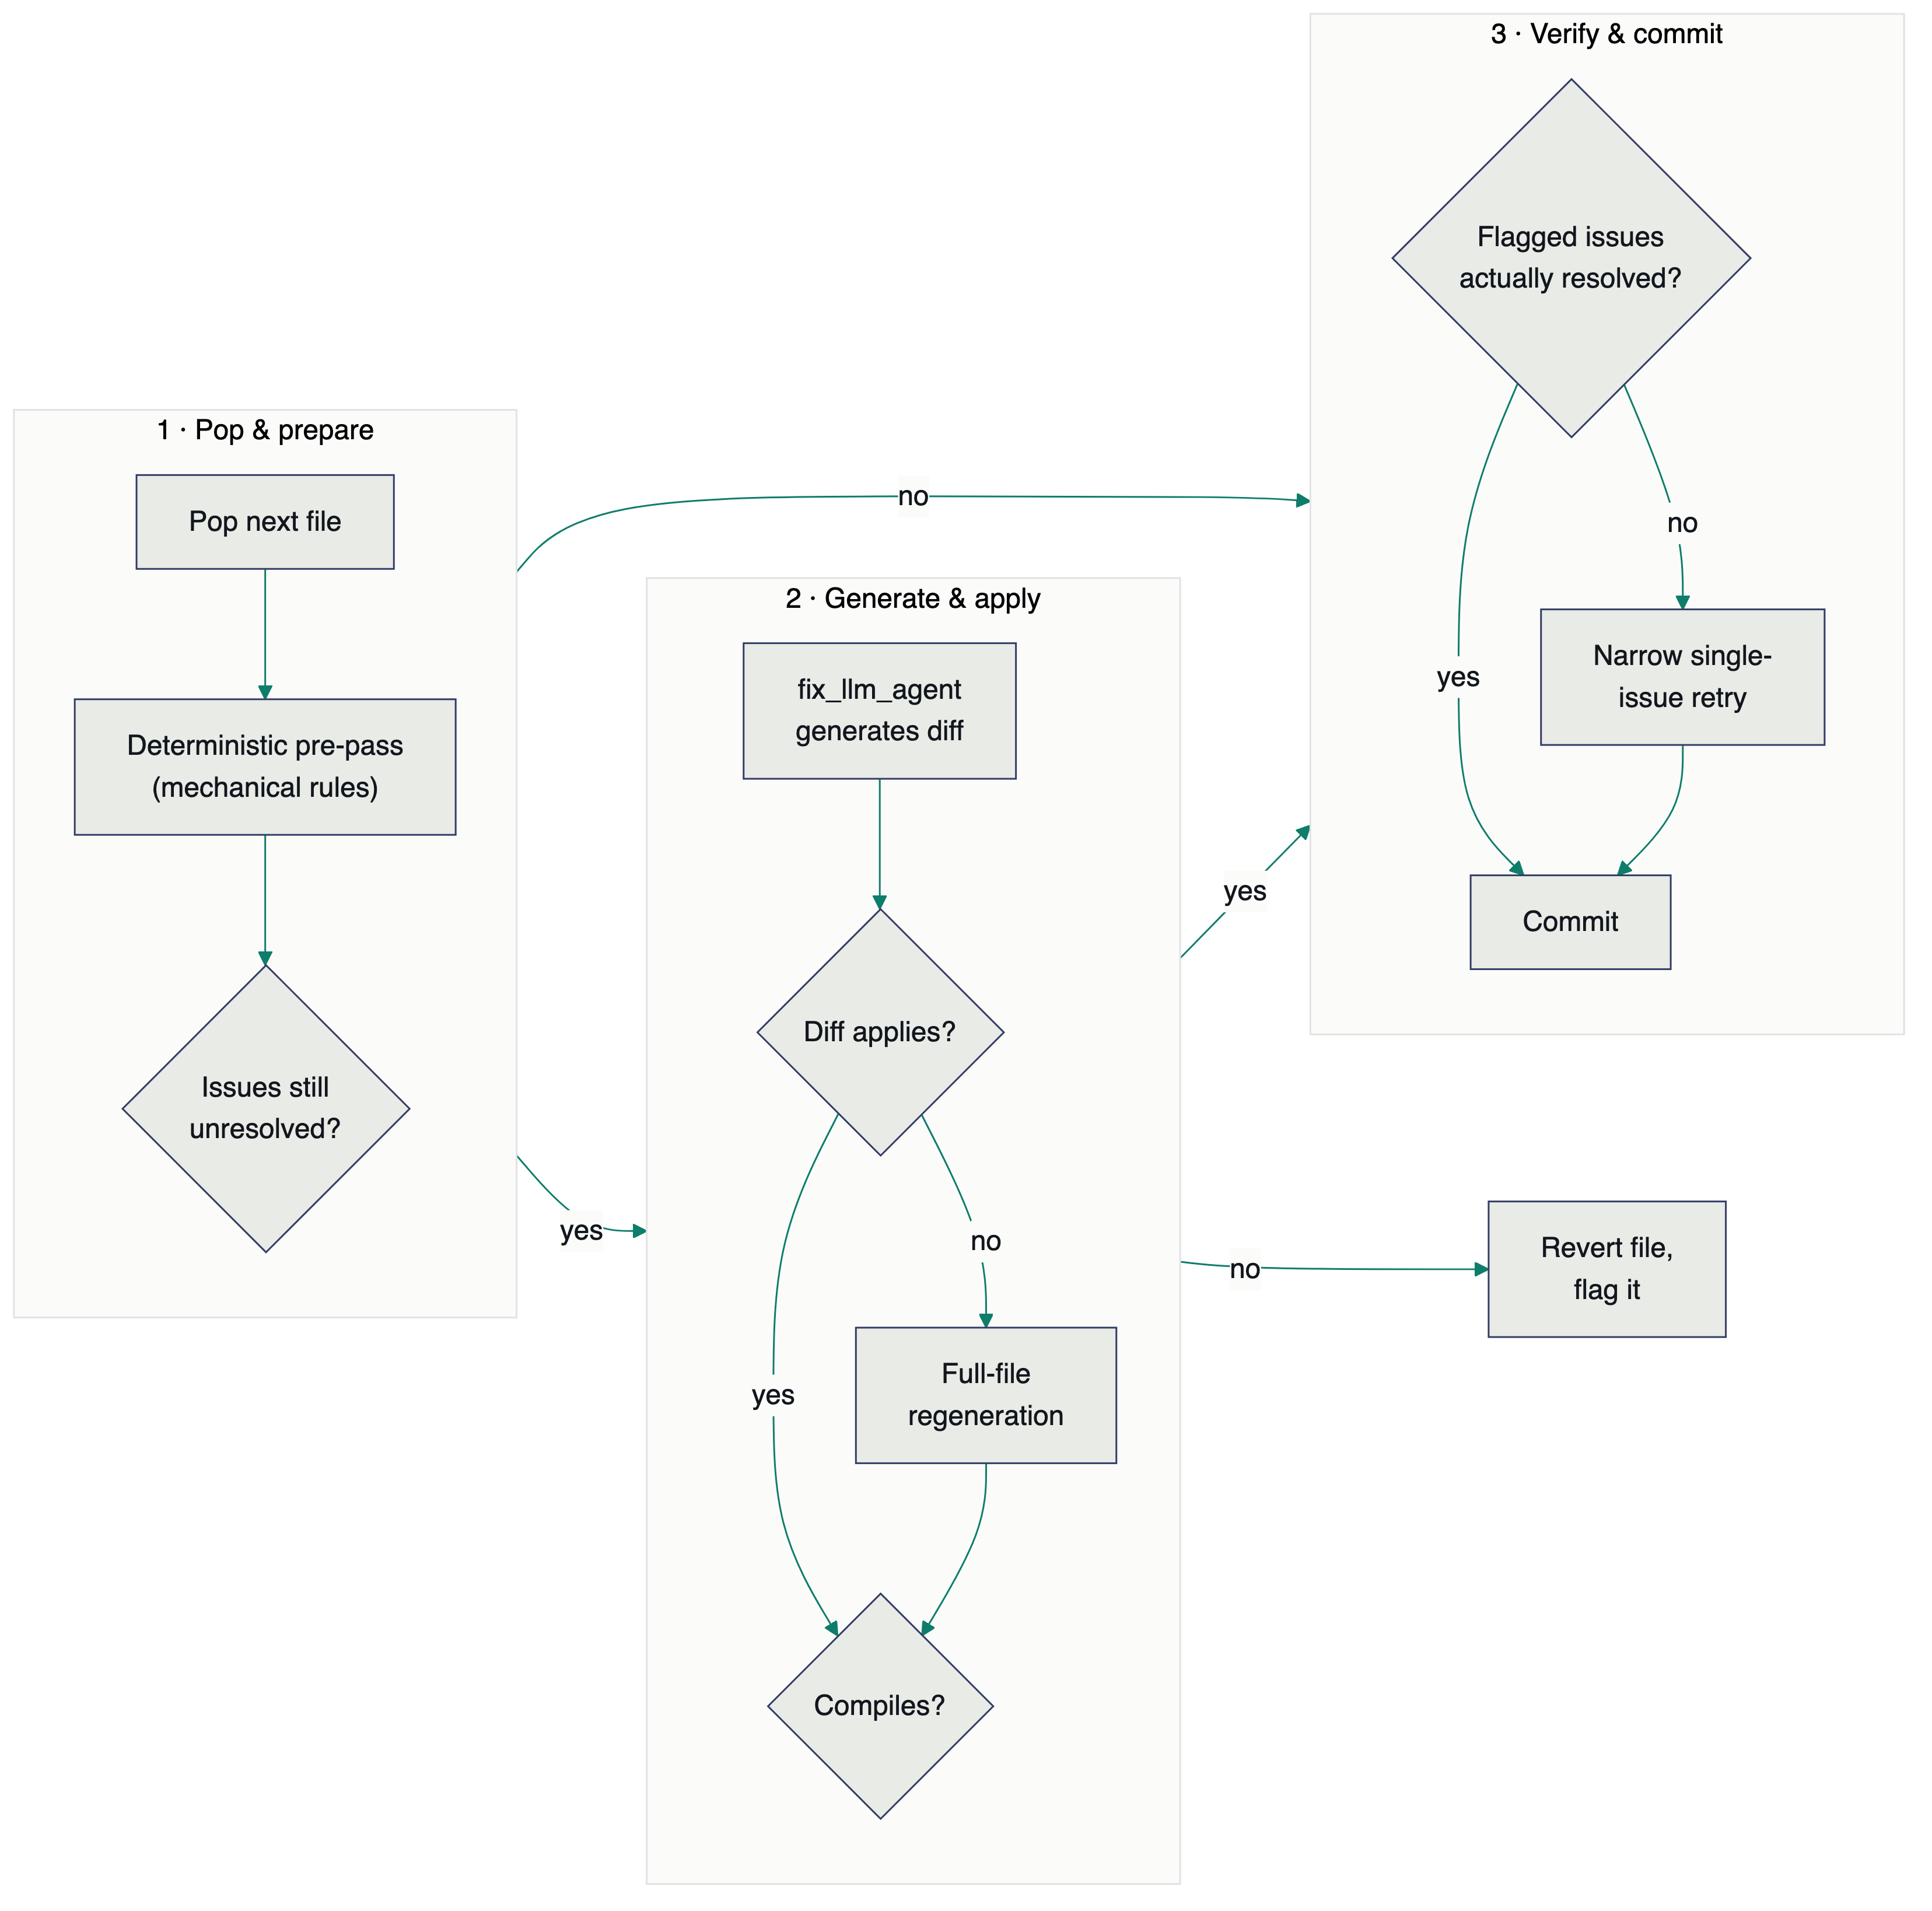
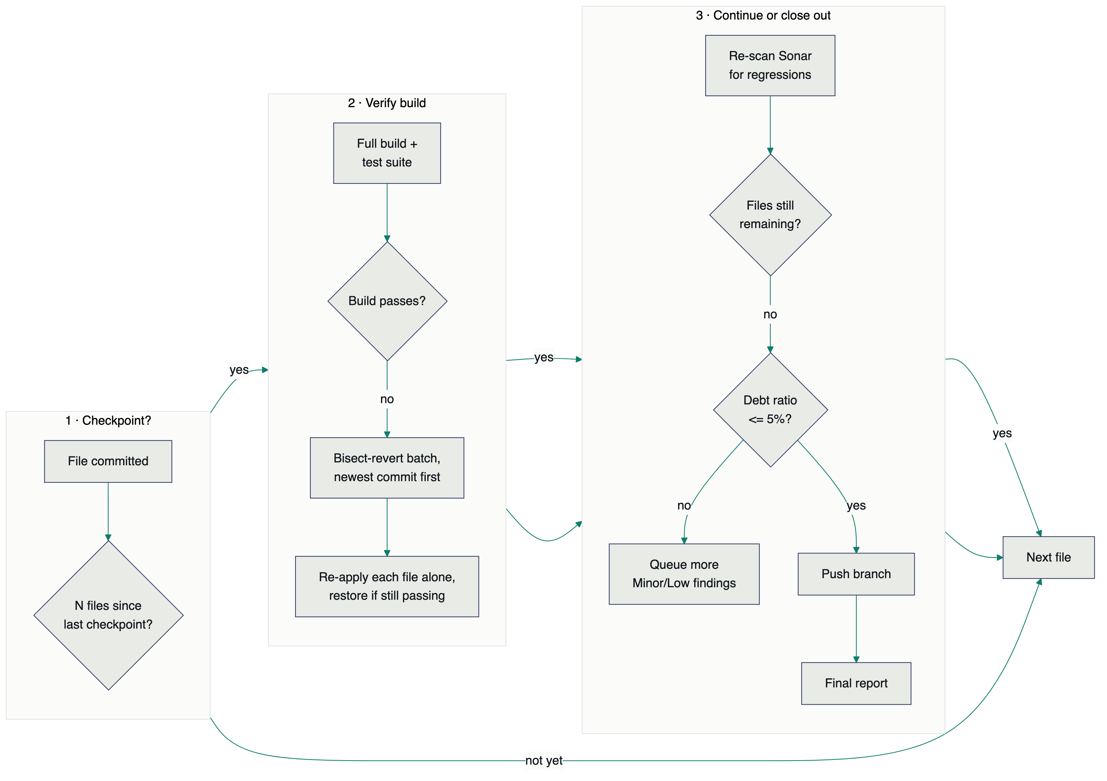
— 05 — RUNTIME FLOW
Per-file fix → checkpoint → recovery
Per-file fix attempt
Checkpoint, recovery & wrap-up
06 / 16

Slide 7
— 06 — TECH STACK
What it's built on
ORCHESTRATION
Google Agent Development Kit (ADK) — BaseAgent, LlmAgent, LoopAgent, SequentialAgent
MODEL
Gemini, via fix_llm_agent — configurable thinking-effort level per run
RUNTIME
Python 3, run to completion from pre-seeded state (not a chat loop)
STATIC ANALYSIS
SonarQube — Community Build and Developer+, over its REST API
BUILD TOOLS
Maven and Gradle, including wrapper-only projects (mvnw / gradlew)
VERSION CONTROL
git — local resolution, GitHub clone, branch, commit, push
TESTING
pytest — hermetic fixtures, real temp git repos, mocked HTTP, no network in CI
ENTRY POINTS
run_local.py for real runs; adk web for interactive exploration
07 / 16

Slide 8
— 07 — PREREQUISITES
Checked automatically, fail-fast
Validated before a single git branch is touched or a single issue is fetched — a failure here stops the run with a specific, actionable message instead of a confusing mid-pipeline error.
TOOLING
On PATH, or wrapped
java; mvn / gradle, or a committed wrapper script and its wrapper jar.
REPOSITORY
A resolvable project
pom.xml or build.gradle[.kts] at the root, resolving to a Sonar project key; local sources must be a real git repo.
SONAR SERVER
Reachable and already scanned
Token authenticates against SONAR_BASE_URL, and the resolved project key has at least one prior analysis on the server.
Configuration: GOOGLE_API_KEY, SONAR_BASE_URL, SONAR_TOKEN, SOURCE_TYPE (+ path or repo/token), LANGUAGE
08 / 16

Slide 9
— 08 — CHECKS & VALIDATIONS
Nine gates between a diff and a commit
1 Preflight — tooling, repo shape, and Sonar reachability, before anything else starts.
2 Deterministic pre-pass — mechanical rules resolved without a model call, where the fix is truly unambiguous.
3 Diff apply — falls back to full-file regeneration if a unified diff won't apply cleanly.
4 Quick compile check — scoped to the touched file/module, before anything is committed.
5 Pattern verification — confirms the specific flagged line actually changed, not just that an issue count dropped somewhere.
6 Narrow retry — one focused, single-issue follow-up call, only triggered by a verified miss.
7 Full build + test suite — a real checkpoint, every few files.
8 Bisection + restore — isolates a checkpoint failure to its true cause and reinstates innocent files caught in the sweep.
9 Sonar re-scan — catches regressions a local build and test suite wouldn't, like a new issue elsewhere.
09 / 16

Slide 10
— 09 — HUMAN IN THE LOOP
The agent is deliberately not fully autonomous
ROUTED TO REVIEW
FLAGGED
Minor/Low Security & Reliability
Never auto-resolved. Sent to a won't-fix / false-positive review queue for a human to triage — the agent will not guess on low-severity security judgment calls.
“No safe fix” declines
If the model can't safely fix an issue with the context it has, it says so explicitly and the file is left untouched — not guessed at.
REVERTED & FLAGGED
GATED
Anything that breaks verification
A fix that fails the build, the tests, or introduces a new Sonar issue is reverted automatically, with the real build/test error attached to the flag.
Publishing the result
Pushing to GitHub needs an explicit, deliberately-configured write token. The final report always states plainly whether every rating actually hit A.
10 / 16

Slide 11
— 10 — ADVANTAGES
What this buys you
✓ Consistent and auditable — every decision traces back to session state and a real git history, not an engineer's mood that day.
✓ Nothing lands unverified — compile, full build, full test suite, and a Sonar re-scan, every single time, not just on a good day.
✓ Self-correcting mid-run — narrow retries, checkpoint bisection, and restore-the-innocent recovery mean one bad file doesn't sink a whole batch.
✓ Small, contained blast radius — the model only ever produces one file's diff at a time; it never touches orchestration, prioritization, or verification logic.
✓ Resilient to flaky infrastructure — a blocked or dropped model call flags one file and keeps going, instead of taking the whole run down with it.
11 / 16

Slide 12
— 11 — DEVELOPER EFFICIENCY
Minutes of agent time, not days of manual triage
831
issues fetched, classified, and prioritized automatically in a single pass on a real project (WebGoat) — no manual triage spreadsheet.
78
files fixed and build-verified in one continuous run before completion — each one compiled, tested, and checkpointed.
5-10 min
typical end-to-end run time on a mid-size project, fetch through final report.
Manually working through a comparable batch — reading each finding, understanding the rule, writing a fix, then rebuilding and re-testing — is realistically days of focused engineering time for a project this size, done one file at a time. The agent compresses that into a single automated pass, so engineers spend their time reviewing the handful of flagged edge cases instead of hand-fixing routine, well-understood findings.
12 / 16

Slide 13
— 12 — DISADVANTAGES
What to plan around
– LLM output isn't deterministic — the same underlying issue can get a safer or a riskier fix on different runs; a self-injection pattern once shipped with a null-safe fallback, another time without it, and broke a checkpoint.
– Full verification is slow — a checkpoint on a real project takes minutes; a full run can run 5–10+ minutes end to end.
– Local runs share one working directory — an interrupted run leaves state a later run has to correctly reset past before starting clean.
– Bisection isn't binary search — deliberately, so it correctly handles multiple simultaneous culprits, but that makes the common single-culprit case slower than it needs to be.
– No coordinated multi-file refactors — one file, one prompt, by design; fixes that require touching several files together are out of scope.
– Still maturing on very high-issue-count projects — every run makes real, verified progress, but on projects with a large volume of open findings the agent doesn't yet reliably drive every rating category all the way to A in one pass. An active area of improvement, not a hard ceiling.
– Java, Maven/Gradle, SonarQube only — today.
13 / 16

Slide 14
— 13 — CURRENT STATUS
Supports today / doesn't yet
SUPPORTS NOW
DOESN'T YET
✓ Java — Maven and Gradle, including wrapper-only projects
✓ Local filesystem source, or GitHub source with clone + push
✓ SonarQube Community Build and Developer+, branch-aware ratings on both
✓ Security, Reliability, Security Hotspots, and ratio-based Maintainability
✓ Full checkpoint / bisection / re-scan safety net
✓ Deterministic pre-fixes for select mechanical rules
– Any language other than Java — TS/JS and Python adapters are stubbed placeholders in the registry
– Duplication and Coverage metrics — out of scope by design, not an oversight
– Automatic resolution of Minor/Low Security or Reliability issues — human-gated by design
– Static analysis tools other than SonarQube
– Resuming an interrupted run — every run starts fresh, by design
– Coordinated multi-file refactors
14 / 16

Slide 15
— 14 — FUTURE ENHANCEMENTS
Where this goes next
A A family of specialized agents in adk web — this agent stays the general fix-code-smells agent; a fix-duplication-agent and a fix-coverage-agent join it, each scoped to a single concern and a specific branch, so a developer can pull in exactly the narrow pass they need.
B The same orchestration pattern, other tools — SBOM scanners, Black Duck, and other static-analysis sources plugged into the same fetch → prioritize → fix → verify → report shape.
C Multi-language support — TypeScript/JavaScript and Python via the existing LanguageAdapter interface, already designed for this; only the adapters are missing.
D Local / self-hosted LLM, to cut cost — fix_llm_agent is a single, swappable model endpoint, so routing it to a self-hosted open-weight code model (e.g. Qwen2.5-Coder or DeepSeek-Coder, benchmarked against this exact diff-generation task before committing) removes per-call API cost at scale. “Learning from its own mistakes” isn't automatic in a base model, though — the realistic path is fine-tuning or a retrieval-based feedback loop over real checkpoint-revert history, formalizing what today is hand-curated as rule-specific prompt guidance.
E Deploy beyond a local machine — runs today as a single local process (run_local.py); moving it to Google Cloud (Cloud Run jobs or GKE, triggered on a schedule or a Sonar webhook) would enable centralized logging, scheduled sweeps across many repos, and further verification at a scale a laptop can't sustain.
15 / 16

Slide 16
— CLOSE
One file at a time.
Never unverified.
Questions, edge cases, or a specific project you'd like to see it run against — happy to walk through any slide in more depth.
16 / 16

