Slide 1



Bakar Alir – Supporting Developers in Construction of Information Flow Contracts in SPARK
Hariharan Thiagarajan John Hatcliff
Jason Belt Robby
Department of Computing and Information Sciences
Kansas State University
Support
Notes:
Bakar alir is our tool developed in kansas state university

Slide 2
Context: SPARK Ada
Language and verification framework designed for critical systems
Interface Specification Language
Automated Verification Tools
information flow specifications
Examiner
simple static analysis and verification condition generator
Annotation for pre/post-conditions
Simplifier
decision procedure package that simplifies and tries to automatically prove verification conditions
+
Programming Language
Subset of Ada appropriate for critical systems
No heap data
No pointers
No exceptions,
No recursion
No gotos & aliasing
Proof Checker
semi-automated framework for manually caring out proof steps to discharge remaining verification conditions
Notes:
[timing: XX ]
SPARK comes with a set of tools. The Examiner performs usual static analysis for critical systems
It verifies that the code confirms to the contract

Slide 3
Context: Information Flow
Language and verification framework designed for critical systems
Interface Specification Language
Automated Verification Tools
information flow specifications
Examiner
simple static analysis and verification condition generator
Annotation for pre/post-conditions
Simplifier
decision procedure package that simplifies and tries to automatically prove verification conditions
+
Programming Language
Subset of Ada appropriate for critical systems
No heap data
No pointers
No exceptions,
No recursion
No gotos & aliasing
Proof Checker
semi-automated framework for manually caring out proof steps to discharge remaining verification conditions
Notes:
In this presentation we focus only on the information flow contract and the examiner

Slide 4
Information Flow Contracts
Specification and checking of information flows between interface
inputs and outputs -- the basis of MILS security contracts
Inputs
x
y
z
w
v
Spark contract
--# global in x,y,z,w,v;
--# out a,b;
Procedure
“out”- write only
“in”- read only
…can also have “in/out”- both read and written
Outputs
a
b
Start by identifying procedure inputs and outputs (both parameters and any globals used) -- provides “frame conditions”
Notes:
(time = 45s)
So what do SPARK information flow contracts look like? The main idea is that SPARK contracts describe how information flows from procedure inputs to outputs.
So the first thing that you do in SPARK is that you identify what the procedure inputs and outputs are by listing any global variables used, and then by attaching “in” “out” modes to both global variables and parameters.
Roughly speaking, variables with mode in are read only, out variables are write only, and then then you can have variables that are in/out, which means they are both read and written.
From another point of view, these declarations specify frame conditions – they tell exactly which portions of the state will be observed by the procedure or modified by the procedure.
--------------
One can also have in / out variables but we are not illustrating that here.
In summary, these “mode” declarations, the “in out” keywords help define what are called “frame conditions” where you are specifying what the procedure modified and

Slide 5
Information Flow Contracts
Specification and checking of information flows between interface
inputs and outputs -- the basis of MILS security contracts
Inputs
x
y
z
w
v
Spark contract
--# global in x,y,z,w v;
--# out a,b;
--# derives a from x,y,z
Procedure
--# and b from w,v
Contract captures the separation (non-interference) of the red and blue “channels” of information flow
Outputs
a
b
Notes:
Once you specify the inputs and outputs of a procedure, you then specify how information flows between inputs and outputs.
For example, if the initial values of x,y,z are used in some sequence of steps to compute the final value of a, then you would use a SPARK derives annotation to say that final value of a is derived from the initial values of x,y,z.
From another point of view, derives clauses capture dependences between inputs and outputs. So if the initial values of w,v flow in b our derives clause for b captures that fact that the final value of b depends on the initial values of w,v.

Slide 6
What is the Big deal?
Lacks in tool support for writing contracts
In real world information flow contracts can be huge
6X the size of source program
Information flow contracts
Source Program
Tools exists to write programs
Notes:
(time = 1:30m)
We have seen spark program in which the information flow contract is 6 times bigger than the source program
Spark tools helps to verify contracts but it cannot generate contracts
there is a lot of tool available to write this source program but
very less tool support for writing contracts
Our tool bakar alir helps a developer to understand the contracts and also to auto generate them
later he can verify using spark examiner
Using our tool a developer can also verify some information flow properties

Slide 7
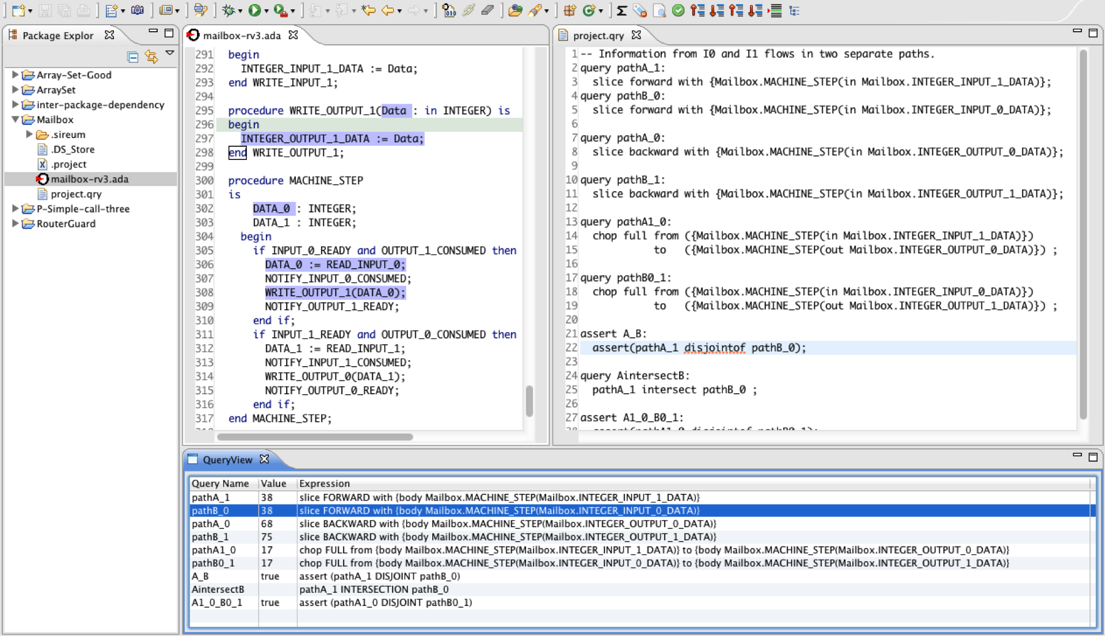
Bakar Alir
Buttons to browse
information flow
Button to infer
Derives clause
Spark
Program Editor
Query Editor
Query Launcher
Integrated Development Environment (Eclipse)
Intuitive visualizations of information flows
Automatically generate flow contracts
DSL for querying information flow properties
Notes:
Our tool is a eclipse plug-in
it has a program editor with buttons to browse and generate information flow contract
Using our tool a developer can also query and assert information flow contracts

Slide 8
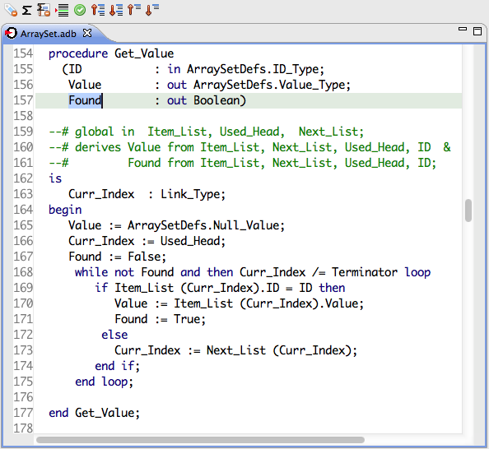
Browsing
How can I understand these annotations?
Developer Selects “Found” and
Clicks “Backward Slice” button
Why is there a dependency between Found and ID?
Which information flow channel includes this statement?
Notes:
(time = 2m)
Suppose a developer what to modify a procedure
he needs to understand the information flow contracts
He wants to understand why is there a dependency on this param

Slide 9
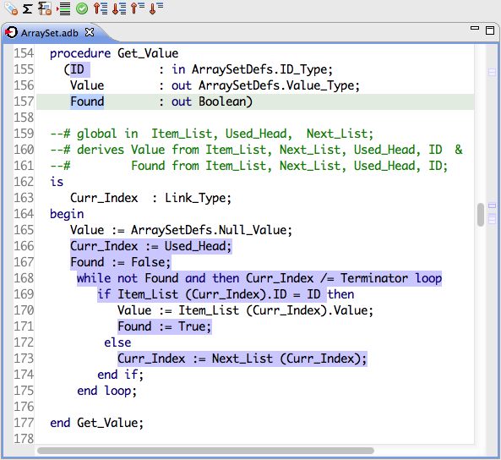
Browsing
Why there is a derives annotation between X and Y?
Developer Selects “Found” and
Clicks “Backward Slice” button
Bakar Alir Computes the Information
flow and highlights the corresponding
program statements
Notes:
TO answer all these questions
developer can select any statement or parameter on the procedure and click backward slice
out tool computes the information flow and highlights the statements involve in the flow
TO do this we use the classic slicing technique
Yes there are similar tools available

Slide 10
What is New in This?
SPARK Package comes in two parts Specification and Implementation
Procedure Specification
State X
Inputs
Abstract parameters
In procedure specification the information flow contract is specified in term of abstract variables
State
Outputs
Inputs
Procedure
Implementation
S Pointer X
Pointer
Corresponding refined parameters
S
Pointer
Outputs
Notes:
Spark Package comes in 2 parts
spec
implementation
Specification can abstract the implementation parameters
state is an abstract paramater
and the corresponding refined parameters are specified in the implementation
Note that the information flow contract in specification is specified in term of abstract parameters

Slide 11
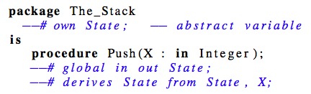
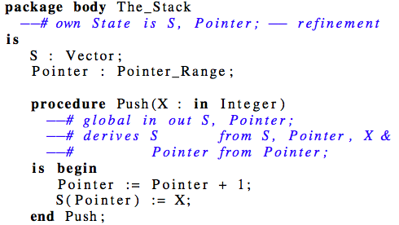
What is new in this?
Information flow between abstract and refined variables
State X
Inputs
Spec
Refinement
State
Outputs
Inputs
S Pointer X
Pointer
Body
Outputs
S
Pointer
Abstraction

Slide 12
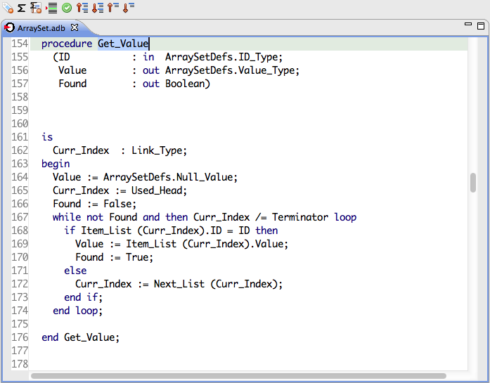
Inferring : Info. Flow Contracts
Developer selects the procedure and click “insert annotations”
Notes:
To do that, a developer can select a procedure and click a button
And our tool computes and inserts the contracts
Then a developer can check it using spark examiner

Slide 13
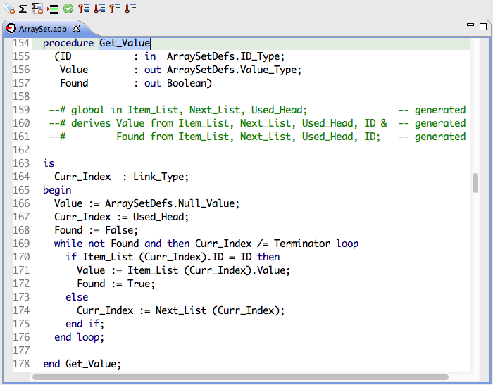
Inferring
Developer selects the procedure and click “insert annotations”
Bakar Alir automatically generate and inserts derives clauses
Notes:
This may be simple for a small program but rem we are talking abt programs with drives clause of

Slide 14
Query Motivation: Developer’s View
Performing the same slice again and again
How can I repeat without going through all the browsing process?
How to present it to an Auditor?
How to save and include in regression process?
We provide a simple query language
(inspired by CodeSurfer)
Slicing & Chopping
Assertion

Slide 15
Query Language
Sample queries and their capablities
Named Queries
Direction of browsing
query pathA_1:
slice forward with {Mailbox.MACHINE_STEP(in Mailbox.INTEGER_INPUT_1_DATA)};
query pathB0_1:
chop full from ({Mailbox.MACHINE_STEP(in Mailbox.INTEGER_INPUT_0_DATA)})
to ({Mailbox.MACHINE_STEP(out Mailbox.INTEGER_OUTPUT_1_DATA)}) ;
assert A_B:
assert(pathA_1 disjointof pathB0_1);
Mode of chop (fast or full)
Reuse results of another query
Support simple set operations
Notes:
(time = 4m)

Slide 16
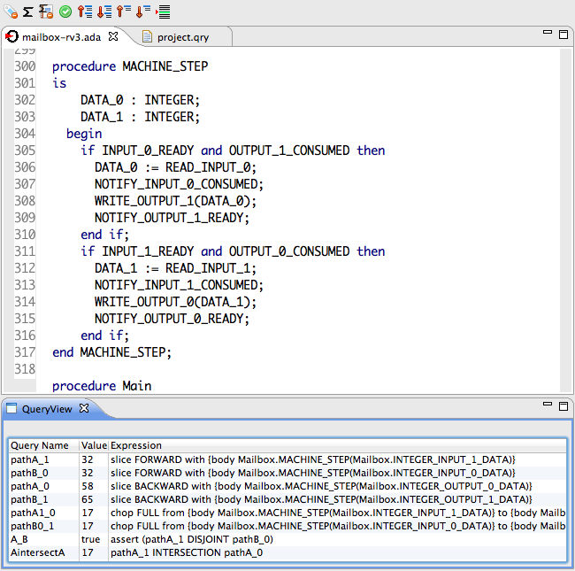
Querying
Queries are written in “.qry” file and click “Execute query”
How can I save and repeat browsing ?
Queries are displayed in the “query view”
Notes:
How this language helps a developer?

Slide 17
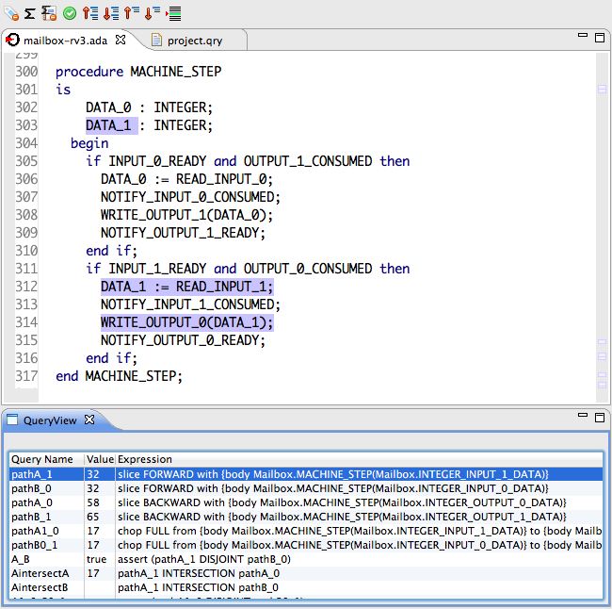
Querying
Can I verify information flow properties?
Selecting a query in the “query view” highlights the result in the editor”
Assertion results are displayed
Notes:
How this language helps a developer?

Slide 18
Conclusion
Applied Bakar Alir to a collection of embedded systems
Demonstrated
Rockwell Collins
Altran Praxis and AdaCore
Feedback
Potential to improve development time
Collaborating with AdaCore to incorporate in SPARK tools

Slide 19
Questions
Tool Available at
http://www.sireum.org/downloads/Alir
Questions, suggestions and comments
thari@ksu.edu

