Slide 1
Cloud IoT Energy Monitoring
and Automation Platform
14-minute assessed presentation with live end-to-end simulation
Member 1 - Intro
Member 2 - Logic
Member 3 - Demo
Telemetry -> decision -> control -> verification

Slide 2
Run of Show
Clear 14-minute pacing for 3 presenters
Timeline
Speaking Ownership
• 00:00-05:00 Presentation by Member 1 and Member 2
• 05:00-14:00 Live demo by Member 3
• Target: prove full loop, not only visualization
• Final 40s reserved for crisp conclusion
Member 1
Problem, architecture, firmware strategy
Member 2
Automation rule, evidence, demo handoff
Member 3
Live simulation and verification

Slide 3
Why This Project Matters
From passive dashboards to active operations
Problem
Our Objective
• Many IoT systems only visualize data
• Operational decisions remain manual and delayed
• Tool fragmentation increases integration overhead
• Low traceability makes audit difficult
• Ingest live telemetry reliably
• Evaluate a deterministic 15-minute rule
• Dispatch control commands automatically
• Verify every action through feedback and logs

Slide 4
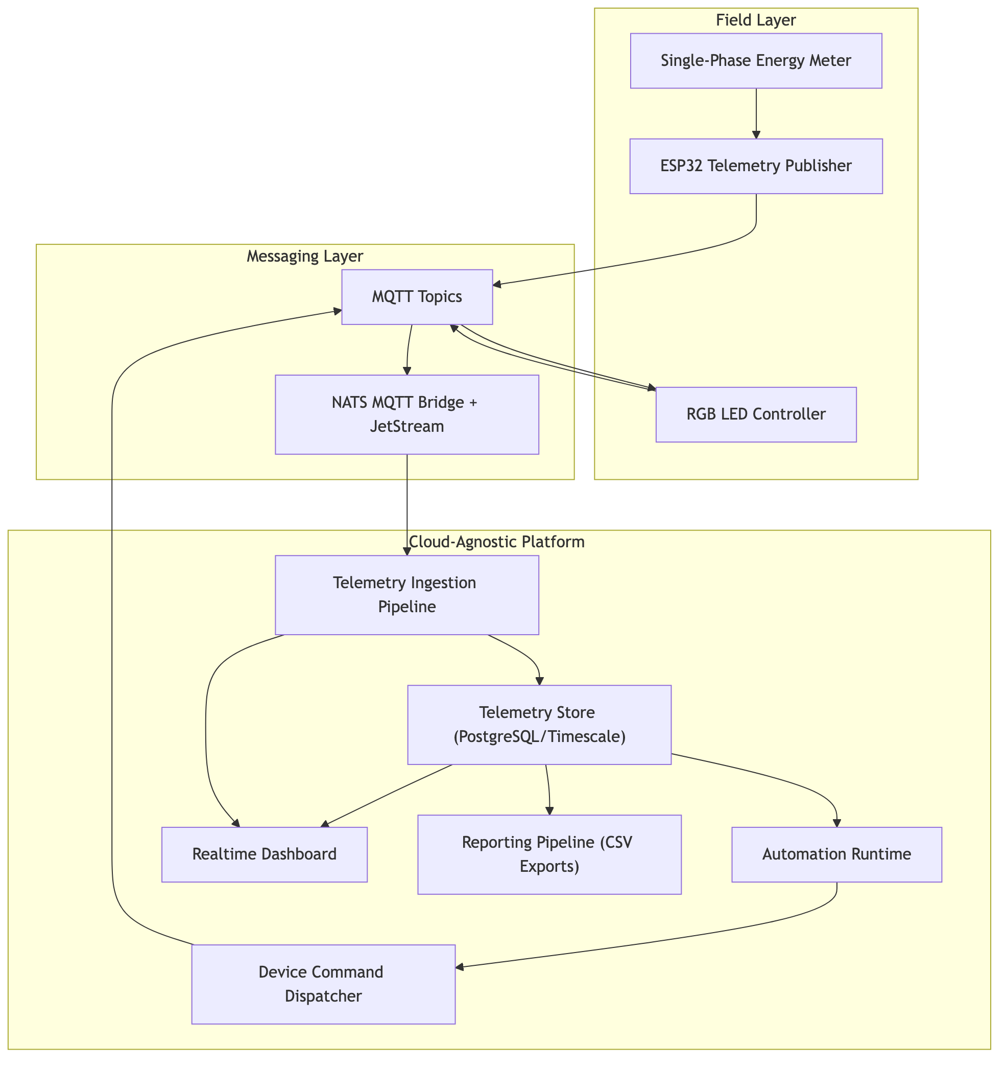
End-to-End Platform Architecture
Single operational boundary for ingest, automation, control, and reporting
What this architecture gives us
• Unified telemetry contract
• Near real-time condition evaluation
• Deterministic command lifecycle
• Shared source for dashboard + exports
• Better governance at team scale

Slide 5
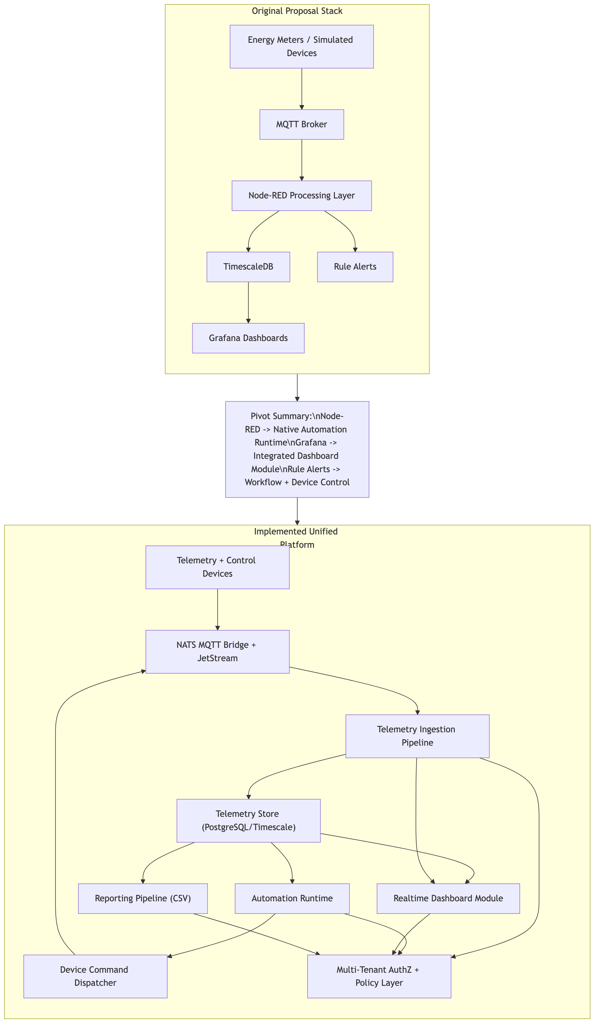
Design Decision
Why we moved from fragmented tools to an integrated platform
Practical benefits in this project
• One governance boundary for users, workflows, and evidence
• Fewer integration seams to maintain under time pressure
• Lower risk of mismatched schemas and policies
• Faster onboarding of new devices using shared contracts
• Cleaner story for assessment and real operations

Slide 6
Firmware Strategy
Reusable ESP32 runtime + device-specific modules
Common Runtime Layer
Device Modules
• WiFi/MQTT lifecycle
• LWT + presence publishing
• Reconnect and retry behavior
• Shared telemetry envelope
• RGB actuator: control + state acknowledgment
• PZEM meter: RS485 Modbus polling
• Read-only safety for meter v1
• Same contract, easier future expansion

Slide 7
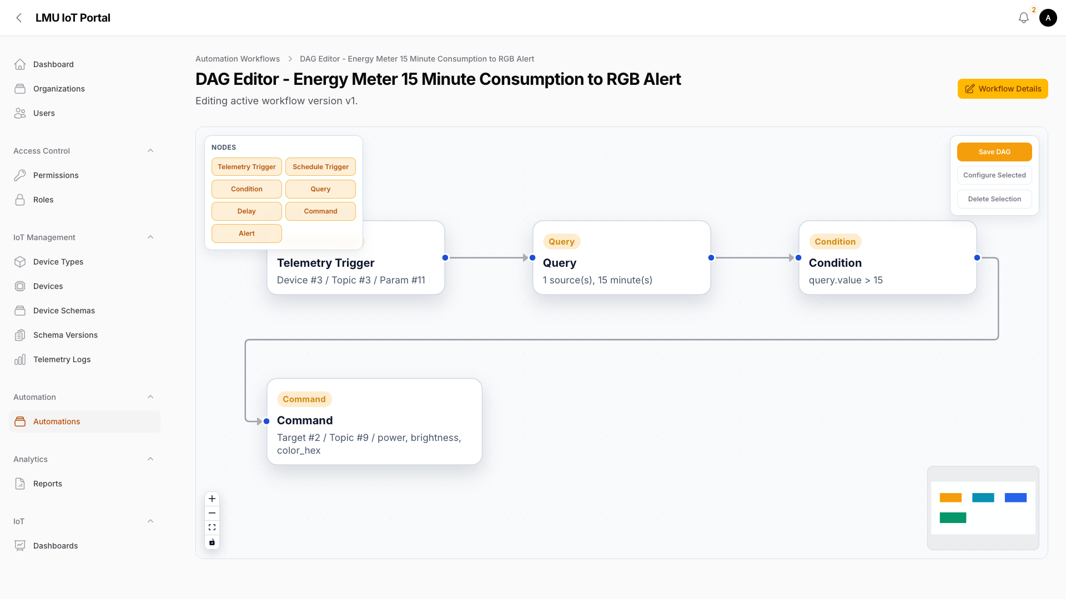
Automation Logic
15-minute energy rule drives deterministic control
Consumption (15 min) = MAX(total_energy_kwh) - MIN(total_energy_kwh)
Branching behavior
• If threshold passes -> dispatch RGB alert command
• If threshold fails -> no control side effects
• Every step stored in run-step records
• Command lifecycle reconciled with device feedback

Slide 8
Live Demo Plan (Member 3)
9-minute simulation with measurable checkpoints
Minute-by-minute flow
4 Success Checkpoints
• 05:00-06:00 Baseline state and expected behavior
• 06:00-08:00 Simulated meter publishes rising telemetry
• 08:00-09:30 Rule threshold crosses and workflow fires
• 09:30-11:00 RGB command dispatch + acknowledgment
• 11:00-12:30 Lifecycle evidence + CSV report
• 12:30-13:30 Negative path: no command when rule fails
• 13:30-14:00 Conclusion
• Telemetry spike visible
• Rule passes
• Command dispatched
• Feedback verified

Slide 9
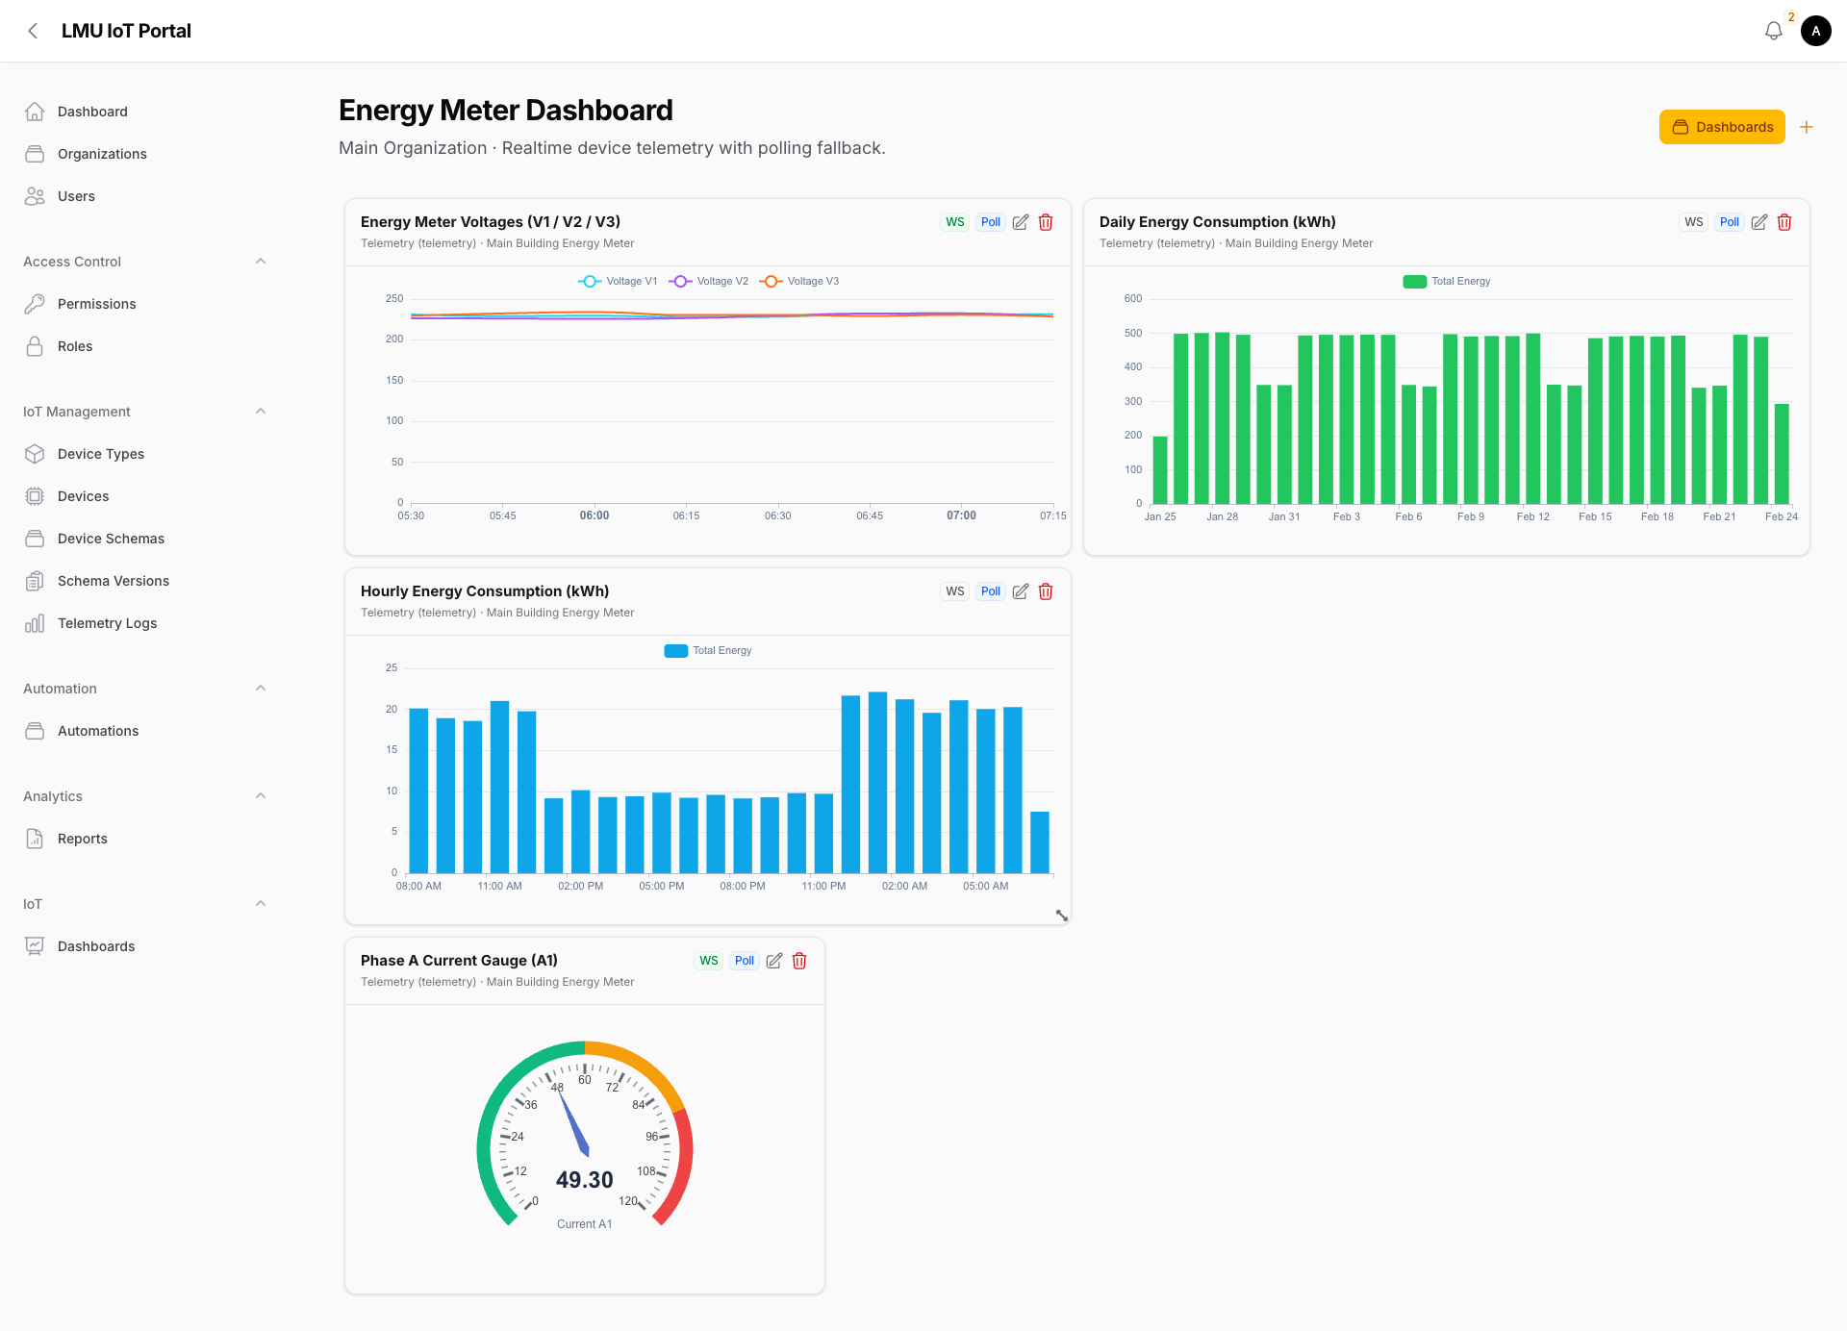
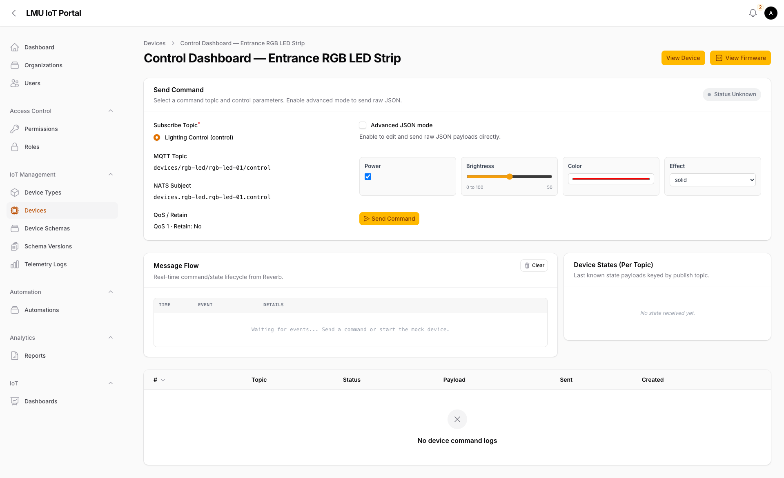
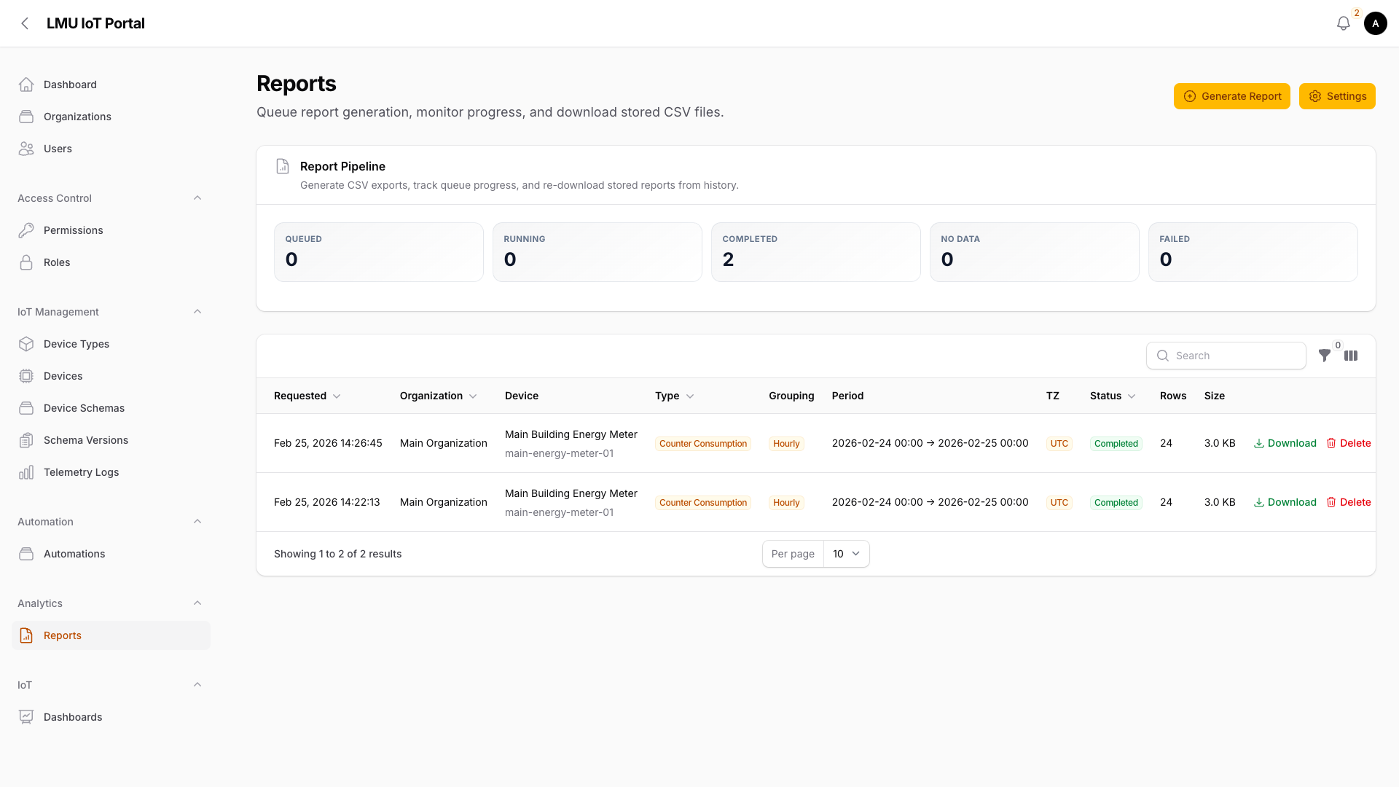
Operational Evidence
What assessors should see during and after the demo
Realtime Dashboard
Control Lifecycle
Reporting Pipeline
Evidence chain: ingest -> evaluate -> command -> acknowledge -> export

Slide 10
Demo Risk Control
Keep delivery stable even if live environment is noisy
Live risks + mitigation
If live demo fails
• Service not ready -> verify tabs and baseline data 10 min before
• Simulation lag -> keep fallback snapshot tabs pre-opened
• Rule not triggering -> pre-check threshold and latest telemetry
• UI delay -> narrate lifecycle records as source of truth
• Use prepared screenshots in fixed order
• Keep the same 4 checkpoint narrative
• Show that each stage has stored evidence
• Finish with the same closing statement

Slide 11
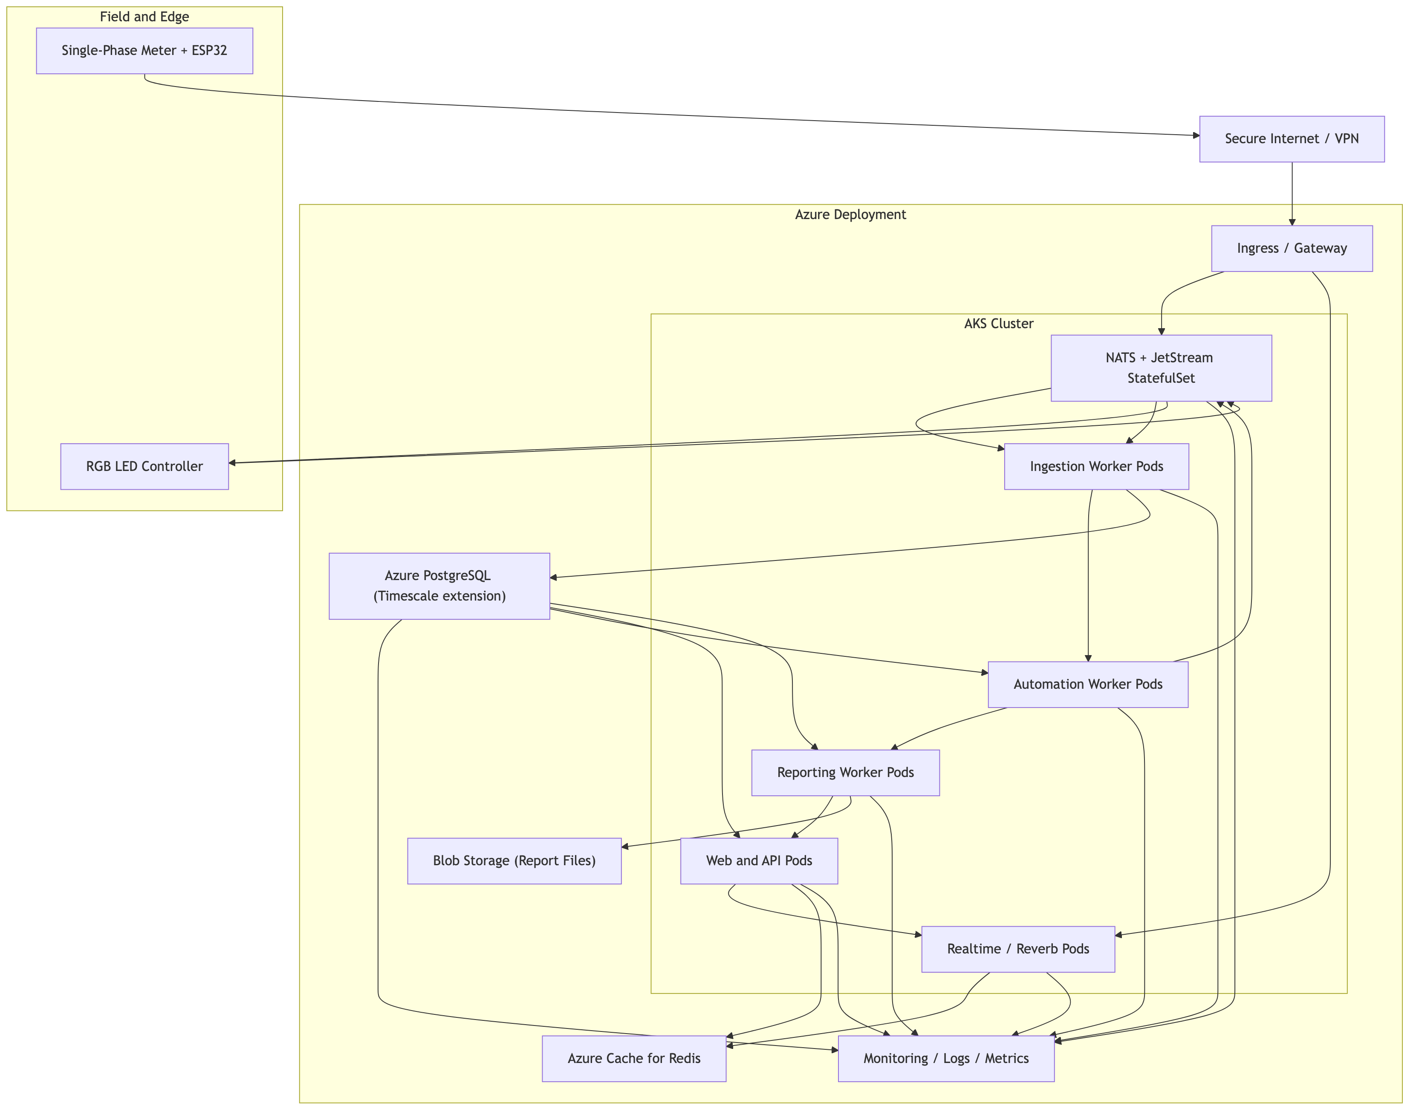
Scalability and Portability
Designed for growth beyond a classroom prototype
What scales well
• Cloud-agnostic deployment model
• Kubernetes-ready service decomposition
• Schema-based device onboarding
• Queue-backed ingestion and reporting
• Audit-friendly command and run records

Slide 12
Full-Loop IoT Proven
Ingest. Decide. Act. Verify.
Q&A
Presentation team: Member 1, Member 2, Member 3

